Slide 1

Characterizing epitaxially-grown InGaAs quantum dot chains using transmission electron microscopy
APS March Meeting 2013 Baltimore, MD
Tyler Park
John Colton Haeyeon Yang*
Jeff Farrer
* South Dakota School of Mines

Slide 2
Outline
Quantum dots – Growth
Quantum dot chains
Motivation
Transmission Electron Microscopy (TEM)
Results

Slide 3
Quantum Dot Growth
GaAs
InGaAs
GaAs
GaAs Substrate
Self-Assembled
Modified Stranski-Krastanov Method
  Wetting layer grown at cooler temperature
  Annealing process added

Slide 4
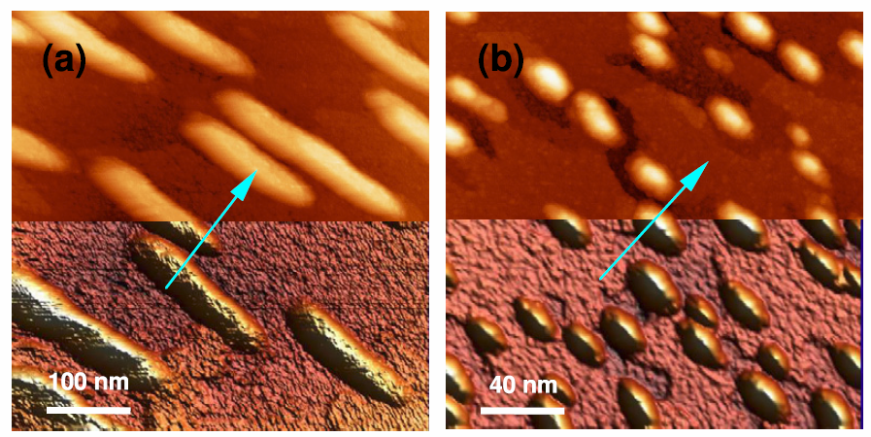
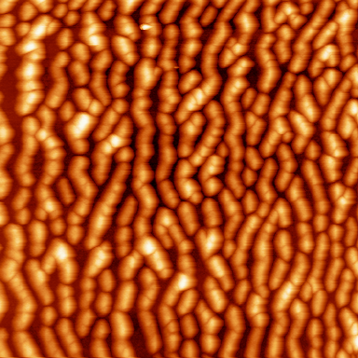
Quantum Dot Chains
(110)
(110)
Kim & Yang, Nanotech 19, 475601 (2008)
STM Images (Uncapped samples)
  Wetting layer thickness affects QD shape

Slide 5
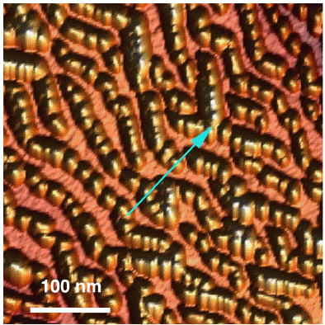
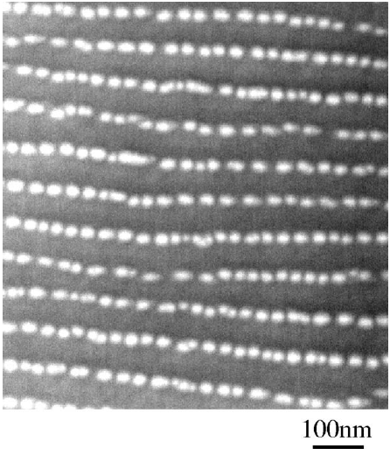
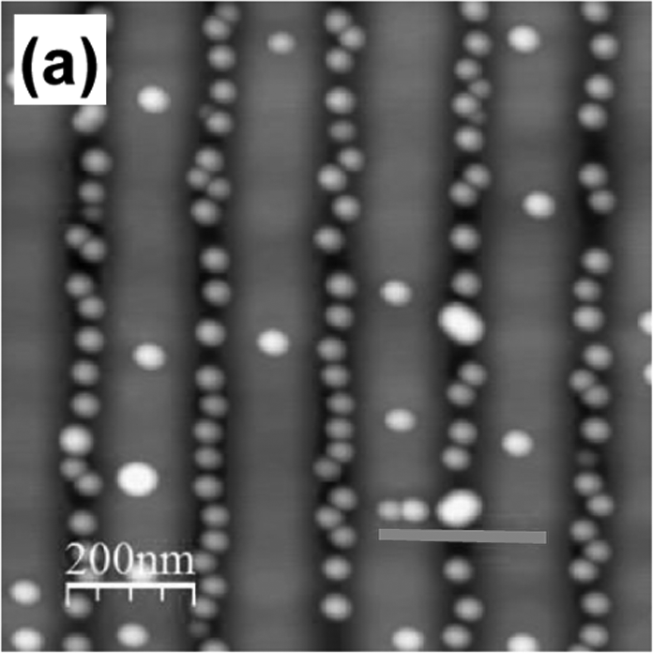
Quantum Dot Chains
Dong Jun Kim and Haeyon Yang,
Nanotechnology,(2008).
Zh. M. Wang, et al.,
Journal of Applied Physics, (2006).
T. V. Hakkarainen et al. Journal of Appl. Phys., (2011).
Yang accomplished forming QD chains on a non-patterned substrate

Slide 6
Motivation
Tunable in infrared wavelengths
Applications:
  Optoelectronics
  Infrared Detectors/Lasers (Fujitsu and Tokyo University (2010), P. Martyniuk and A. Rogalski. (2008))
  Quantum Computing (Albert M. Chang. (2001))
Capping layer known to alter nature of dots (D. Awschalom et al. (2002))
Physical measurements

Slide 7
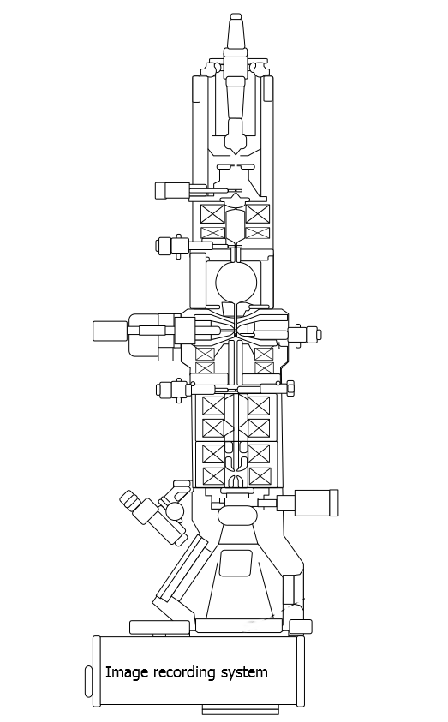
Transmission Electron Microscopy
Electron source
Apertures
Sample
Electromagnetic Lenses

Slide 8
Transmission Electron Microscopy
Electron source
Apertures
Sample
Electromagnetic Lenses
e-beam
diffracted beam
direct beam

Slide 9
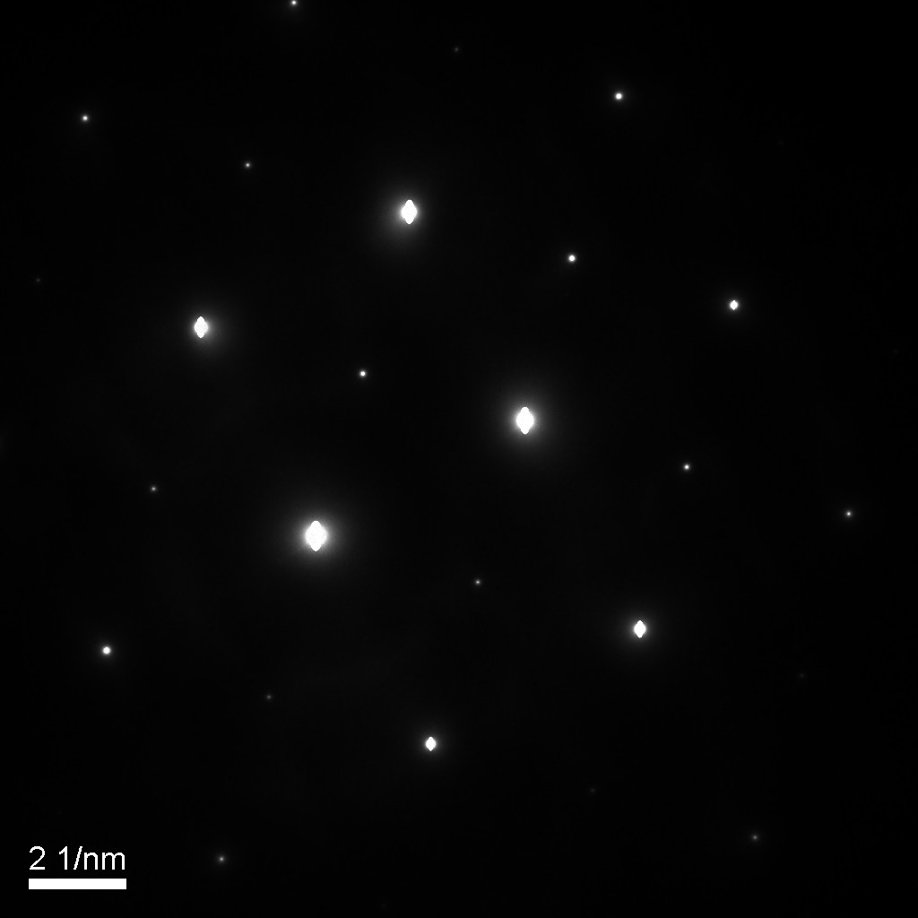
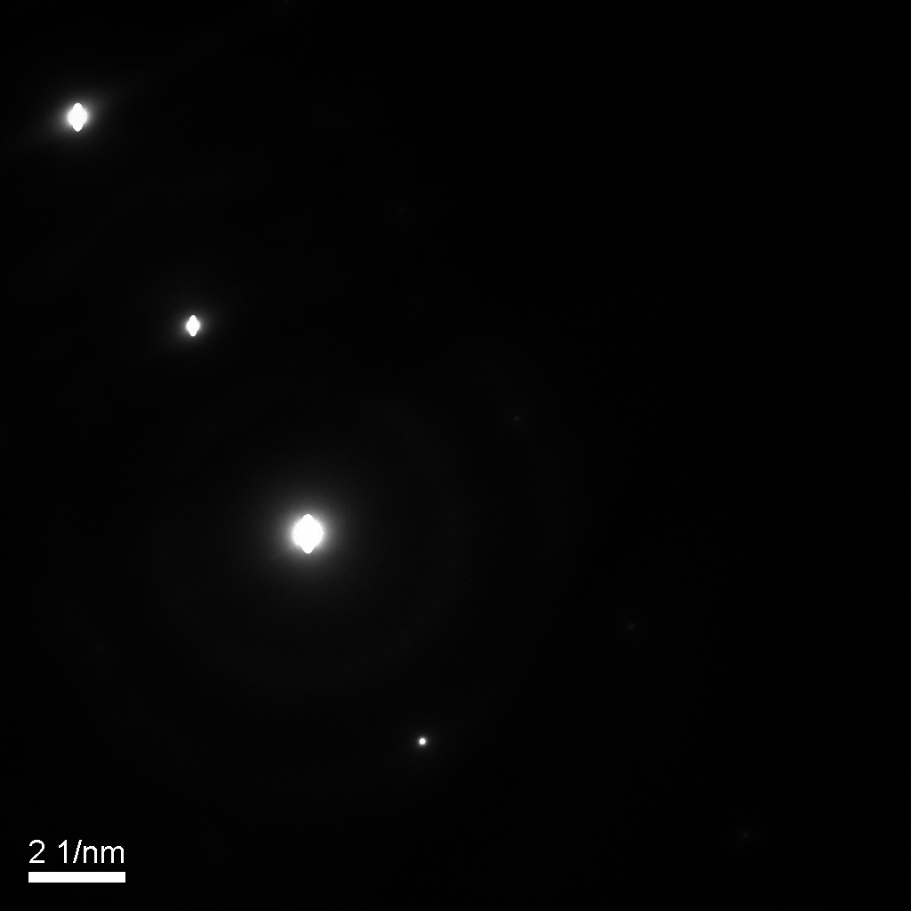
Transmission Electron Microscopy
220
400
220
000
220
000
220
Two-Beam condition
  Diffraction contrast – strain contrast

Slide 10
Transmission Electron Microscopy
Cross-sectional and plan view cuts
  Annealing temp.: 460°C, 480°C, 500°C
Analytical transmission electron microscopy (chemical analysis)
  Parallel electron energy-loss spectroscopy (PEELS)
  X-ray energy dispersive spectroscopy (XEDS)

Slide 11
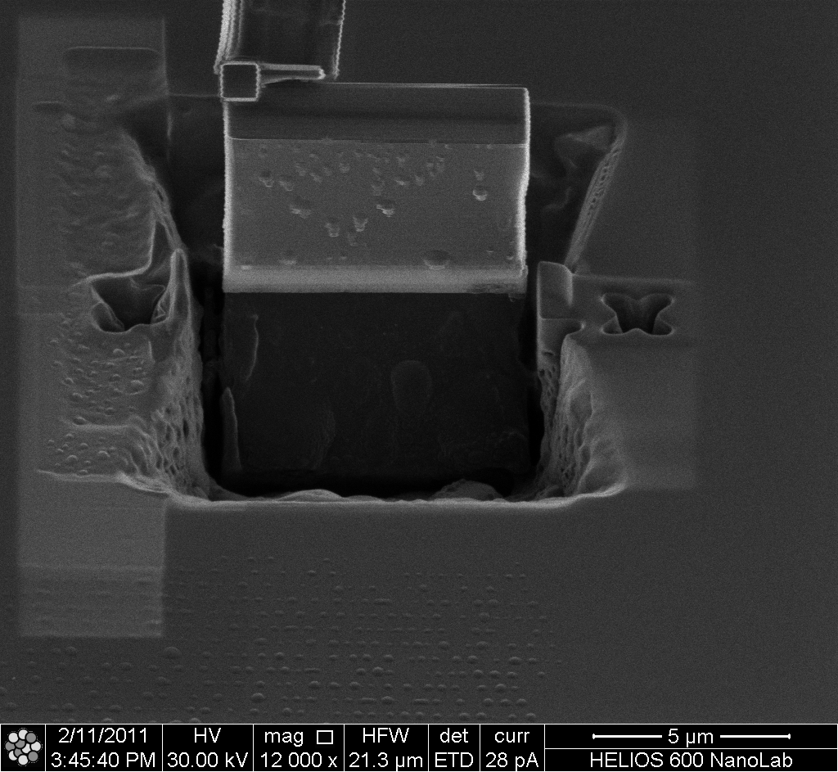
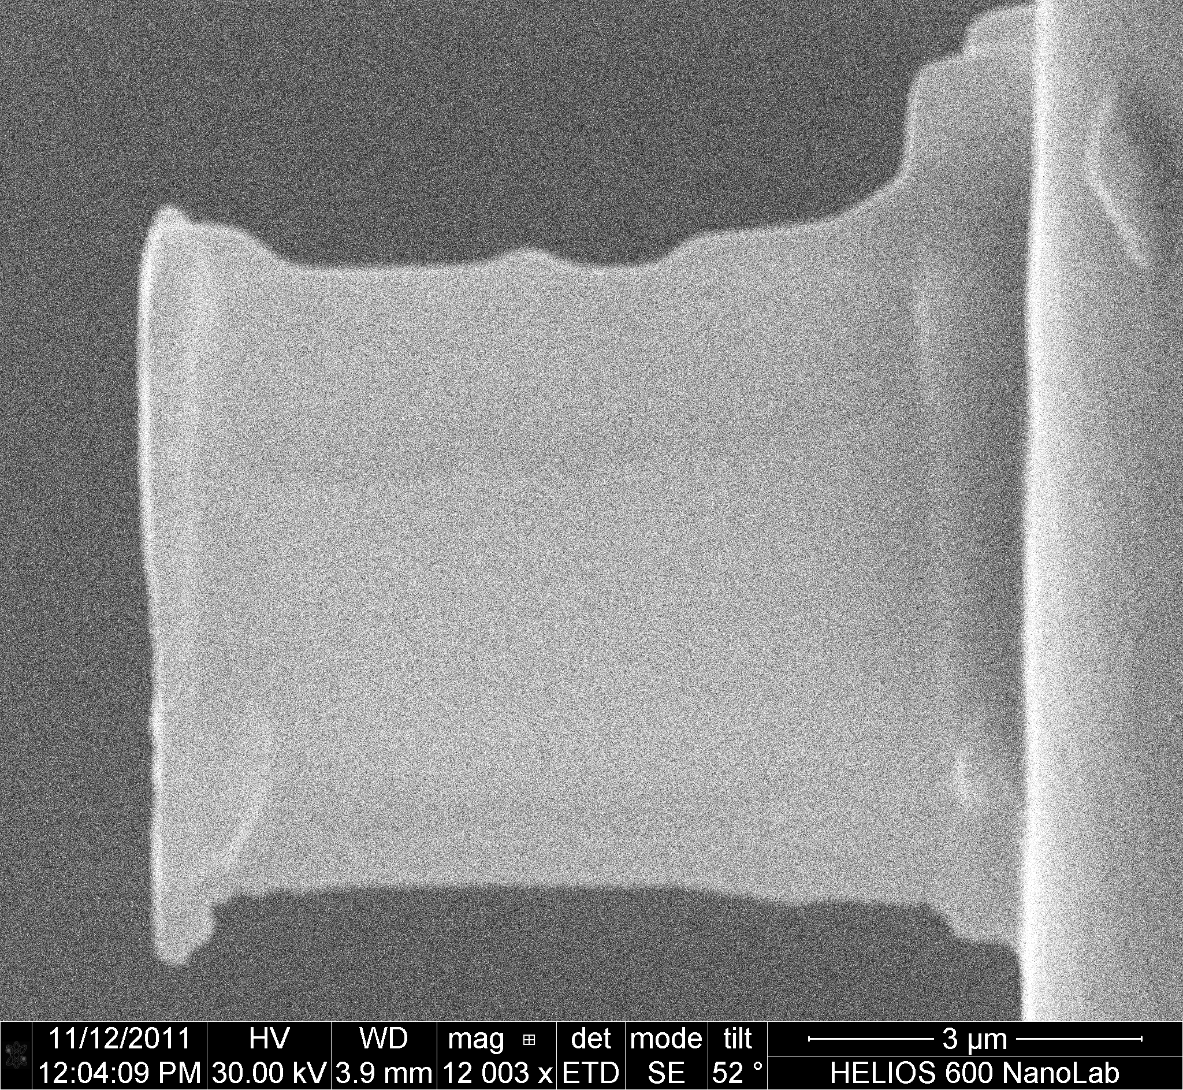
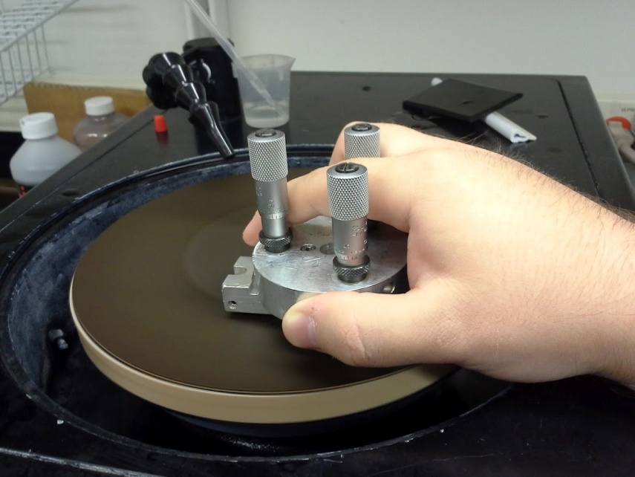
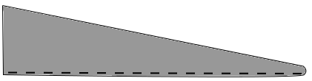
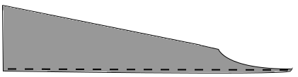
Sample Preparation
Cross-section Cuts
  Focus Ion Beam (FIB) – Lift-out method
Plan View Cuts
  Lift-out method
  Hybrid method
    Mechanical thinning
    FIB
FIB
Mechanically thinned sample
QD layer

Slide 12
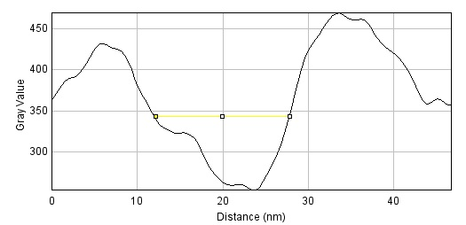
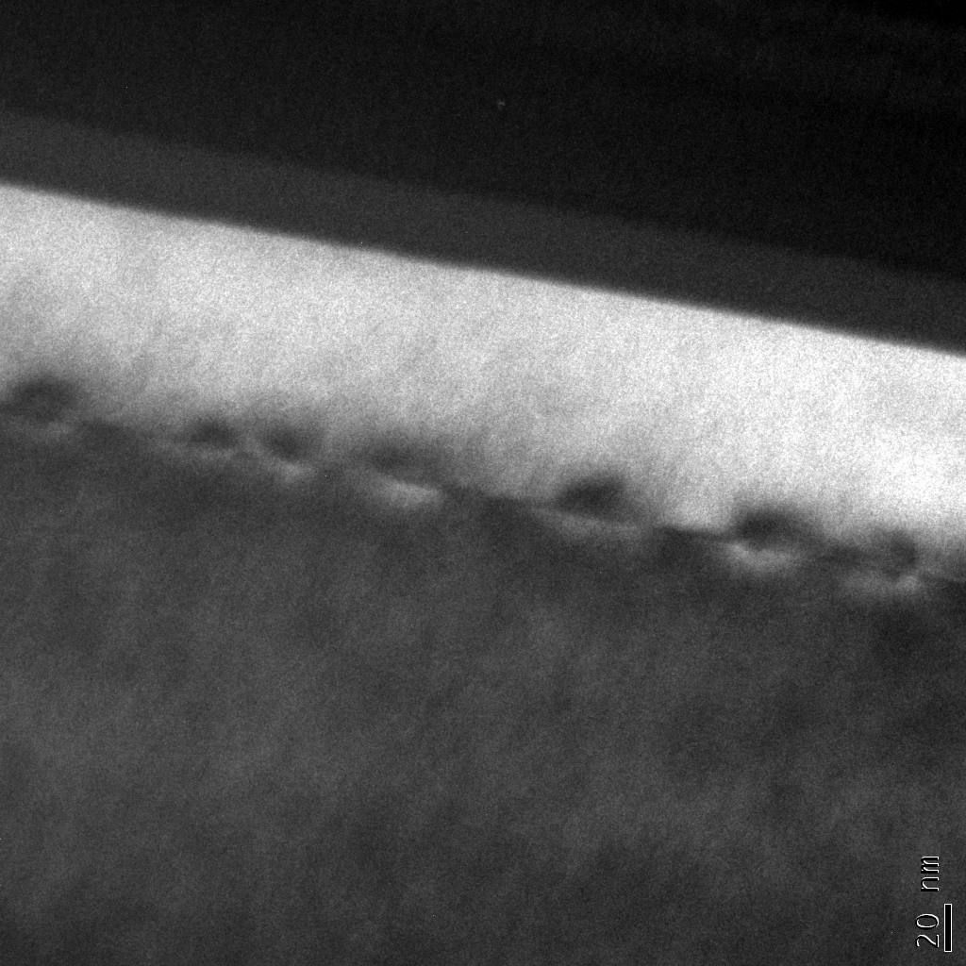
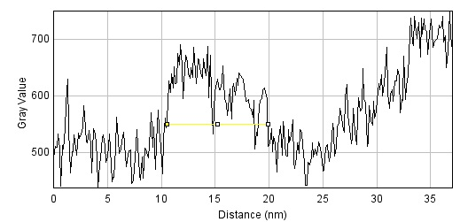
Results
460°C
Cross-section Images
  2-beam conditions
    Diffraction contrast (Strains)
  STEM
  Mass Thickness Contrast
  HRTEM
Measurements
  Current task, incomplete results
  Show that dots flatten w/ annealing temperature
Chemical Analysis:
  ~10% Indium in the 500°C sample
  ~2% Indium in the 460°C sample (redo)
  ~5% Silicon contaminates!
~15 nm
480°C
GaAs Cap
In Progress
GaAs
500°C
InGaAs QD layer
~10 nm

Slide 13
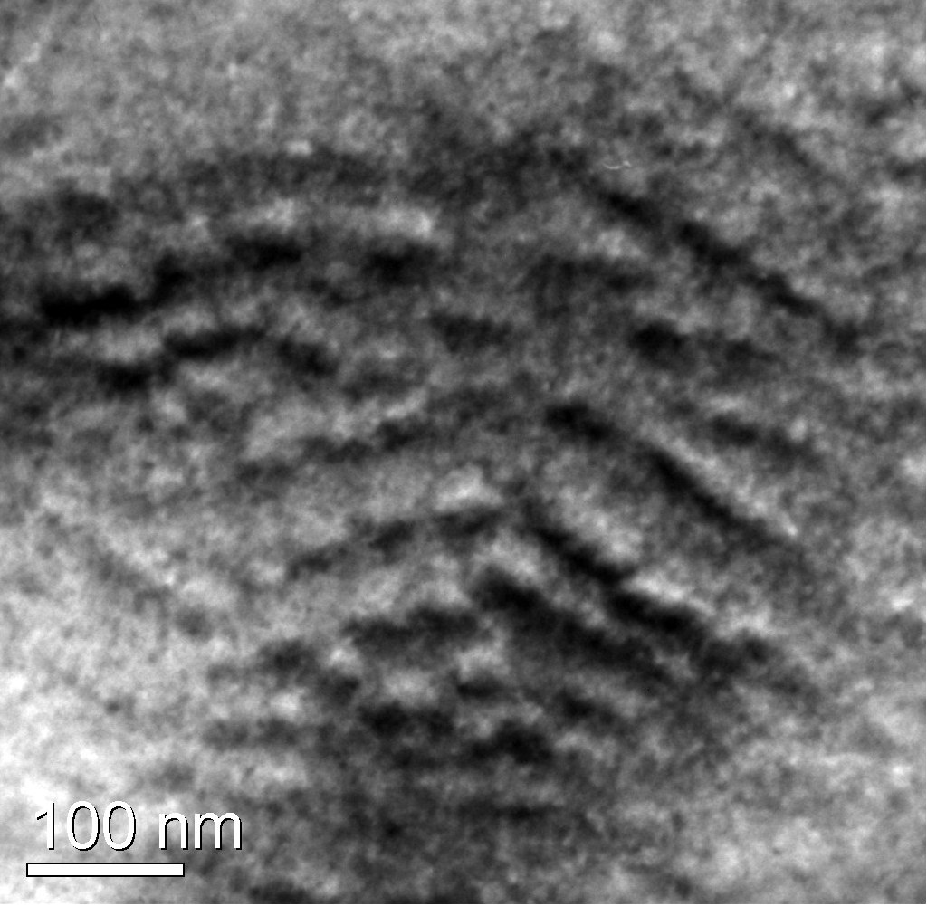
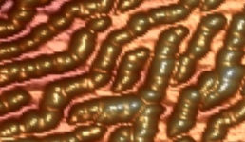
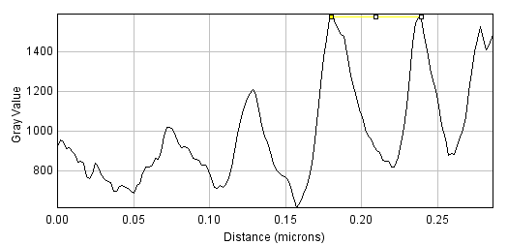
Results
Plan View Images
  2-beam conditions
    Diffraction contrast (Strains)
Measurements
  Separation of chains/dots
  Dot dimensions
~90 nm
500°C
~30nm

Slide 14
Conclusions
Dots have formed as expected
  Capping layer has little effect
  Chains in all 3 samples
Measurements (height x width x chain separation):
  460°C: 15nm x 30nm x 70nm
  480°C: ??nm x 35nm x 90nm
  500°C: 10nm x 30nm x 90nm
Chemical Composition
  Estimated to be 10% In, 35% Ga, 50% As, 5% Si (from the sample annealed at 500°C)
Special thanks to Felipe Rivera and Thomas McConkie for assistance w/ lift-out

