Slide 1
Characterization of quantum dot chains using transmission electron microscopy
APS March Meeting 2012, Boston
Tyler Park
Jeffrey Farrer
John Colton
Haeyeon Yang
* Special thanks Felipe Rivera and Thomas McConkie for sample preparation (FIB/SEM)

Slide 2
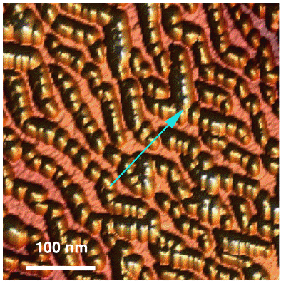
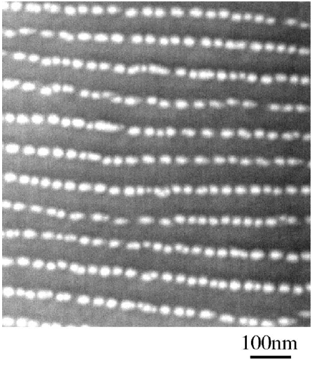
Introduction
What are quantum dot “chains?”
What is their significance?
Optoelectronic Devices
Conduit for spin information W. V. Schoenfeld et al., Appl. Phys. Lett. (1999)
(110)
Dong Jun Kim and Haeyon Yang,
Nanotechnology,(2008).
Zh. M. Wang, et al.,
Journal of Applied Physics, (2006).

Slide 3
Previous work
Stranski-Krastanov (1939)
Prepatterned Substrates Lee et al., Nanotechnology, (2006)
Strain driven self-assembly M. Riotte et al., Applied Physics Letters, (2004)
InGaAs

Slide 4
Our samples
Grown at lower temperature so quantum dots don’t form yet
Annealing process, during which dots are formed
More control on growth A.O. Kosogov et al., Appl. Phys. Lett. (1996)
3 samples with slightly different growth parameters
InGaAs

Slide 5
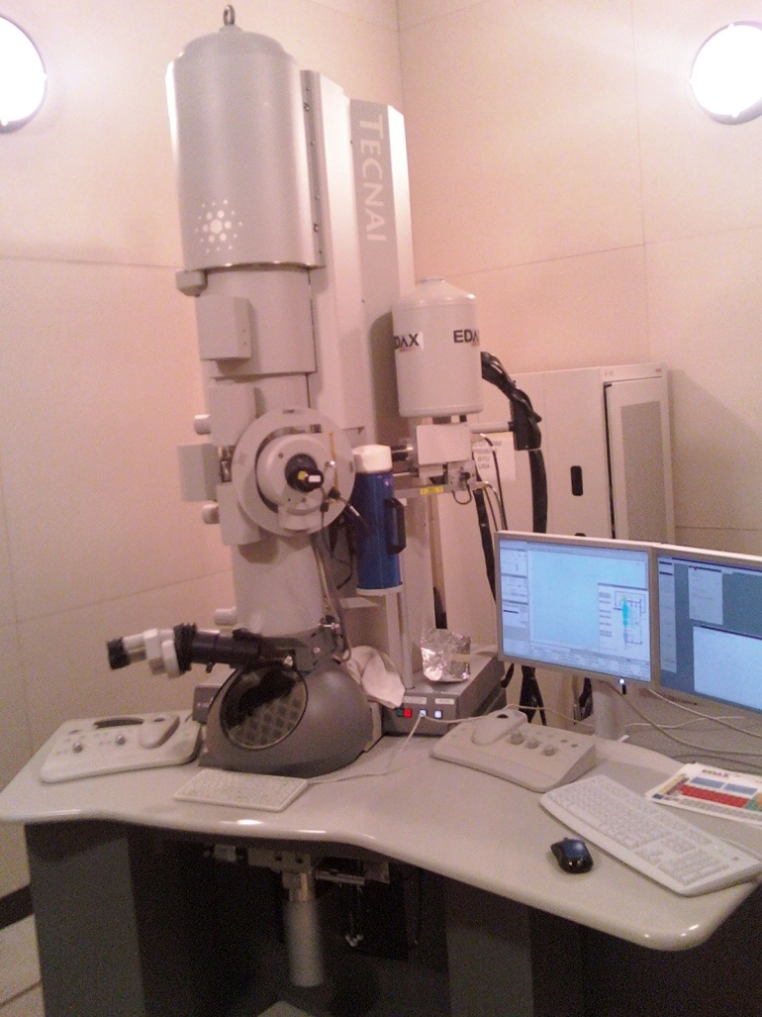
Our Samples - methods
Photoluminescence (PL) spectroscopy
Time-resolved PL
Transmission electron
microscopy (TEM)
Chains with GaAs cap*
Chemical analysis
Partial electron energy-loss spectroscopy (PEELS)
X-ray energy dispersive spectroscopy (XEDS)
*Zh. M. Wang et al., Journ. Of App. Phys. (2006)

Slide 6
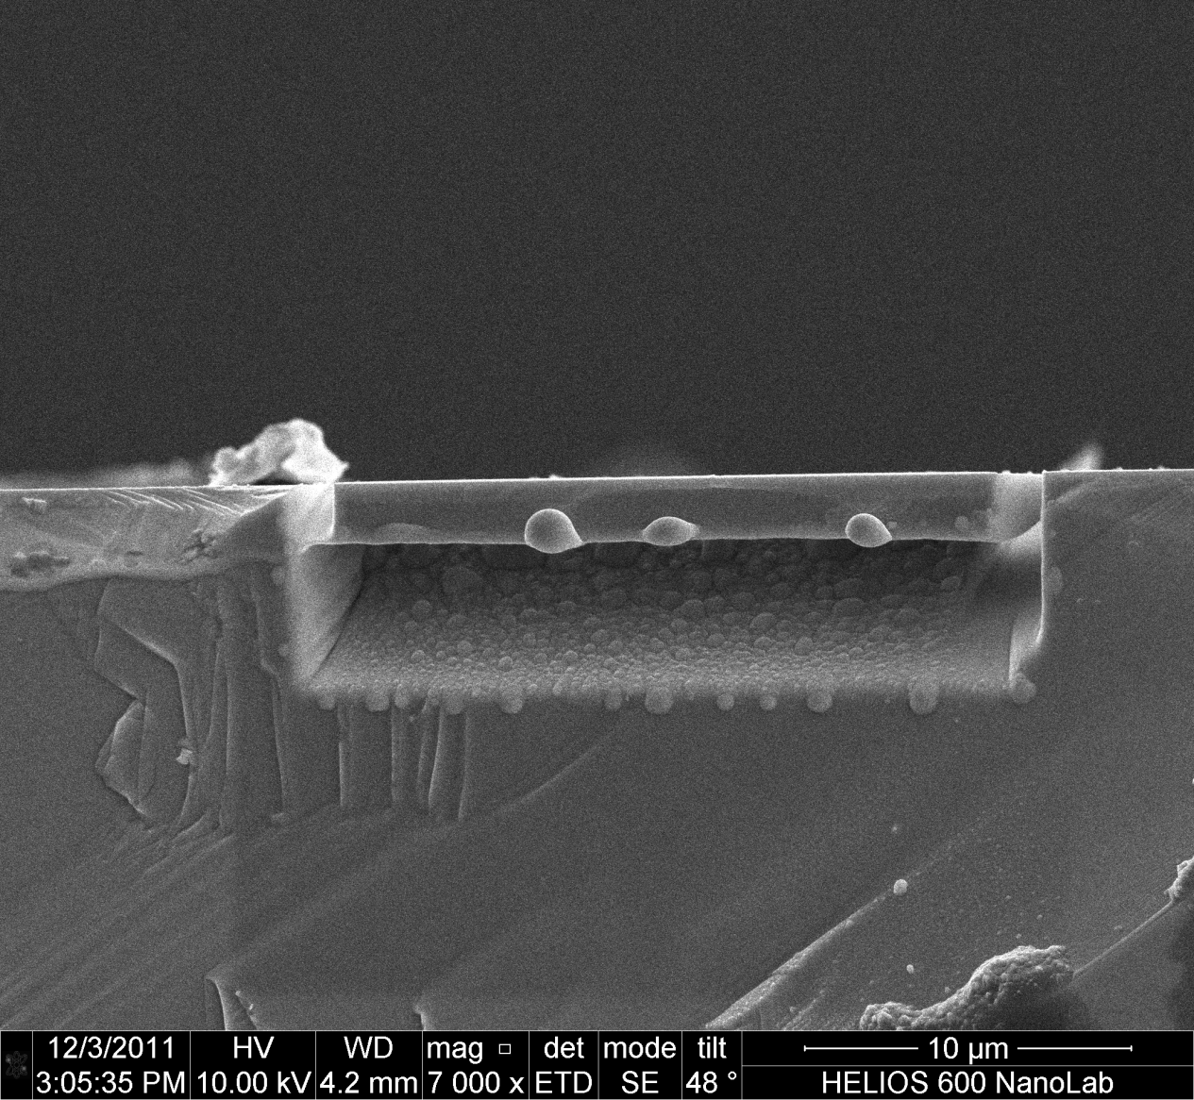
Sample preparation
Focused Ion Beam (FIB)
Cross-section cuts
Lift-out method
Plan view cuts
Our own method?

Slide 7
Issues
Contamination
Damage from silicon sample holder
Cross-section cuts
Difficult to see an individual dot
Plan view cuts
Quantum dots are close to surface
Thinning issues
Platinum deposits

Slide 8
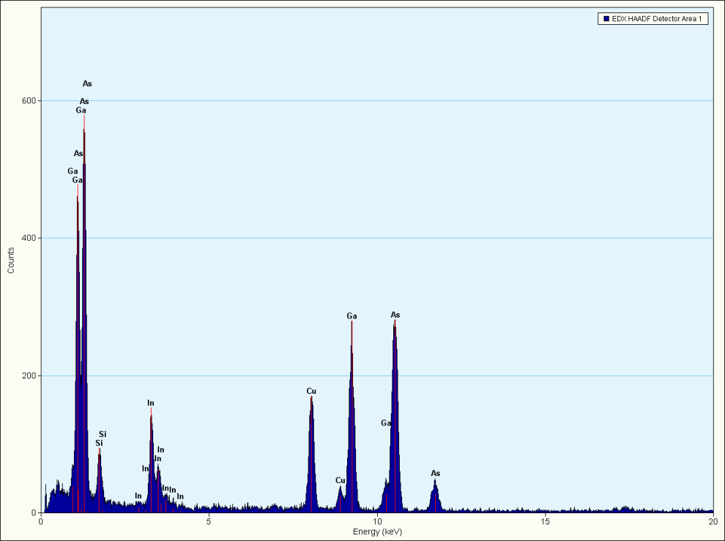
Current results
Images
Chemical Analysis:
032607B (EDS)
032607B
032607B
GaAs cap
InGaAs layer
GaAs cap
GaAs bulk
InGaAs layer
GaAs bulk
032607A

Slide 9
summary
The quantum dots seen, but not individually
Chemical analysis is so far close to what we were expecting
Continue with chemical analysis on cross-section cuts
Find a practical way of obtaining a plan view cut
Future work: Spin information transmission?

