Slide 1
Photoluminescence spectroscopy and transmission electron microscopy imaging of InGaAs quantum dot chains
Tyler Park
Kenneth Clark David Meyer
Andrew Perry Scott Thalman
John Colton Haeyeon Yang
APS 4CS Meeting 21-22 October 2011

Slide 2
Introducing the Quantum Dot
Confine the electrons (carriers) in three dimensions by creating a potential barrier
Quantum Well constrained in 1 dimension
Quantum Wires constrained in 2 dimensions

Slide 3
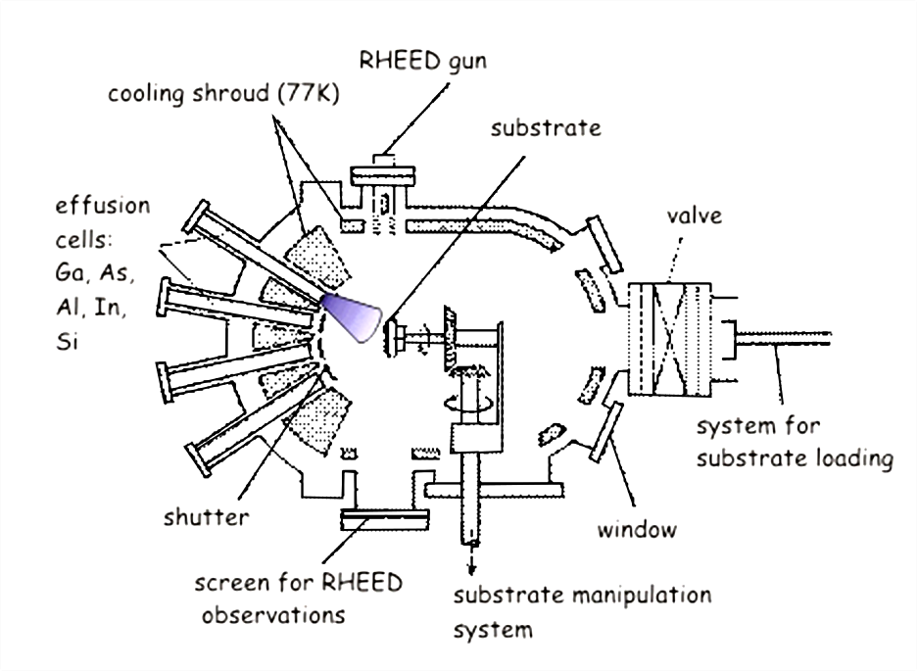
Quantum Dot Chains
Molecular Beam Epitaxy (MBE)
Modified Stranski-Krastanov (SK) method
Potential applications in quantum computing schemes
Applications for narrowband infrared lasers and detectors
Other applications similar to quantum dots
Anneal

Slide 4
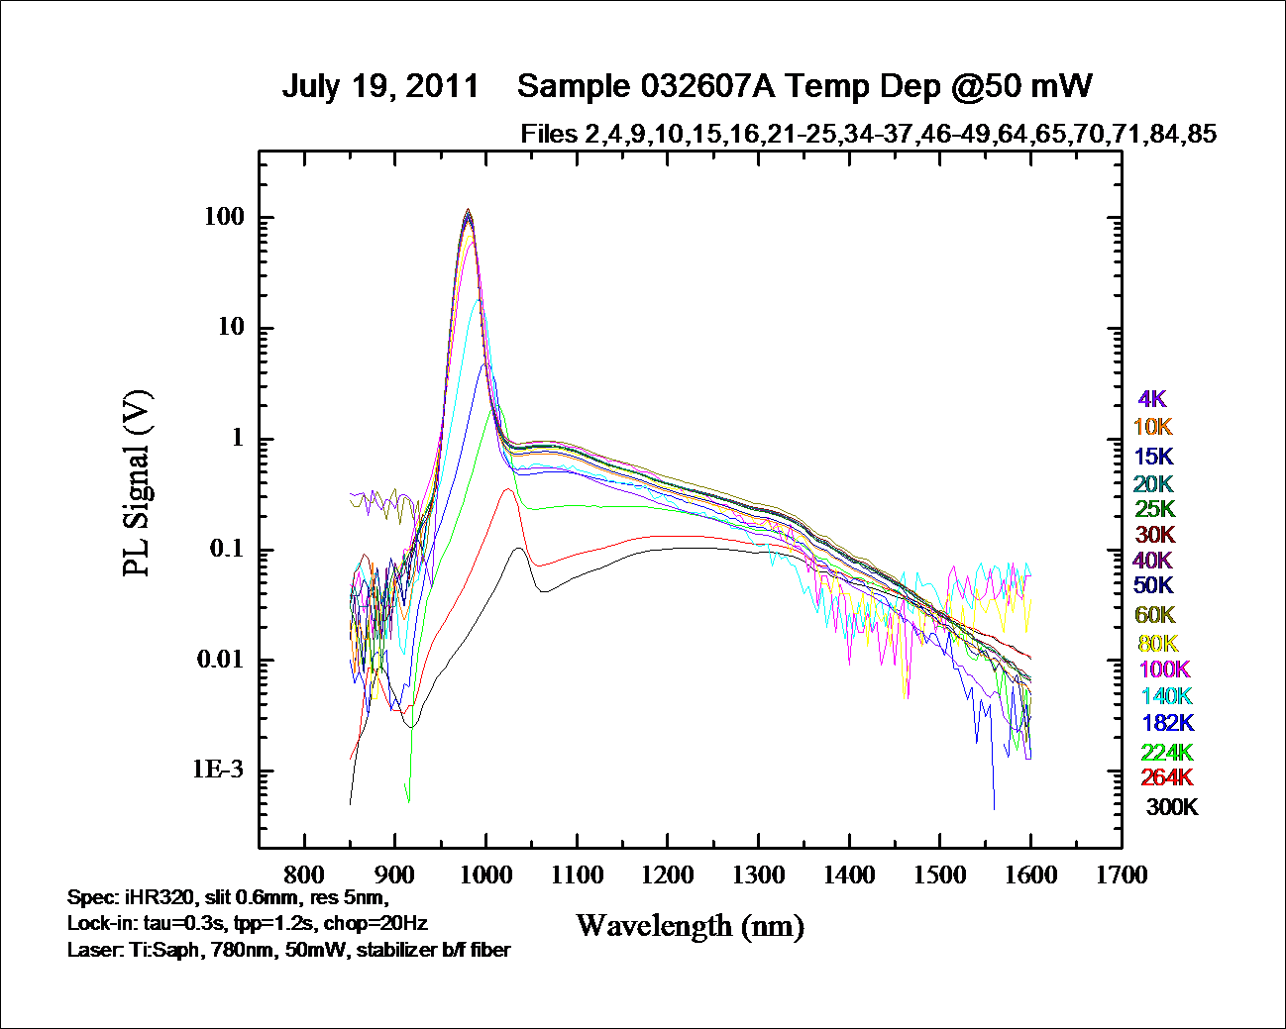
Photoluminescence Spectroscopy
Photon
Electron

Slide 5
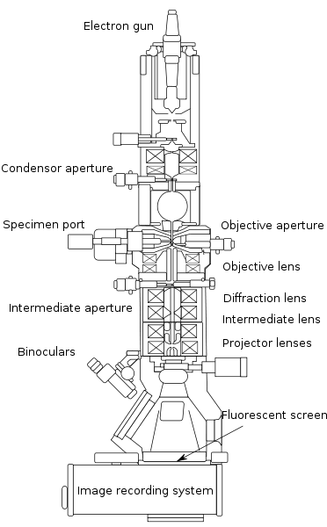
Transmission Electron Microscopy
Do we have chains?
Size and spacing of quantum dots
Chemical composition

Slide 6
TEM Images
Quantum Dot?
Platinum
Carbon
GaAs
Capping Layer
QD Layer
5 nm
GaAs Substrate

Slide 7
Conclusion
Plan view cuts and other cross-section cuts
Photoluminescence lifetime measurements
High resolution photoluminescence

