Slide 1
Tunable band gaps of protein enclosed nanocrystals for high efficiency solar energy conversion
Stephen Erickson
Trevor Smith
Dr. Richard Watt
Dr. John Colton
APS Four Corners Meeting
October 17, 2014

Slide 2
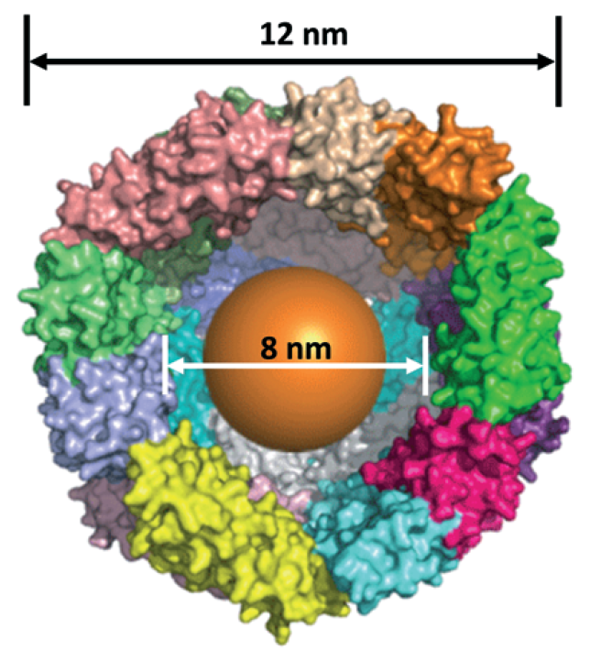
Ferritin protein
Template for controlled, uniform, and self-assembling nanocrystal synthesis
Ferroxidase center captures loose metal ions and reattaches them to the nanocrystal
Can be deposited in ordered arrays on a substrate

Slide 3
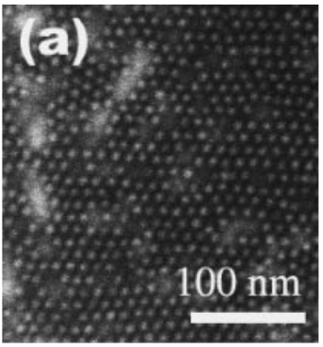
Matsui, et al Jpn. J. Appl. Phys., 46, L713-15

Slide 4
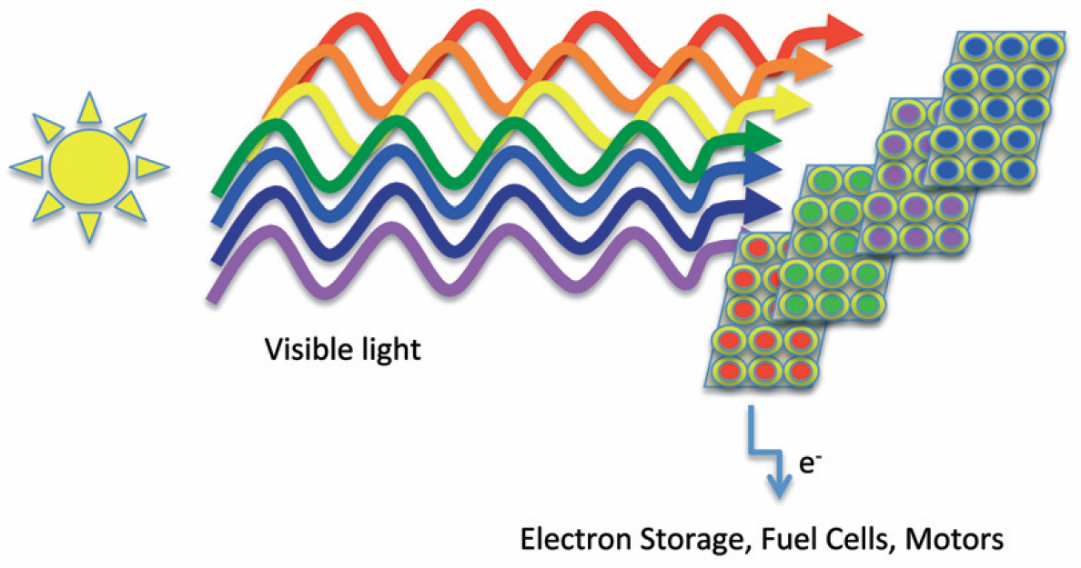
Motivation
Single junction photovoltaic cells are subject to the Shockley-Quieisser limit of 33.7% efficiency.
Layered PV cells of multiple band gaps have reached efficiencies of 44%.

Slide 5
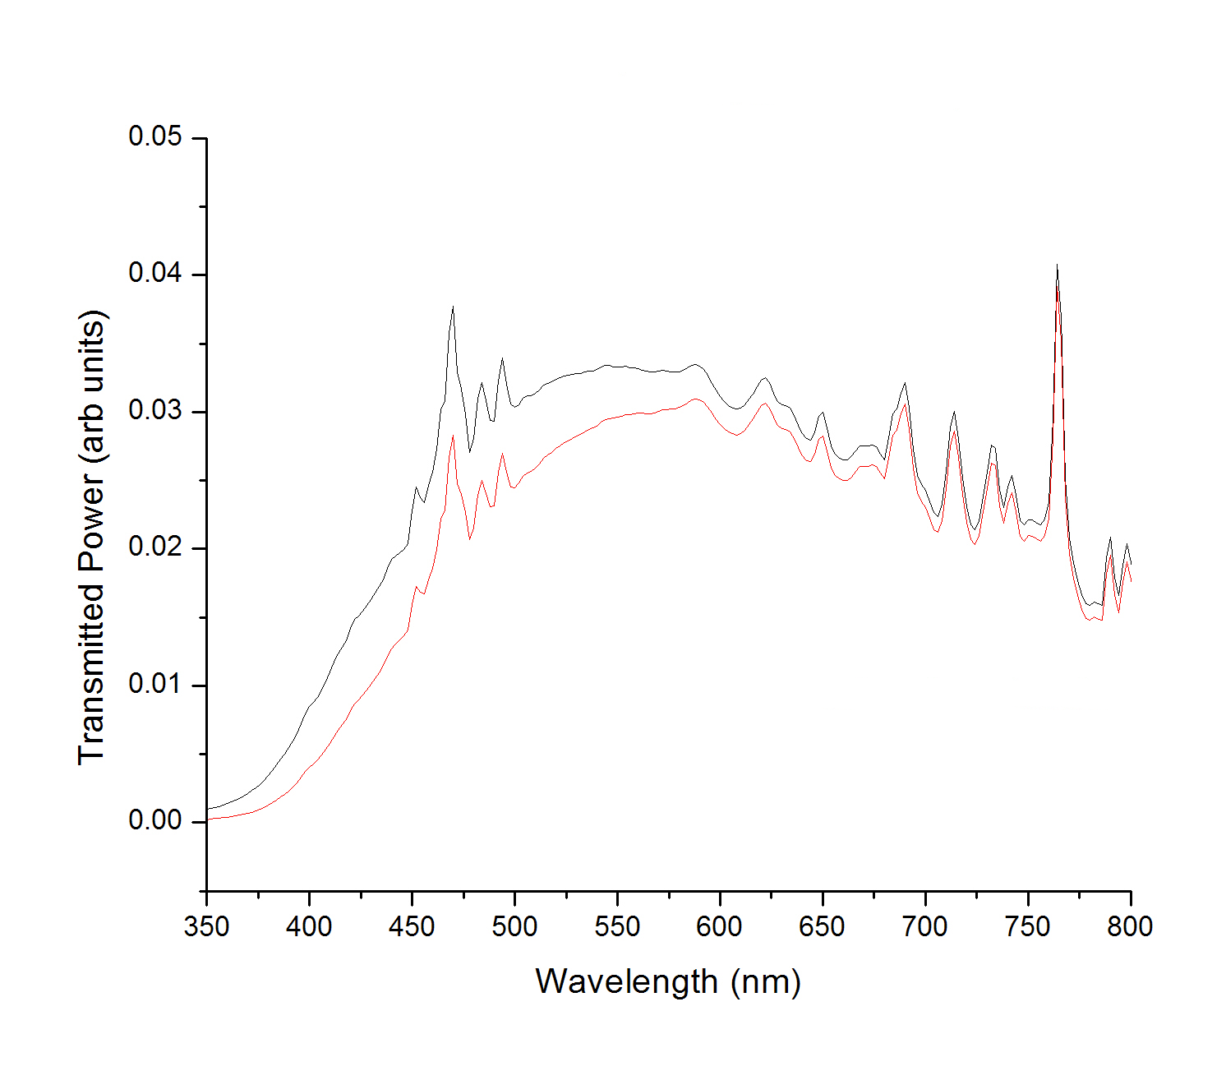
Experimental Methods
Optical absorption spectroscopy:
Transmitted power through the sample is compared to a control to get percent transmitted as a function of wavelength
After some mathematical analysis, linear fits are extrapolated to the x-axis to find the band gap
For a more detailed description, see: J.S. Colton, S.D. Erickson, T.J. Smith, and R.K. Watt, Nanotechnology 25 135703 (2014)
Blank, solution with no ferritin
Control
With ferritin

Slide 6
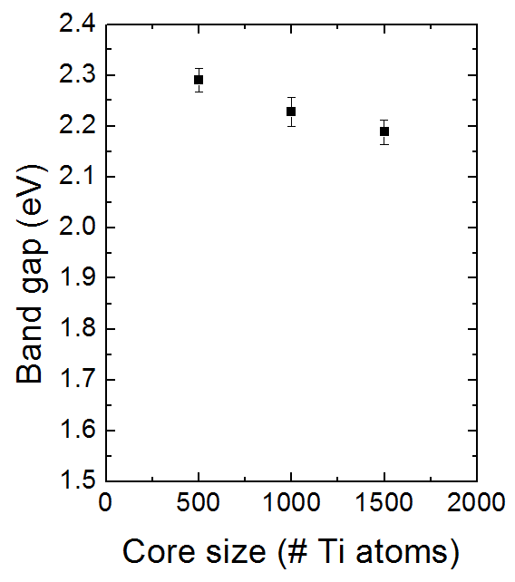
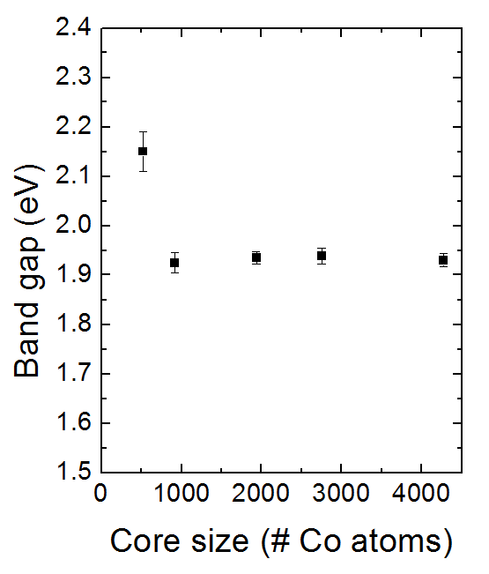
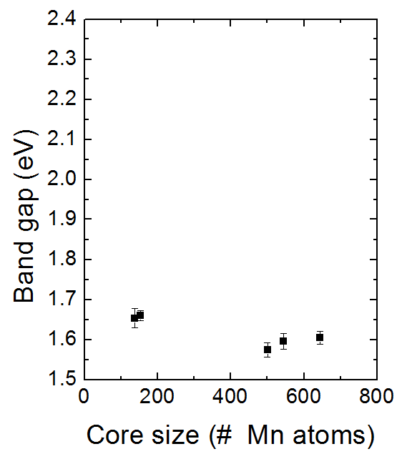
Co, Mn, and Ti-oxides

Slide 7
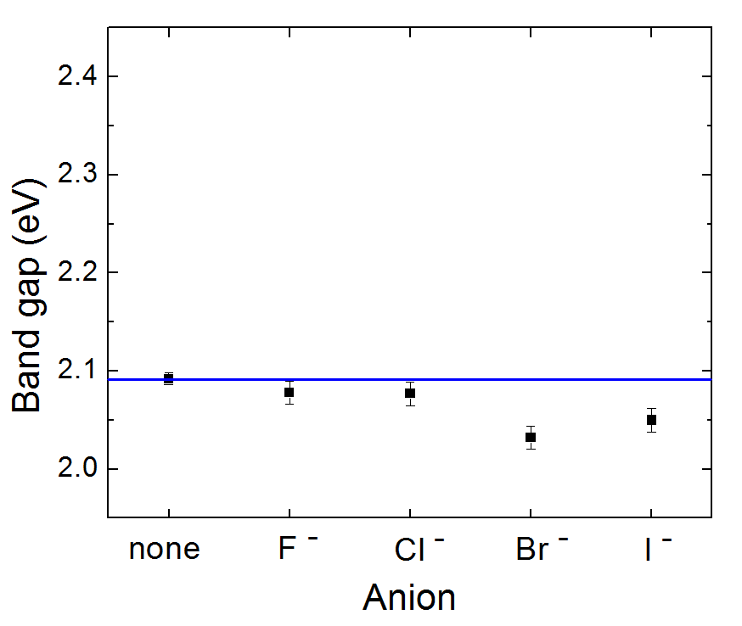
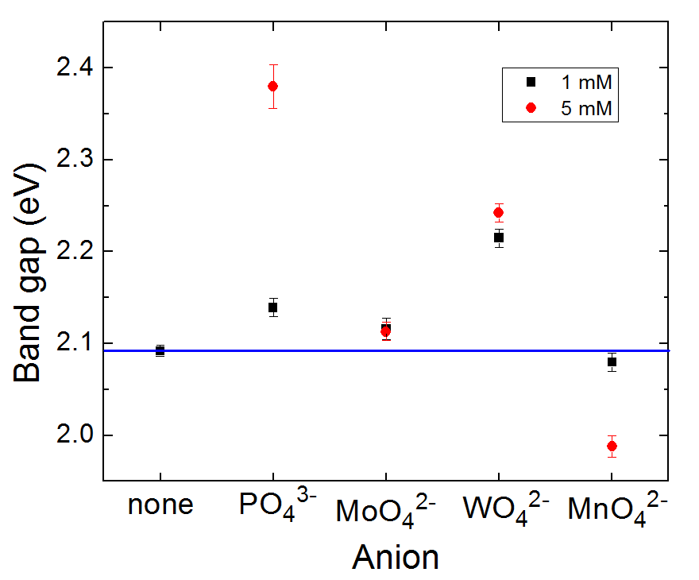
Co-depositing anions into Fe(O)OH

Slide 8
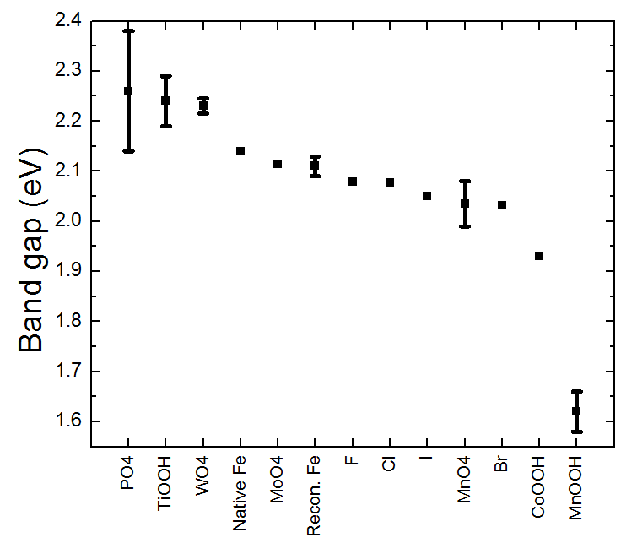
520 nm
775 nm

Slide 9
Calculating theoretical efficiencies
Use a detailed balance model similar to Shockley and Queisser
Coupling between the layers due to mutual irradiance
Maximizing the electrical power yields a system of coupled transcendental equations:
$$P=\sum_{i=1}^{n}{\left(I_{photon, i} − I_{diode, i}){ V}_{i}\right.}$$
$$I_{photon, i}=qf_{Ω}A \int_{{E_{g,i−1}}/hc}^{{E_{g,i}}/hc}{\frac{\left.S(λ\right)}{\left.E_{photon}(λ\right)}dλ}+qe^{{qV_{i−1}}/{kT}}A\int_{{E_{g,i−1}}/h}^{∞}{N\left(f,T\right) df}+qe^{{qV_{i+1}}/{kT}}A\int_{{E_{g,i}}/h}^{∞}{N\left(f,T\right) df}$$
$$I_{diode,i}={qe}^{{qV_{i}}/{kT}}2A\int_{{E_{g,i}}/h}^{∞}{N\left(f,T\right) df}$$

Slide 10
Solving the system of equations
Solving for optimal operating voltages must be done numerically, which requires a good initial guess to converge on the solution
Ignoring coupling between layers, each can be optimized independently from a single transcendental equation:
$$\left(1+\frac{qV_{i}}{kT}\right)e^{{qV_{i}}/{kT}}=\frac{F_{solar,i}}{F_{dark recomb,i}}$$

Slide 11
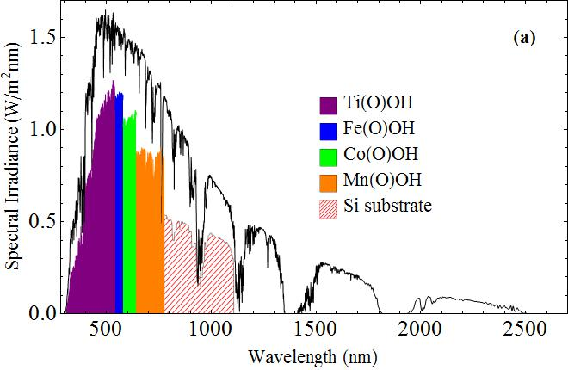
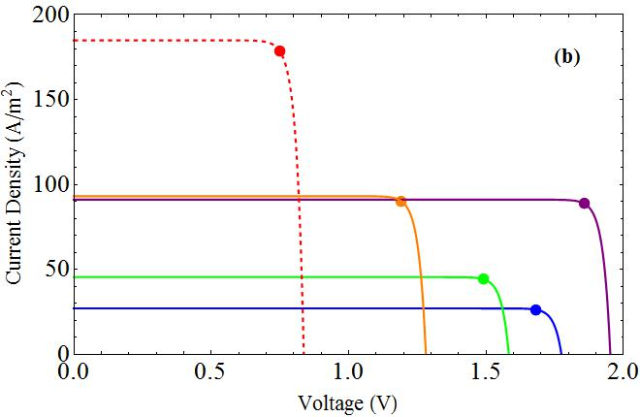
Maximum Efficiency
I-V Characterisitics
AM 1.5G spectrum

Slide 12
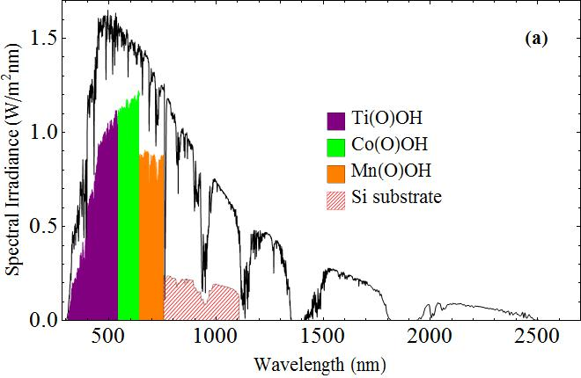
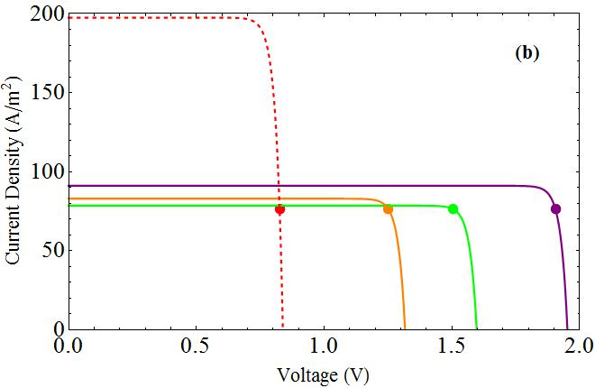
Current Matching
Advantage:
Higher output voltage
Disadvantage:
Current limited by lowest producing cell

Slide 13
Efficiency Table
 | f_{W} (# suns) | Operating voltages (V) | Theoretical efficiency (%)
Ti,Fe,Co,Mn | 1 | 1.856,1.680,1.490,1.181 | 38.0
 | 100 | 1.974,1.798,1.607,1.298 | 41.0
 | Max | 2.130,1.954,1.764,1.453 | 44.9
Ti,Fe,Co,Mn,Si | 1 | 1.856,1.680,1.490,1.191,0.748 | 51.3
 | 100 | 1.974,1.798,1.608,1.308,0.864 | 56.4
 | Max | 2.130,1.954,1.764,1.464,1.012 | 63.1
Ti,Co, Mn,Si | 1 | 1.905,1.505,1.251,0.825 (5.49 total) | 41.6
(current matched) | 100 | 2.024,1.622,1.370,0.944 (5.96 total) | 45.2
 | Max | 2.182,1.778,1.527,1.103 (6.59 total) | 50.0

Slide 14
Conclusions
Band gaps of ferritin enclosed nanocrystals can be tuned to cover most of the visible spectrum, from about 520-775 nm
These materials show promise in solar energy applications, with high potential efficiencies
Future work will characterize II-VI semiconductors
For more information see: TJ Smith, SD Erickson, CM Orozco, A Fluckiger, LM Moses, JS Colton, and RK Watt, submitted to J. Mater. Chem. A. (2014) SD Erickson, TJ Smith, LM Moses, RK Watt, and JS Colton, submitted to Nanotechnology (2014)

