Slide 1
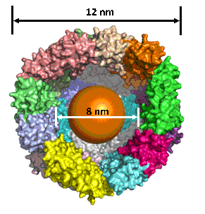
Properties of protein-based ferrihydrite nanoparticles
Stephen Erickson
Trevor Smith
Dr. John Colton
Dr. Richard Watt
Ferritin
Ferrihydrite
Special thanks to the NSF for funding

Slide 2
Motivation
Previous studies do not agree on the band gap, giving values from 1.1-3.5 eV
Self assembling cores, allows for controlled size and composition
Seek to show tunable band gaps
Useful for light harvesting, detectors, etc
Provide experimental evidence for hypothesized aging effect

Slide 3
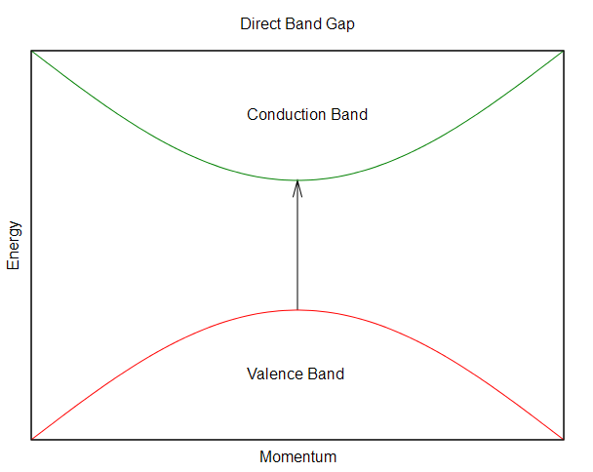
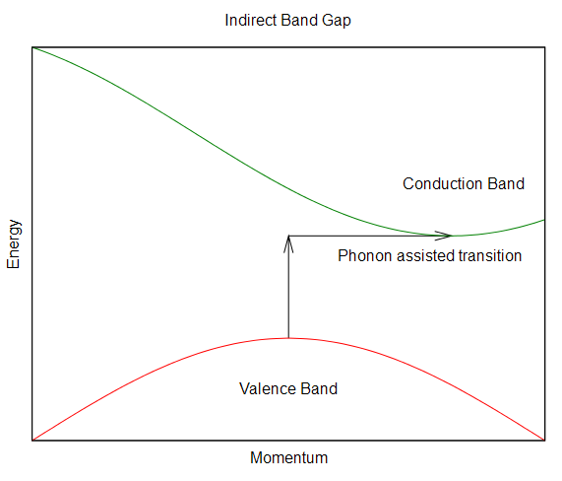
Direct and indirect band gaps
Indirect band gaps require a phonon to be emitted or
absorbed in order to conserve momentum.
Images courtesy of Wikipedia

Slide 4
Experimental setup
Spectrometer
Sample Holder
Xenon Arc Lamp
Lenses
Iris
Photodiode
Chopper
Computer steps through wavelength of spectrometer and records data from lock-in
Ref
Signal
Lock-in Amplifier

Slide 5
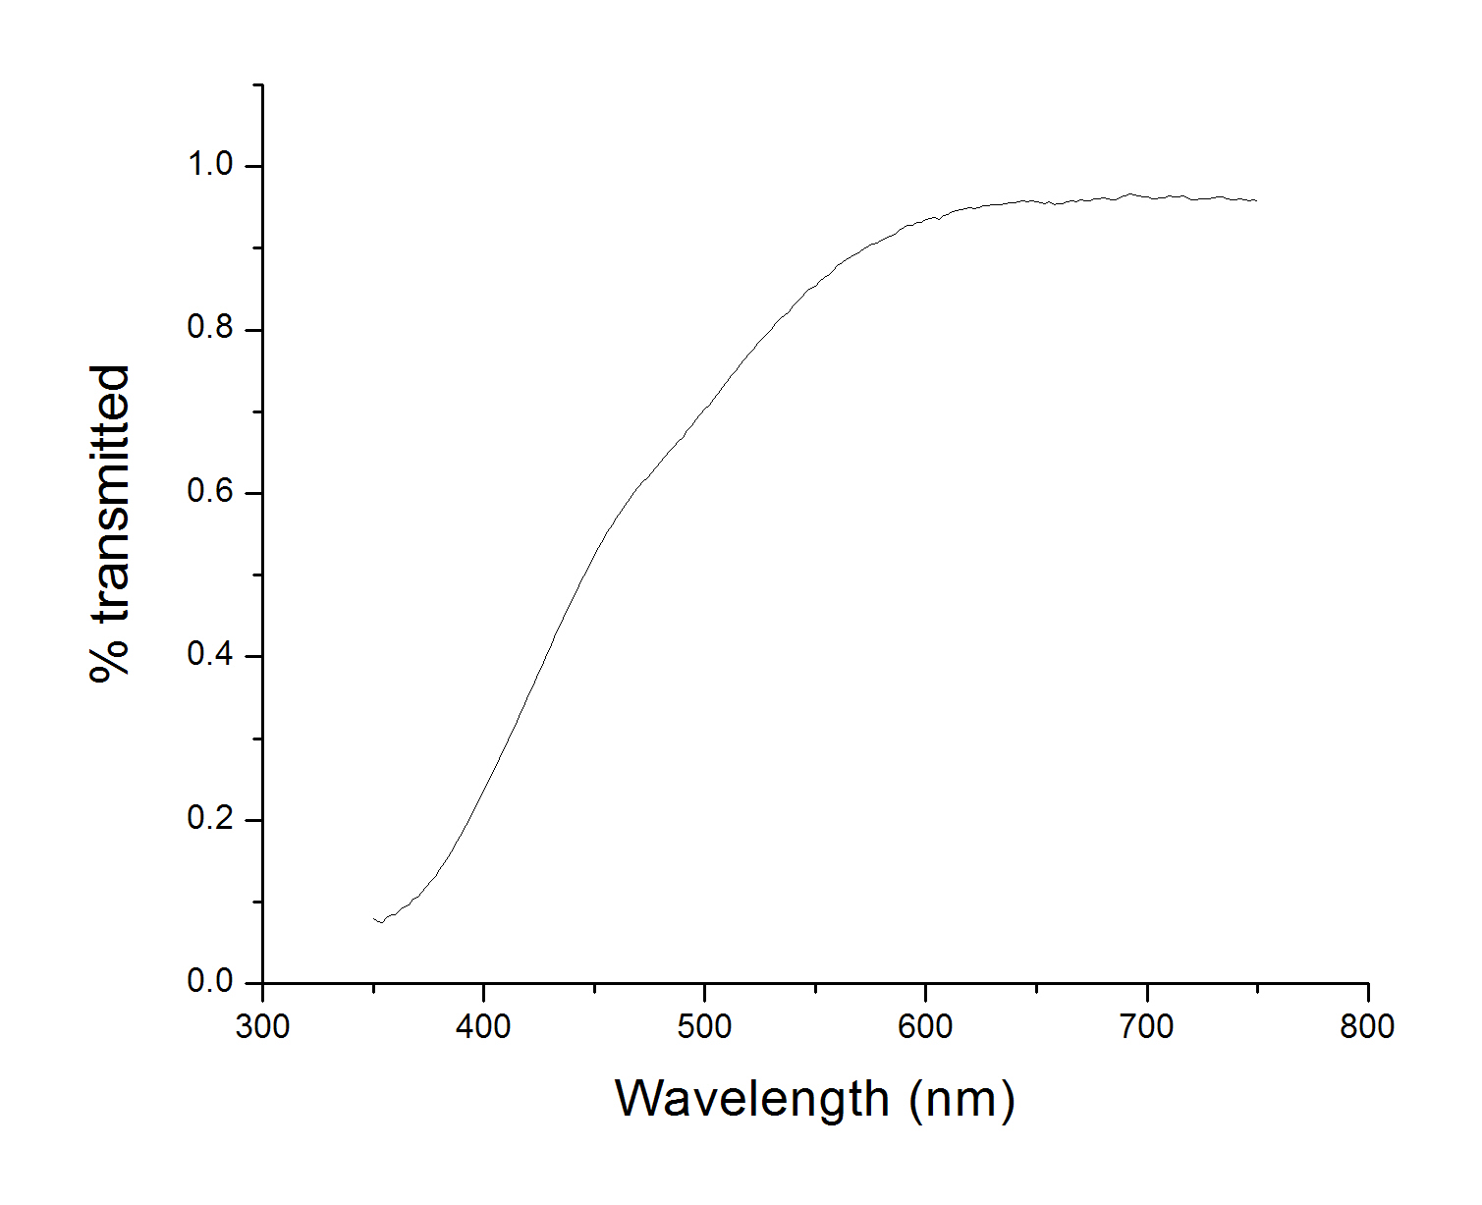
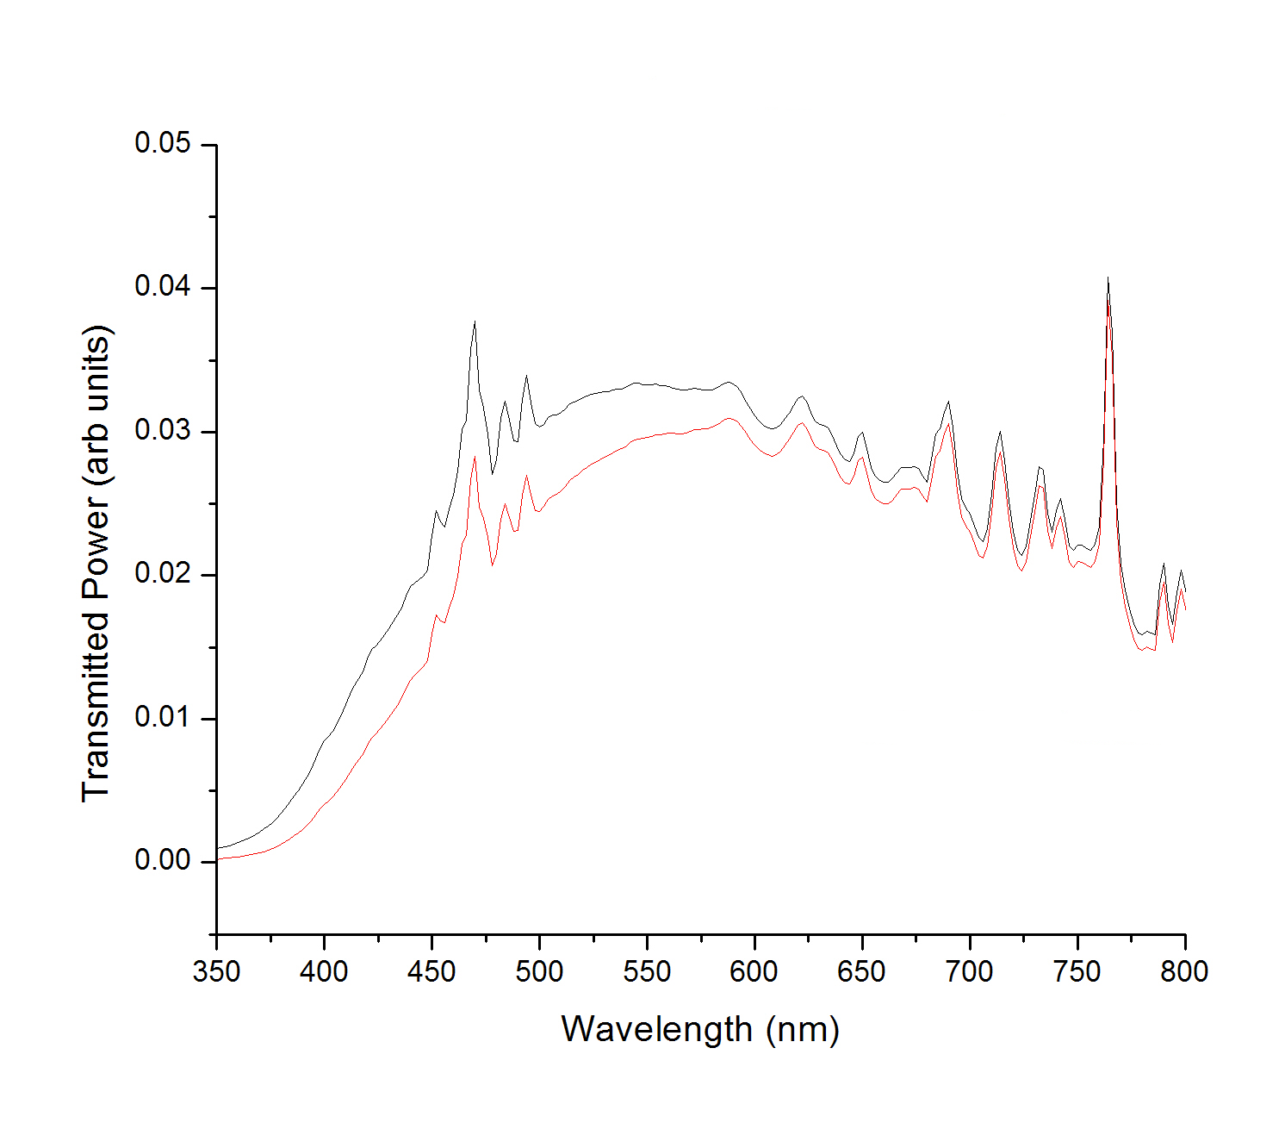
Typical raw data
Control
With ferritin

Slide 6
Data analysis
Absorption coefficient α:
direct gap
indirect gap, phonon emitted
We arrive at the band gap by plotting α² and α^{1/2} versus
phonon energy then extrapolating a linear fit to the x-axis

Slide 7
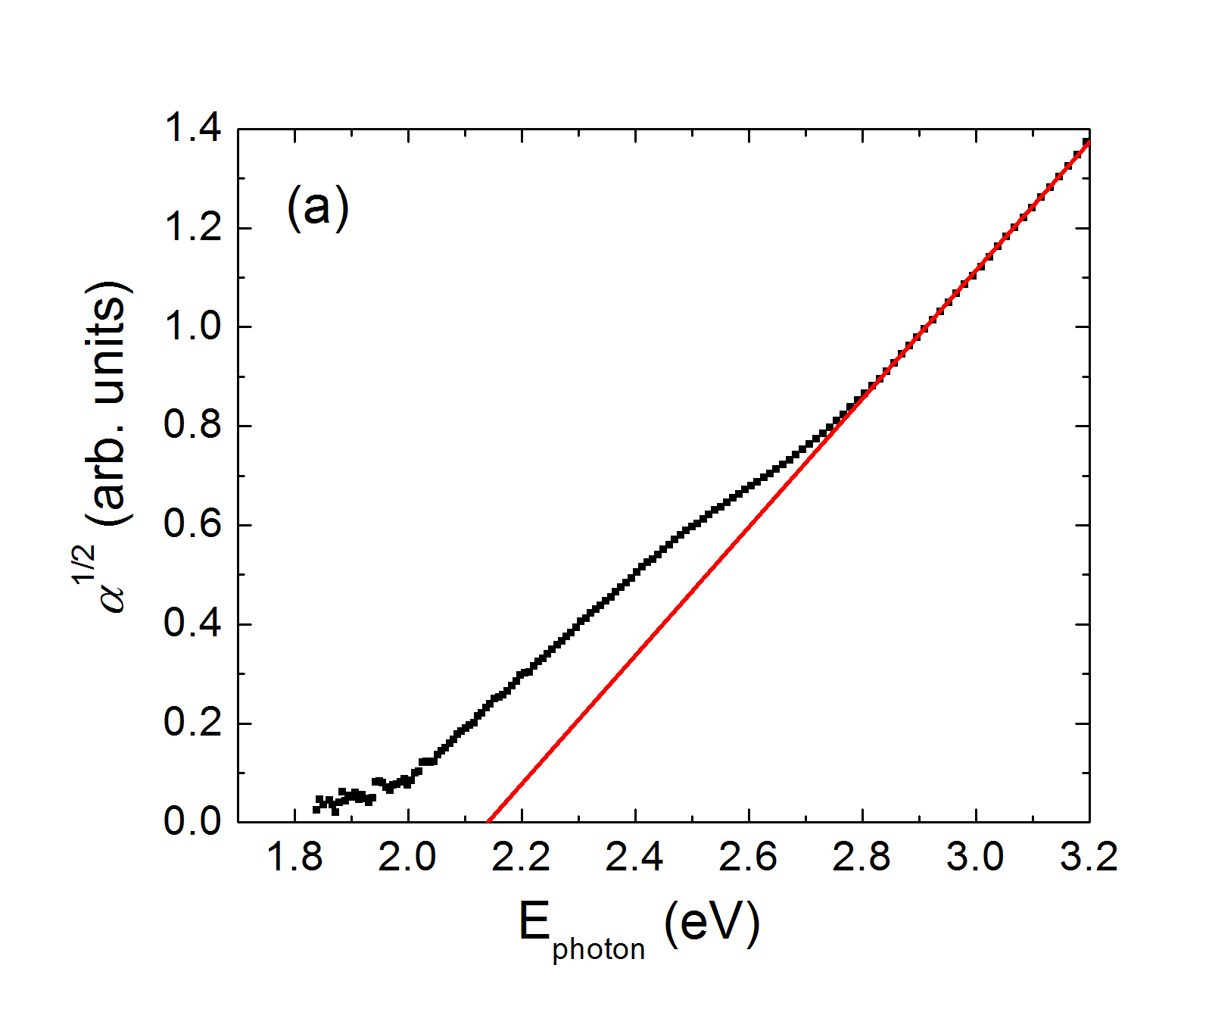
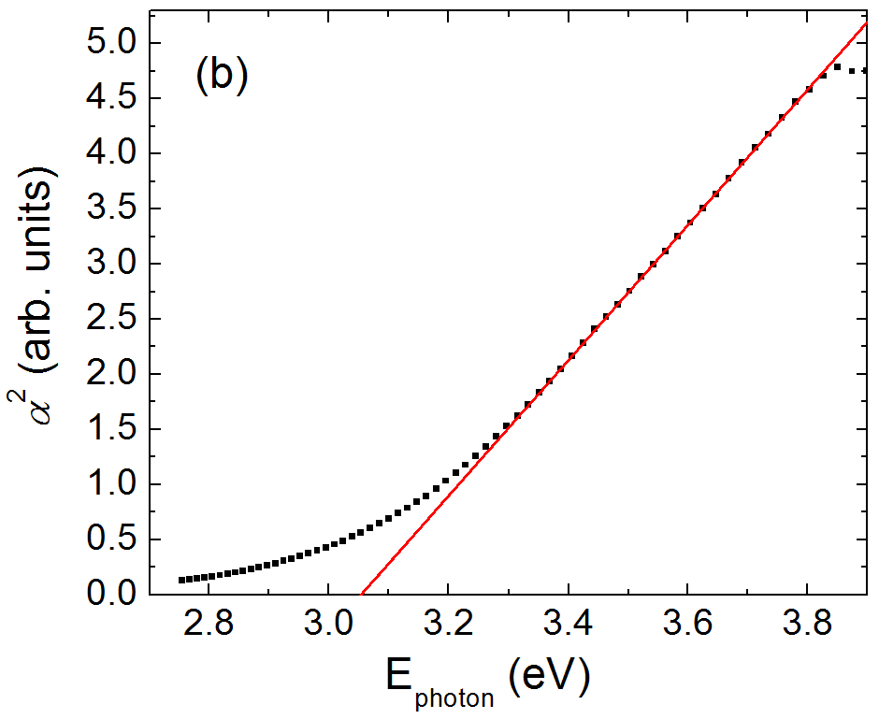
Extrapolating band gaps
Indirect gap
Direct transition

Slide 8
Possible band structure

Slide 9
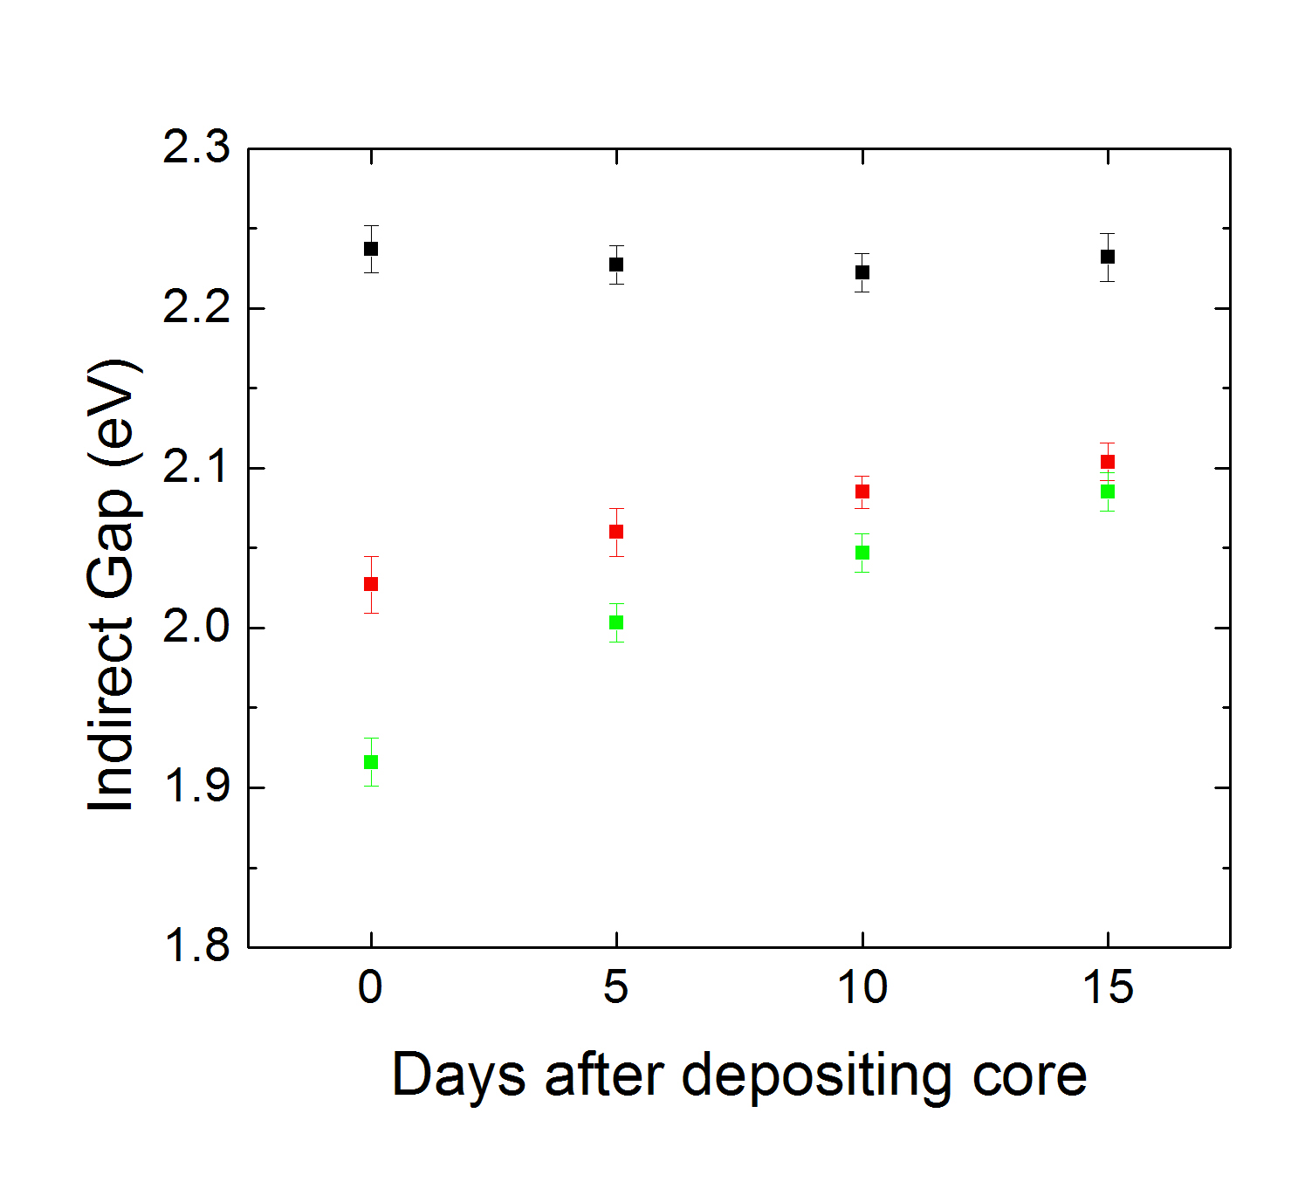
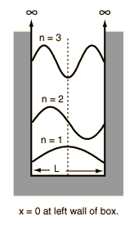
Different core sizes
Smaller particle
→ larger gap
Core crystallizes
with time
500 Fe atoms
1000 Fe atoms
1500 Fe atoms
Image courtesy
http://hyperphysics.phy-astr.gsu.edu/hbase/quantum/imgqua/pbox1.gif

Slide 10
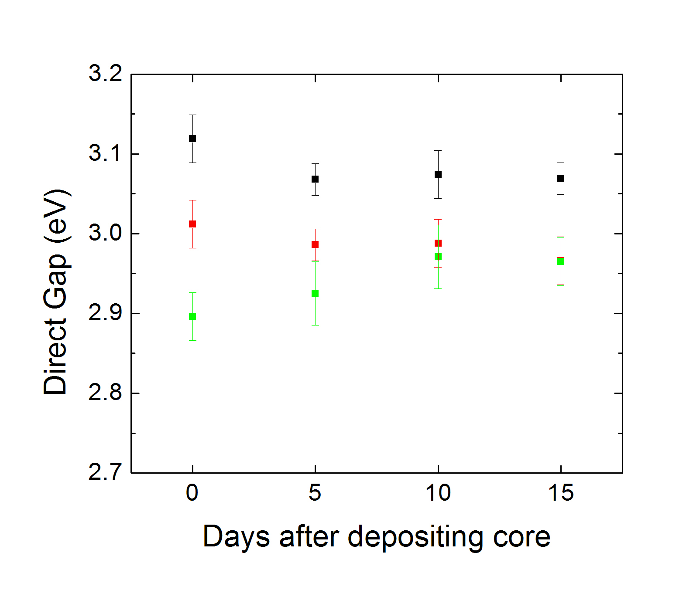
Different core sizes – direct transition
500 Fe atoms
1000 Fe atoms
1500 Fe atoms

Slide 11
Summary
Reconciled previous band gap studies
Showed tunable band gaps through different particle sizes
Provided first experimental evidence of theorized aging effect
Future experiments will focus on demonstrating even greater control over the band gap through different mineral cores, like Co, Mn, Ni, etc.

