Slide 1
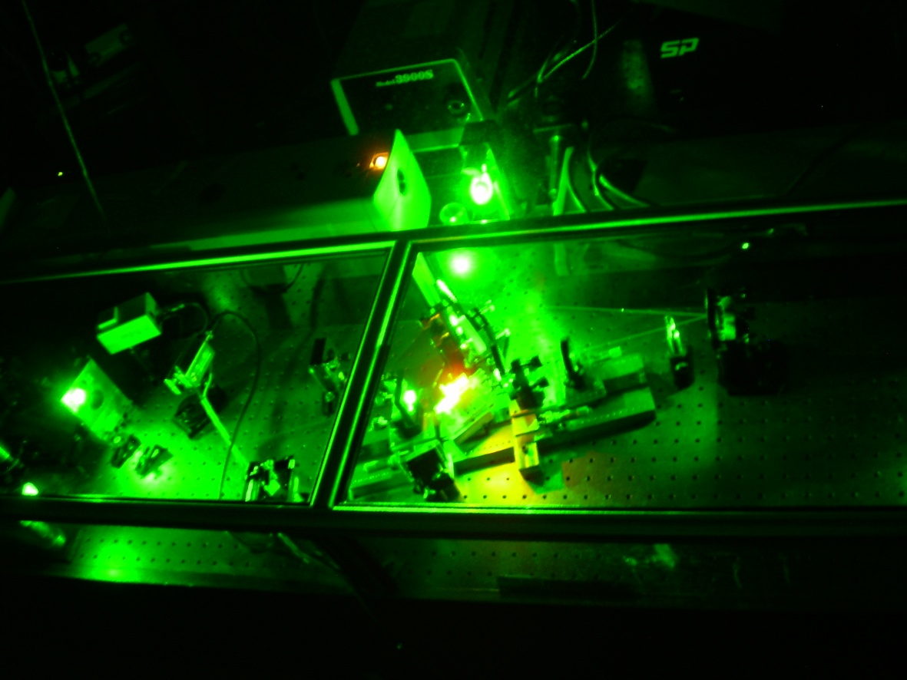
Time-Correlated Single Photon Counting (TCSPC)
Scott Thalman
Brigham Young University
Advisor: Dr. John Colton
Dr Haeyeon Yang USU Physics
Help from Mitch Jones, Steve Brown, Dallas Smith
Notes:
Add other names, plan to do not have done, also use tcspc, haeyeon and matt asplund, add BYU, introduce myself

Slide 2
Overview
Time-correlated single photon counting (TCSPC) measures photoluminescence (PL) lifetimes
  Pulsed laser illumination source
  Single-photon detectors
  Very fast timing module
100 picosecond time resolution with deconvolution
InGaAs Quantum Dots
Optical properties are an indicator of sample quality
Notes:
Spell out tcspc

Slide 3

Photoluminescence
Excited States
(conduction band)
e
-
e
-
Excitation
Relaxation
Energy Gap
Photon
-
Ground State
(valence band)
-
e
e
Notes:
Ground state equivalent, maybe add a slide after with a PL scan

Slide 4
Quantum Dots
QD
GaAs
InGaAs
GaAs
40 nm
Scanning tunneling micrograph of InGaAs Quantum Dots on GaAs substrate
Dong Jun Kim et al 2008 Nanotechnology 19 47560
Notes:
Thin out wetting layer, add scale,

Slide 5
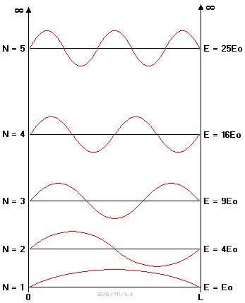

Quantum Dots
Confined electrons must occupy energy states that fulfill the Schroedinger equation
Energy
  Results:
  Discrete energy levels
  Discrete luminescence wavelengths
http://www.vectorsite.net/tpqm_02.html
Notes:
Compare to infinite square well

Slide 6
QD Photoluminescence

Slide 7
Time Correlated Single Photon Counting
Pulsed Laser
~30 fs, center wavelength 800 nm
Fast
Photodiode Detector
Start
Lenses and Filters
Ortec Fast Digitizer
Timing Module
Stop
Si-APD
Detector
QD
Sample
Notes:
Bigger

Slide 8
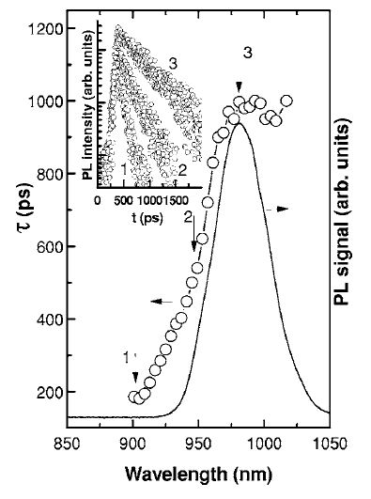
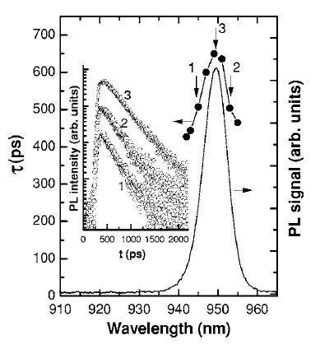
QD Fluorescence Lifetime Expected Results
Fig 1
Fig 2
Fluorescence lifetime of InGaAs Quantum Dot (fig 1) and Quantum Well (fig 2) samples measured by a streak camera.
Mazur et al 2006 Journal Of Applied Physics 100 054313
Notes:
Image of haeyons qd chains, islifetime different from chains to dots, CdSe dots,This is not our data, don’t mention streak camera

Slide 9
InGaAs QD Results
Instrument Response
Notes:
Present the convolution as a problem and our solution.

Slide 10
InGaAs QD Results:
Convolution
Definition of Convolution
Convolution Theorem
Notes:
Add slide with summary of results. Make curves thicker, get rid of reconvolution

Slide 11
Summary of Results
Sample Number | Photoluminescent Lifetime (ns)
 | Unfocused Laser | Focused Laser
032607-A | 0.86 | 0.65
032607-B | 0.78 | 0.78
032907 | 0.96 | 0.60

Slide 12
Conclusion
Using TCSPC we were able to measure the photoluminescent lifetimes of self-assembled InGas QDs to help determine their quality.
Our samples had lifetimes of 0.6-1.0 ns.
Using deconvolution we were able to enhance our results.
Future studies will determine if quantum structures such as QD chains can be formed by this growth method.
Thank You

