Slide 1
Tunability and Stability of Lead Sulfide Quantum Dots in Ferritin
J. Ryan Peterson
Dr. John S. Colton (advisor)
Kameron Hansen, Micah Shelley, Alessandro Perego, Cameron Olsen, Luis Perez

Slide 2
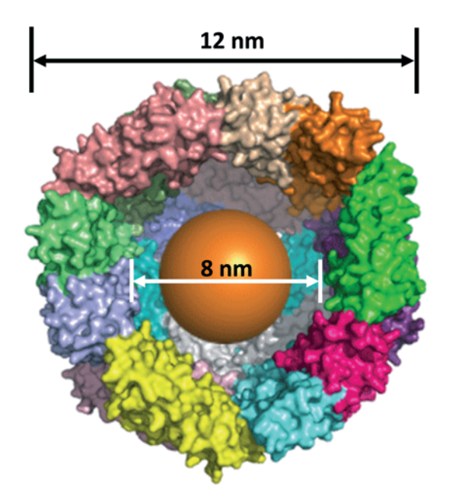
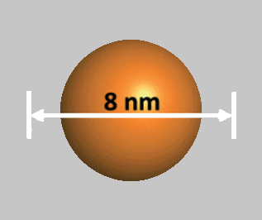
PbS Quantum Dots
in Ferritin
For PV applications
PbS QD Features:
Widely tunable
Low bulk band gap
Multiple exciton generation
Ferritin Features:
Growth template
Electrostatic gradient for synthesis
Corrosion protection
Catalysis Science & Technology 3, 3103 (2013)
Notes:
Explain capping agent
Introduce ferritin
Make PbS QD features text bigger, make title appear with FTN
Mention reassembly synthesis method as well as adding lead solution then sulfide solution

Slide 3
PbS Quantum Dot Synthesis
Traditional synthesis
Thioglycerol used as capping agent
Ferritin Synthesis
Remove existing core from protein
Add lead II acetate
Add sodium sulfide
Our findings
Ferritin synthesis works in oxygen atmosphere

Slide 4
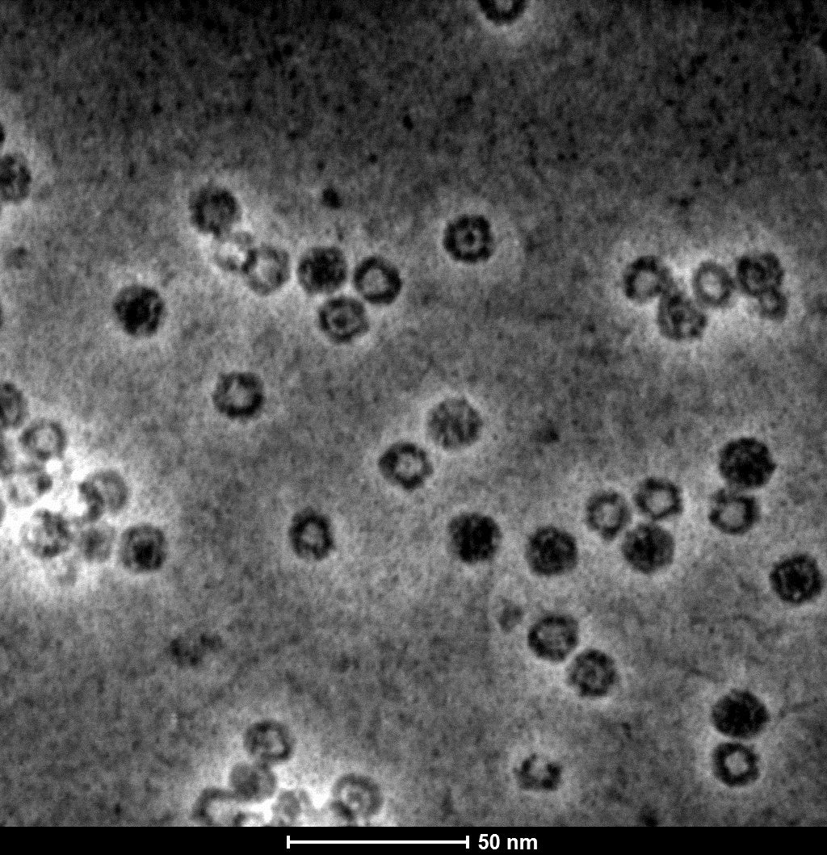
PbS Quantum Dots in Ferritin
Ferritin shell
Sample | Measured Core Diameter
Sample 1 | 2.25 ± 0.48 nm
Sample 2 | 3.03 ± 0.39 nm
Sample 3 | 3.04 ± 0.54 nm
Sample 4 | 5.70 ± 0.89 nm
Sample 5 | 6.10 ± 0.89 nm
PbS Quantum Dot
Nonuniform core sizes
Notes:
Explain how image was taken
What can I say about the halo shape of the quantum dot?
Mention that dots have been shown by XRD to be very defective at the start, so annealing is necessary to improve performance.

Slide 5
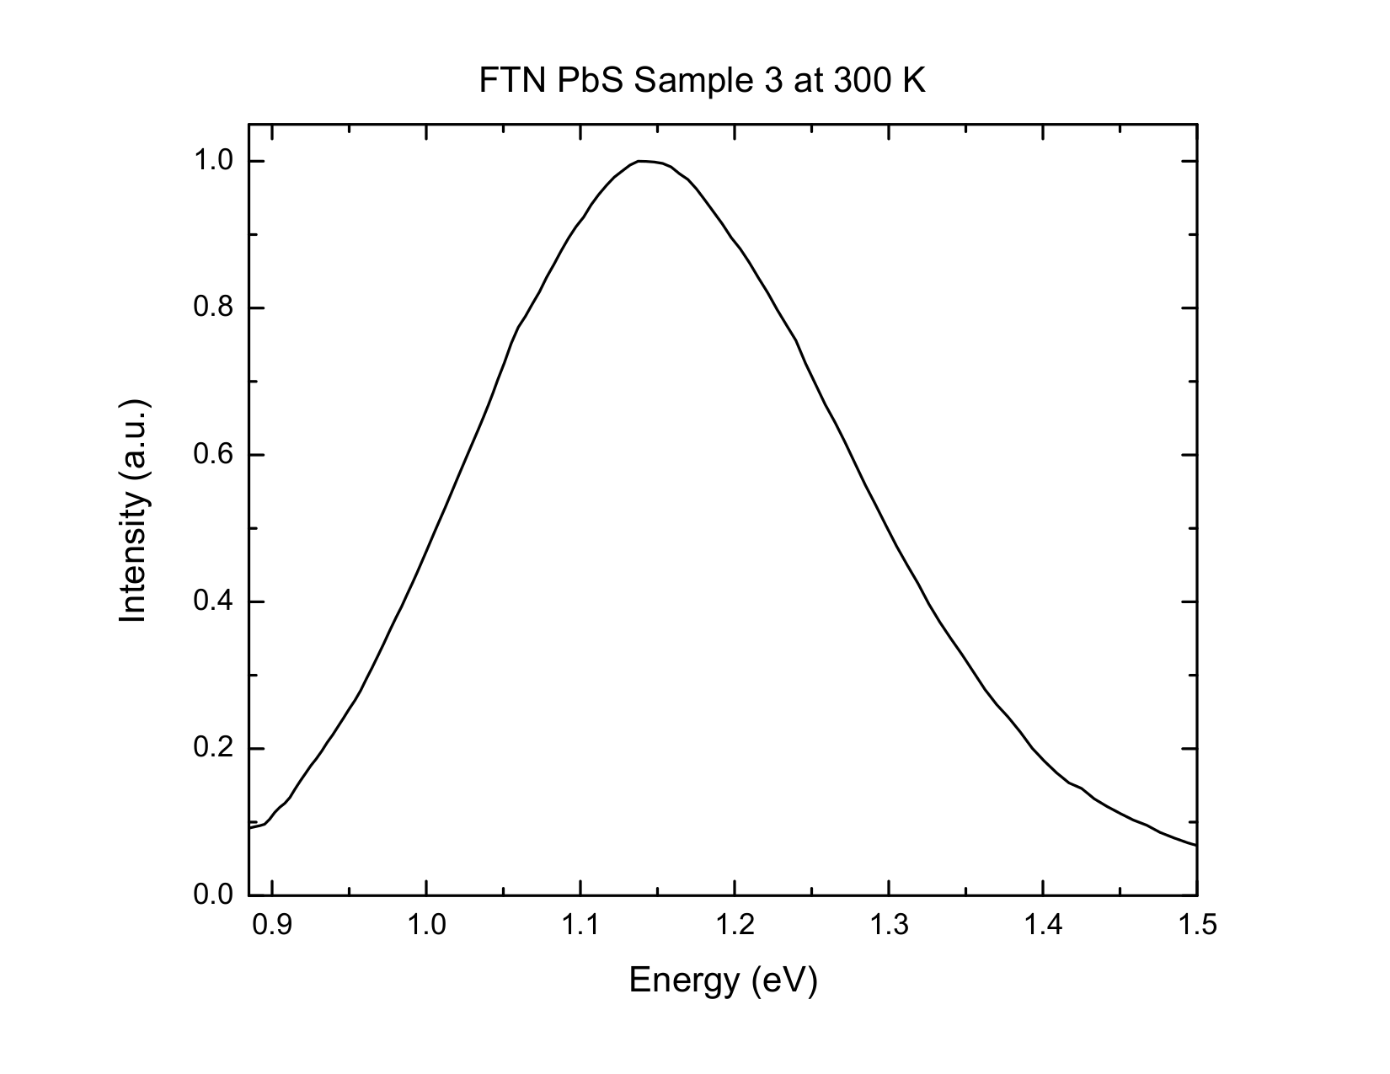
Photoluminescence
Band gap at 25 K: 1.15 eV
1.14 eV
0.29 eV
Notes:
Explain how the orange line is calculated
Remember how earlier I pointed out that the particles aren’t completely homogeneous? There are slight size variations, leading to a distribution of band gaps.
Mention that while we can’t target a super narrow band gap, the Shockley-Queisser limit for a single cell as nearly the same max efficiency for 1.1-1.3 eV band gaps.
Add second PL spectrum

Slide 6
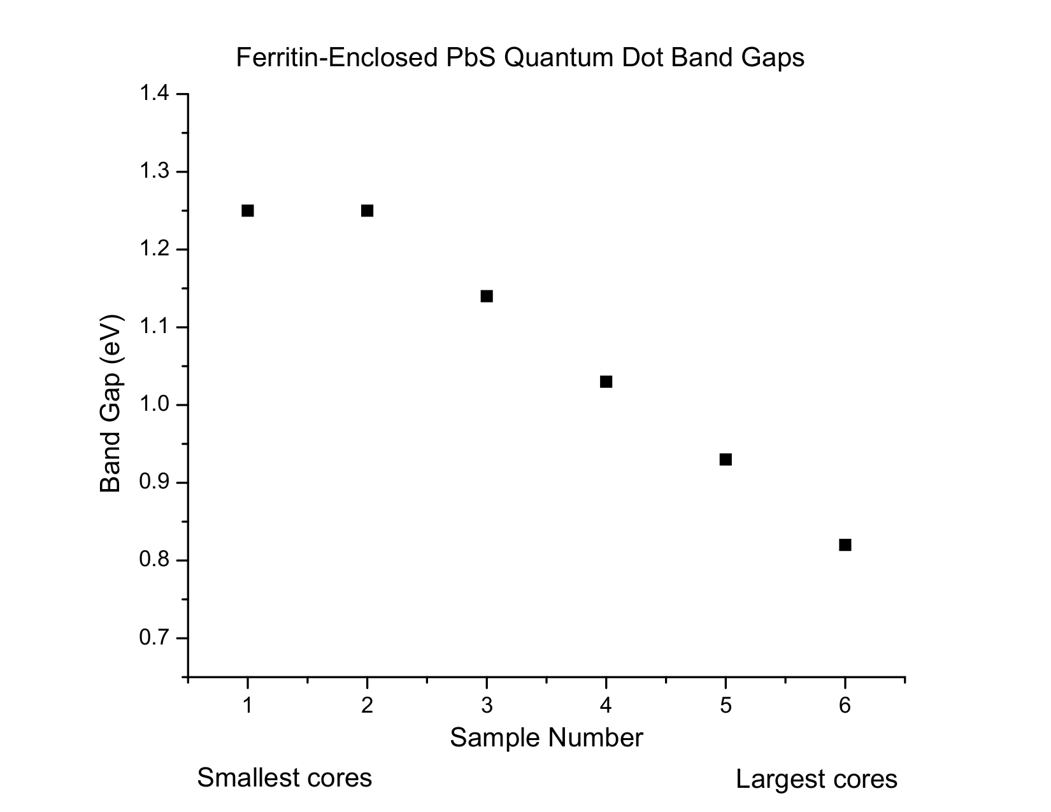
Tunability
FWHM
Notes:
Need to get S1 remeasured!
Make vertical scale smaller, maybe put
S2 FWHM: .3
S6 FWHM: .17

Slide 7
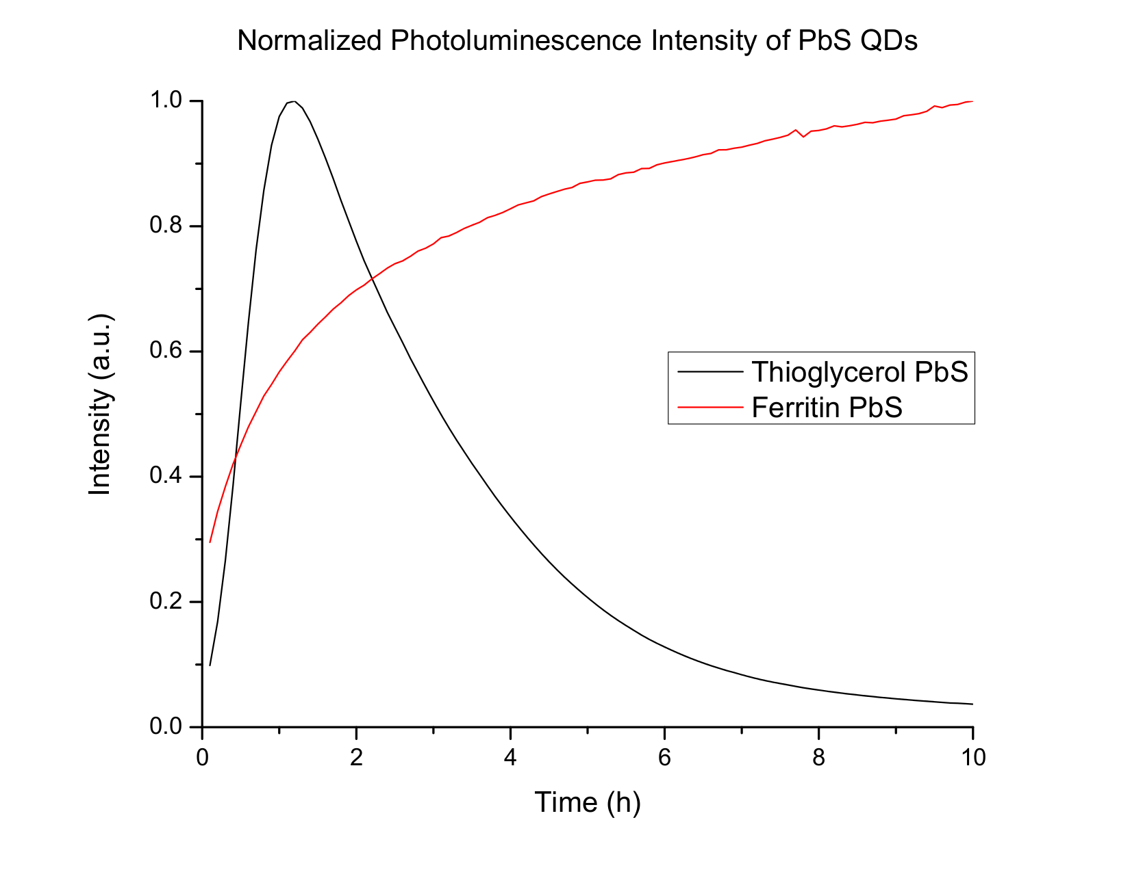
Protection Against Photocorrosion
Samples illuminated by 398nm laser (10 W/cm²) in atmosphere
8x
Thioglycerol PbS
Ferritin PbS
1x
Notes:
Explain why it was normalized
Mention that after 18 hours, the FTN absolute intensity was roughly 8x higher than TGL PbS
Initially, QDs very defective (shown by XRD peaks), and seems likely that this is a thermal annealing effect from the laser.
Include laser intensity.
Show photos of laser burns
Put normalization factor on graph

Slide 8
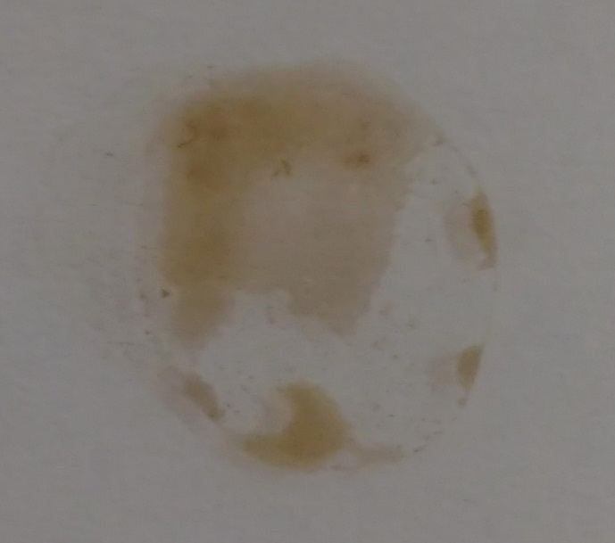
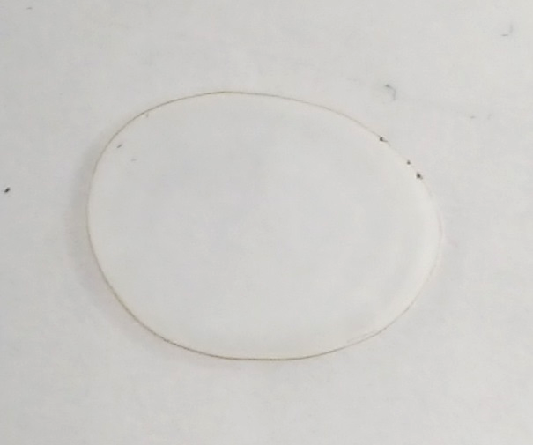
Protection Against Photocorrosion
3x solar intensity for two hours
Before
After
Thioglycerol-capped PbS
Ferritin-enclosed PbS
Notes:
Explain what these samples were exposed to: Xenon arc lamp at 3x solar intensity for two hours
Put this on the slide

Slide 9
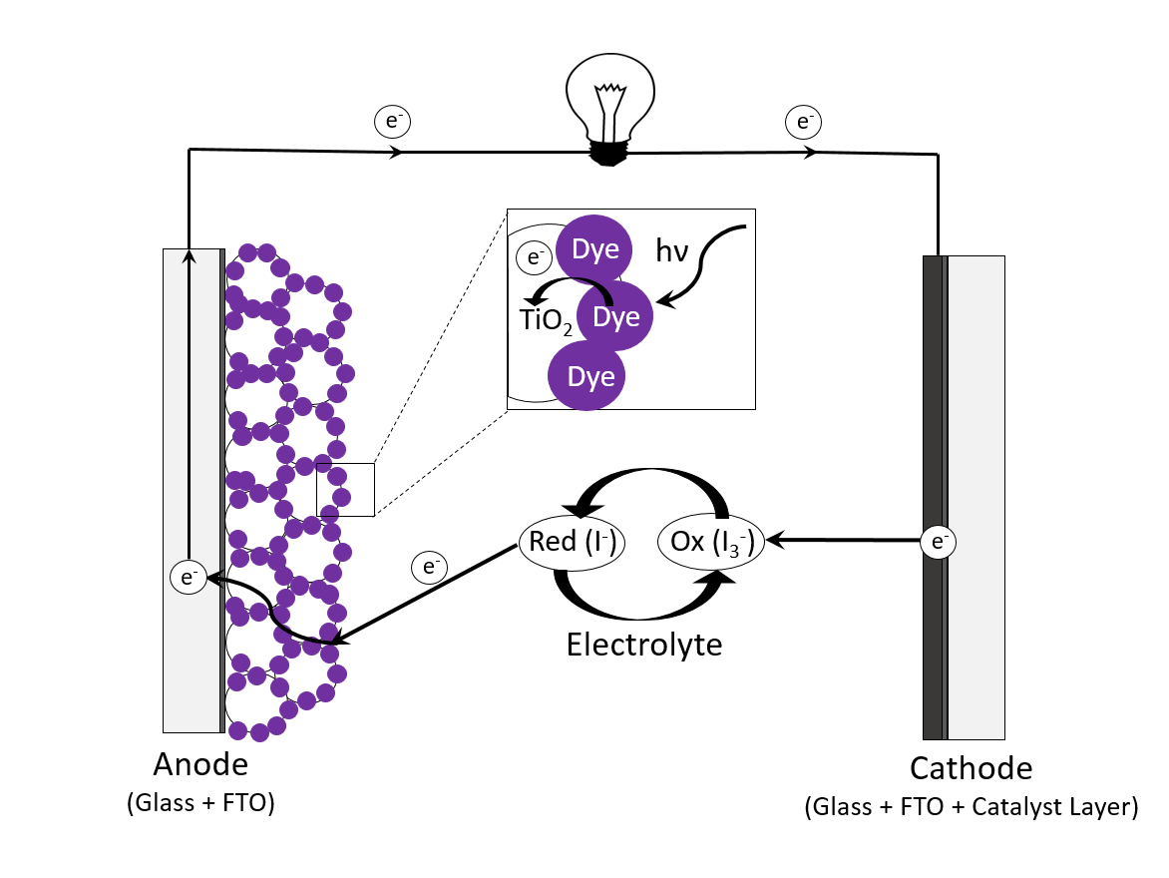
Dye-Sensitized Solar Cell

Slide 10
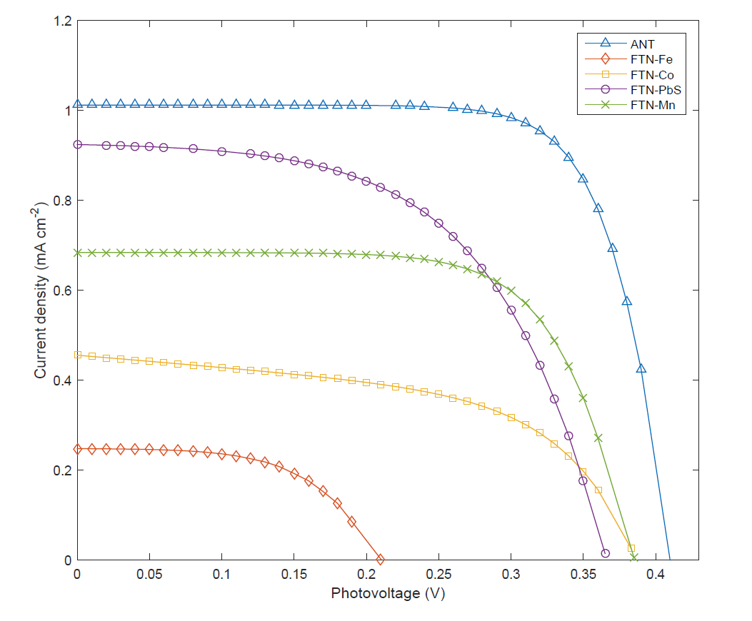
Solar Cell Performance
Anthocyanin (0.31%)
PbS-FTN (0.26%)
Mn-FTN (0.25%)
Co-FTN (0.14%)
Fe-FTN (0.06%)
Notes:
Add a schematic of solar cell
Explain that we use TiO2 and ITO on one end, Pt on other end, iodide electrolyte

Slide 11
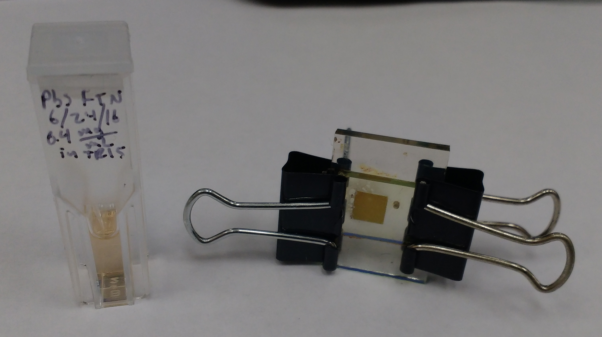
Conclusions and Future Work
If interested in synthesis, see Kameron Hansen’s talk, right now at 12:03, in Room 288
Widely tunable band gaps
Effectively protects against photocorrosion
Solar cell fabrication in progress
PbSe quantum dots currently being investigated
PbS-Ferritin solution
PbS-Ferritin solar cell

