Slide 1
Lead Sulfide Quantum Dot Band Gap Investigations
J. Ryan Peterson
Thanks to:
Dr. John S. Colton (advisor)
Kameron Hansen, Luis Perez, Cameron Olsen

Slide 2
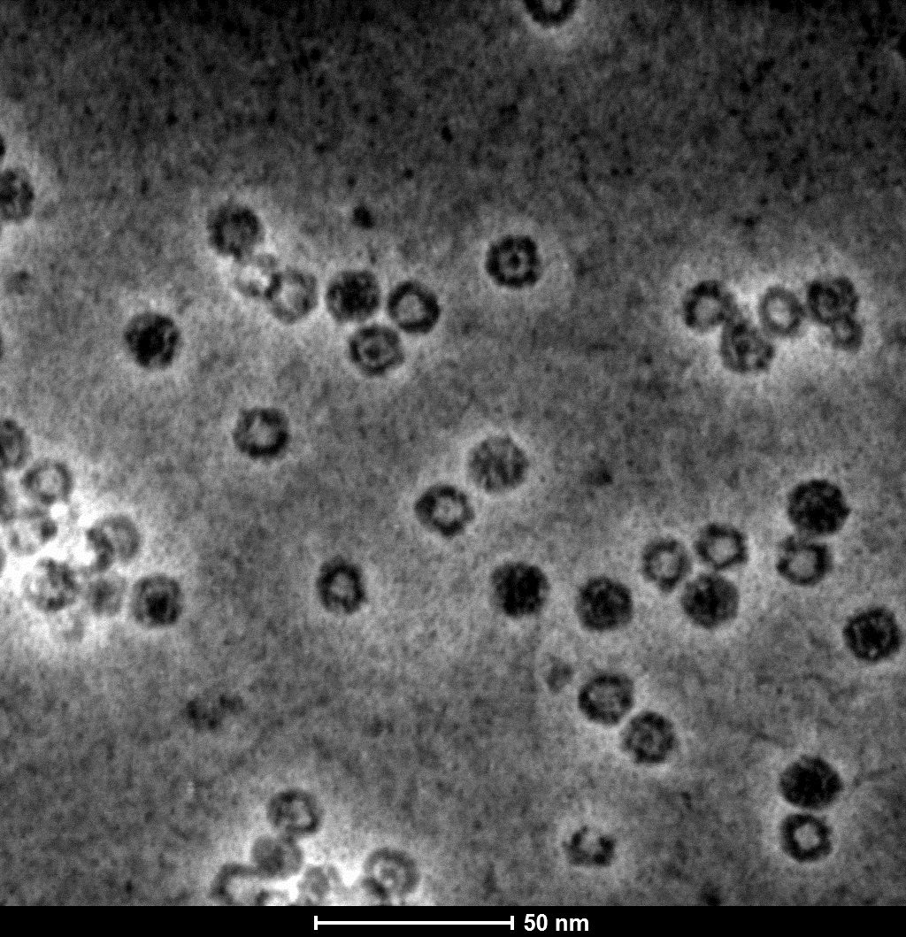
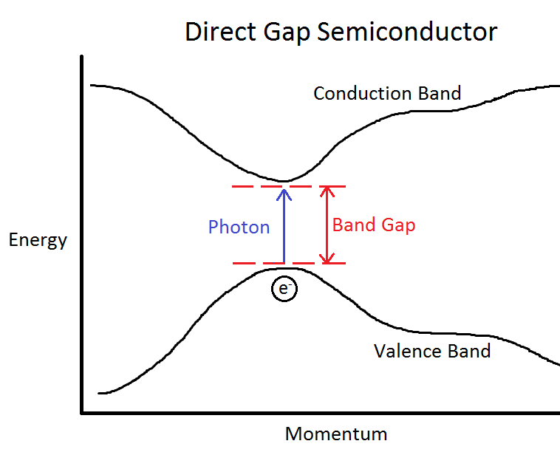
Quantum Dot Synthesis
Different core sizes
Notes:
Explain how image was taken
Explain PL briefly
Mark FWHM and write that it equals .3eV explicitly

Slide 3
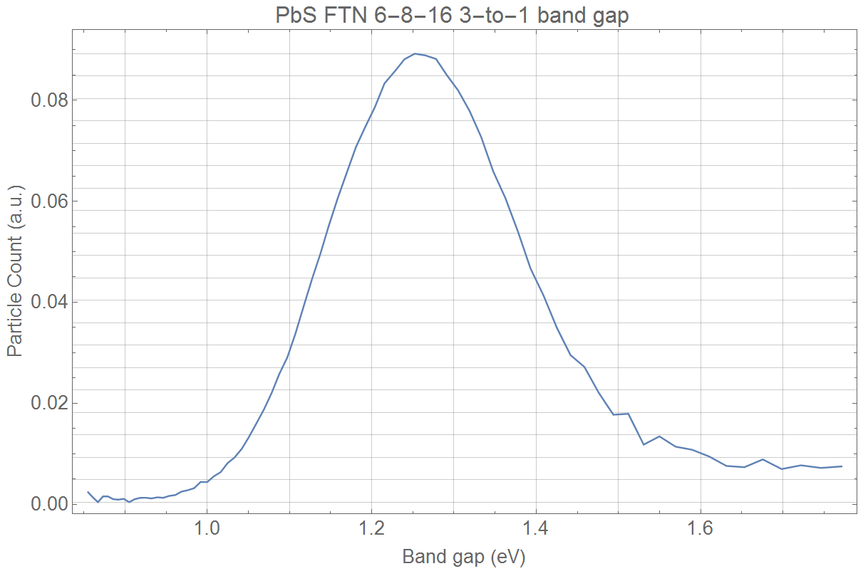
Band gap distribution
FWHM: 0.3 eV
FWHM: 0.007 eV
Notes:
Show a plot of a sharp PL result due to a single narrow band gap
Mark FWHM, write the number (.005eV or whatever)
Explain that the PL spectrum would be even narrower but is limited by the spectrometer resolution

Slide 4
Varying Band Gap Energy Using the Brus Equation
$$E\left(r\right)=E_{gap}+\frac{h^{2}}{8r^{2}}\left(\frac{1}{m_{e}}+\frac{1}{m_{h}}\right)$$
$$E_{gap}:Band gap of bulk material$$
$$m_{e}:effective electron mass$$
$$m_{h}:effective hole mass$$
PbS quantum dot band gap
Bulk PbS band gap
Notes:
Show plot for Brus predictions on this page
Explain quantum confinement in the nanoparticles; that is why the band gap increases as the radius decreases.
If I have time, an even more thorough explanation might be good.
Explain how it was derived (assuming parabolic band structure and assuming periodic wavefunctions, so no edge effects)

Slide 5
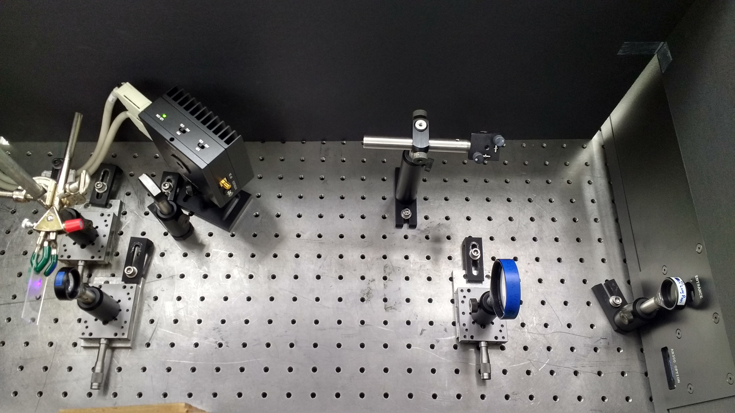
Photoluminescence Experimental Setup
0.25m Spectrometer and Germanium Detector
398nm Diode Laser
Sample
Notes:
Label setup: sample, laser, spec, etc.
Say short wavelength, not high energy (they might think high power)

Slide 6
PbS Photoluminescence
Signal adjusted for system sensitivity
Signal adjusted for system sensitivity
Half max
Measured signal
Half max
Measured signal
Notes:
Explain how the orange line is calculated

Slide 7
Size and Band Gap Results
Sample | Measured Radius | Expected Band Gap (Brus equation) | Measured Band Gap and FWHM
Sample 1 | 2.25 ± 0.48 nm | 1.70 eV (1.29 eV - 2.50 eV) | 1.33 eV (0.33 eV)
Sample 2 | 3.03 ± 0.39 nm | 1.12 eV (.97 eV – 1.35 eV) | 1.14 eV (0.31 eV)
Sample 3 | 3.04 ± 0.54 nm | 1.12 eV (.92 eV – 1.46 eV) | 1.23 eV (0.23 eV)
Sample 4 | 5.70 ± 0.89 nm | 0.61 eV (.56 eV - .69 eV) | 1.0 eV (0.3 eV)
Sample 5 | 6.10 ± 0.89 nm | 0.59 eV (.54 eV - .65 eV) | < 1.0 eV
Notes:
Explain why we couldn’t measure below 0.93 eV
Explain that when the radius gets small, the assumptions made by the equation don’t hold. It assumes periodic wavefunctions, but the wavefunctions become very nonperiodic when
Aerobic Sample 1
Aerobic Sample 3
Anaerobic Sample 3
Anaerobic Sample 6
Aerobic Sample 6

Slide 8
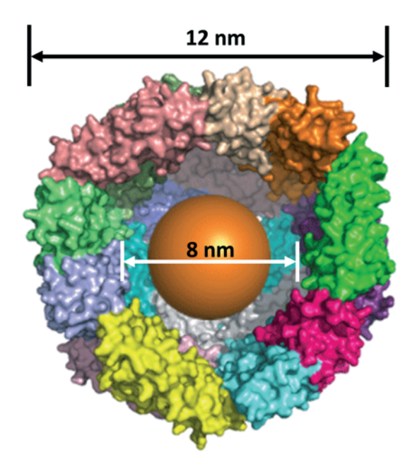
Protection Against Photocorrosion
Fe(III) oxide $→$ Fe²⁺ (aq.) $→$ Fe³⁺ (aq.) $→$ Fe(OH)₃
Catalysis Science & Technology, 2013, 3, 3103
Notes:
Cite ref in small print, may abbreviate
Find a different figure that is simpler or explain better what is going on in it.
Look up this equation again in Richard’s paper

Slide 9
Thioglycerol PbS Time-Dependent PL
Spectra taken at 5 minute intervals
Notes:
This data was taken every four minutes, with the direction of the intensity and band gap indicated by the blue line.
Ask for advice on legend
Mention that after 3 hours, the emission was only 31% of the peak
Try rainbow plot colors
Write the illumination intensity and time interval on graph

Slide 10
Ferritin PbS Time-Dependent PL
Notes:
PL Amplitude only decreases to 61% of original by 3 hours. By 10 hours, still 59%.
Explain why it is so noisy (weaker signal)
Maybe repeat to get clearer data

Slide 11
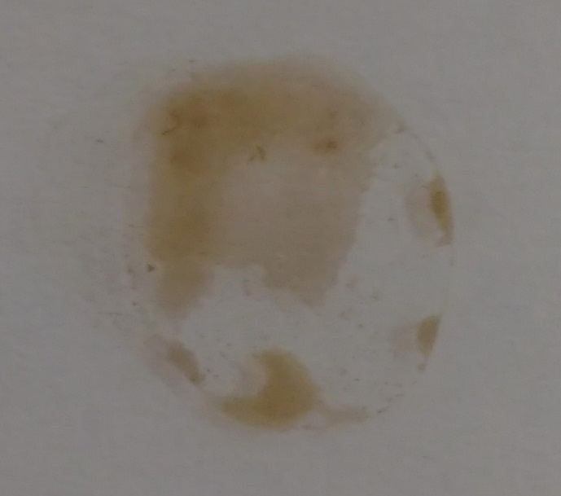
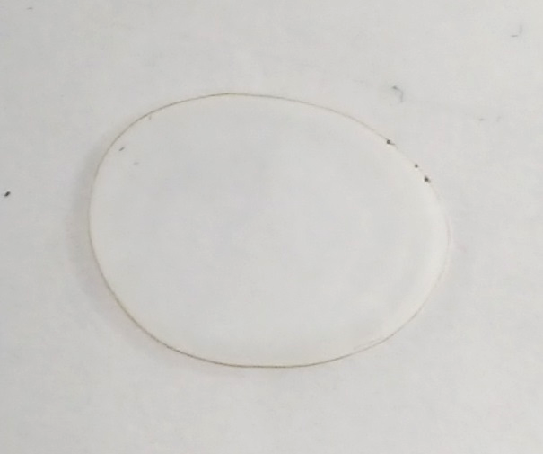
Thioglycerol PbS Photocorrosion
Before
After
Thioglycerol-capped PbS
Ferritin-enclosed PbS
Notes:
Explain what these samples were exposed to: Xenon arc lamp at 3x solar intensity for two hours

Slide 12
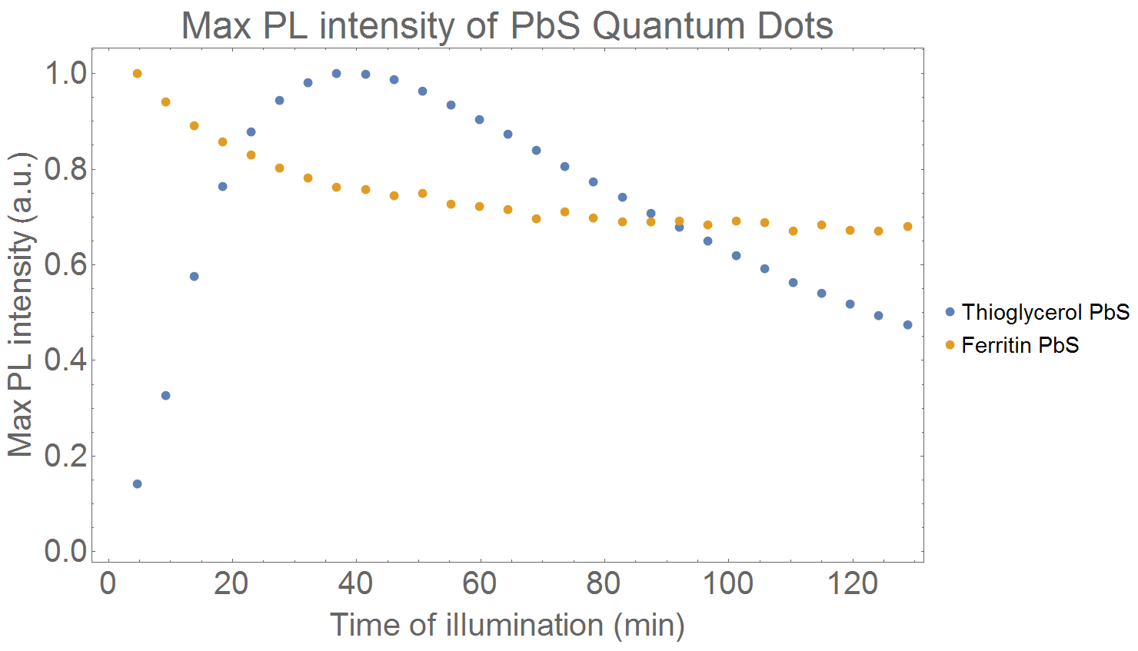
Conclusions and Future Work
Ferritin core size and band gap widely tunable
Ferritin effectively protects against photocorrosion
FTN-PbS 3 hours
Thio-PbS 3 hours
Notes:
Explain that these samples

Slide 13
Measurement limits
Detector Response
Signal adjusted for system sensitivity
Half max
Measured signal
Notes:
Explain spec response too

Slide 14
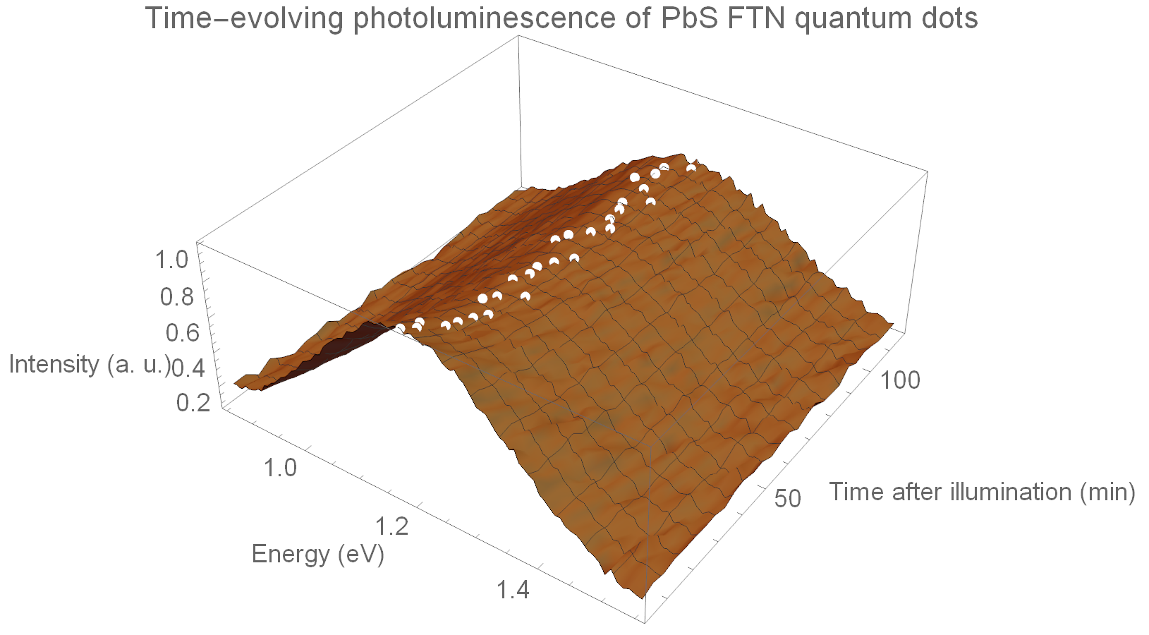
Ferritin PbS Time-Dependent PL
1.2 eV
Notes:
Point out stable band gap
This graph could be optional (or maybe both this and previous graph on one slide)

Slide 15
Thioglycerol PbS Photocorrosion
Thioglycerol-capped PbS
Ferritin-enclosed PbS
Notes:
Explain what a capping agent is again
Explain what these samples were exposed to: 400nm laser, 100mW, unfocused
Explain what area the laser hit
Maybe don’t include this slide

