Slide 1
PHOTOLUMINESCENT PROPERTIES OF InGaAs QUANTUM DOT STRUCTURES
Kenneth Clark, John Colton, Matt Guerron, Dallas Smith, Scott Thalman
Brigham Young University
Haeyeon Yang
Utah State University
Notes:
I will be presenting on our ongoing studies of P.L. in InGaAs quantum dot structures.

Slide 2
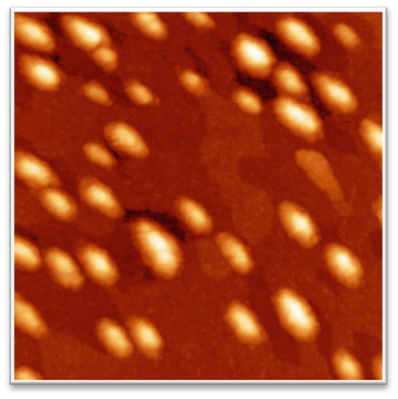
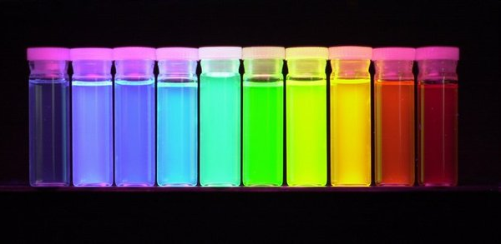
Quantum Dots
GaAs
InGaAs
GaAs
Dong Jun Kim et al 2008
Nanotechnology 19 47560
Grown on surface with molecular beams
http://uwnews.org/uweek/article.aspx?id=42599
Chemically grown in solution
Notes:
A quantum dot is a semiconductor which has a localized concentration of electrons. They are created by confining a small number of electrons by creating a potential barrier around them. Quantum dots have discrete electron energy states. They can be created through varied processes, such as growth on a surface through the utilization of molecular beams to create the separation. They can also be grown in chemical solution. As you can see, they outwardly display interesting optical properties. These properties make them excellent candidates for use in optical applications such as near infrared photo-detectors. The size of the quantum dots determine their energy level and emission wavelength.

Slide 3
Photoluminescence (P.L.)
Conduction Band
Electron Energy
Band Gap
e
e
e
e
e
e
e
e
e
e
Valence Band
Notes:
Photoluminescence is a very useful property of semiconductors. In, for example, a bulk GaAs semiconductor we find the energy states split into two continuous bands known as the valence band and the conduction band. The conduction band is composed of higher energy states but they are continuous. The difference in energy between these two bands is known as the Band Gap. Quantum dots however, as I previously mentioned, have discrete energy states which divide up these bands. In general, the lower energy states are filled with electrons and when a photon is introduced into the sample an electron is promoted to a higher energy state. When that electron relaxes back to a lower energy level it emits a photon. That emitted photon has a wavelength and energy which are proportional to the band gap. Photoluminescence is an important property when evaluating the purity and crystalline quality of semiconductors.

Slide 4
Spectroscopy
Lock-in Amplifier
BNC Cable
Monochromator
Cryostat
Lenses
Detector
Sample
Focusing Lens
Mirror
Chopper
Power Controller
Notes:
Through methods of spectroscopy, we can identify the wavelength and intensity of the P.L. This allows us to determine the size of the band gap and determine the optical quality of our samples. This is our basic experimental setup. The sample is placed in a cryostat and kept under vacuum conditions, then cooled to approximately 3K. We use a variety of lenses and mirrors to direct the laser to our sample, and to then collect the emitted light. A monochromator is used to separate the wavelengths of the P.L. and a Ge detector then measures the intensity of each wavelength in the spectrum. We send the laser beam through a power controller to stabilize any power fluctuations that our laser may have and then this beam is directed towards the sample by this mirror. We use a lens with a long focal length to focus the laser onto our sample so as to achieve high power densities (measured in W/cm^2). The energized sample then emits light which we collect through these lenses and focus onto the entrance slit to the Monochromator. A grating then diffracts the light into a continuous spectrum which is scanned over the exit slit and into the Ge detector. The detector can then measure the intensity of the exposed wavelength interval. To retrieve this data, we make use of a lock-in system. This is comprised of a lock-in amplifier and a chopper. The chopper is a fanlike device which physically chops the laser to a desired frequency. This frequency is referenced into the Lock-in. When the signal from the detector is received by the lock-in, it sends the data that corresponds to the reference frequency to the computer to be logged and graphed.

Slide 5
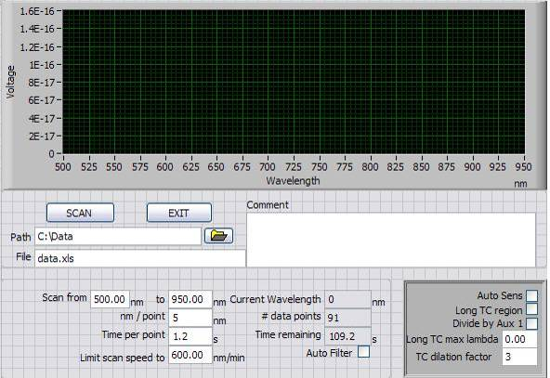
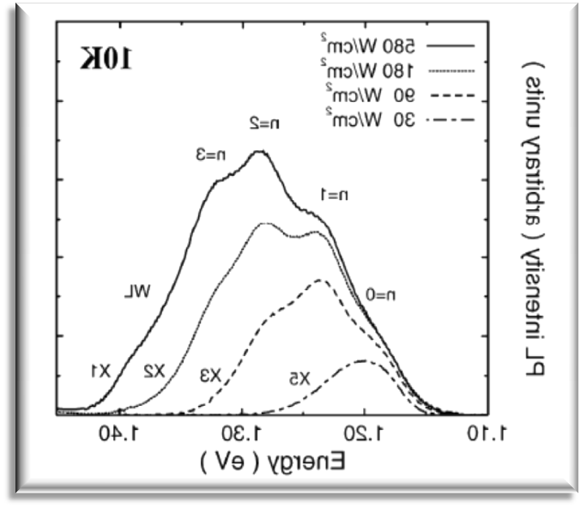
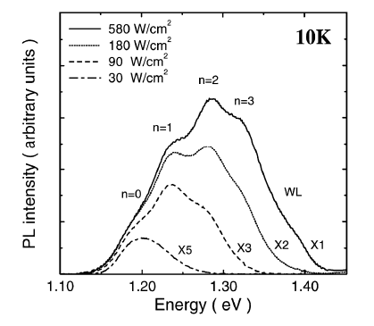
The Experiment
Quantum Dots
Indium Rich
Regions
Wetting Layer
Wavelength
W. Chang et al (1999 )
Notes:
This is the control panel we use to setup the scans and record the data. . . This is what the data looks like once we have graphed it for analysis. Features that we commonly see on PL Scans are, the wetting layer peak which is generally at a lower wavelength than the QD emissions. The QD emission peak, and a high wavelength peak due to indium rich regions. At higher excitation energies we can witness the state filling effect. This occurs when the excitation energy is sufficiently high that the electrons are being promoted to higher energy levels faster than they can relax which causes the excited states to radiate. This results in a shift of the peak to the left and multiple close, overlapping peaks indicating the discrete energy states that I mentioned before.

Slide 6
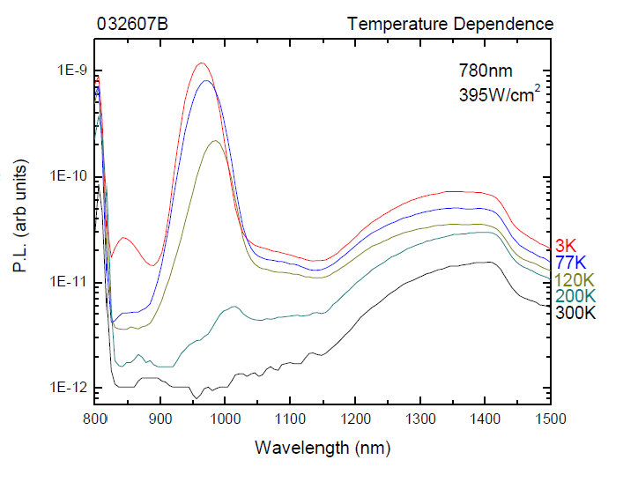
Scan Results
Problem: Peaks shift giving
Inaccurate scan results.
Reason: Higher excitation energy
causes sample heating.

Slide 7
The Solution
Duty Cycle decreased from 50% to 8.33%

Slide 8
Ability to use higher
Excitation energies
Less signal, meaning lower
intensity readings.
Notes:
Less laser light translates to less signal and lower intensities.

Slide 9
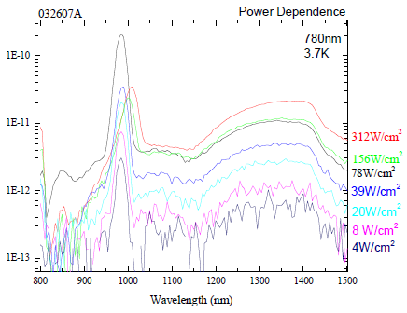
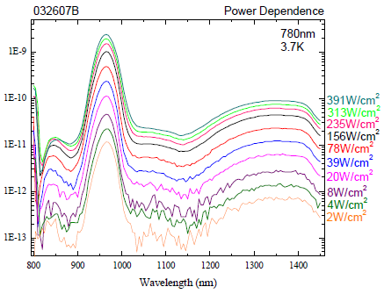
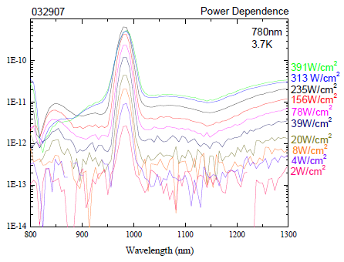
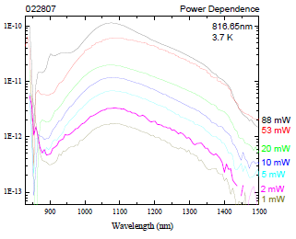
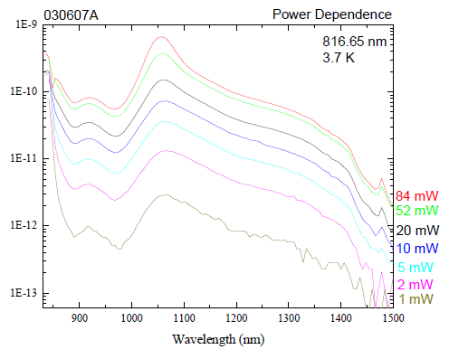
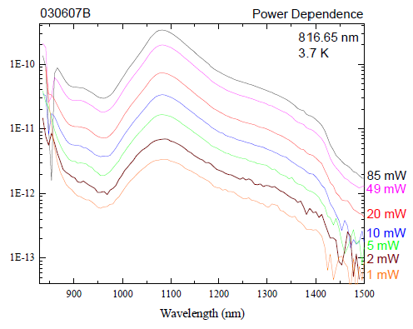
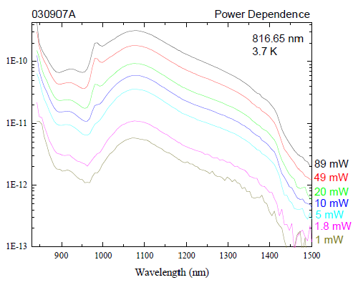
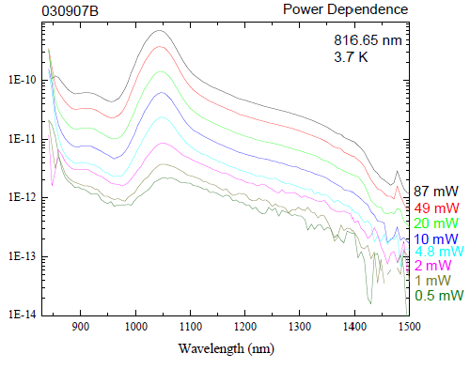
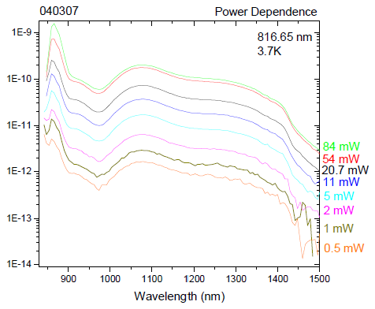
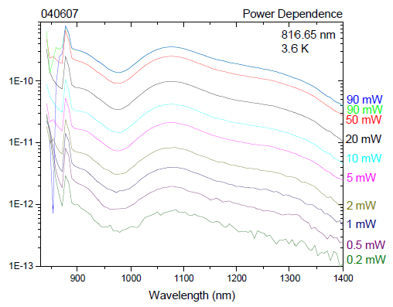
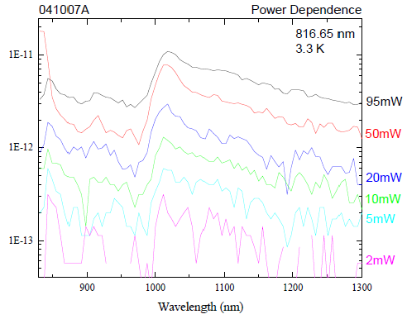
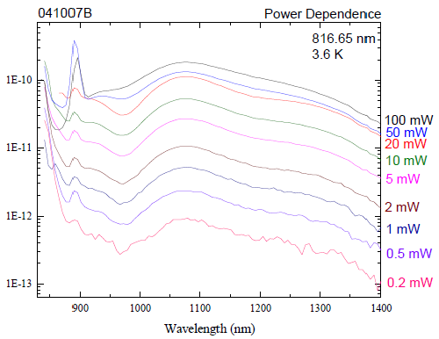
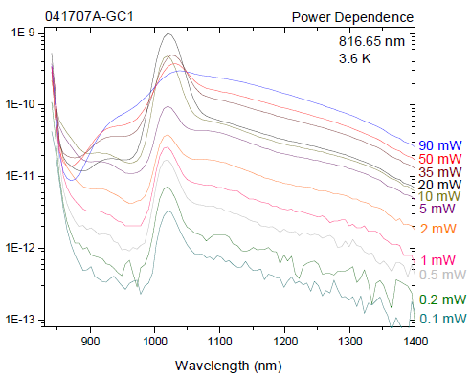
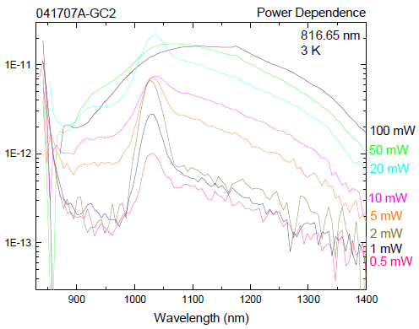
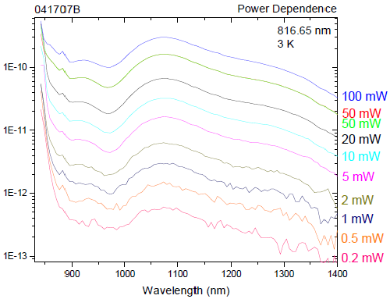
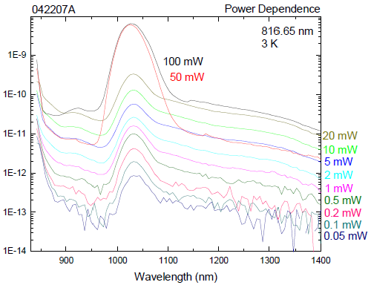
Notes:
Similar tests run on 16 varied samples.

Slide 10
In Conclusion
These samples have strong P.L.
Adjust growth technique
P.L. up to 1400nm even at
room temperature
Patterned samples
100nm
Yang et al., submitted to Nanoletters

