Slide 1
Measurement of Spin Coherence Times in Proton-Irradiated 4H-SiC
Jacob Embley
Research Advisor:
Dr. John Colton
Collaborators:
Dr. Sam Carter (Naval Research Lab)
Margaret Morris
Kyle Miller
Michael Meehan
Funding:
National Science Foundation,
Grant PHY-1461219
BYU Physics Department

Slide 2
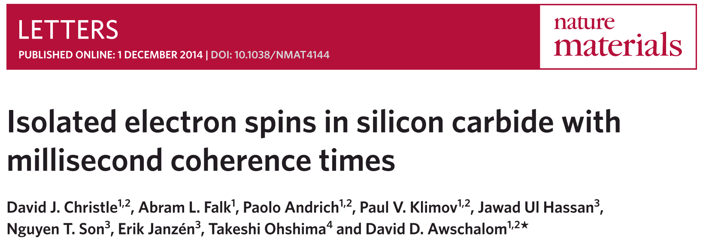
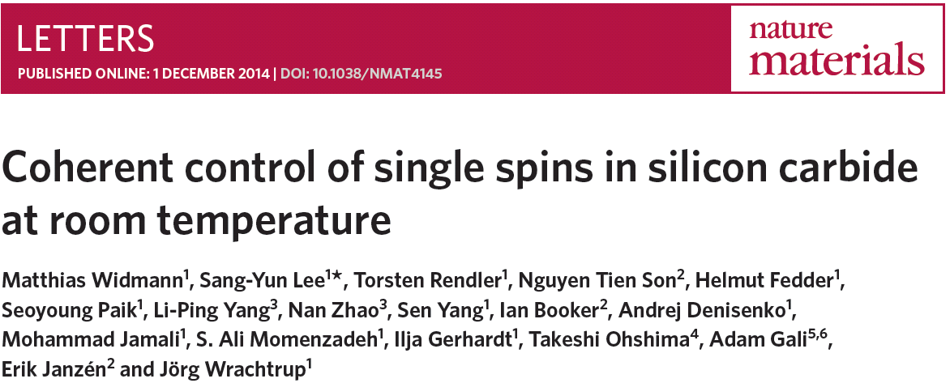
Silicon Vacancy Defects in SiC
Divacancies
20 K
T₂ times of ~1 ms
Single vacancies
Room temperature
T₂ times of ~160 µs

Slide 3
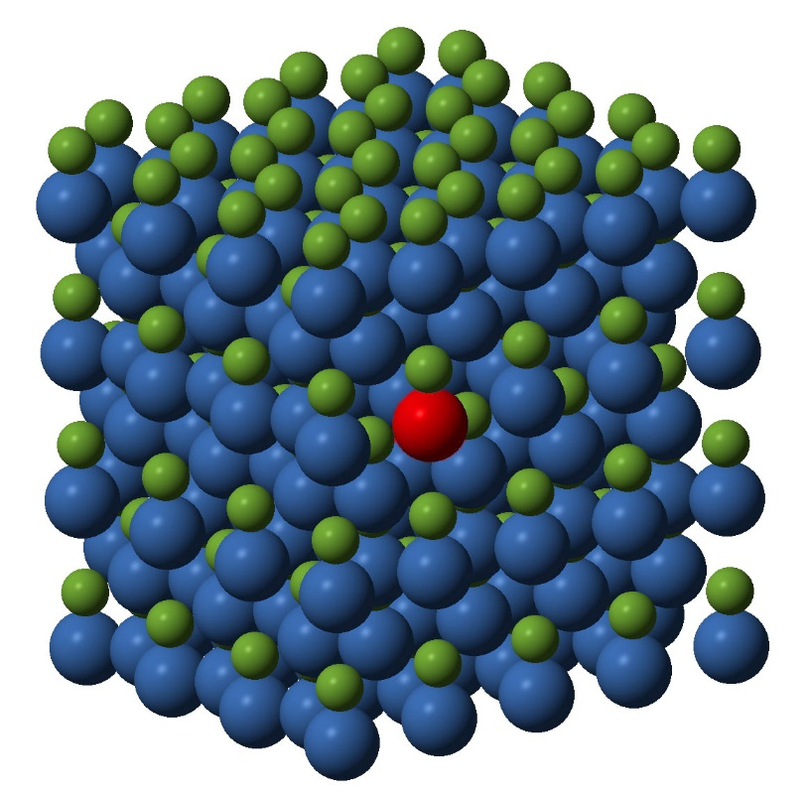
Silicon Carbide Samples
4H-Silicon Carbide (SiC)
Single vacancies
10¹³ and 10¹⁴ cm⁻² proton-irradiated (2 MeV)
ODMR and Spin Echo

Slide 4
Energy Levels
S=3/2 system
±3/2
±1/2
m_{s}=+3/2
Energy
m_{s}=+1/2
optical
Non-radiative
2D
m_{s}=-1/2
m_{s}=-3/2
±3/2
B
±1/2
See P. G. Baranov et al., Phys. Rev. B 83, 125203 (2011)

Slide 5
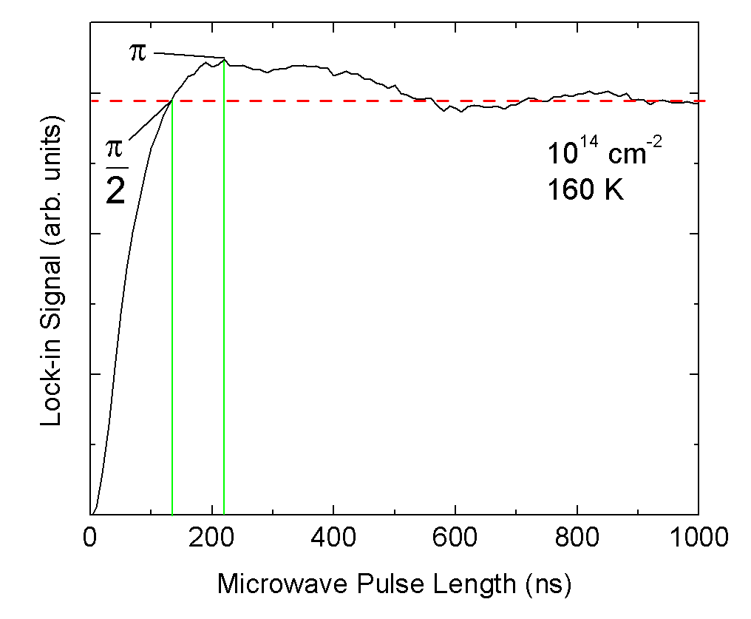
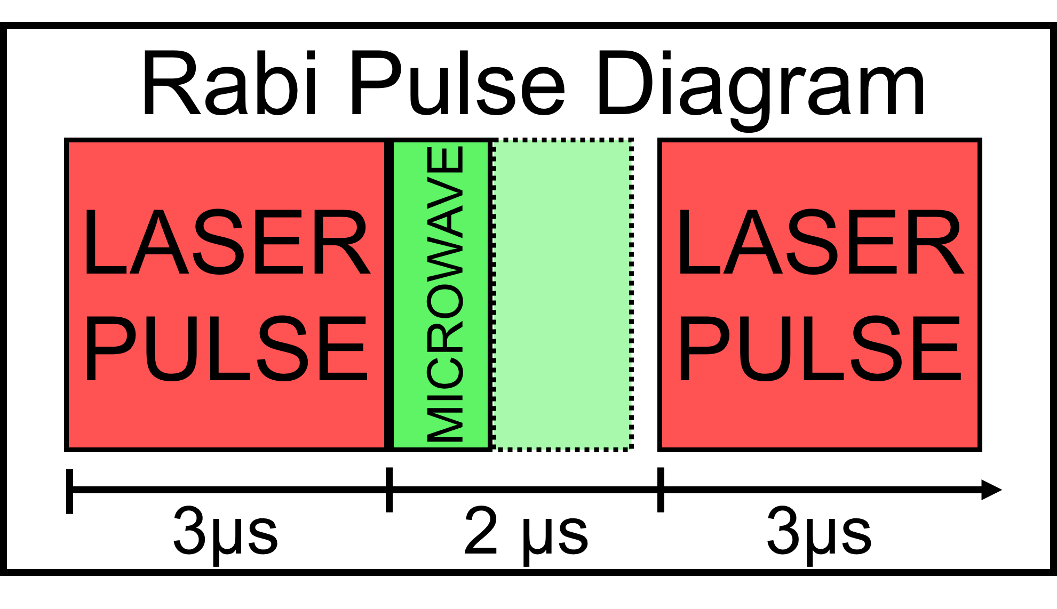
Rabi Oscillations

Slide 6
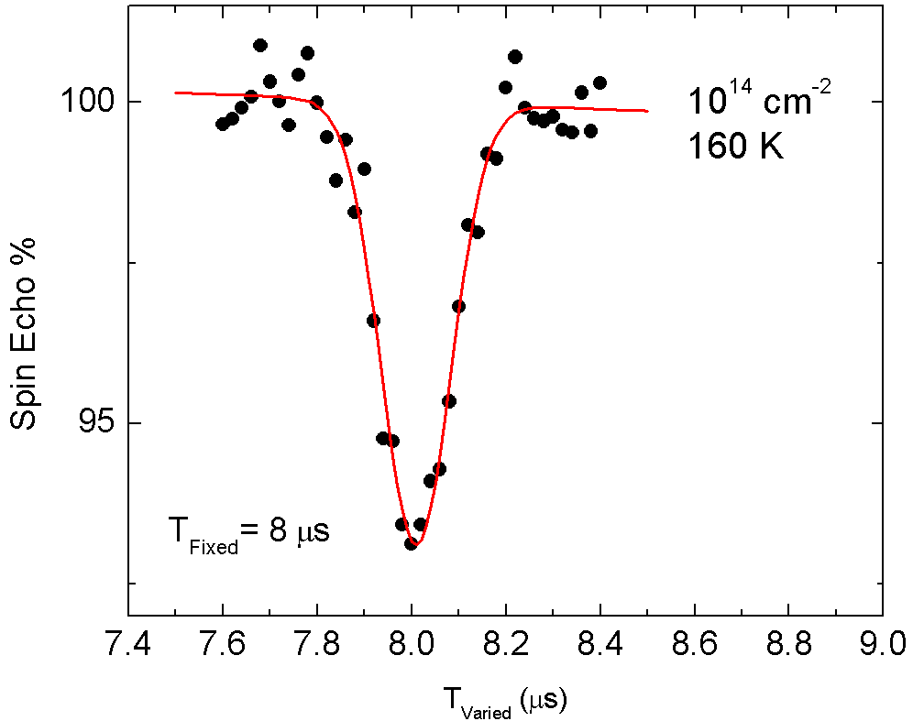
Spin Echo

Slide 7
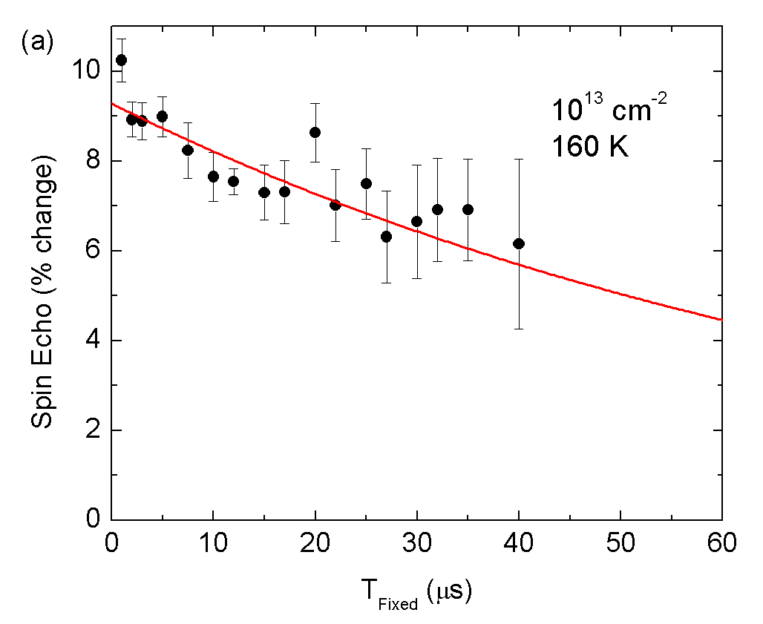
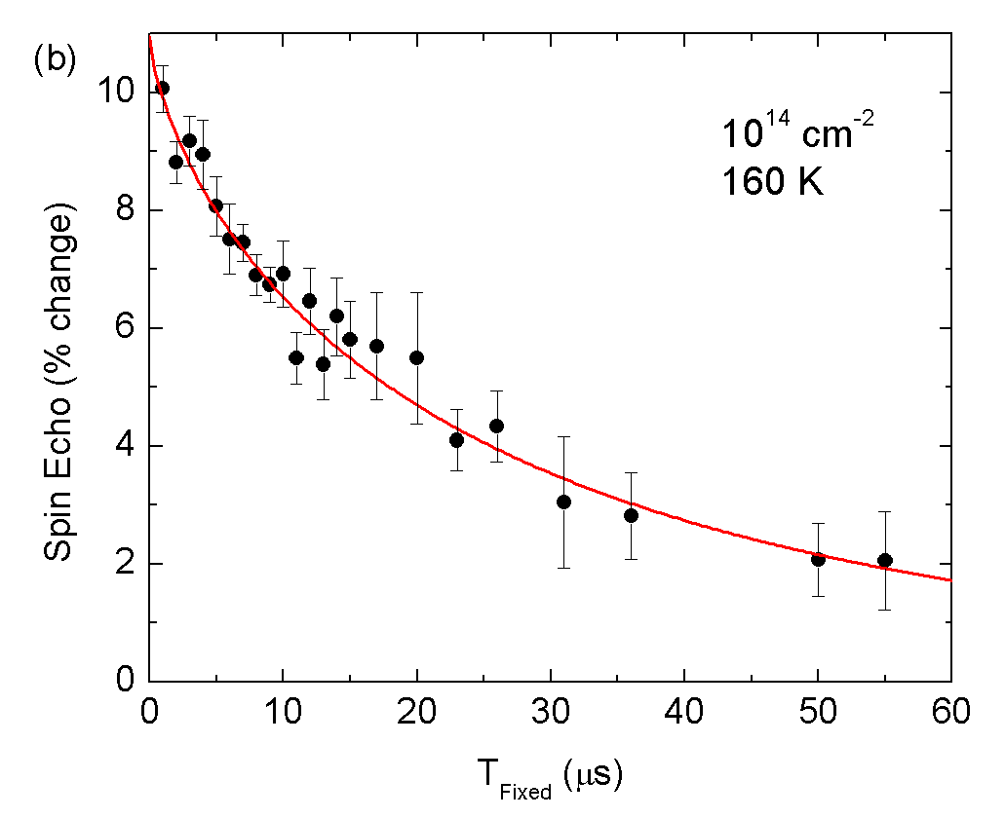
Spin Echo Decay
T₂ = 163.7 µs
T₂ = 50.6 us
T₂
T₂

Slide 8
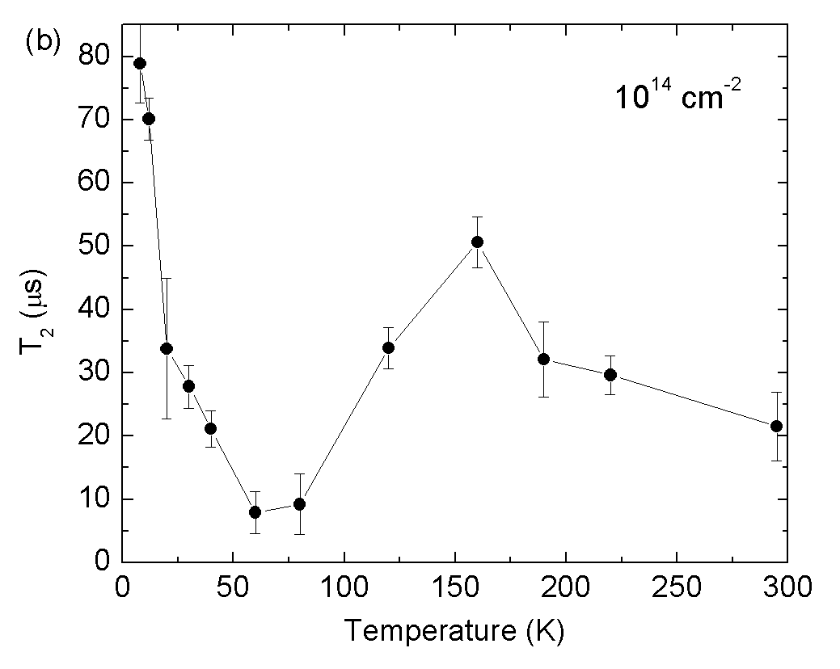
Spin Coherence vs. Temperature

Slide 9
Similar Results Found by Others
Falk et al., Phys. Rev. Lett. 114, 247603 (2015)
Measured T₂* in silicon divacancies of 6H-SiC
Our results

Slide 10
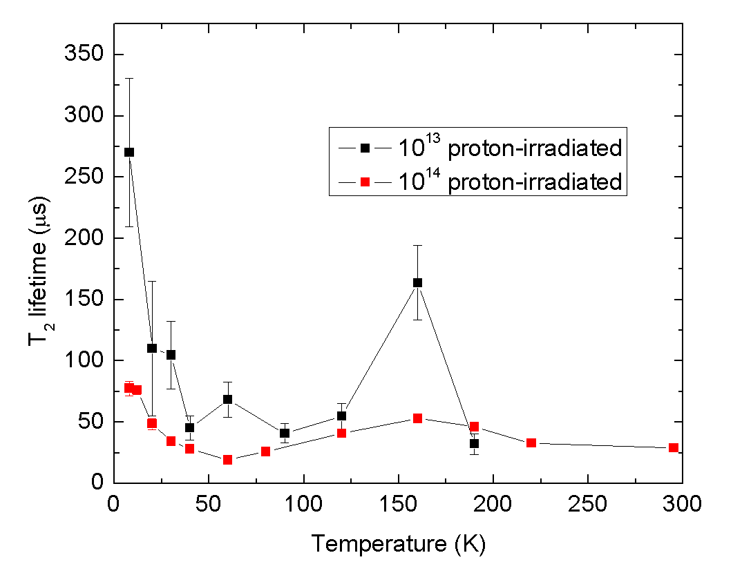
Conclusions
Highest temperatures limit spin coherence
Longer coherence times for less-irradiated sample
Future work:
Explain the temperature dependence

Slide 11
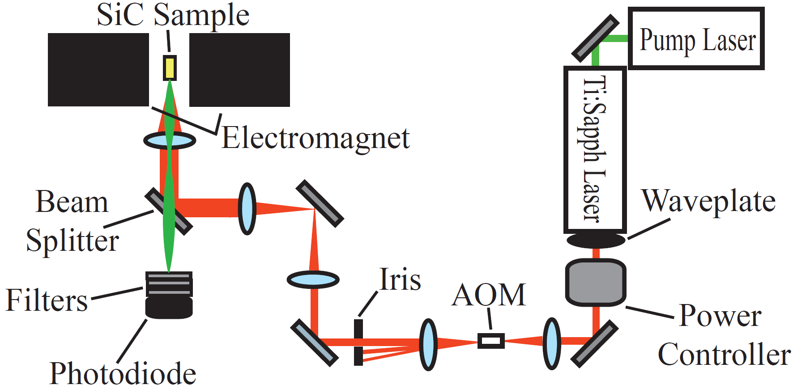
Experimental Set-up

