Slide 1
Studies of Electron Spin in Gallium Arsenide Quantum Dots
Daniel Craft, Dr. John Colton, Tyler Park, Phil White,
Brigham Young University

Slide 2
Quantum Computing
Quantum states are the “1”s and “0”s of a classical computer
Certain tasks—like factoring large numbers—are exponentially faster
Must understand quantum states
Jun Li et al, Sci. Rep. 2012/02/10 online
Notes:
have reference show up at the same time as picture—Shor is a database search

Slide 3
Quantum Dots
Tiny, energetically and spatially constrained structures: 2-10 nm
Quantum computers with interacting quantum dots that have an extra electron
Fast, optical control
Evidence of long lifetimes relative to control
Notes:
can make quantum computers out of interacting quantum dots with an extra electron. spin being qubit, communicate with neighboring spins. evidence of long lifetimes. can control through fast optics. fast control relative to lifetime

Slide 4
Zeeman Splitting and Electron Spin
% Pol=%Low-% High

Slide 5
Faraday Effect
Linearly polarized light rotates
Must be parallel with magnetic polarization of sample
More magnetic polarization means more rotation
Wikipedia: Faraday Effect

Slide 6
2
Superconducting
Magnet Set-up
Signal to Lockin amplifier
Polarizing
Beam Splitter

Balanced
Detector
Linear Polarizer
B
Chopper
Probe-942nm
Power Stabilizer
AOM
Photoelastic Modulator

Slide 7
Timing Sequence
Time
Pump Pulse
Probe
Probe
Probe
Probe
Probe
Probe
Probe
Probe
Probe
Probe
Probe
Beginning of Period
End of Period
Notes:
add time axis, label as pump, mention time duration of it

Slide 8
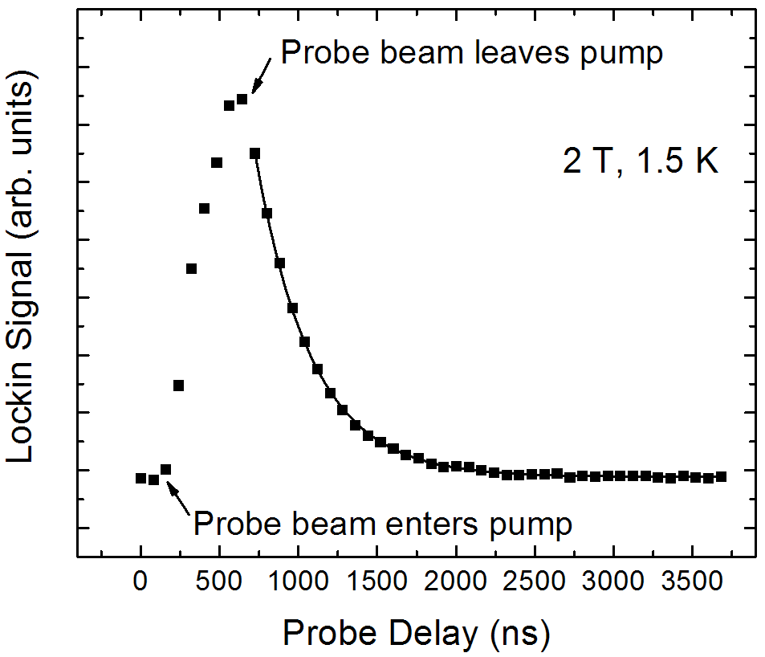
Expected Scan Results
T1=359 ns

Slide 9
Probe out of pump

Slide 12
Electromagnet Set-up

B
Sample
Linear Polarizer
Chopper
Signal to Lock-in Amplifier
942 nm
Power Stabilizer
AOM
PEM
Balanced
Detector
Polarizing
Beam Splitter
Notes:
insert actual picture of magnet

Slide 14
Electromagnet Scan Goals
Same oscillations?
Does frequency change with laser power?
Does it change with pump pulse width?
Notes:
look for changes in frequency with laser power, could be inducing coherent changes from one spin state to another, also check duration of pump pulse (can we change pattern?)

Slide 15
Conclusions
Quantum computing potential depends on understanding quantum dots
We measure spin lifetimes using the Faraday effect
We saw oscillating spin polarization instead of decay
We need to do further tests

