Slide 1
Electron Spin Coherence of Silicon Vacancies in Proton-Irradiated 4H-SiC
John S. Colton
Physics Department
Brigham Young University
Co-authors:
J. S. Embley,* K. G. Miller, M. A. Morris,* M. Meehan, S. L. Crossen
Students at BYU
*funded by NSF RUI program (M.A. Morris visiting from Brandeis U)
B. D. Weaver, E. R. Glaser, and S. G. Carter
Naval Research Lab
Helpful discussion: Michel Bockstedte, University of Salzburg
Embley et al., PRB 95, 045206 (2017)
APS March Meeting, Mar 14, 2017

Slide 2
Motivation: long T₂ coherence times
NV center in diamond
3 ms at 300 K, 600 ms at 77K (Bar-Gill, Nat Comm 4, 1743, 2013)
Many, many others
4H SiC divacancies:
360 us at 20 K, 50 us at 300 K (Falk, Nat Comm 4, 1819, 2013)
184 us at 20 K, 263 us at 200 K (Koehl, Nat 479, 84, 2011)
1.2 ms at 29 K (Christle, Nat Mater 15, 160, 2015)
4H V_{si}
81 us at 300 K (Carter PRB 92, 161202, 2015)
160 us at 300 K (Widmann Nat Mat 14, 164, 2015)
Can likely be extended via dynamical decoupling pulse sequences such as Carr-Purcell-Meiboom-Gill (CPMG)

Slide 3
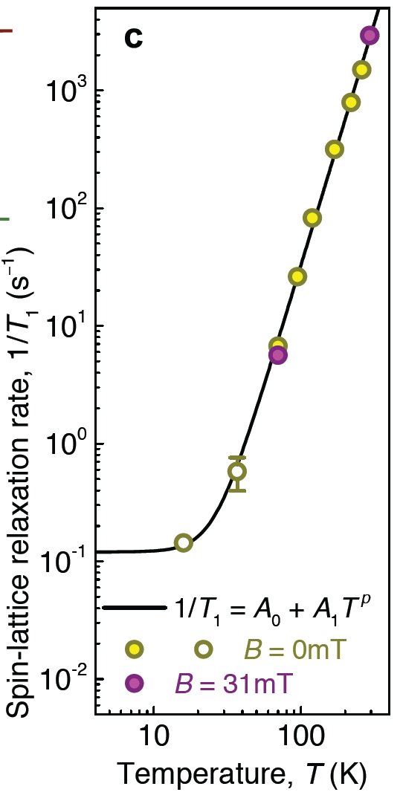
How does T₂ change with temperature?
?
T₁ vs. temperature for V_{si}
Phonon effects → monotonic decrease with temperature
Simin et al, arXiv:1602.05775v1 (2016)

Slide 4
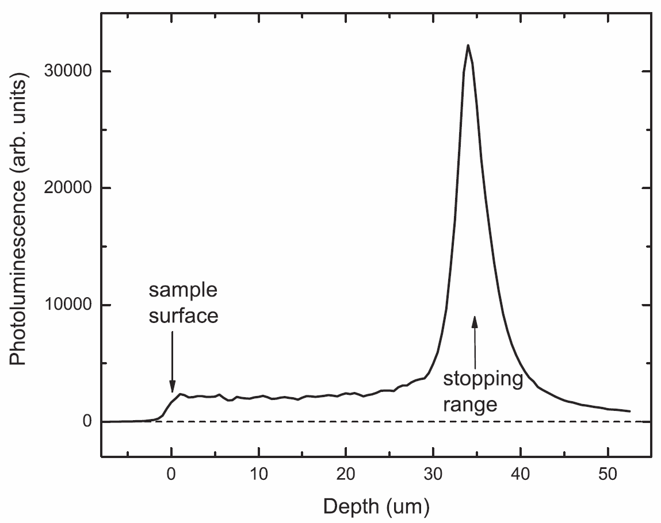
Another motivation: proton irradiation
Plotting the vacancy-related PL
concentrated
region
10¹² cm⁻² sample
diffuse
region

Slide 5
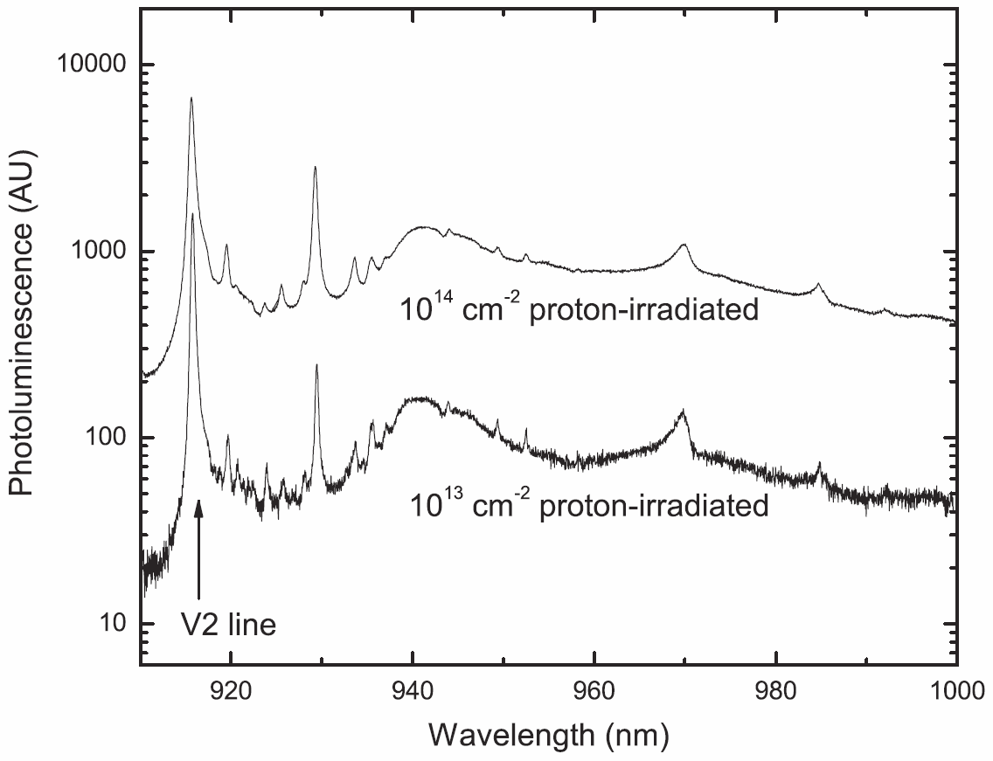
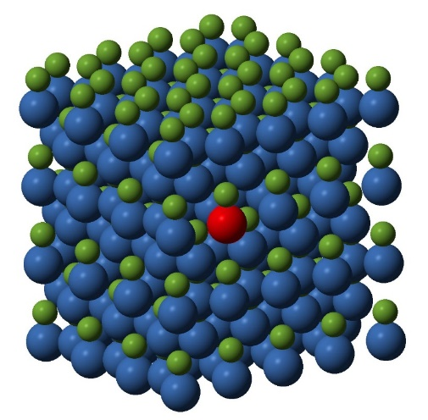
SiC samples
10¹² cm⁻² sample
Proton irradiated 4H SiC
2 MeV protons, fluences of 10¹¹,10¹²,10¹³, and 10¹⁴ cm⁻²
Single vacancy electronic defect states, most at ~34 um below surface
Defect concentrations ≈ 3 × 10¹¹, 3 × 10¹², 3 × 10¹³, 3 × 10¹⁴ cm⁻³ in diffuse regions, ×10 in stopping layer

Slide 6
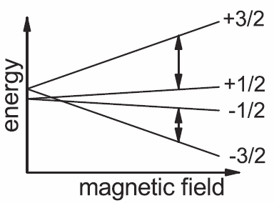
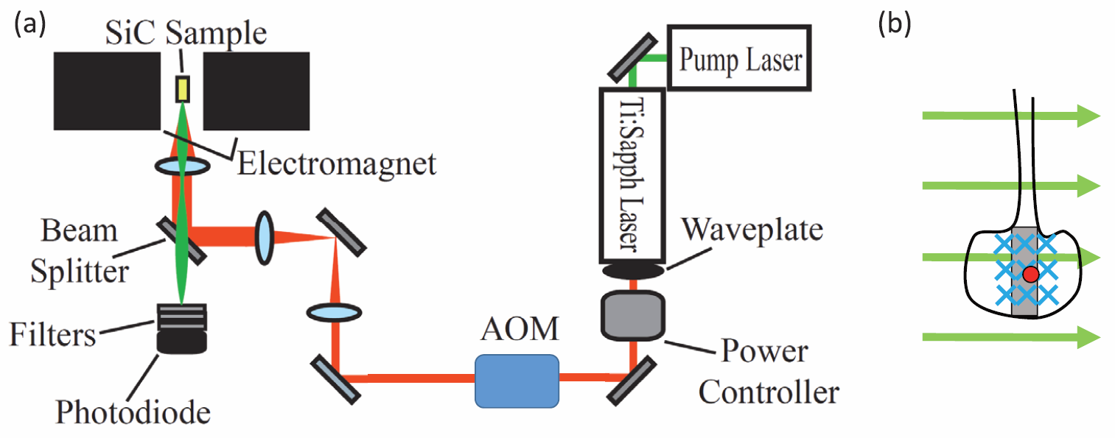
Optically-detected magnetic resonance
Spin 3/2 system
Polarized via optical pumping
Detected via change in PL
Laser hits sample edge on
(turned 90°)

Slide 7
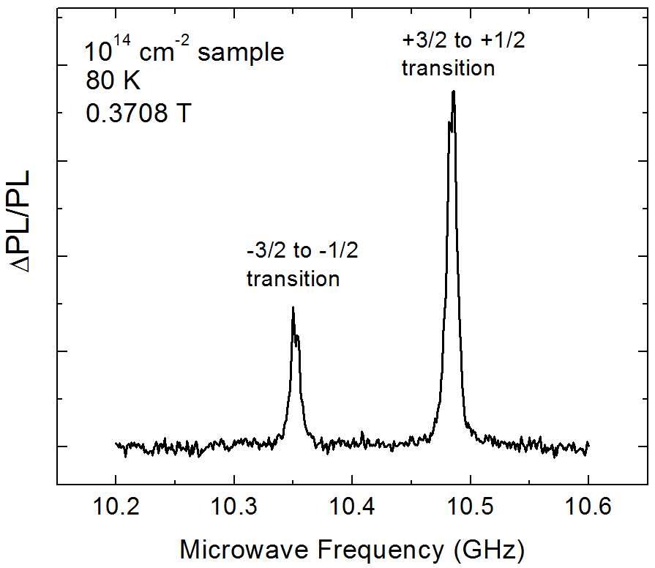
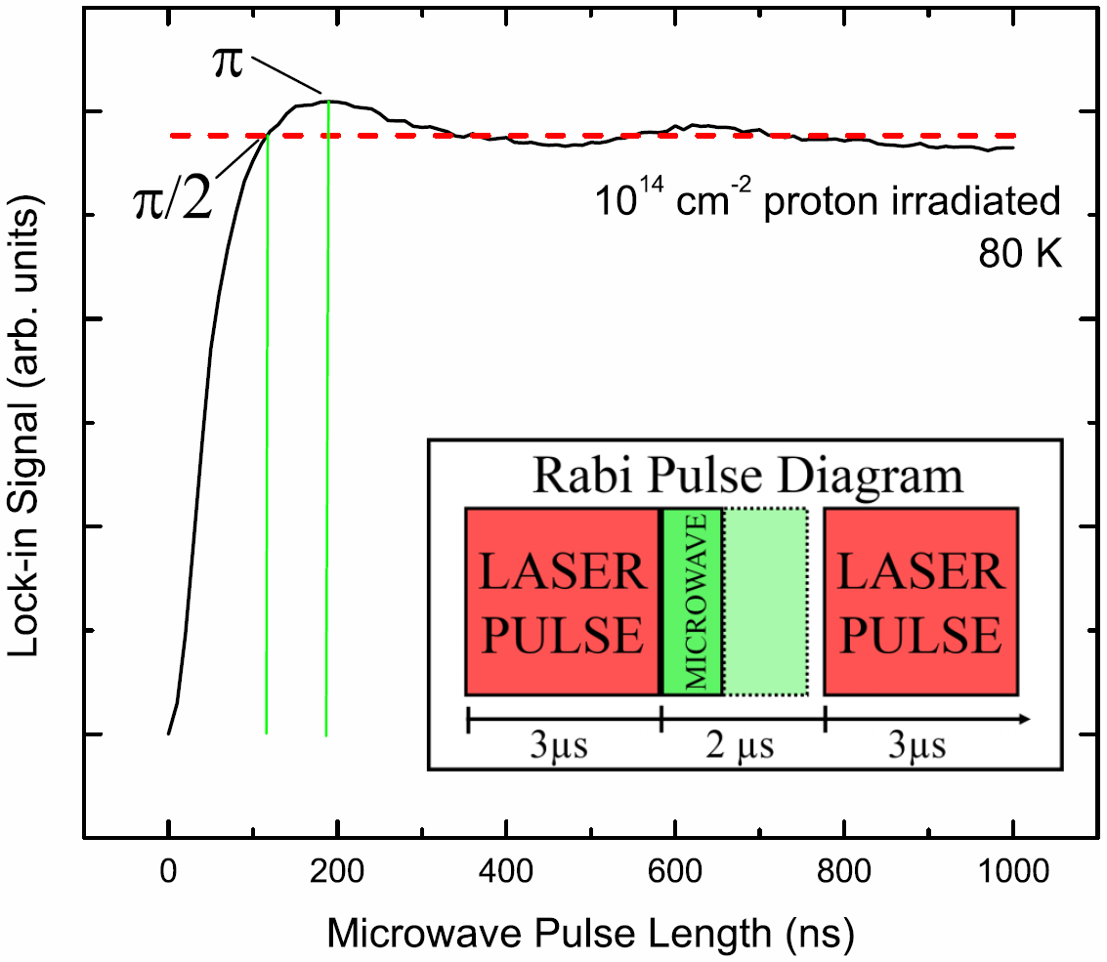
10.49 GHz transition

Slide 8
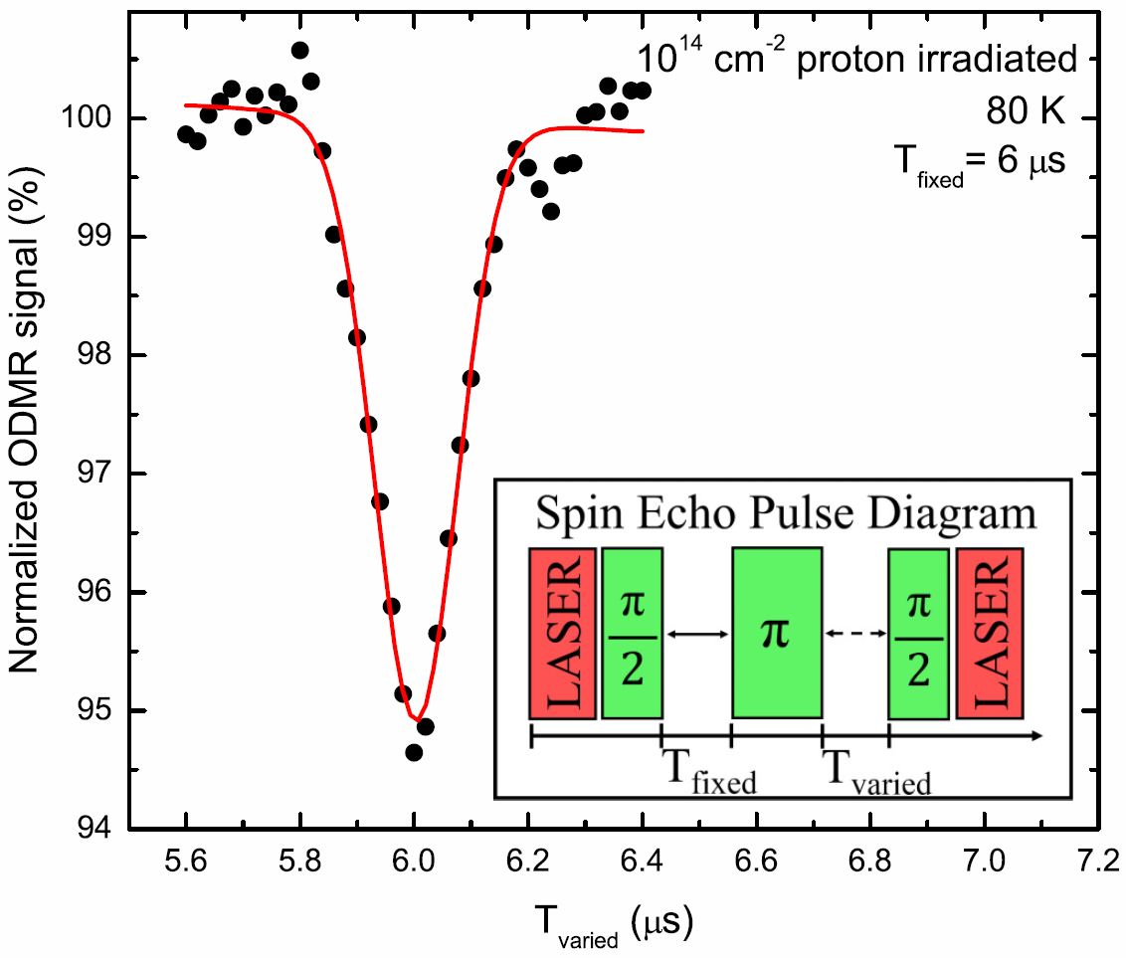
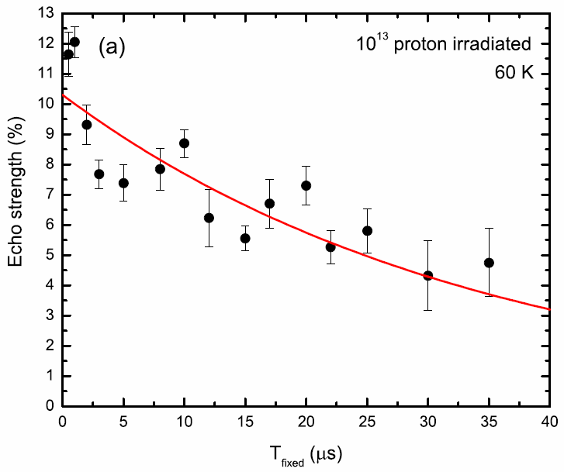
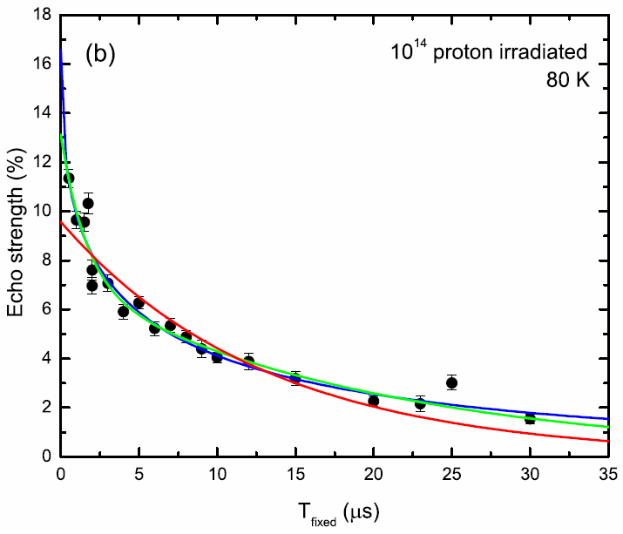
Spin Echo
$${y=Ae}^{−{{2T}_{fixed}}/τ}$$
$${y=A_{1}e}^{−{{2T}_{fixed}}/{τ_{short}}}$$
$+{A_{2}e}^{−{{2T}_{fixed}}/{τ_{long}}}$
$$τ_{long}=40 μs$$
$${y=Ae}^{−{\left({{2T}_{fixed}}/τ\right)}^{β}}$$
$${y=Ae}^{−{{2T}_{fixed}}/τ}$$
$$τ=69 μs$$

Slide 9
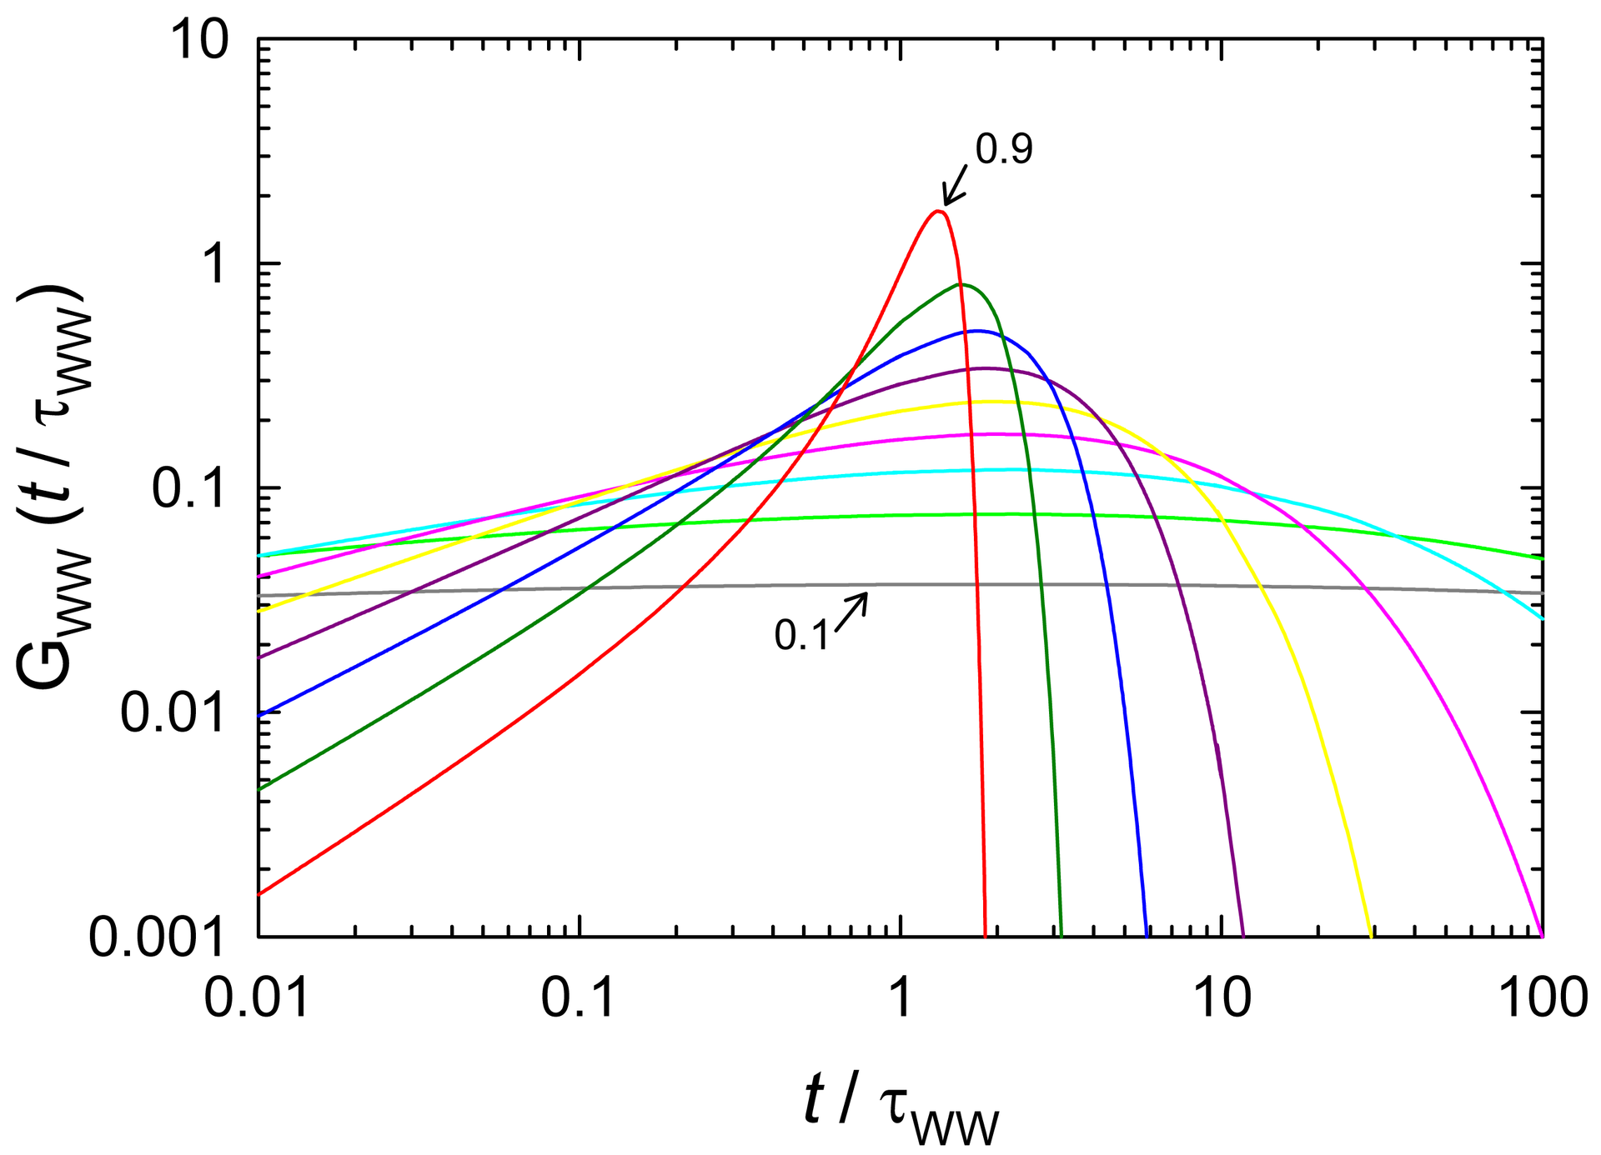
Biexponential vs. Stretched Exponential
$${y=A_{1}e}^{−{{2T}_{fixed}}/{τ_{short}}}+$$
$${A_{2}e}^{−{{2T}_{fixed}}/{τ_{long}}}$$
$${y=Ae}^{−{\left({{2T}_{fixed}}/τ\right)}^{β}}$$
Distribution of lifetimes
Has been used in SiC phenomenologically with β = 2 (compressed) (Christle, 2015)
Our fits β = 0.5-0.8
mean T₂ times of 1.3-3.3 τ
widths of 2.5-14 τ
Assumes two populations
However, long time component has more amplitude than short time component (opposite to expected)
Wikipedia
10¹² cm⁻² sample

Slide 10
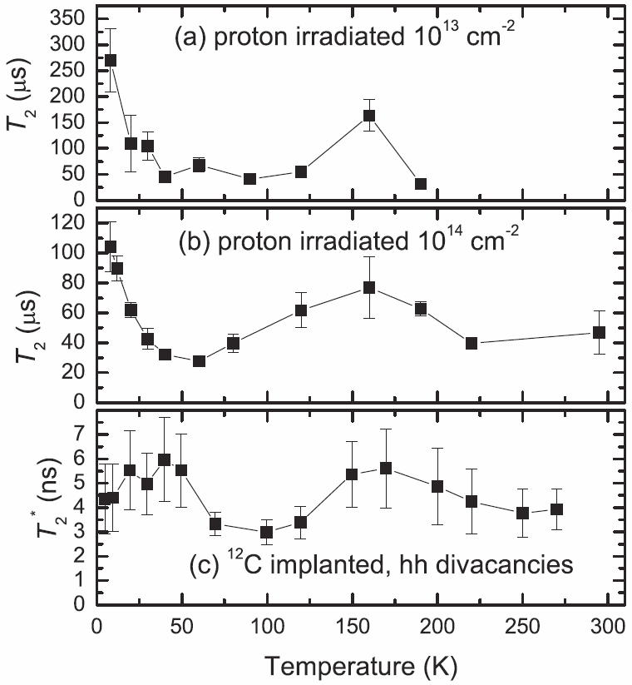
Coherence times vs. temperature
τ_{long}
Longer times
Shorter times
A. L. Falk et al. PRL 114, 247603 (2015).

Slide 11
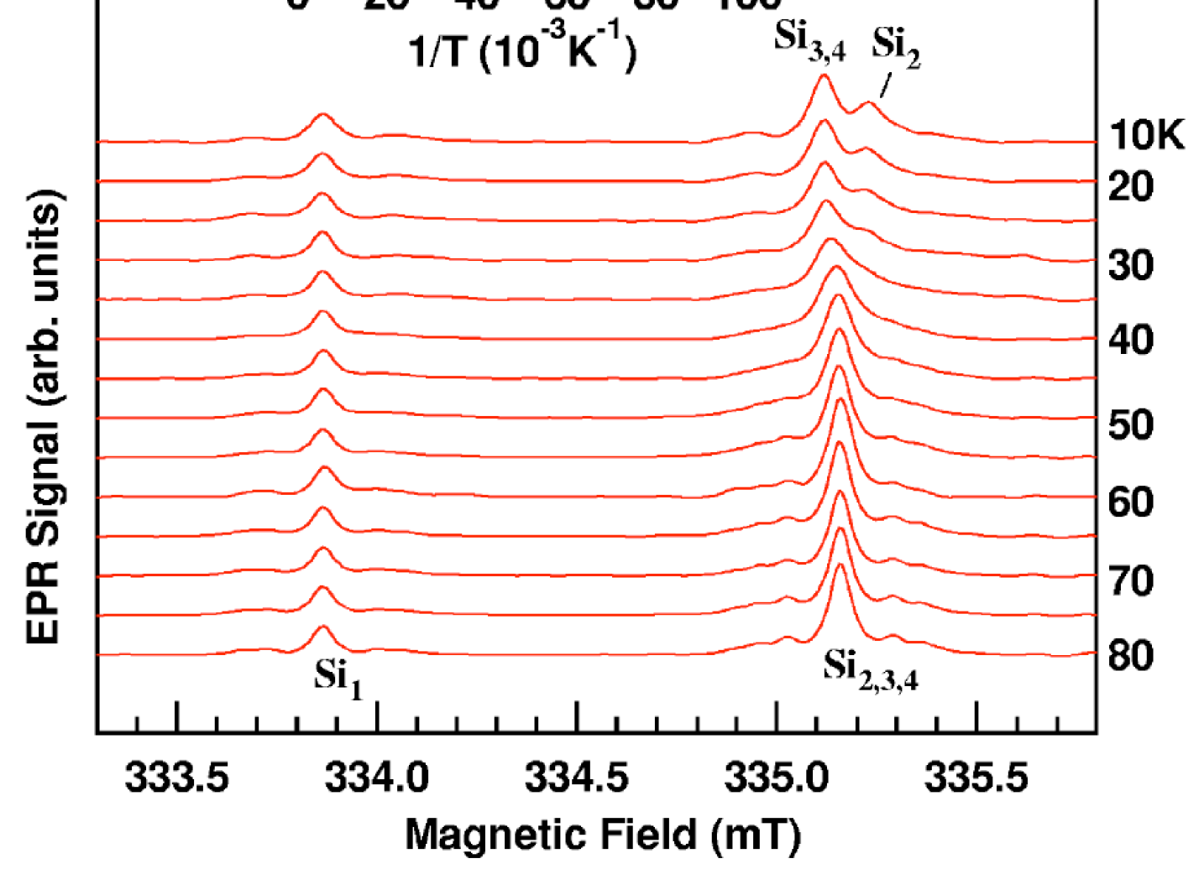
Motional/dynamic Jahn-Teller effect
Thermally activated rapid reorientation of the vacancy (bond switching)
Example: Positively charged V_{C} in SiC, Umeda PRB 70, 235212 (2004)
Above 40 K, linewidth narrows with temperature (T₂ increases)

Slide 12
Conclusions
T₂ coherence times up to 270 us (8 K, lower doped sample)
Dipole-dipole interactions are significant
Motional Jahn-Teller effect lengthens times from ~60-150 K
Inhomogeneous distribution of spins
$${y=Ae}^{−{{2T}_{fixed}}/τ}$$
$${y=A_{1}e}^{−{{2T}_{fixed}}/{τ_{short}}}$$
$+{A_{2}e}^{−{{2T}_{fixed}}/{τ_{long}}}$
$$τ_{long}=40 μs$$
$${y=Ae}^{−{\left({{2T}_{fixed}}/τ\right)}^{β}}$$
Embley et al., PRB 95, 045206 (2017)

Slide 13
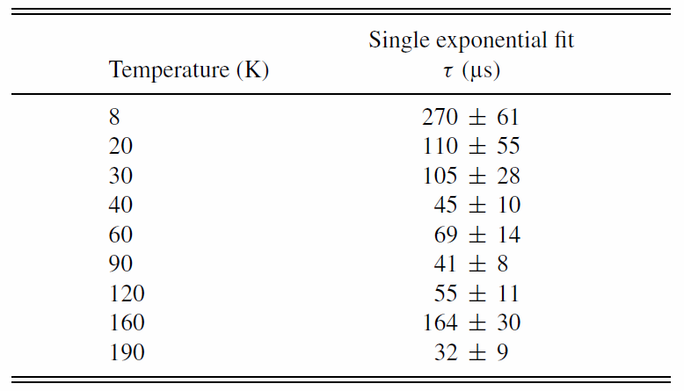
10¹³ cm⁻² sample results

Slide 14
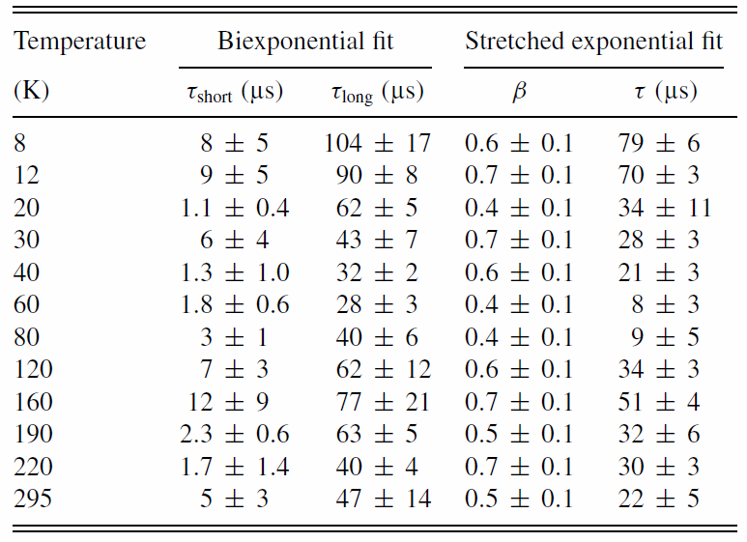
10⁻¹⁴ cm⁻² sample results

Slide 15
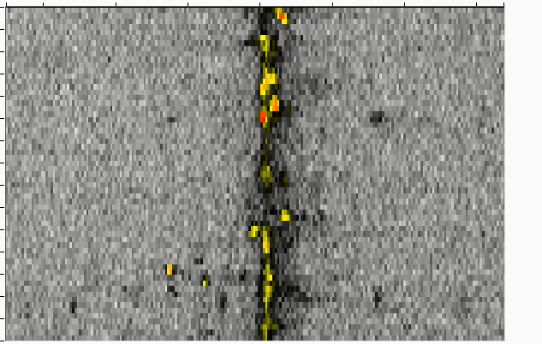
Spatial/spectral map of V1 vacancies along a line
In 1e11 cm^-2 proton irradiated epilayer
1436
Emission energy (meV)
This was taken at a position well above the higher density region at the stopping range of protons
30
1438
1440
1442
24
V1
18
Position (μm)
12
6
0
Jumps/gaps in ZPL should indicate individual Si vacancies
Estimate on the order of 1 vacancy per μm
Depth resolution roughly 2-3 μm
Assume V1 and V2 about the same density (pretty good assumption)
About 0.3/μm^3 = 3e11cm^-3 for proton irradiation at 1e11cm^-2
For 1e13cm^-2 irradiation, assume 100 times higher density
This is the density above the proton end of range at about 32um. At the
Stopping range that density is about 20 times higher.

