Slide 1
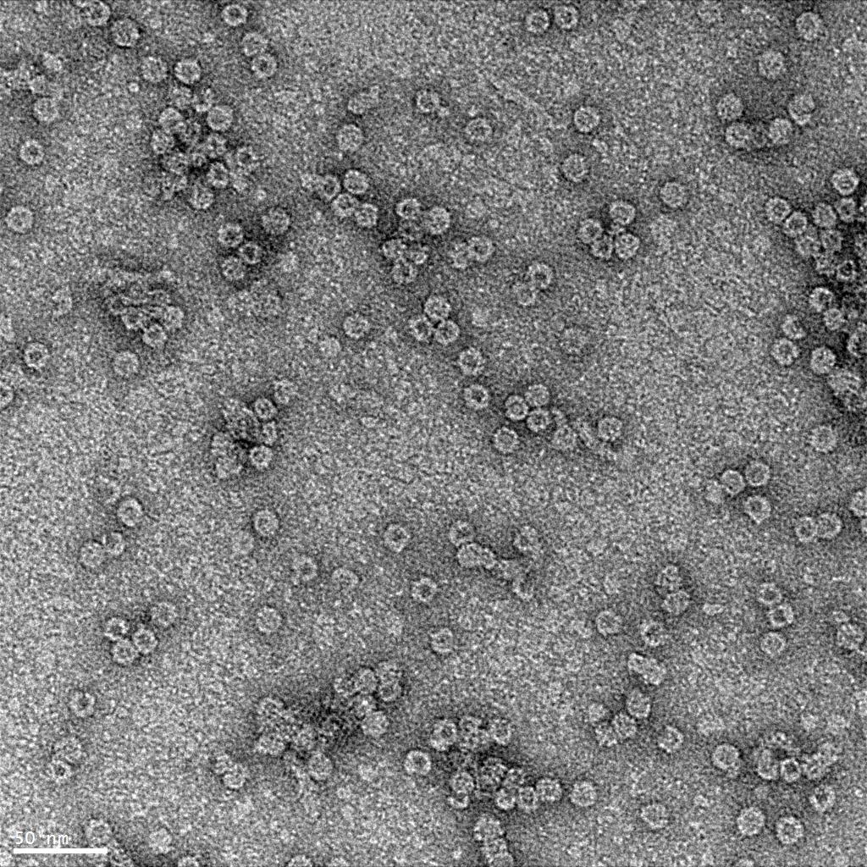
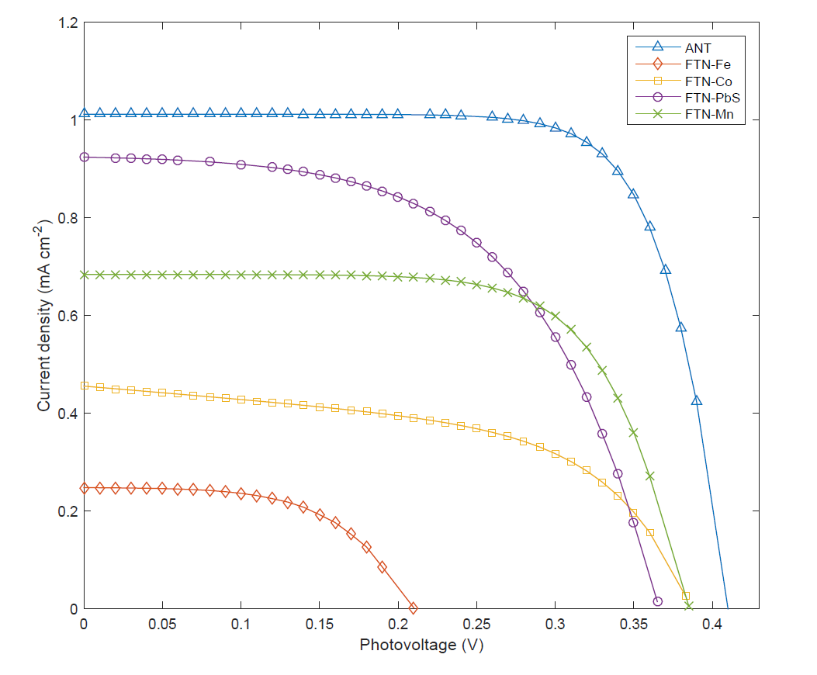
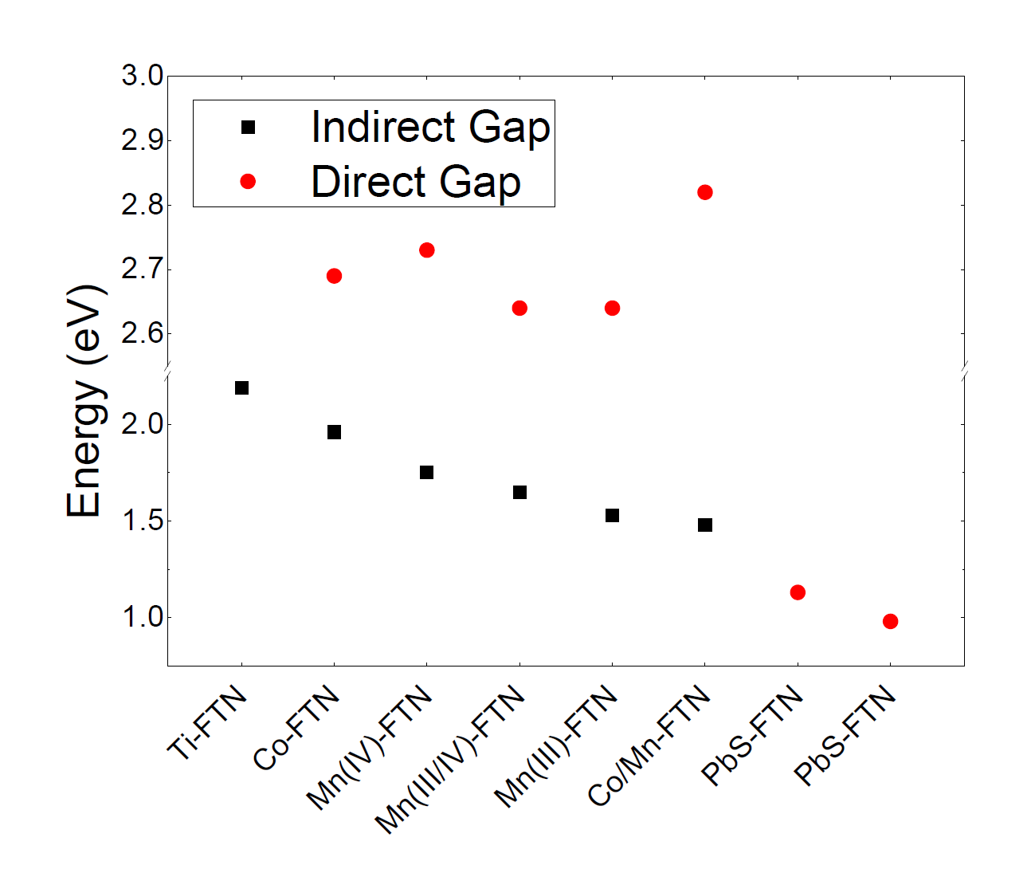
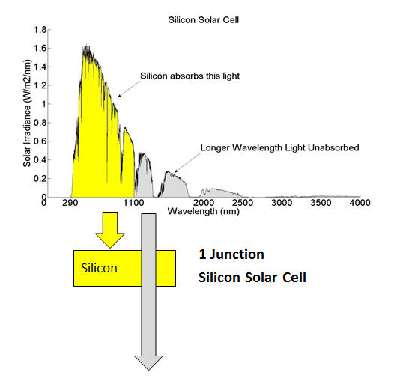
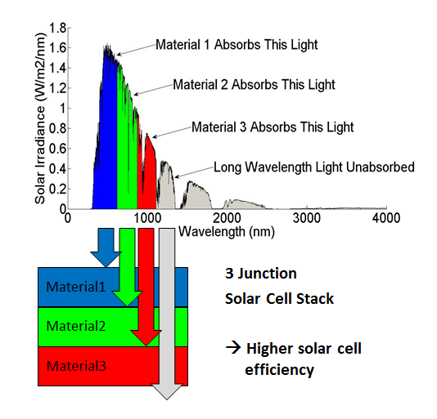
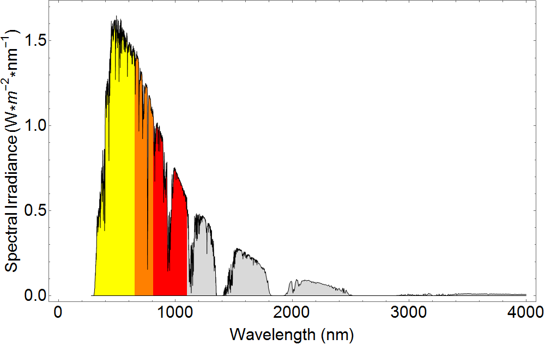
Harvesting Solar Energy using Bioinorganic Nanoparticles
Cameron Olsen¹, Jacob Embley¹, Alessandro Perego², Dr. John Colton¹, Dr. Richard Watt³
1: Brigham Young University, Department of Physics and Astronomy, 2: Brigham Young University, Department of Chemical Engineering,
3: Brigham Young University, Department of Chemistry and Biochemistry
Objective
Synthesis and Characterization
Ferritin-based Solar Cells
Use ferritin-based nanoparticles as a substrate for solar energy harvesting
Prepare a wide array of available ferritin materials for incorporation into a multi-junction ferritin solar cell
Ferritin containing the following minerals were synthesized for study in a solar cell: Fe(O)OH, Mn(O)OH, Co(O)OH, and PbS.
Synthesis was verified through imaging on a transmission electron microscope, and elemental analysis was performed through use of ICP-MS and EDX.
Dye-sensitized solar cells (DSSC) were constructed using ferritin-based minerals as the substrate.
Several minerals were tested individually in order to observe their capacity to absorb and convert light into electricity.
Introduction: Ferritin
Ferritin is a 12 nm spherical protein found in most organisms with a hollow 8 nm cavity. It naturally forms a ferrihydrite (Fe(O)OH) mineral in its interior.
The ferrihydrite mineral can be removed and new nanoparticles can be assembled within the protein shell. Some materials that have been synthesized in ferritin include the oxyhydroxides of Fe, Mn, Co, Ti, Ni, and Cr, and minerals such as PbS, CdS, and others.
The protein shell also aids in protecting the mineral against photocorrosion.
e⁻
e⁻
hν
e⁻
e⁻
Red (I⁻)
Ox (I₃⁻)
e⁻
TiO₂
Ferritin as the dye
Anode
(Glass + ITO)
Diagram for a typical DSSC constructed using ferritin
Cathode
(Glass + ITO + Catalyst)
12 nm
Solar Cell Results
Left: TEM image of Mn-FTN. Right: STEM image of Mn-FTN
Preliminary solar cells show the ability of ferritin-based substrates to convert solar energy into electricity. The graph to the right shows IV curves for each sample.
8 nm
Band Gap Results
Each material synthesized in ferritin has a unique band gap energy and absorbs light at different wavelengths.
Our objective is to determine which ferritin minerals will work together to achieve the highest level of solar energy conversion.
All the oxyhydroxide minerals were determined to be indirect band gap materials and their band gaps were measured using absorption spectroscopy. PbS is a direct gap material as expected, and its band gap was measured using photoluminescence spectroscopy.
The Protein Ferritin
Current Density (mA cm⁻²)
Multi-Junction Solar Cells
The Shockley-Queisser limit for a single layer photovoltaic is around 33.7%.
Layering different materials can increase theoretical efficiencies up to >50%.
Voltage (V)
Future Work
Silicon Solar Cell
Optimize solar absorption and energy conversion through increasing absorption and electron transfer across protein shell
Construct a multi-junction cell using several different mineral types
Platinum nanoparticle growth for hydrogen evolution on ferritin
Silicon absorbs this light
Longer Wavelength Light Unabsorbed
Images retrieved from: http://www.sj-solar.com/technology/
Graph of solar spectrum and wavelength regions that would be absorbed by Co-FTN (yellow), Mn-FTN (orange), and PbS Ferritin (red) in a multi-junction solar cell.

