Slide 1
Fabrication of Dye Sensitized Solar Cells
Using Native and Non-Native
Nanocrystals in Ferritin as the Dye
Student : Alessandro Perego
Mentors: Dr. John S. Colton & Dr. Richard K. Watt
Funding :
- BYU department of Chemistry and Biochemistry
- BYU department of Physics and Astronomy
- BYU Office of Research and Creative Activities
Notes:
Funding, Watts

Slide 2
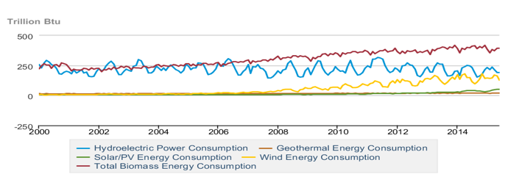
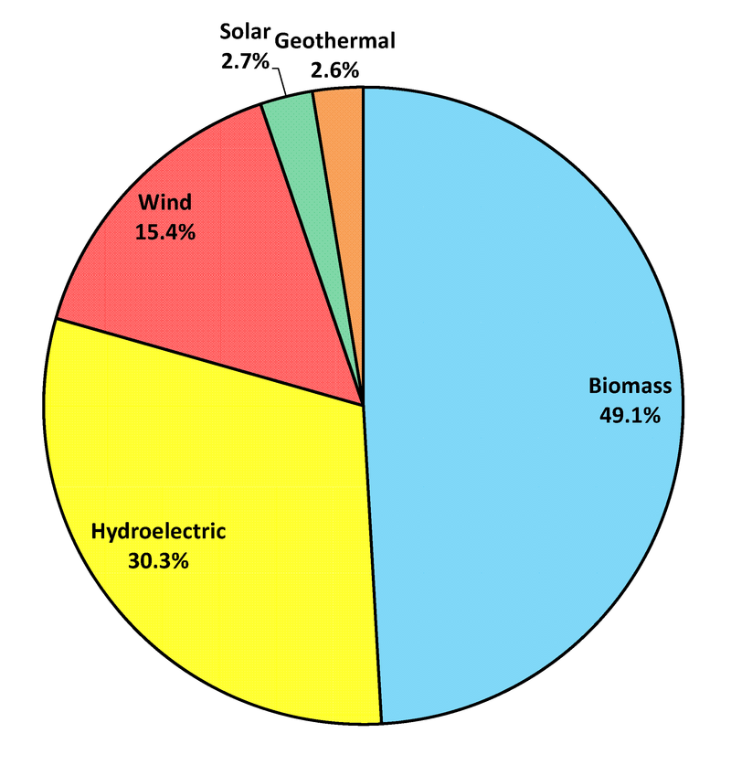
Renewable energies in the USA
Source: U.S Energy Information Administration (EIA)
Notes:
We live in world that is moving towards renewable energy.
Utah potential : 6.0 kWh/m^2/day
Solar energy is frequently lauded as a potential game changer in the energy landscape and with
good reason: it is the fastest growing source of renewable electricity globally and its average cost is
quickly falling, with the cost per watt installed having declined over 17 %in the past years
Title smaller – Text bigger

Slide 3
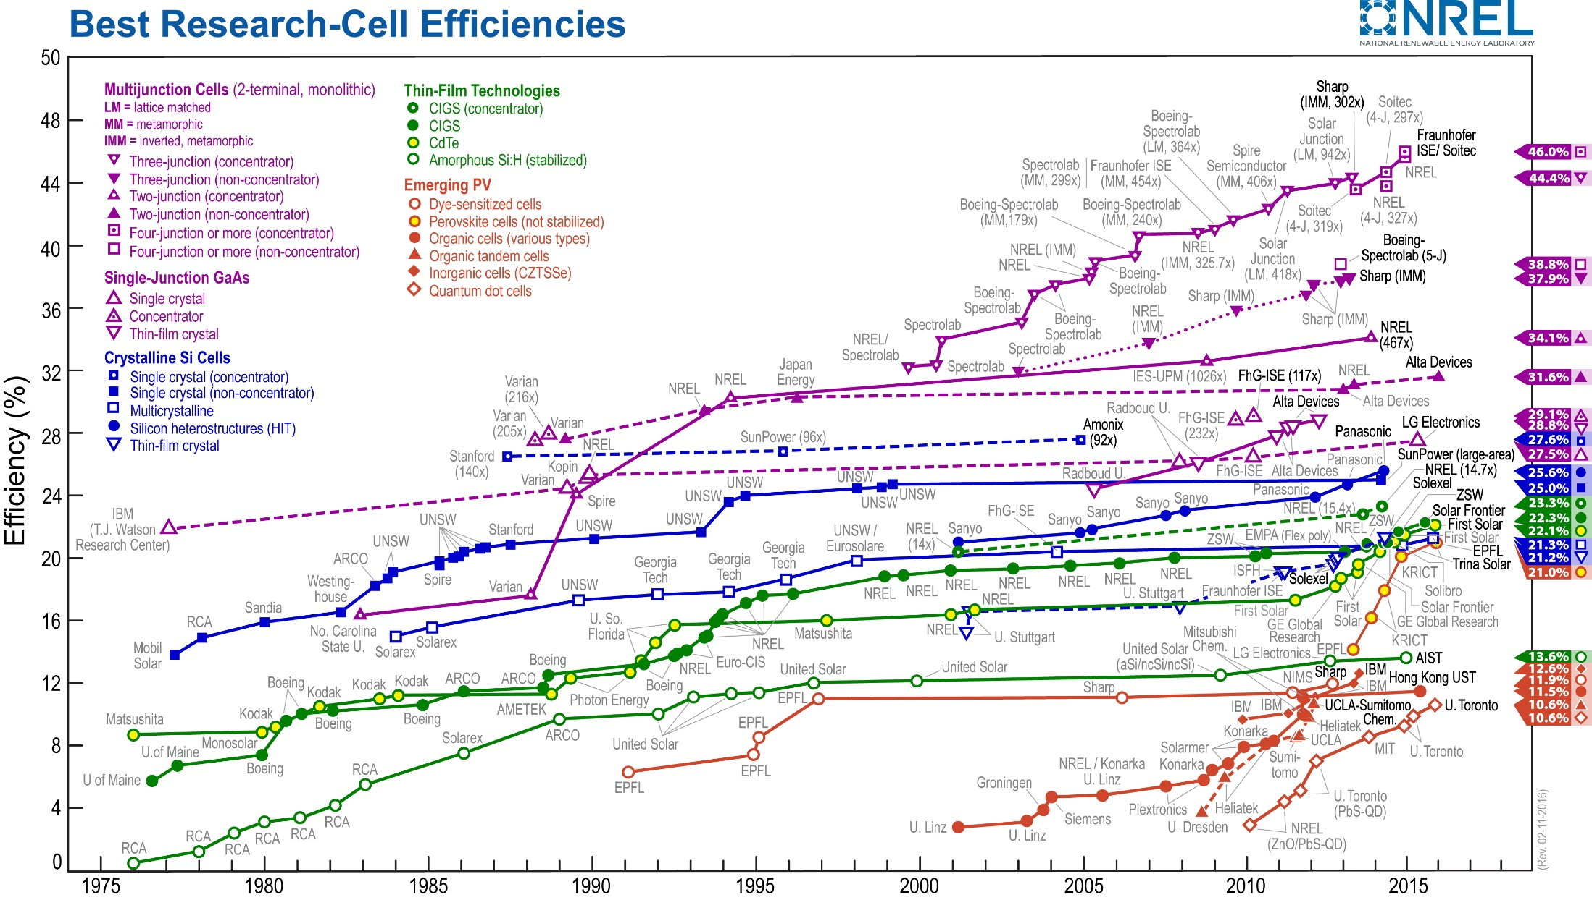
http://www.nrel.gov/ncpv/images/efficiency_chart.jpg
Notes:
25% Silicon
11.9 % DSSC
10.6 % Quantum dot solar cells

Slide 4
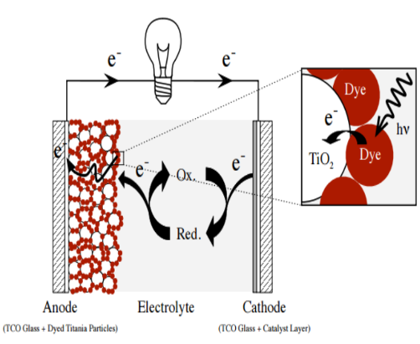
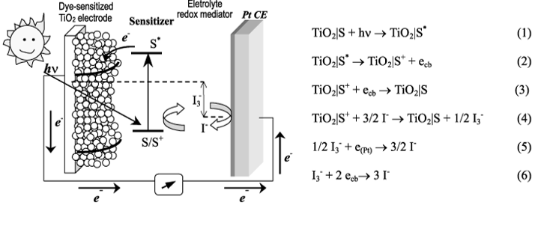
Mechanism of Dye Sensitized Solar Cells (DSSCs)
http://www.solaronix.com/documents/dye_solar_cells_for_real.pdf

Slide 5
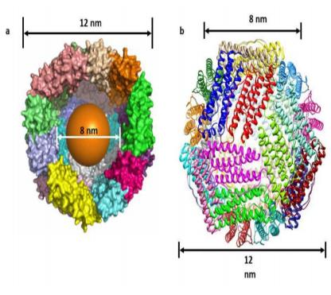
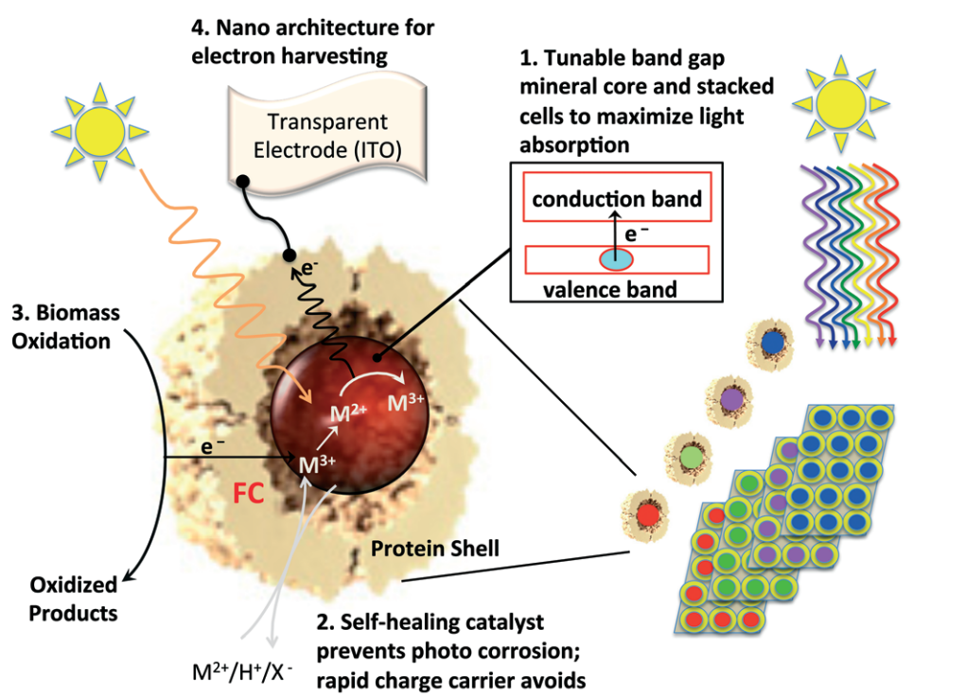
Why Ferritin?
Different wavelengths of light can be absorbed using different nanocrystals
Prevent photo-corrosion in metal oxide semiconductors
Thermo-stable up to 80ºC.
Notes:
The range of band gaps obtainable from these three types of nanocrystals (titanium, cobalt, and manganese) is 2.19–2.29 eV, 1.93–2.15 eV, and 1.60–1.65 eV respectively.
Titatium Dioxide - 3.2-3.35 eV
Ferritin - 2.140 eV
Iron metal count 4000-4500 atoms

Slide 6
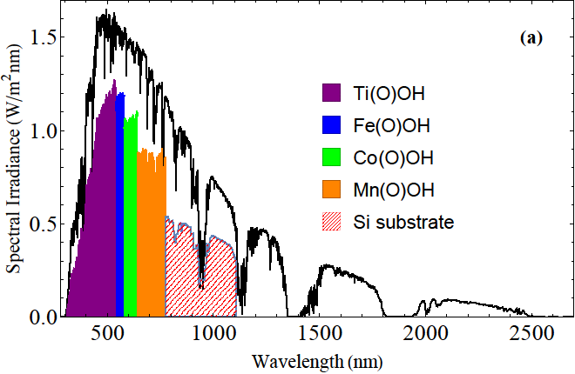
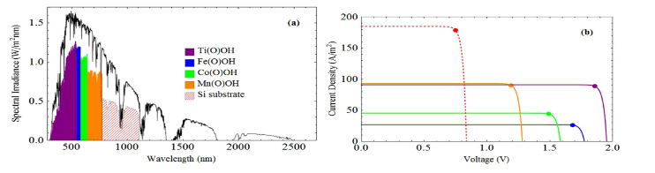
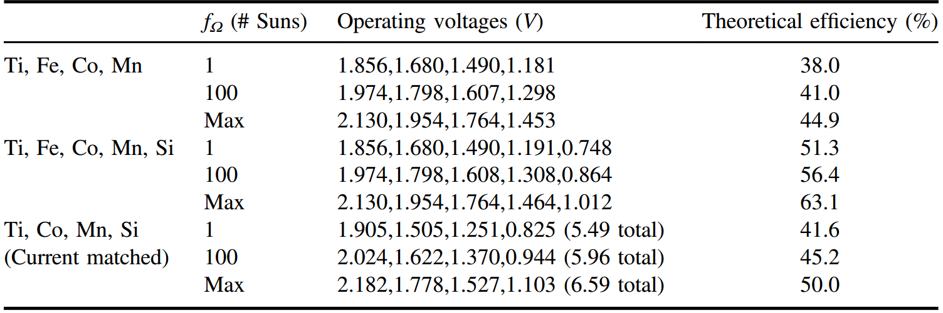
Theoretical Efficiency of Ferritin Based Solar Cells
Source : Erickson, S. (2014). NonnativeCo-, Mn-, and Ti-oxyhydroxide nanocrystals in ferritin for high efficiency solar energy conversion. Nanotechnology, 015703-015703.
Notes:
The range of band gaps obtainable from these three types of nanocrystals is 2.19–2.29 eV, 1.93–2.15 eV, and 1.60–1.65 eV respectively.
Titatium Dioxide - 3.2-3.35 eV
Ferritin - 2.140 eV
Shockley–Queisser limit of 33.7% efficiency [2], which comes from the interplay between the solar spectrum and a semiconductor absorption model where photons with energy below the band gap are not absorbed whereas photons above the band gap are absorbed. Excess photon energy above the band gap is lost to phonon-related heating. The 33.7% maximum efficiency is obtainable with a material having the optimal band gap of 1.34 eV. Band gap energies lower than 1.34 eV (e.g. silicon at 1.12 eV) will be less efficient because too much of the photons' energy will be lost, while band gap energies higher than 1.34 eV will be less efficient because too many photons will go unabsorbed.
Here we have used OAS to measure band gaps sensitively enough to see shifts in band gap from quantum confinement effects as particle size is changed; the results of the optical absorption spectroscopy measurements indicate the range of band gaps obtainable from titanium, cobalt, and manganese oxyhydroxide nanocrystals is 2.19–2.29 eV, 1.93–2.15 eV, and 1.60–1.65 eV respectively. Finally, we have used these band gap measurements to calculate theoretical efficiency limits for multi-junction PV cells using these materials. For concentrated sunlight efficiencies as large as 44.9% are theoretically obtainable, or 63.1% if another ferritin-based nanocrystal can be found with a band gap similar to silicon (i.e. 1.12 eV).

Slide 7
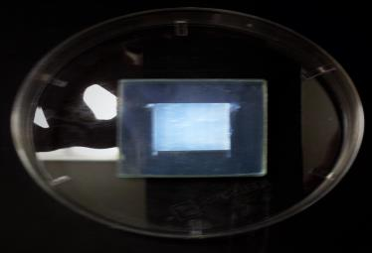
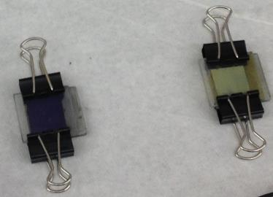
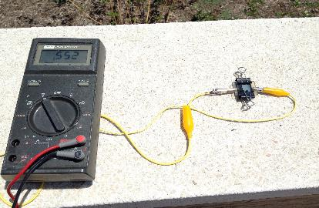
Left: Picture of the electrode right after the aneling process.
Right : Scanning electron microscope picture of a nanocrystalline TiO₂ (anatase) film used in the dye-sensitized solar cell
Right: Assembled anthocyanin (purple) and manganese ferritin ( yellow) dye-sensitized solar cells.
Left: Measurement of the open circuit voltage of the Cobalt based dye-sensitized solar cell.

Slide 8
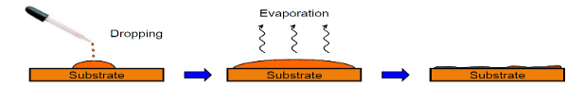
First Approach

Slide 9
Second Approach

Slide 10
Second Approach – More time

Slide 11
Objective

Slide 12
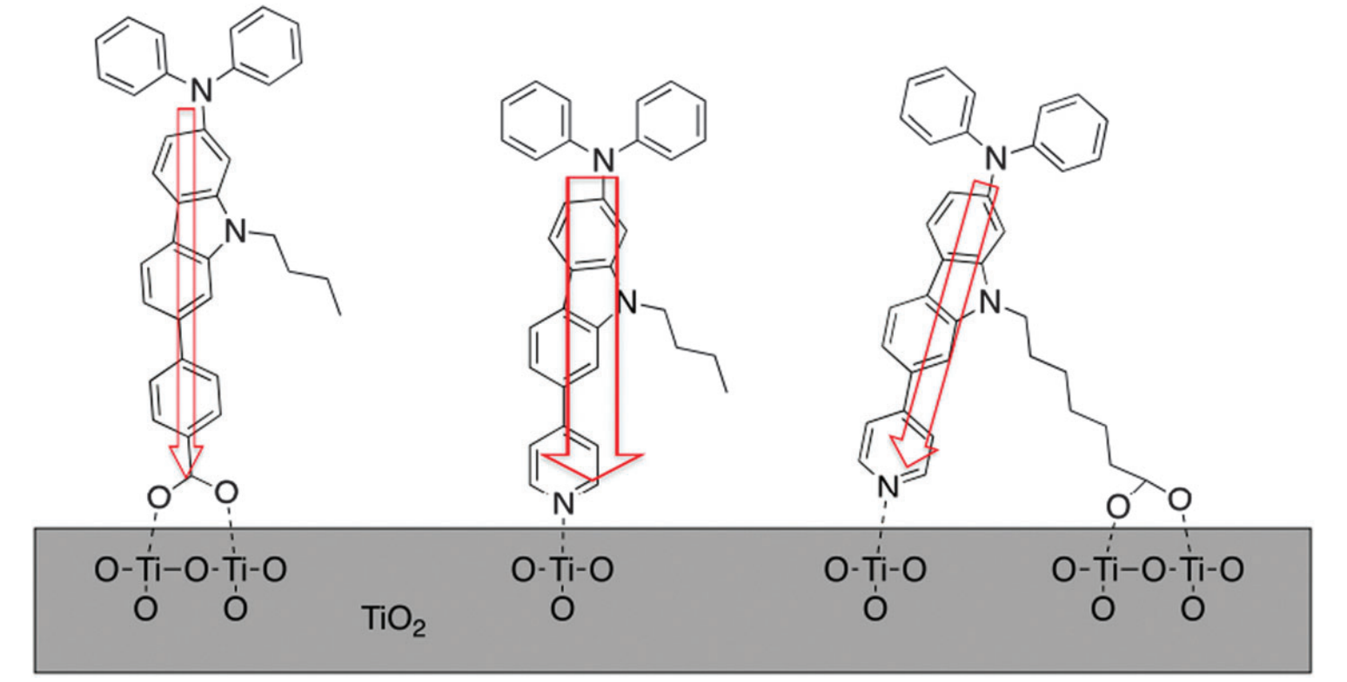
Challenges
Understanding the chemical and physical interactions between ferritin and TiO2
http://pubs.rsc.org/en/content/articlepdf/2012/oc/c2oc90016e

Slide 13
Conclusions & future works:
Ferritin has been used as an alternative dye for DSSCs
Optimization performed in order to increase the efficiency of the DSSCs
Need to investigate physical and chemical interactions between ferritin and titanium dioxide
Engineering a different ferritin structure
Start to develop multilayer DSSCs
Notes:
No questions. Summary of results

