Slide 1
Electron Spin Coherence in Silicon Carbide
Scott Leland Crossen
Acknowledgments
Dr. John Colton
The College of Physical and Mathematical Sciences
Jacob Embley
Notes:
Hi My name is…
I’d like to thank……For their contribution and consistent help on this project

Slide 2
Quantum Computing
Notes:
The reason why this is so interesting is because of what is called quantum computing.
Whereas most computers have 1-or-0 state bits…superposition
There’s many ways to achieve a superposition. One popular method one is to use electron spin-states as a quantum material that can be probed and manipulated.
Many of you listened to the guest speaker this morning. He referenced a paper on nitrogen-vacancies in diamond as a possible qubit candidate for quantum computing.
In case you haven’t read this paper, they reported a maximum coherence time of .6 seconds
Now… I’m sure most of you are rolling in diamonds, but for the rest of us, it becomes beseeming to investigate other materials that could be used as qubits.
In this case we suggest 4H-SiC as a candidate

Slide 3
Electron Spin Decoherence
Notes:
Now, the major culprit to viable qubits is something called...
In order for quantum computing to work it needs a long-lasting spin-state.
Decoherence is caused by many thing and we will consider two here.

Slide 4
How is electron-spin coherence dependent on lattice defects and temperature?
Notes:
This leads me to the question I want to answer which is…

Slide 5
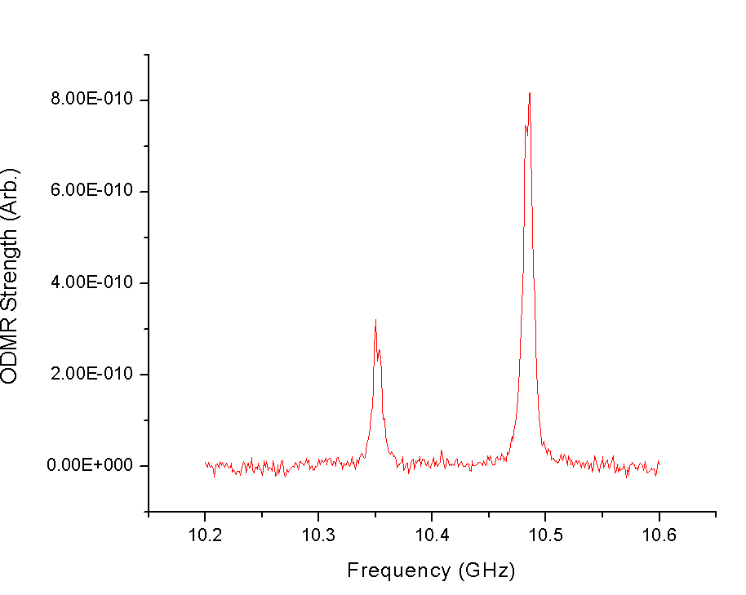
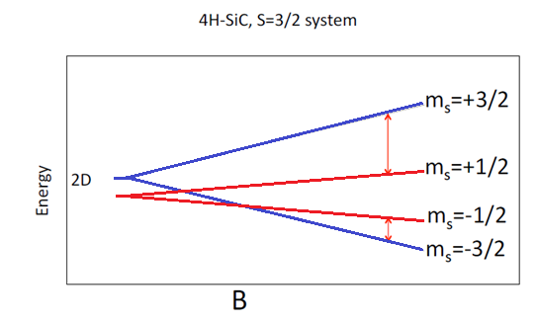
Irradiated 4H-SiC Defects
ODMR (Optically Detected Magnetic Resonance)
B=370.78 mT
Notes:
As most physicist do, we will now grossly simplify SiC to something simple.
I’m sure most of you have heard of the Zeeman effect. I’ve diagrammed it here.
In the presence of a magnetic field the energy levels of atoms split.
ODMR shows this transition.
We will focus on the right ODMR line.

Slide 6
Measuring the
Coherence Time
Notes:
Now, how do we measure the quote-unquote “coherence time” of SiC.
As is our purpose, we want to see what affects coherence time of SiC… to do this we need to know how to measure it.

Slide 7
Step 1 - Offset the Spin

Slide 8
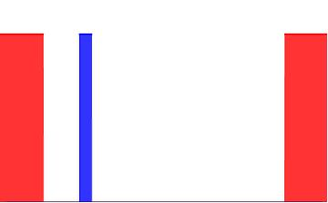
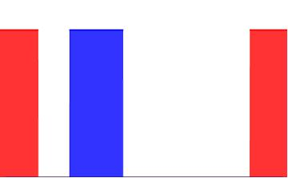
Rabi Oscillations
Microwave
Microwave
Laser
Laser
Laser
Laser
One Sample Period
One Sample Period
(Plot-amplitude is meaningless)
Notes:
Why do we need this? - To Get Pi Pulses
Pi Pulses rotate the spins 90 degrees
Every Temperature!
Experimental Set-up
Red = Laser Pulsed with a dielectric
Ti:Sapph pumped 5 W
Aligns spins in our experiment
Blue = Microwave
Constant Magnetic Field at resonance.

Slide 9
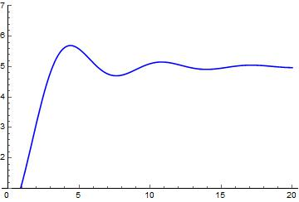
Rabi Oscillations
Spin aligns antiparallel to magnetic field (Pi Length)
Pi/2 Length: Spin aligns perpendicular to magnetic Field (Pi/2 Length)
Response
Pulse length
Notes:
This is theoretically what it should look like
y-Axes arbitrary
Precession causes damping
State Oscillates between “up” and “down”

Slide 10
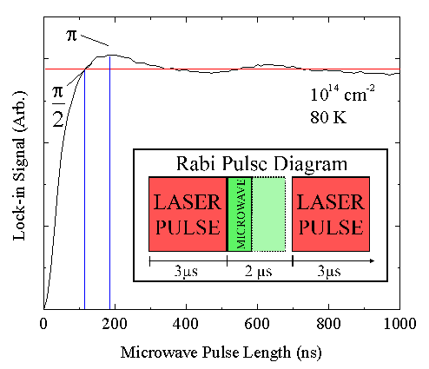
Rabi Oscillations

Slide 11
Step 2 - Observe Decoherence

Slide 12
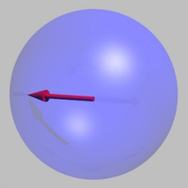
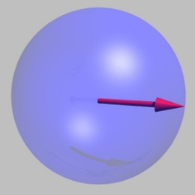
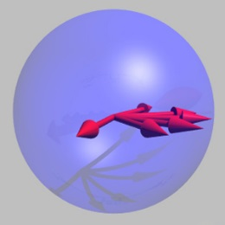
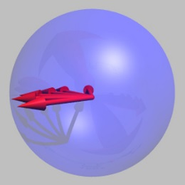
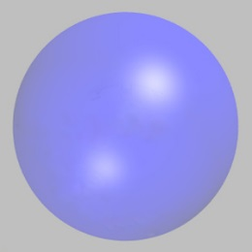
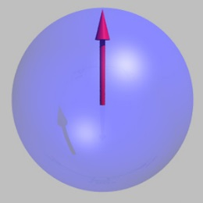
Spin Echo
Pi microwave pulse -> 180 degree rotation
Pi/2 microwave pulse -> 90 degree rotation (superposition of states)
Time delay -> Spins precess
Pi/2 microwave pulse -> 90 degree rotation (spin up)
Laser pulse -> Spins align (spin up)
Time delay -> Spins realign (still superposition of states)

Slide 13
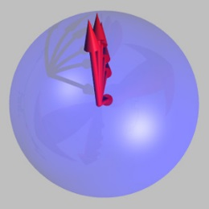
Spin Echo
Spins fail to realign

Slide 14
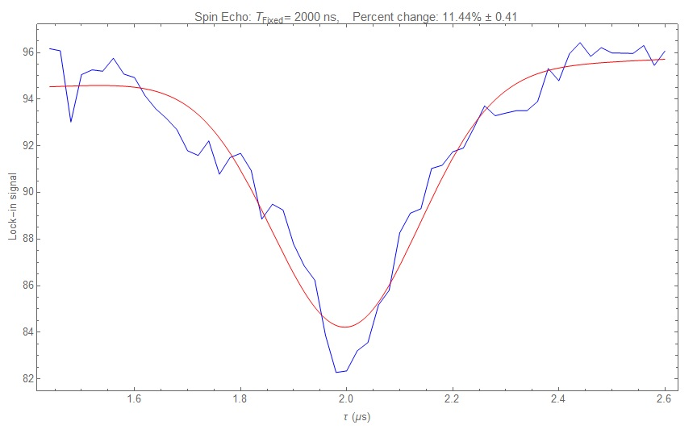
Spin Echo
Spin Echo: Percent Change: 11.44% ± .41
Lock-in Signal (Arb.)
𝜏 (𝜇s)

Slide 15
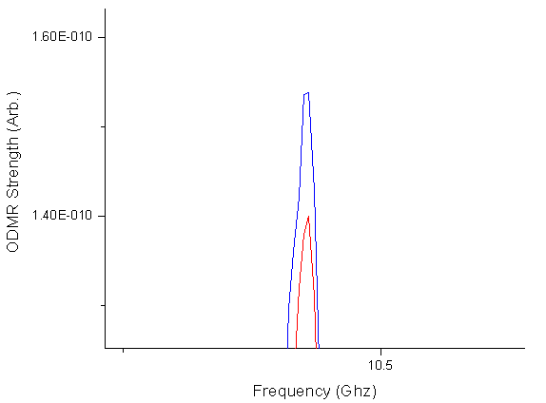
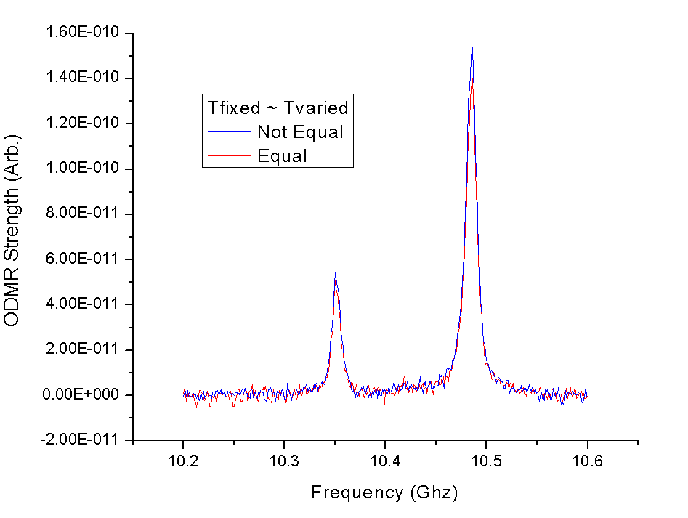
Spin Echo
~10%

Slide 16
Step 3 - Measure “Lifetime”

Slide 17
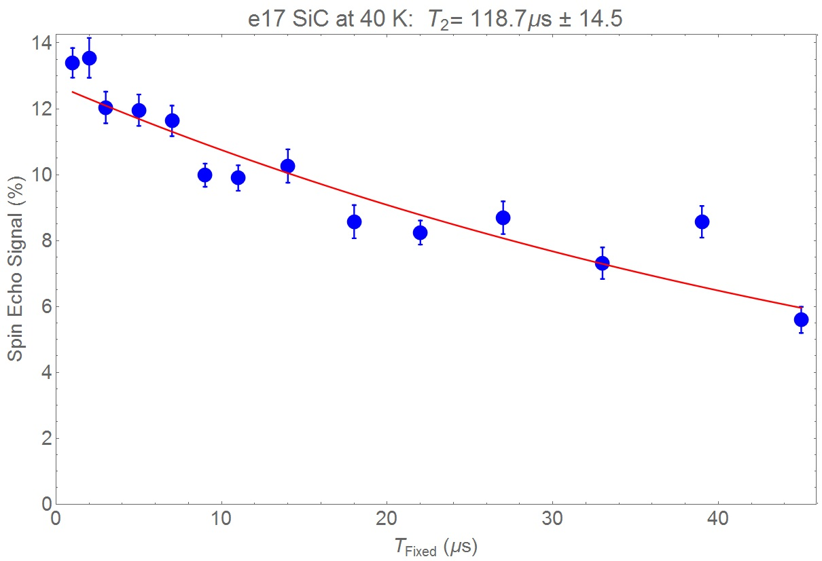
Spin Lifetime

Slide 18
Step 4 - Repeat for different
Temperatures and
Irradiation Fluences

Slide 19
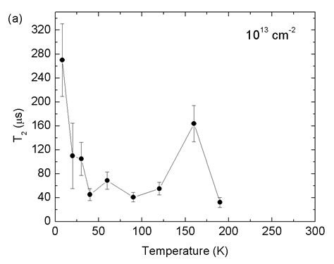
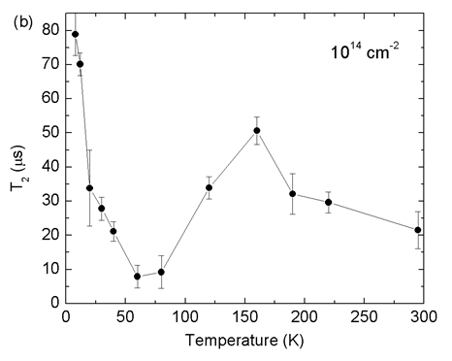
Temperature Dependence
Jahn Teller Effect -
Dynamic reorientation of the vacancy structure
10^13 Proton Irradiated Sample
10^14 Proton Irradiated Sample
(Less Defects)
(More Defects)

Slide 20
Coherence Times on the order of 100 𝜇s
An overall decrease in temperature dependence but with an unexpected rise from 50-160K
Longer spin coherence with less defects (spin-spin interactions)
Conclusion

Slide 21
Thank You!

