Slide 1
Oxidation-Reduction Potential of Iron Encapsulated by Ferritin
Jacob Embley
Dr. John Colton, Dr. Richard Watt, Trevor Smith, Cameron Olsen, Kevin Zenner, and Stephen Erickson
Notes:
Introduce yourself

Slide 2
What is ferritin?
Spherical protein complex
Nano-cage composed of 24 sub-units
Approximately 12 nm in diameter
Intracellular complex found in nearly all organisms
Organisms use ferritin to store and regulate iron

Slide 3
Ferritin further explained
Hollow 8 nm diameter interior
Natively encapsulates ferrihydrite nanoparticle
Up to 4500 Fe atoms per ferritin
Ions enter through 3-fold channels
Notes:
Shorten these bullets

Slide 4
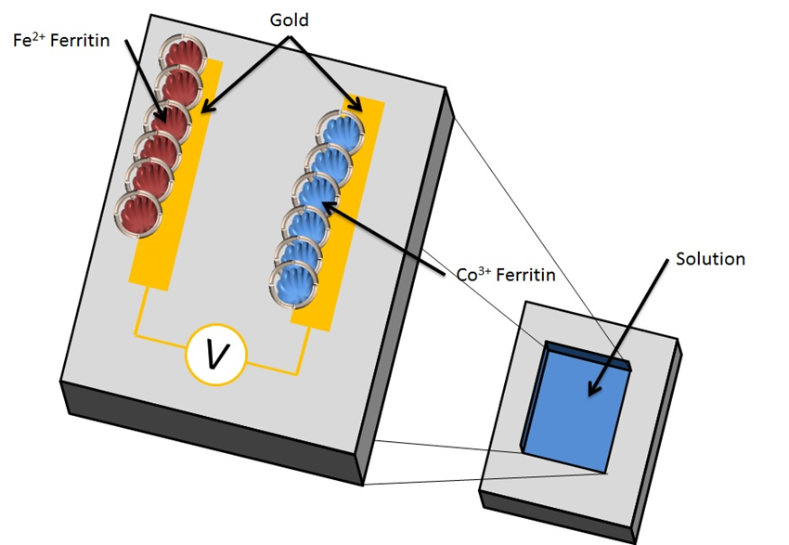
Why is ferritin interesting?
Photovoltaic device
Nanobattery

Slide 5
Batteries
Two half-cells
Current flows across the potential difference
Reduction and oxidation occur at the electrodes
Common issue:
Battery performance deteriorates after repeated charge and discharge cycles

Slide 6
Potential use of ferritin in a battery
Electrodes composed of Ferritin cores of varying reduction potentials
Advantage of this type of battery:
Ferritin protects and maintains the metal core

Slide 7
Effects of salt anions on reduction potential
Notes:
Enlarge the graphic

Slide 8
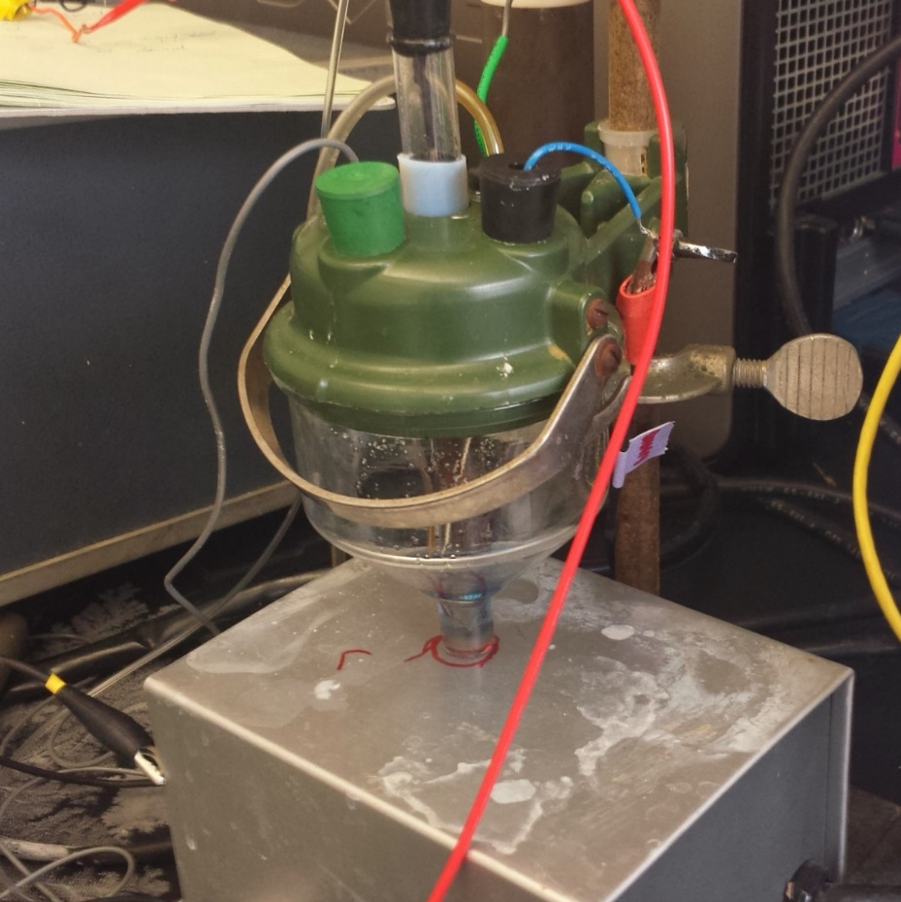
Determining the Reduction Potential
Potentiostatic coulometry
Cyclic Voltammetry

Slide 9
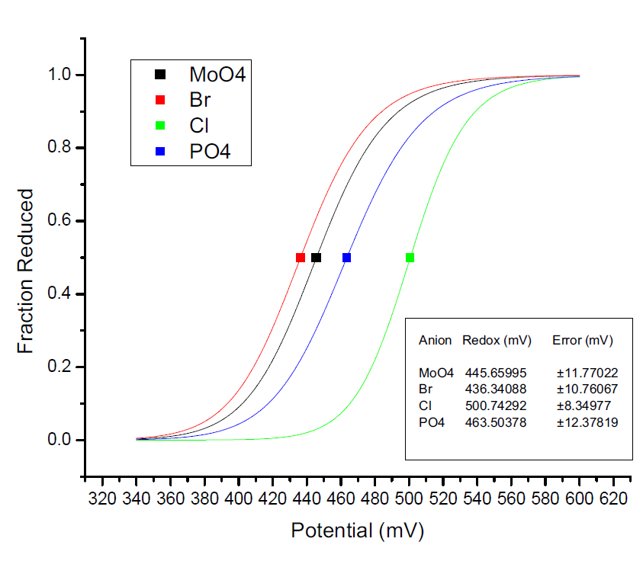
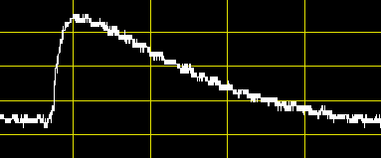
Potentiostatic coulometry
Current
Time
Notes:
Try to show some real data

Slide 10
Results from potentiostatic coulometry

Slide 11
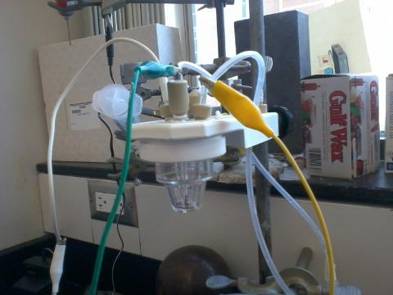
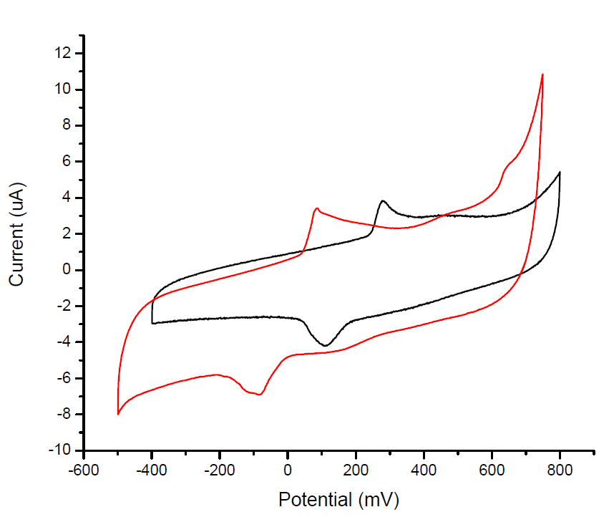
Cyclic voltammetry
Cl-
Br-

Slide 12
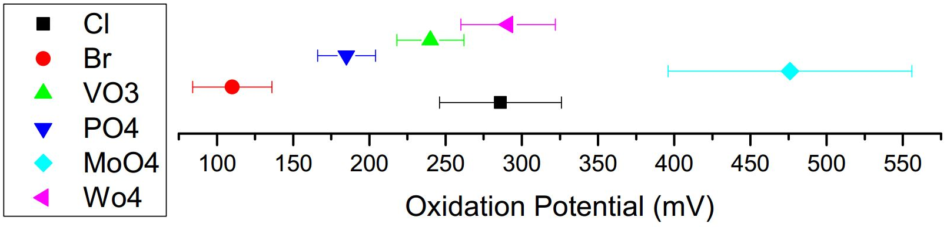
Results from cyclic voltammetry

Slide 13
Ongoing and Future studies
Testing the battery performance of the ferritin cores:
Rate of charge and discharge
Life cycle tests
Reduction Potential of non-iron metal oxide cores in Ferritin

Slide 14
Conclusion
The reduction potential of the iron mineral nanoparticle encapsulated by ferritin is significantly altered by the addition of various salt anions
Anion | Coulometery Reduction | CV Reduction (mV) | CV Oxidation (mV)
Cl⁻ | 500.7 ± 8.35 | 108 ± 52 | 286 ± 40
Br⁻ | 436.3 ± 10.8 | -74.0 ± 31 | 110 ± 26
VO₃³⁻ | --- | 353 ± 74 | 476 ± 80
PO₄³⁻ | 463.5 ± 12.4 | 133 ± 35 | 285 ± 19
MoO₄²⁻ | 445.6 ± 11.8 | 42.0 ± 52 | 240 ± 22
WO₄²⁻ | 411.0 ± 12.4 | 73.0 ± 61 | 291 ± 31

