Slide 1
Ferritin-based semiconductor nanocrystals for solar energy harvesting
Dr. John S. Colton
Physics Department, Brigham Young University
Undergrad students: Stephen Erickson, Cameron Olsen, Jacob Embley, Jake Maxfield, Alessandro Perego, et al.
Dr. Richard Watt
Ph.D. Student: Trevor Smith
Chemistry Department, Brigham Young University
Funding: Utah Office of Energy Dev., BYU Physics Dept, BYU Chemistry Dept
U of U seminar, Jan 13, 2016

Slide 2
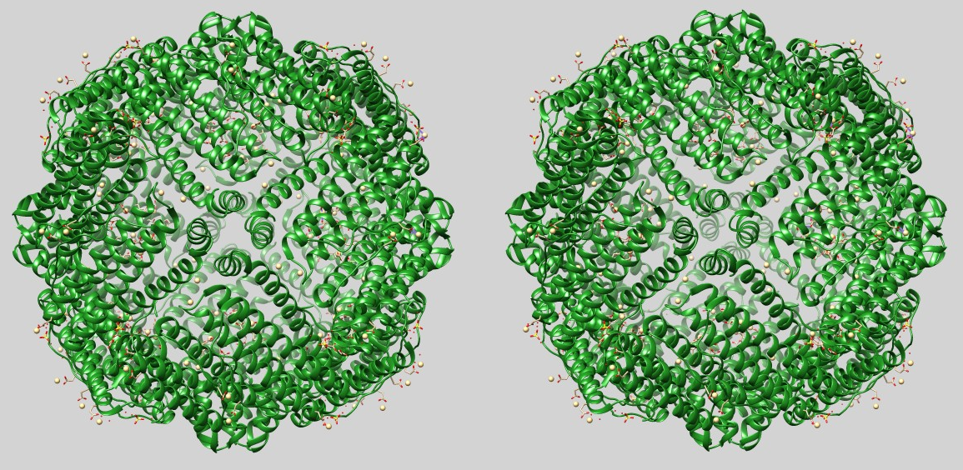
Stereogram of ferritin
8 nm
8 nm

Slide 3
Outline
Native ferritin: Fe(O)OH core
Optical bandgap measurements
Salts
Other metal(O)OH cores
Solar cell theory/efficiency calculations
A bit more synthesis: Mn and permanganate
Solar cell prototypes
The future

Slide 4
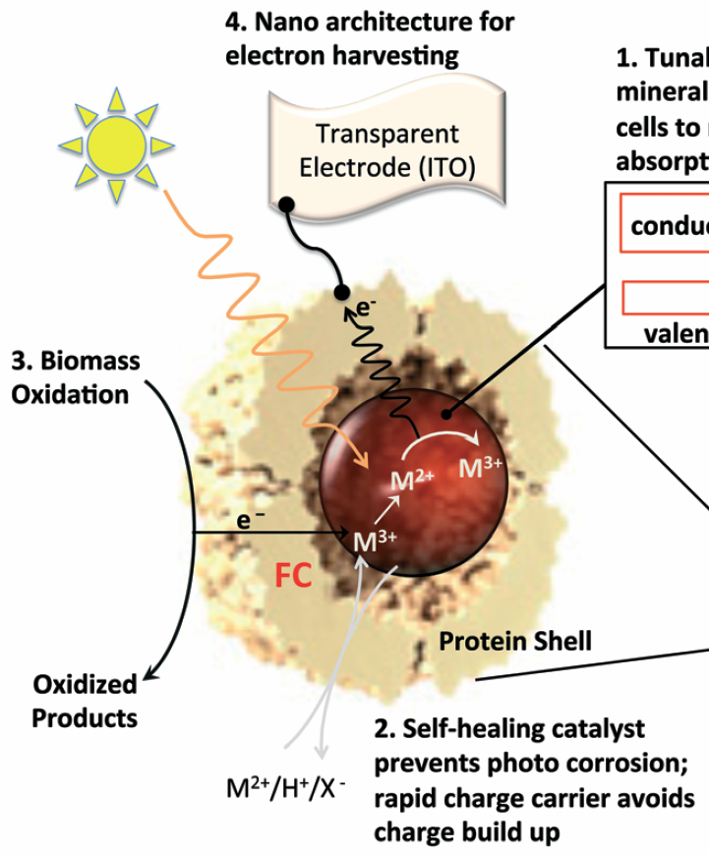
Why is ferritin interesting?
Template for nanocrystals
  Ferroxidase center
Self healing against photocorrosion
Solubility
Photo-oxidation catalyst
1. Nanocrystal
From Watt, Petrucci, and Smith,
Catl. Sci. Technol. 2013

Slide 5
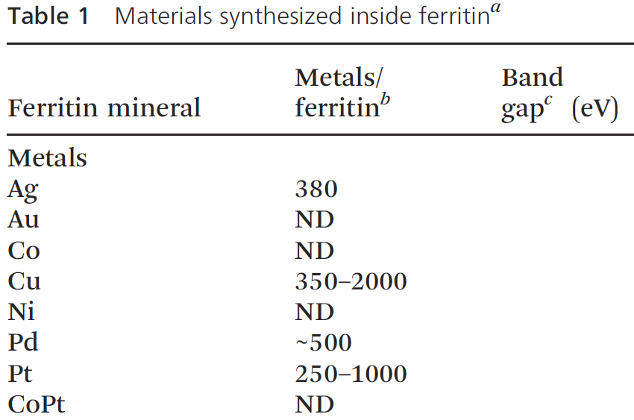
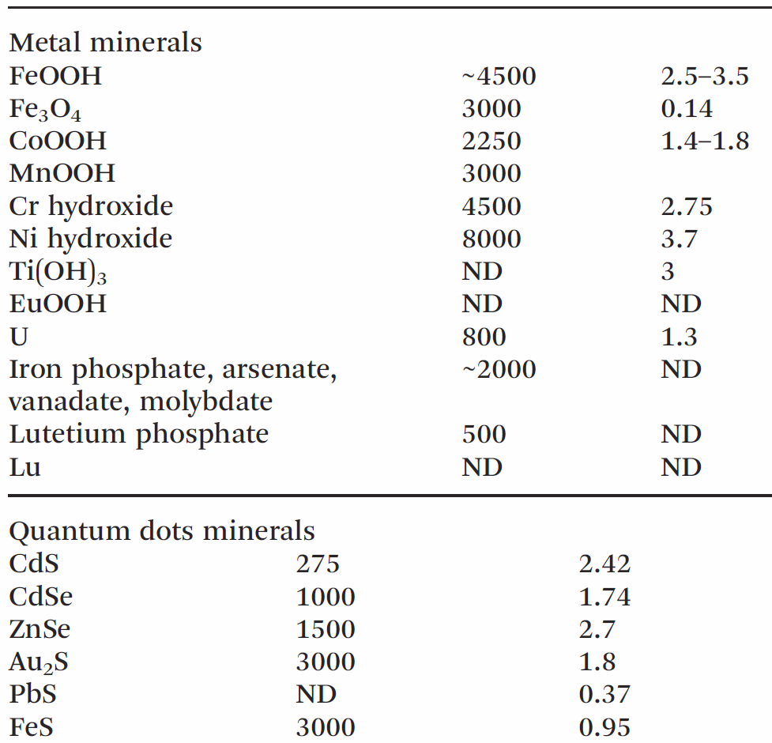
Nanocrystals grown with ferritin
From Watt, Petrucci, and Smith, Catl. Sci. Technol. 2013

Slide 6
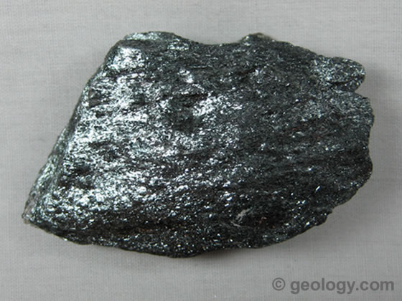
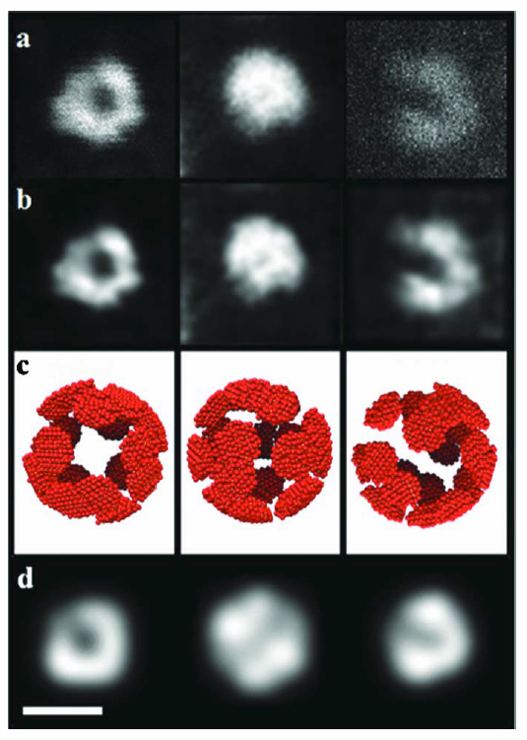
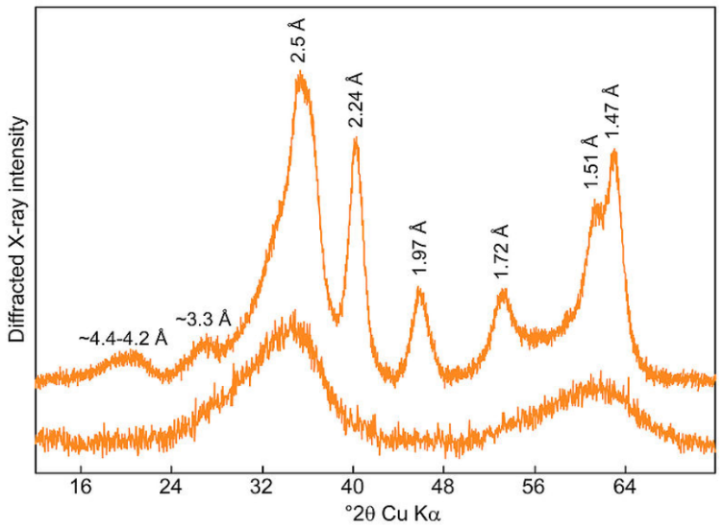
Ferrihydrite basics
(Fe³⁺)₂O₃ • 0.5H₂O
Nanomaterial
About 1100 Fe/ferritin
Found in soils
Found in organisms
Similar to
hematite
Many defects
Lopez-Castro et al., Dalton Trans. 2012
image: Wikipedia

Slide 7
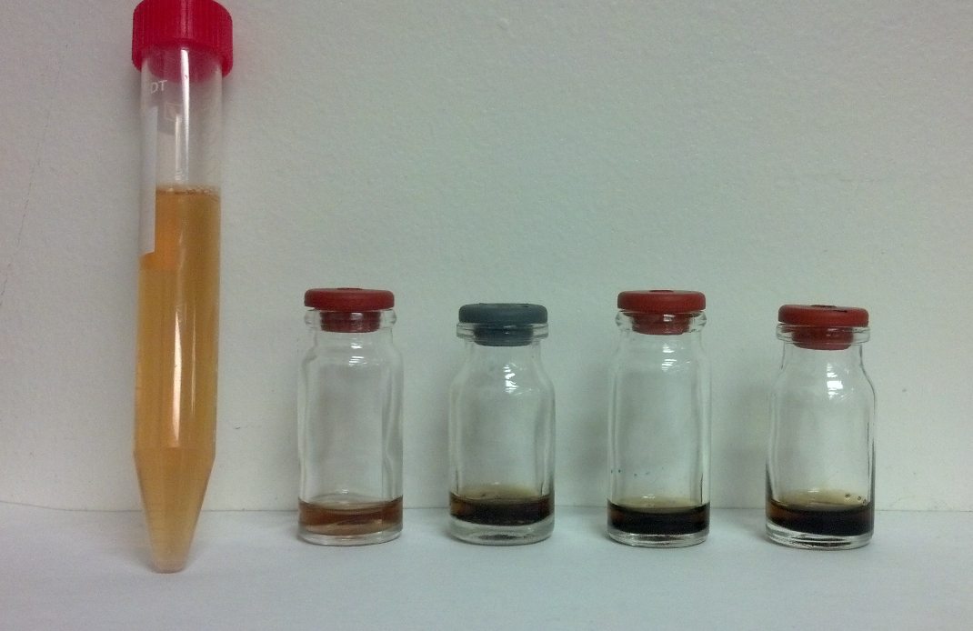
Examples of our samples
Manganese replacing iron
Native
Non-native metal(O)OH samples
Take iron out: dithionite dialysis, 0.050 M TRIS-base buffer at pH 7.4 carefully titrated with NaNO₃.
Putting iron (for example) back in: 10 mM ferrous ammonium sulfate added at a rate of 200 irons per ferritin every 10 minutes

Slide 8
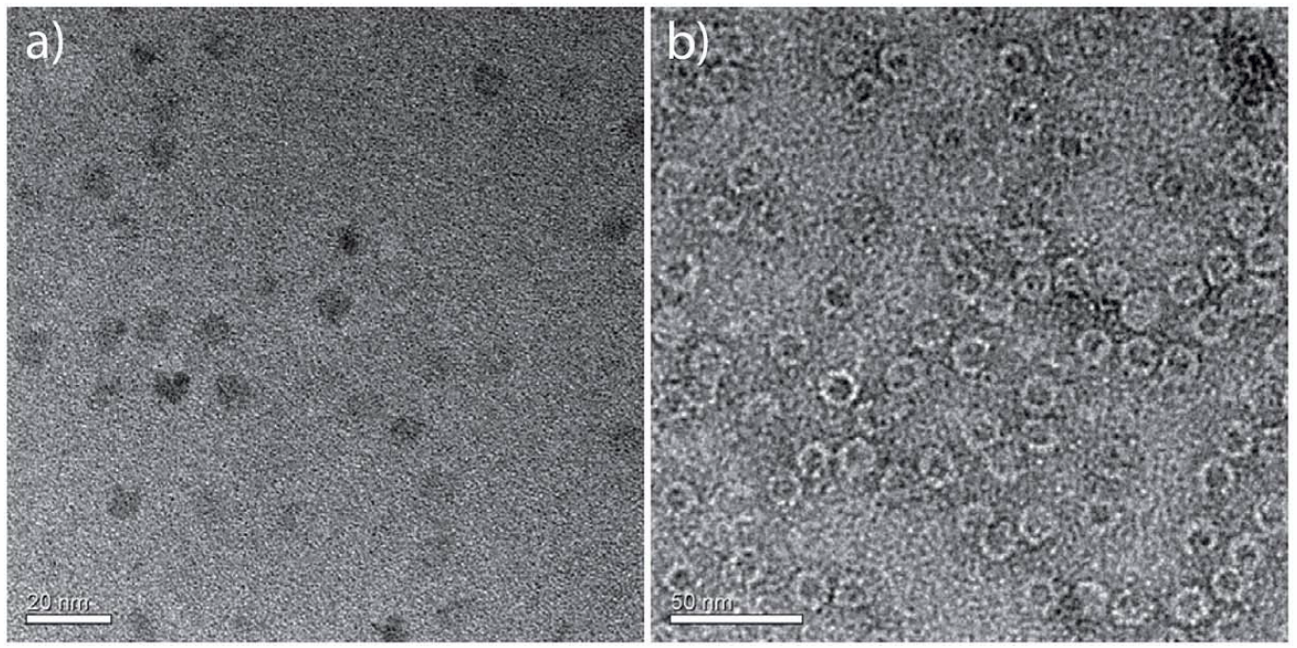
Representative TEM images
unstained
stained with uranyl acetate
Use EDX to verify presence of substitutional elements in core
Use chemical techniques (Lowry, ICPMS) to establish # metal atoms/ferritin

Slide 9
Nanocrystals grown with ferritin
1.0 – 3.5 eV
From Watt, Petrucci, and Smith, Catl. Sci. Technol. 2013

Slide 10
Bandgaps via optical absorption
Spectrometer
Sample (compare sample to blank)
Xenon Arc Lamp
Lens
Photodiode
Iris
Chopper
Computer steps through wavelength of spectrometer and records data from lock-in
Ref
Signal
Lock-in Amplifier

Slide 11
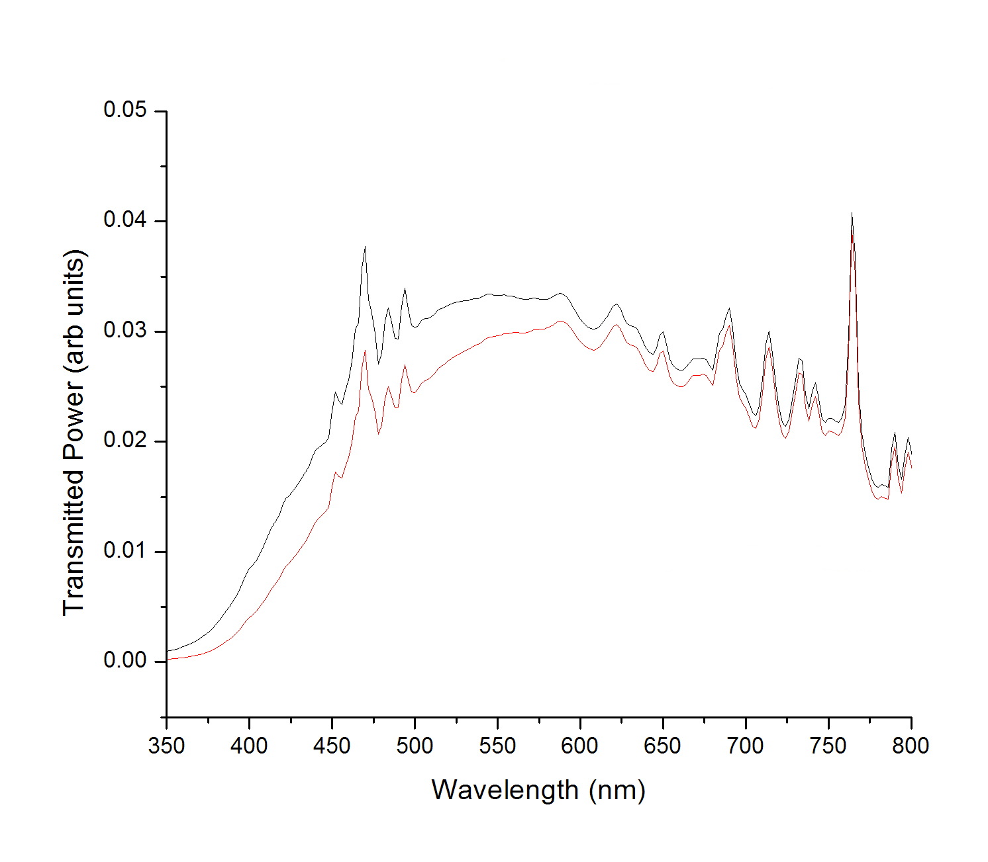
Typical Raw Data
Blank, solution with no ferritin
With ferritin

Slide 12
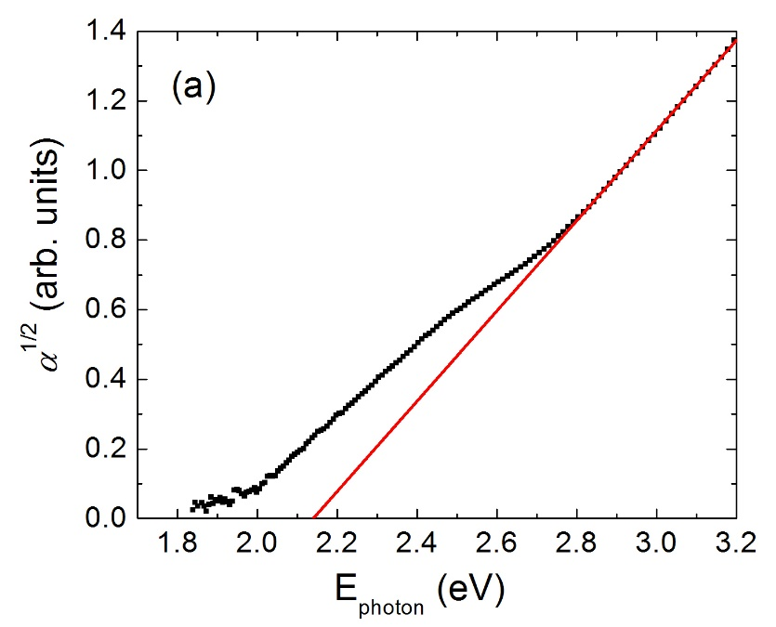
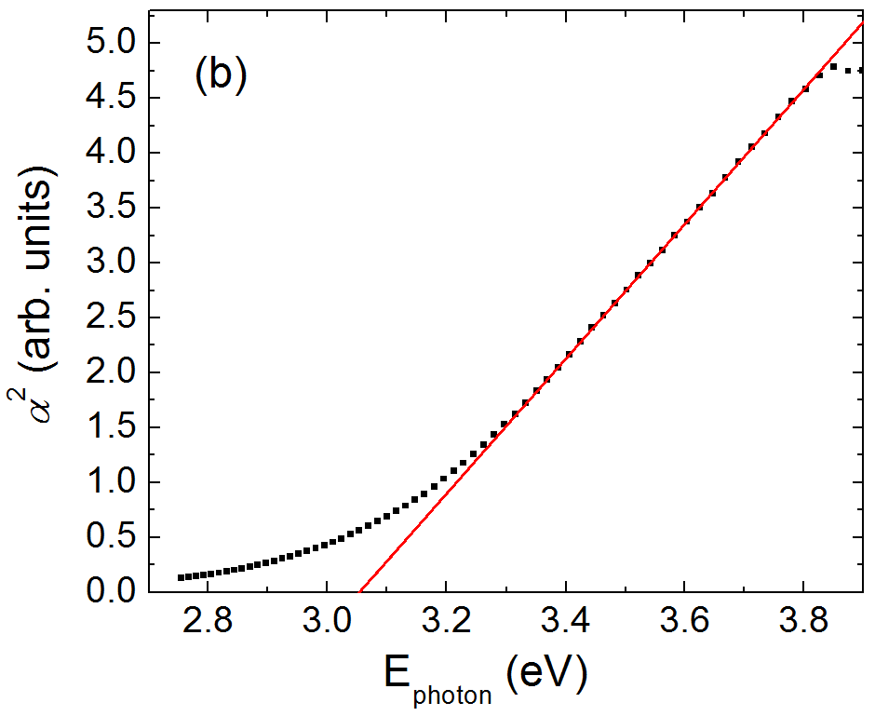
Ferrihydrite, Fe(O)OH
Indirect gap
Direct transition
Defect State
Higher
transition
Band gap
E_{g} = 1.92 – 2.24 eV,
depending on size
direct = 2.92 – 3.12 eV,
depending on size

Slide 13
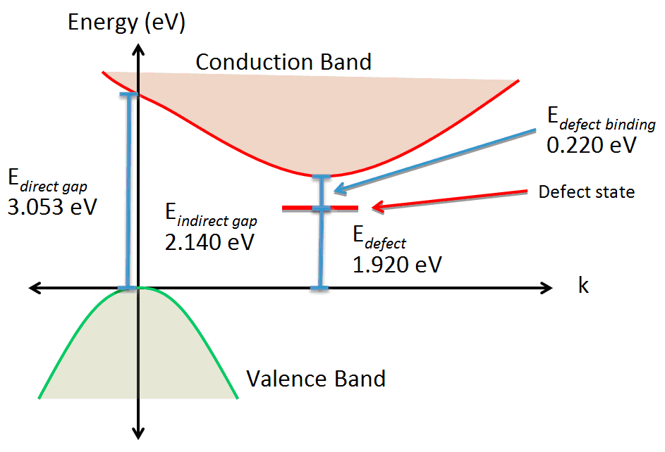
Band structure of ferrihydrite in native ferritin
Figure from Colton et al, Nanotechnology (2014)
Compare table value: 2.5-3.5 eV
~1100 iron atoms per ferritin

Slide 14
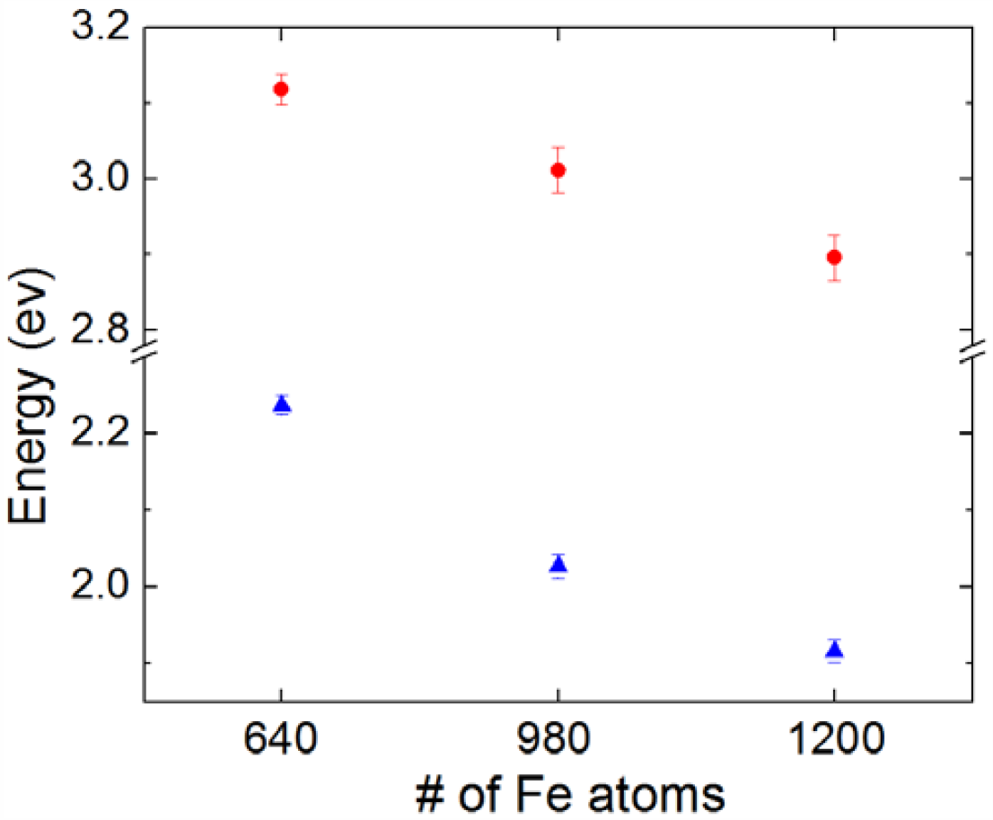
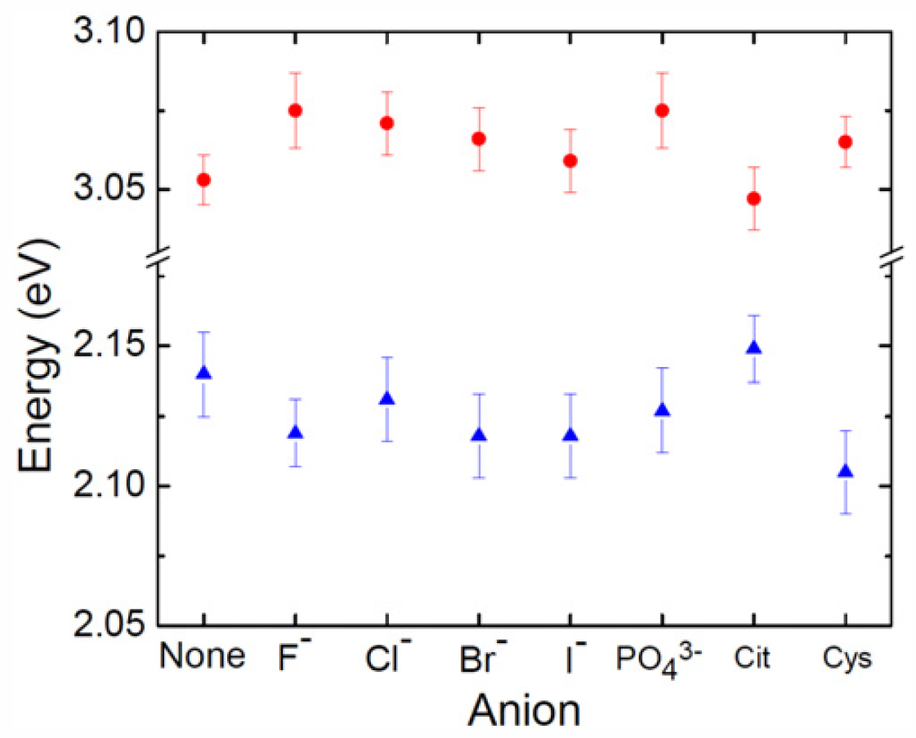
Band gap results
Size dependence:
quantum confinement
Anion dependence
(bonded to surface)
Figures from Colton et al, Nanotechnology (2014)

Slide 15
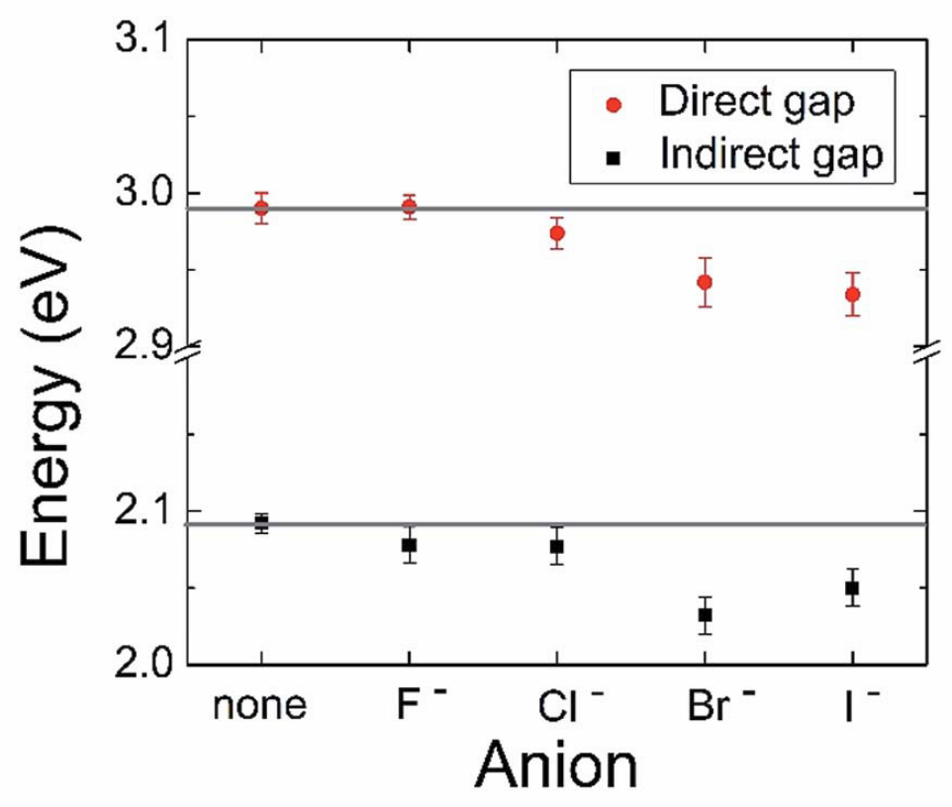
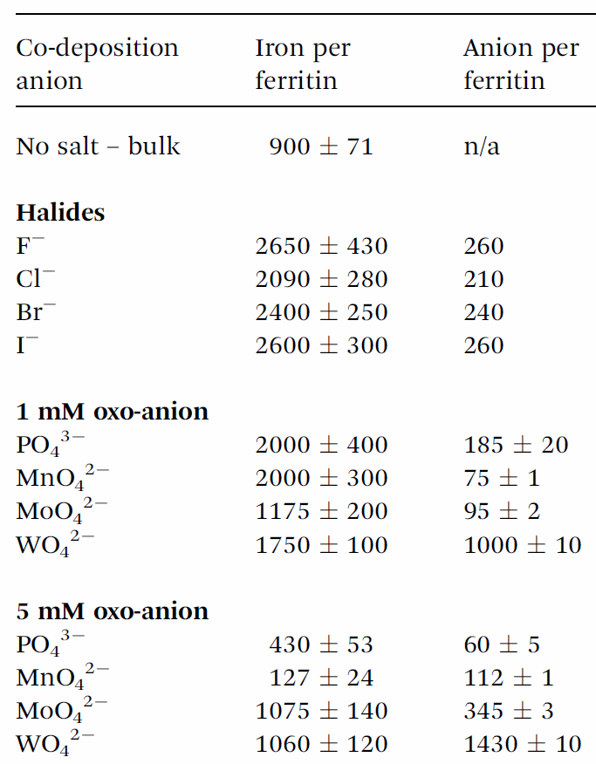
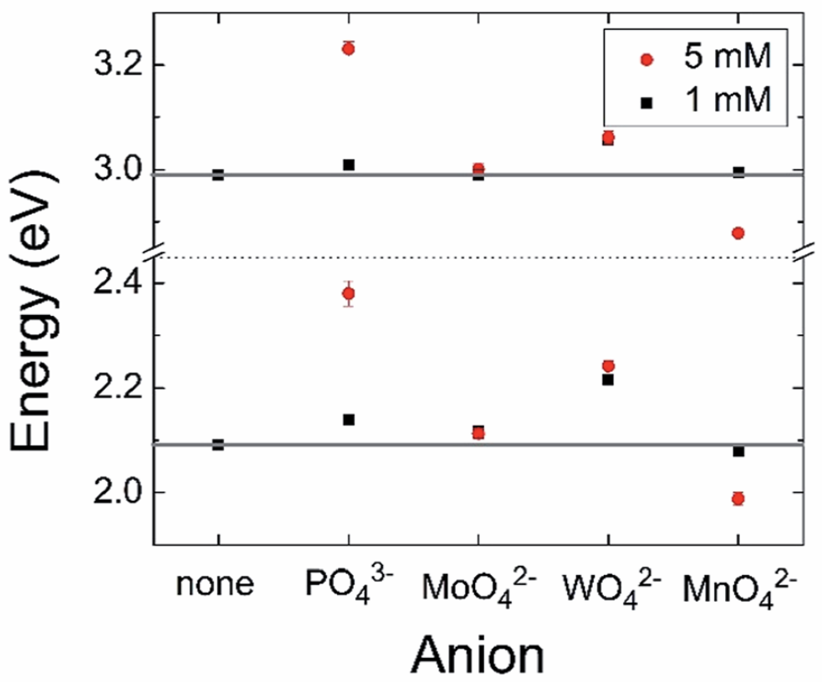
Incorporating anions into the core
despite very small cores!
From Smith et al, J. Mater. Chem A (2015)

Slide 16
Nanocrystals grown with ferritin
From Watt, Petrucci, and Smith, Catl. Sci. Technol. 2013

Slide 17
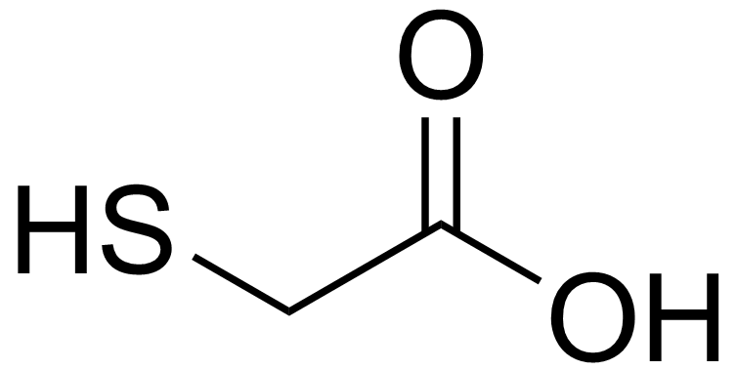

Nanocrystal synthesis: Fe-, Co-, Mn- and Ti(O)OH
Fe
Fe
Fe(O)OH

Slide 18
Nanocrystal synthesis: Fe-, Co-, Mn- and Ti(O)OH
Co²⁺ + H₂O₂
Mn²⁺ + O₂
Fe²⁺ + O₂
(Cobalt with added peroxide)
Loading through ferroxidase centers
Metal³⁺(O)OH
Notes:
Iron(II) (for ferrihydrite mineral) and manganese (II) both use oxygen to load into ferritin. This is because the feroxidase center in ferritin (which is responsible for oxidizing metals) is able to oxidize the metal ions to a 3+ state. (Fe(II) Oxidation 0.77 V) Manganese has similar chemistry to Fe.
Cobalt is more difficult to oxidize (has a higher oxidation potential 1.7 V) and requires peroxide to increase the rate of cobalt loading into ferritin. (Peroxide -1.77 V)
Each metal oxide is unique, with its own photochemical and electrochemical properties.
18

Slide 19
Substitutional metals
Co(O)OH
Mn(O)OH
Ti(O)OH
Direct transition
E_{g}
1.60-1.65 eV
2.19-2.29 eV
1.93-2.15 eV
Total range: E_{g} from 1.60 – 2.29 eV

Slide 20
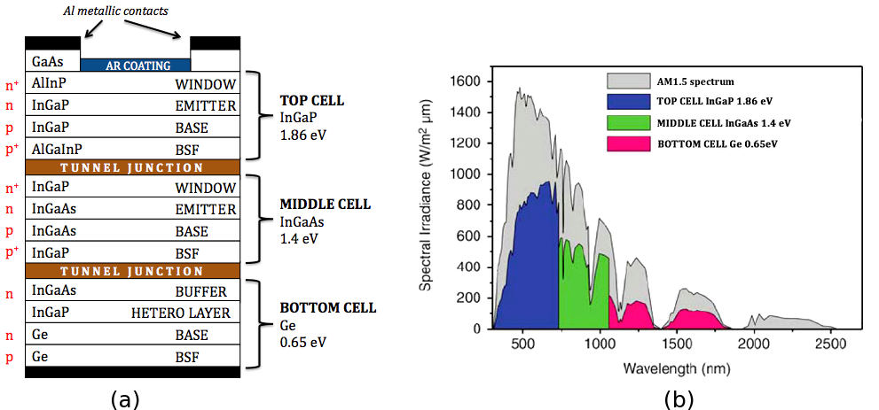
Multi-junction solar cells
Image from Wikipedia

Slide 21
Efficiency calcs: Shockley-Queisser model
n-type
p-type
CB
E_{F}
E_{F}
VB
Photo-current
Recombination current
→ depends on operating voltage
Arrows: direction of electrons

Slide 22
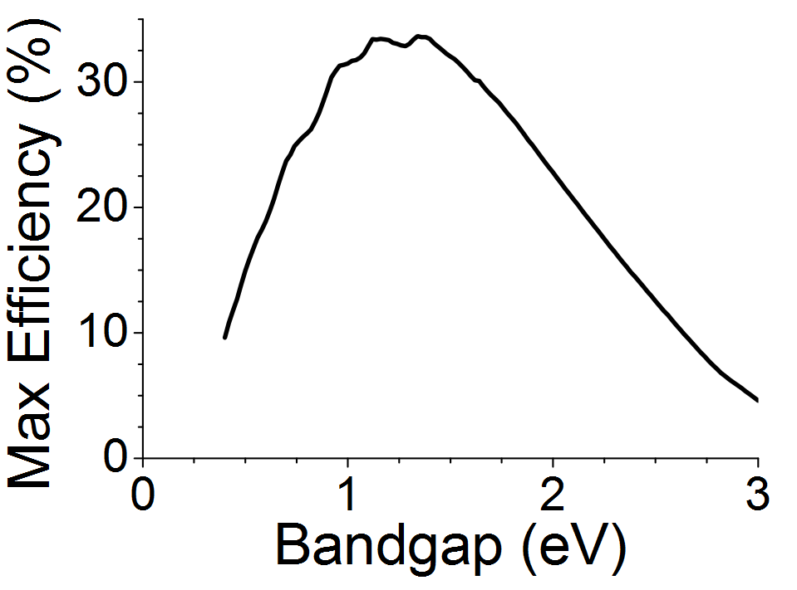
Shockley-Queisser Results, 1961
E_{g} = 1.1 eV (silicon) → eff. = 29%
Best E_{g} = 1.34 eV → eff. = 33.7%, “SQ limit”
Too much unabsorbed
(Using actual solar spectrum
rather than SQ’s 6000K
blackbody model of the sun)
Lose too much to phonons
From Wikipedia, “Shockley–Queisser_limit”

Slide 23
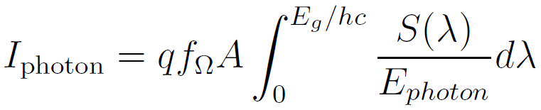
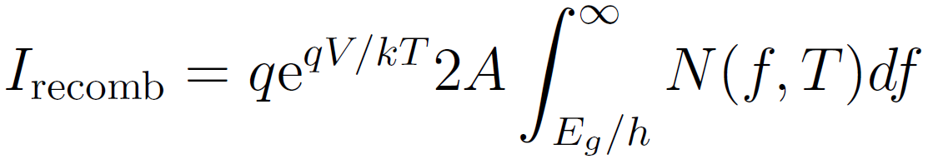

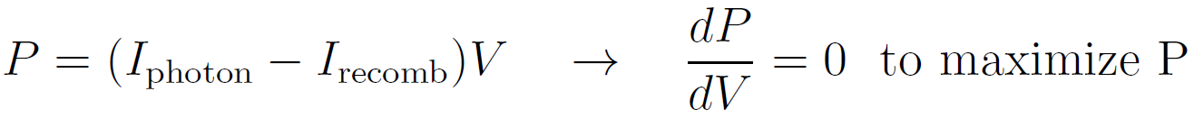
A Review of the Equations
Solar spectrum
constant with V
concentration factor
Blackbody spectrum
exponential with V
I
maximum
power
V
Then compare P_{max} to total solar energy
to define the efficiency

Slide 24
Multi-junction solar cells
Image from Wikipedia

Slide 25
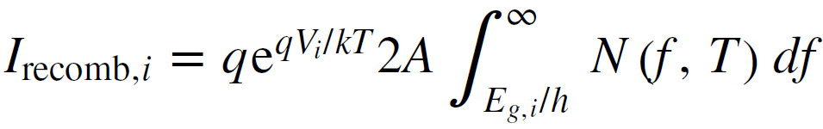
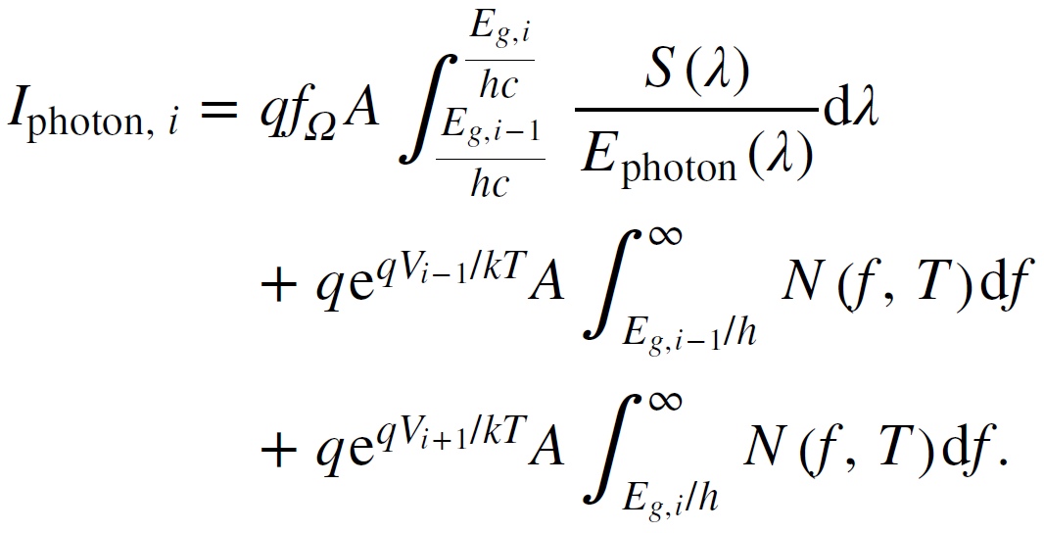
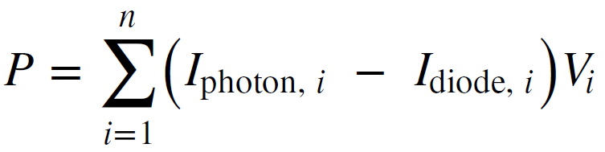
Extension to multiple layers, “i” = “i^{th} layer”
(top layer: i=1)
Not zero, because photons are absorbed by upper layers
Radiative recombination from layer just above
Radiative recombination from layer just below
I_{recomb, i}
Maximize P w.r.t. all of the V_{i}’s
(coupled nonlinear eqns, initialize by solving uncoupled case)
Then compare P_{max} to total solar energy to define the efficiency
General method of: De Vos, J Phys D (1980)

Slide 26
Maximizing Power, Independent Cells
Black line: solar spectrum
Or PbS?
eff = 38%, w/o 1.1 eV layer
eff = 51%, with 1.1 eV layer

Slide 27
Maximizing Power, Current Matched
eff = 42%, with 1.1 eV layer
V_{tot} = 5.5 V

Slide 28
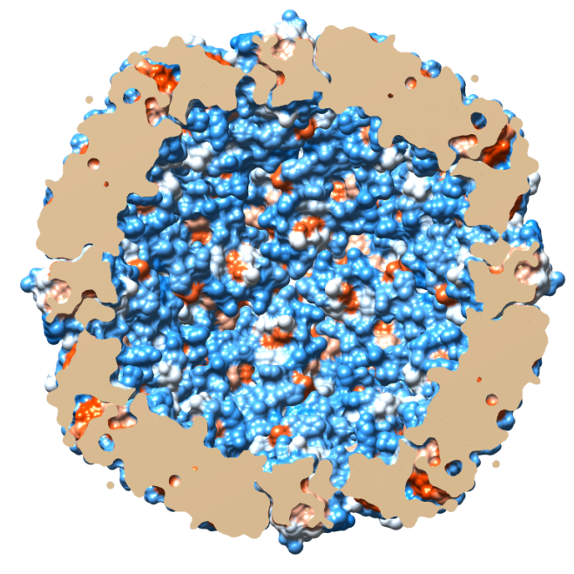
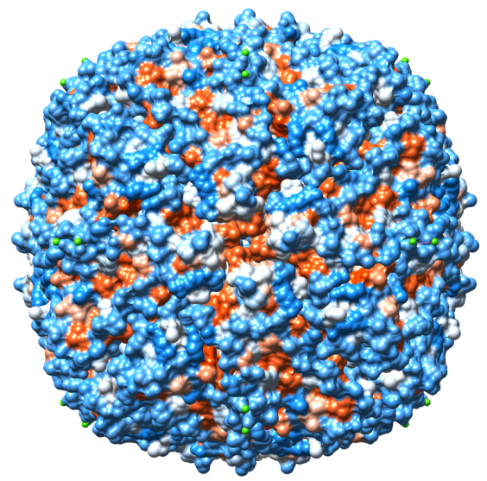

Can we get the electrons out of the ferritin?
Gold nanoparticle formation
hv
Au^{III}
Au⁰
Au
e⁻
Metal oxide
core
e⁻
Citrate
Citrate_{ox}
Notes:
Metal oxide reaction with light to form Au NP.
Note that the ferritin is colored based on the hydrophilic (blue) and hydrophobic (red) residues on the protein.
28

Slide 29
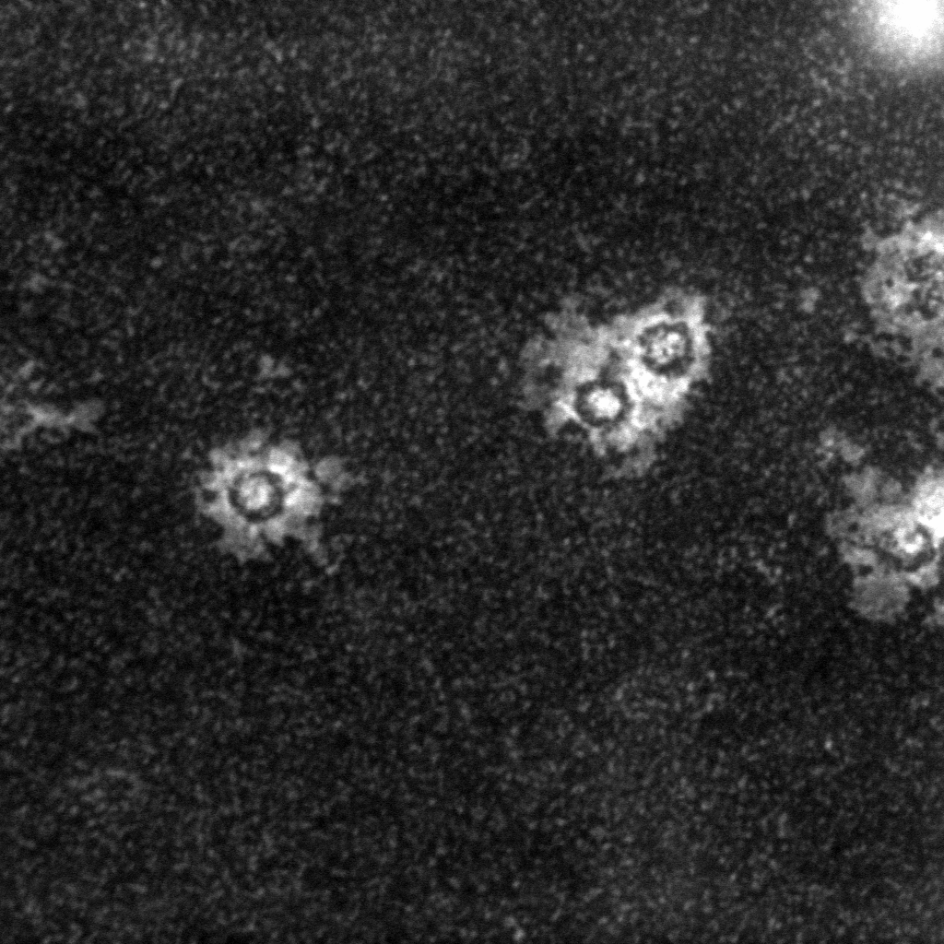
Ti(O)OH and Gold Nanoparticles
Ti(O)OH
nanoparticle core
Protein
shell
Gold nanoparticles
attached to surface
20 nm
TEM image

Slide 30
A little bit more synthesis: back to Mn
E_{g} goes down despite very small cores!

Slide 31
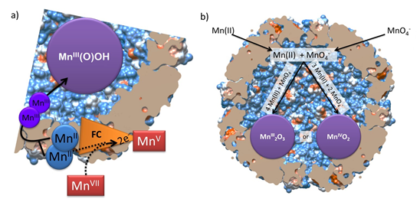
Manganese with permanganate
→ Also: permanganate only as a control (no iron, no Mn(II))
Notes:
Figs: (a) Scheme using the reaction given in Eqn. 1. Mn(II) binds at the ferroxidase center (FC) and is oxidized to Mn(III) by permanganate. After oxidation the Mn(III) ions migrate to the ferritin interior and become mineralized as a Mn(III) compound such as Mn(O)OH. The Mn(V) is either recycled or disproportionates and forms MnO₂. (b) Scheme for the reactions given in Eqs. 2 and 3. Manganese and permanganate first enter ferritin and then undergo a comproportionation reaction to form either a Mn(IV) or Mn(III) mineral.

Slide 32
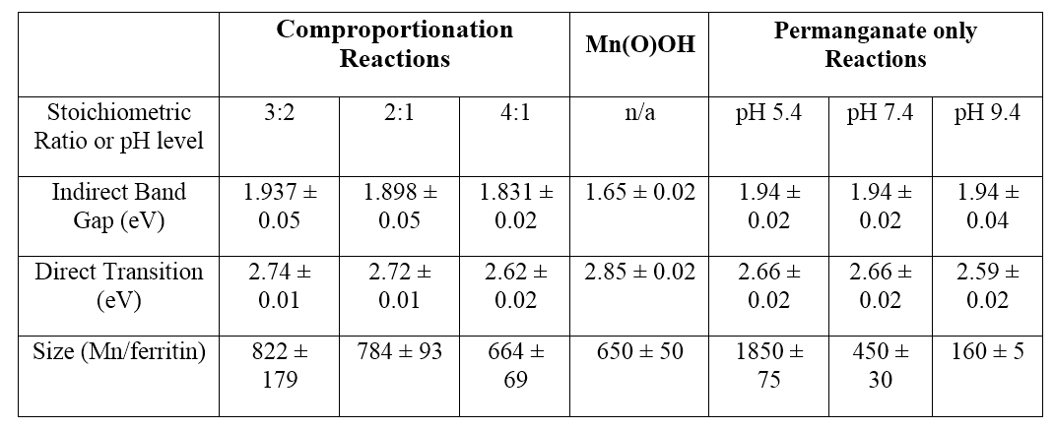
Manganese with permanganate
Results: success!
Mn(II):Mn(VII)
Most
permanganate
Least
permanganate

Slide 33
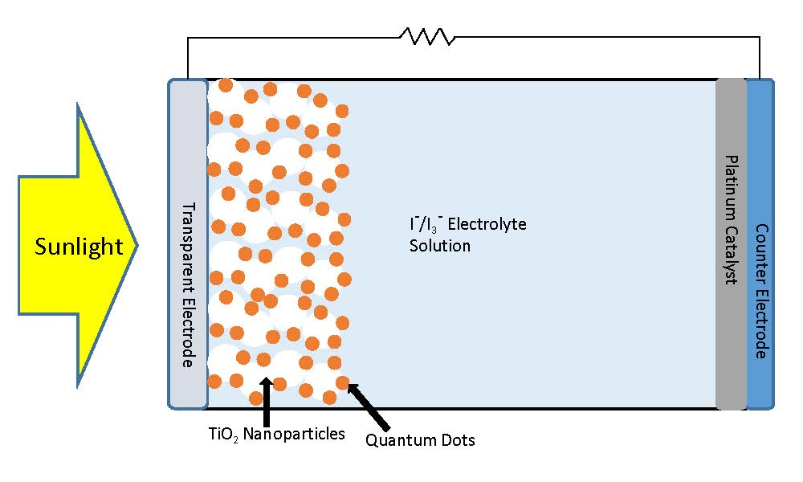
Solar cell prototypes
Model: Dye sensitized solar cell (DSSC) / quantum dot solar cell
Electron flow
Electron flow to QDs (changing
I₃⁻ to I⁻)
Electron flow to I⁻, (creating I₃⁻)

Slide 34
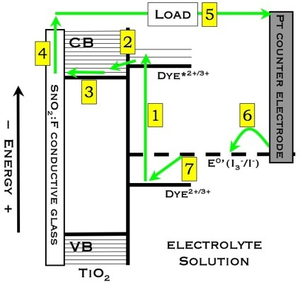
QDSC band diagram
Image: Jordan Katz
https://www.ocf.berkeley.edu/~jordank/Jordan_Katz/Research.html
Notes:
34

Slide 35
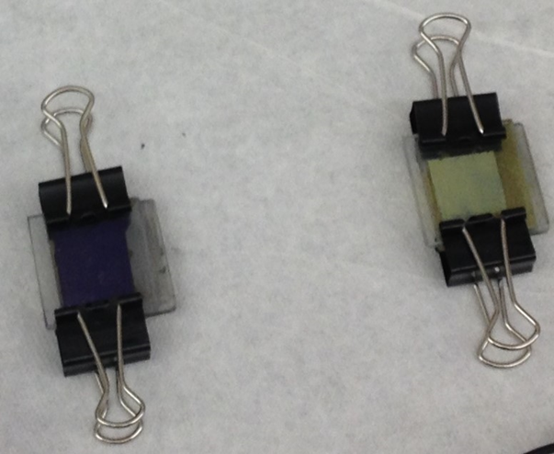
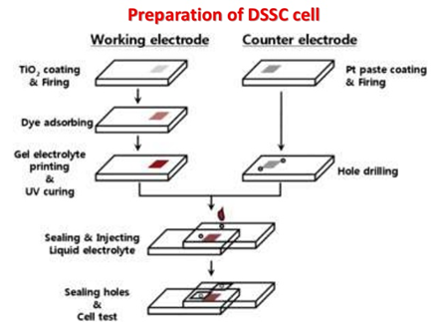
Fabrication
TiO₂ preparation and deposition
Ferritin deposition
Counter electrode preparation
Assembling the cell and electrolyte injection

Slide 36
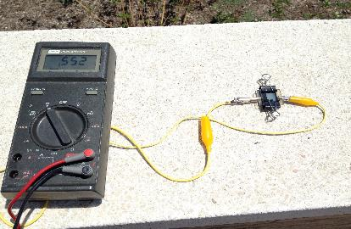
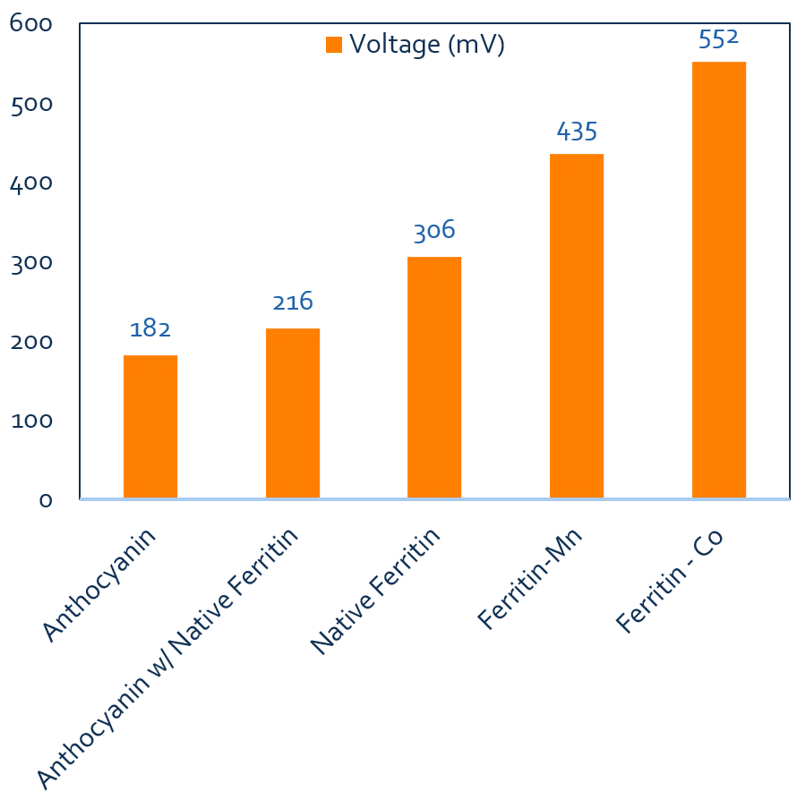
First Results
Open circuit voltage measurements of the different DSSCs fabricated.
Ferritin-Mn open circuit voltage measurement

Slide 37
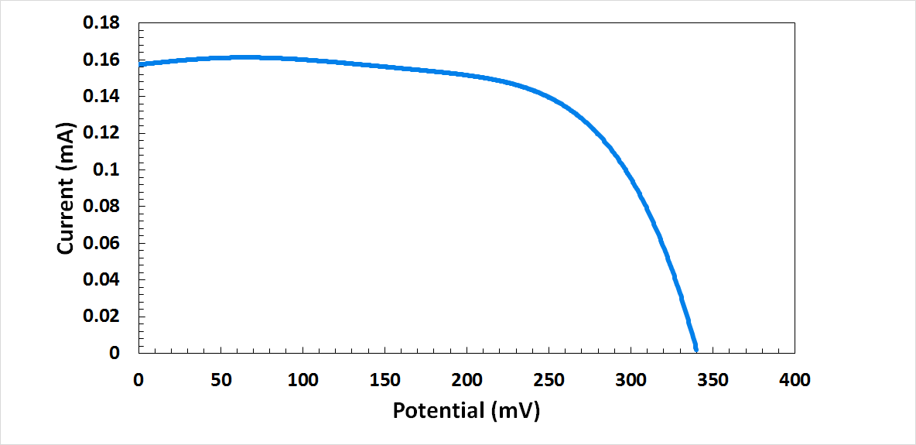
I-V curves
Optimal conditions
Native ferritin
(but efficiency low)
Issues: consistency, cracking, absorption, ferritin-TiO₂ transfer
Plans: pre-made cells, solar filter, genetically altered ferritin?

Slide 38
Conclusions
We’ve now got a large variety of ferritin-based nanoparticles
Multiple band gaps → Large theoretical efficiencies
Maybe we can make an efficient solar cell
Future work:
  More solar cell prototypes
  PbS nanocrystals
  Platinum nanoparticles? → Hydrogen gas
  Ferritin particles as catalysts, esp. reducing oxygen in fuel cells
Refs:
Colton et al., Nanotechn 25, 135703 (2014)
Smith et al., J Mater Chem A 2, 20782 (2014)
Erickson et al., Nanotechn 26, 015703 (2015)
Olsen et al., to be submitted soon
Perego et al., still in progress

