Slide 1
The physics of musical scales: theory and experiment
John Colton and
Dallin Durfee
Brigham Young University
February 24, 2016

Slide 2
Physics drives guitar players crazy!
It irritated some very famous people, like
Pythagoras of Samos (570–495 BC),
Ching Fang (78–37 BC),
Claudius Ptolemy (90–168),
Christiaan Huygens (1629–1695),
Isaac Newton (1643–1727),
Johann Sebastian Bach (1685–1750),
Leonhard Euler (1707–1783),
Jean le Rond d'Alembert (1717–1783),
Hermann von Helmholtz (1821–1894).

Slide 3
Harmonics
$$f_{1}=\frac{v}{2L}$$
$$f_{2}=2f_{1}$$
$$f_{3}=3f_{1}=\frac{3}{2}f_{2}$$
$$f_{4}=4f_{1}$$

Slide 4
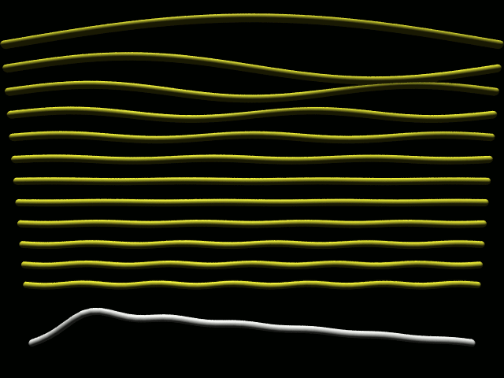

Slide 5
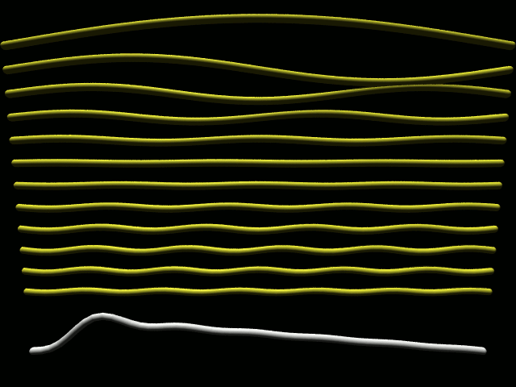

Slide 6
Viewing Harmonics with Spectrum Lab

Slide 7
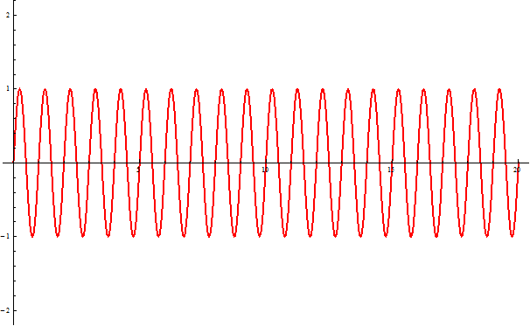
Beats

Slide 8
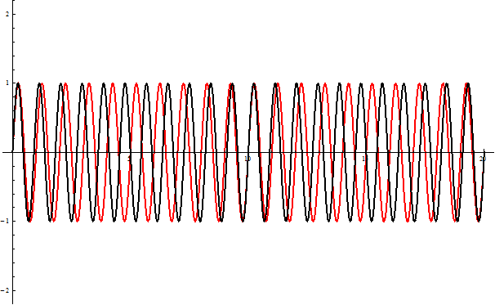
Beats

Slide 9
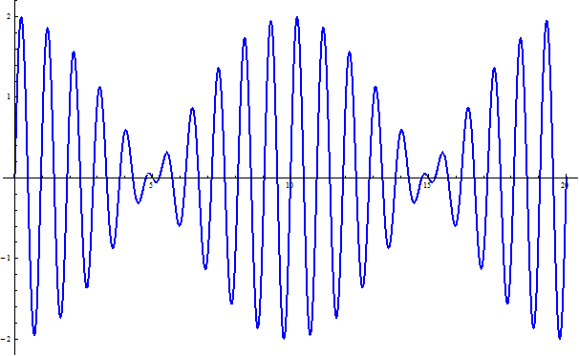
Beats

Slide 10
Hearing Beats
440 Hz
442 Hz
550 Hz

Slide 11
Some definitions
Pitch – which note you play
The first harmonic
Tone – how the note sounds
All of the harmonics
Interval (octave, fifth, fourth, etc.)
Spacing (ratio) between notes
Chord
Multiple notes played together

Slide 12
Keyboard layout
B♭
C
E
G
B
C-sharp/D-flat
D
F
A
C
C to C is an “octave”, factor of 2 in freq.
“Equal temperament”: each half-step is 1/12 of total octave (2^{1/12})
Piano: high B♭ is 13 half-steps from ref. A,
f = 440 Hz × 2^{13/12} = 932.33 Hz
Trumpet: high B♭ is 7th harmonic of low C,
f = 130.81 Hz × 7 = 915.69 Hz

Slide 13
How to describe differences in notes
→ Use RATIOS rather than differences
Octave: 1200 cents
Half-step: 100 cents
Fifth (e.g. C to G): 7 half steps = 700 cents
Fourth (e.g. C to F): 5 half steps = 500 cents
B♭_{piano} vs. B♭_{trumpet}? 31.17 cents

Slide 14
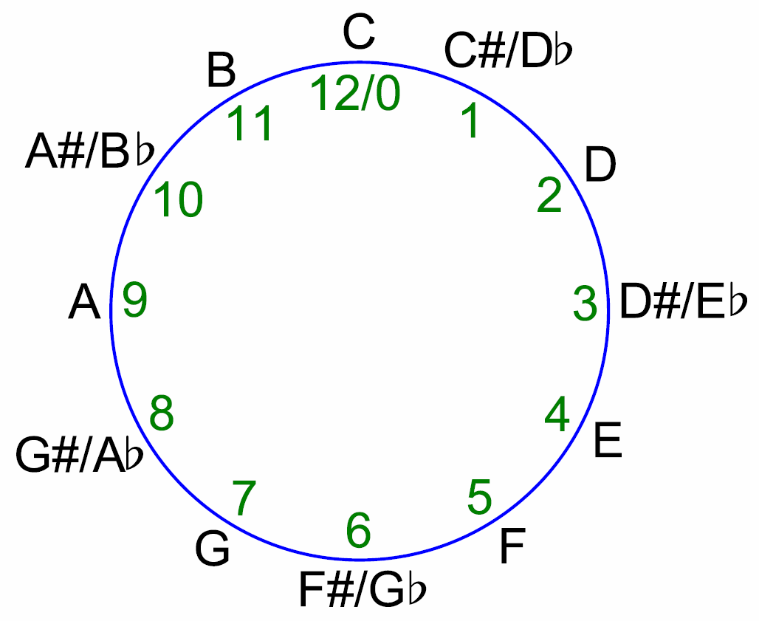
Chromatic scale
What is a scale?
Cyclical nature: like a clock! (Or “mod 12”)

Slide 15
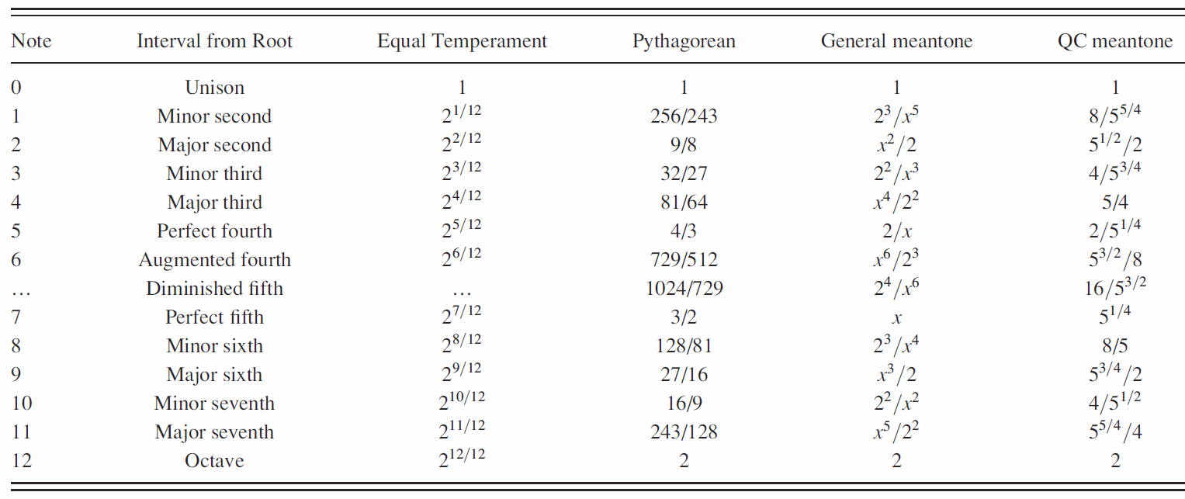
What we mean by a “scale”

Slide 16
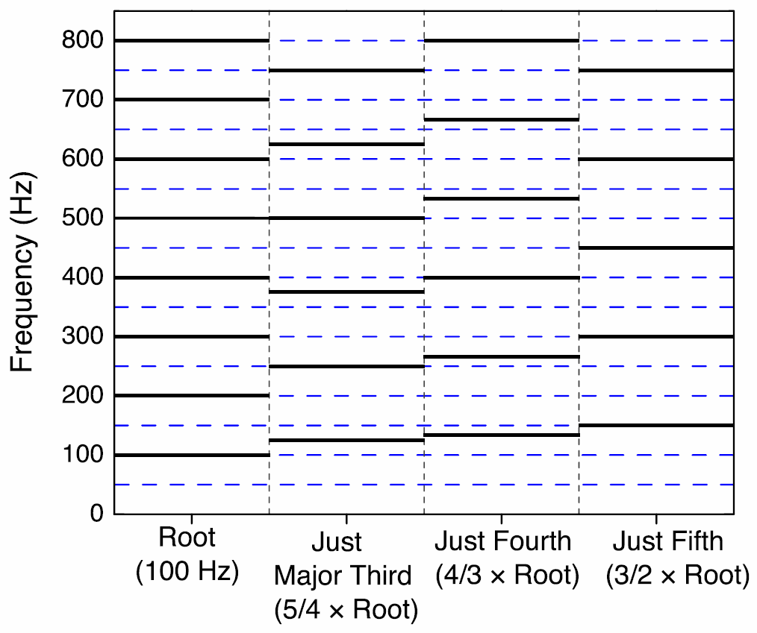
“Just” intervals
Compare to Equal Temperament
How overtones (harmonics) line up in chords:
Octave: 2/1
Just fifth: 3/2
Just fourth: 4/3
Just major third: 5/4
2^{12/12} = 2
2^{7/12} = 1.498
2^{5/12} = 1.335
2^{4/12} = 1.260
Aside: this is why a cappella singers generally tend to go flat! (My theory, anyway)

Slide 17
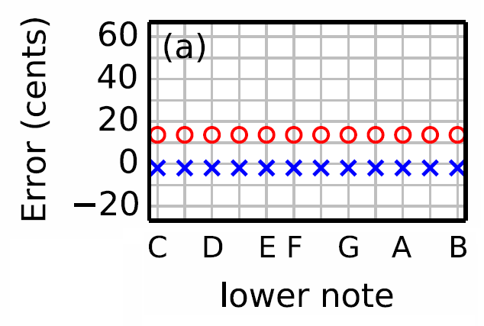
How far is equal temperament from just?
= error of major 3rds (e.g. C to E or D to F#)
× = error of 5ths (e.g. C to G or D to A)

Slide 18
Demonstrations
C
“Just E” (4/3 ratio higher than C)
“Eq Temp E” (2^{4/12} higher than C)
C + Just E
C + EqTemp E

Slide 19
Other scales…
Pythagoras (570-495 BC)
Start with a note, e.g. C
Then go up in just fifths (and down by octaves) to define new notes:
C → G → D → A → E → B → F#
And go down in just fifths (and up by octaves) to define more new notes:
C → F → B♭ → E♭ → A♭ → D♭ → G♭
×3/2
÷3/2

Slide 20
Table of scales, revisited
×(3/2)² (then down 1 octave)
×(3/2)⁶ (then down 3 octaves)
÷(3/2)⁶ (then up 4 octaves)
Pythagorean “comma” = 23.46 cents

Slide 21
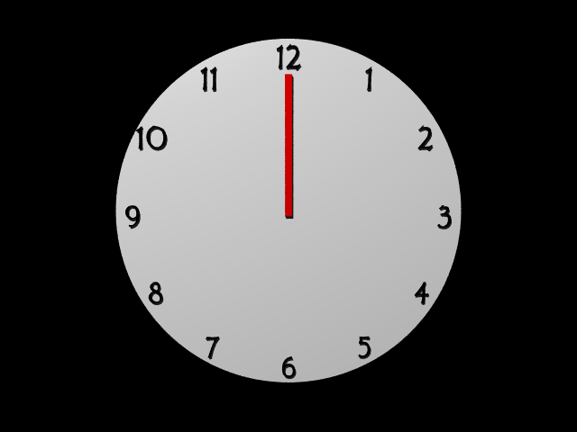
The rotations are not 210°! (They are 210.237°)

Slide 22
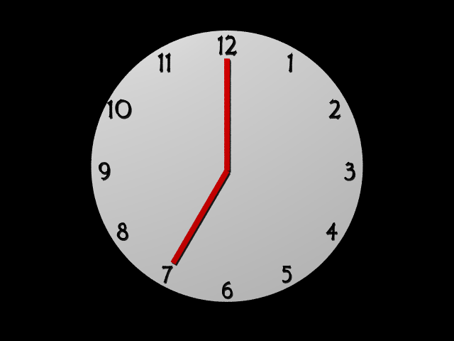
The rotations are not 210°! (They are 210.237°)

Slide 23
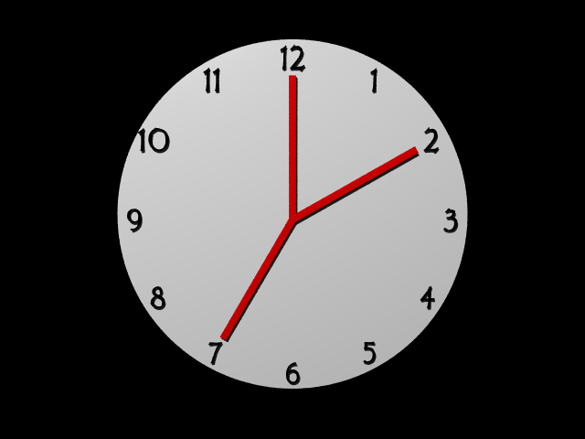
The rotations are not 210°! (They are 210.237°)

Slide 24
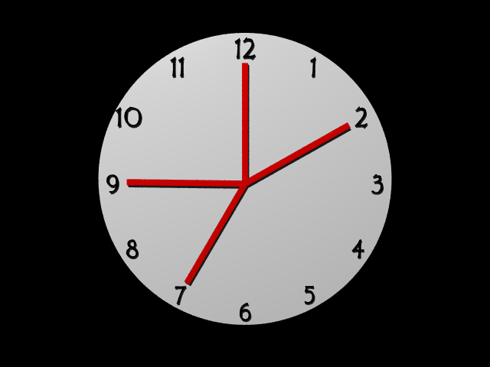
The rotations are not 210°! (They are 210.237°)

Slide 25
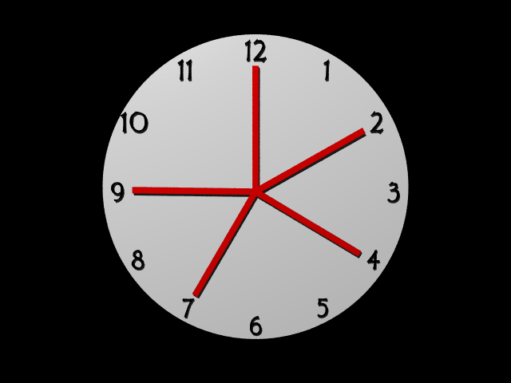
The rotations are not 210°! (They are 210.237°)

Slide 26
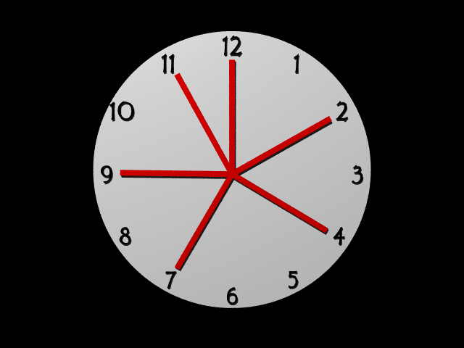
The rotations are not 210°! (They are 210.237°)

Slide 27
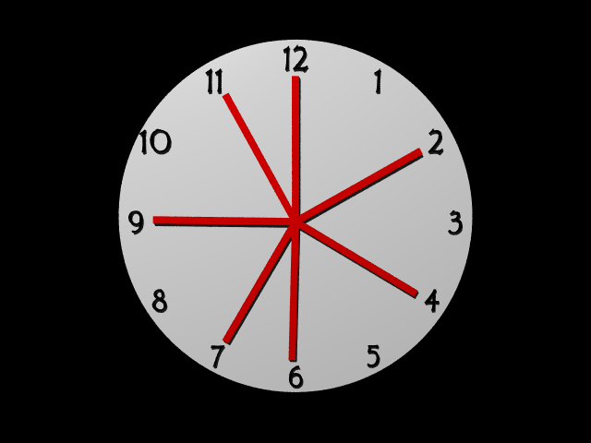
The rotations are not 210°! (They are 210.237°)

Slide 28
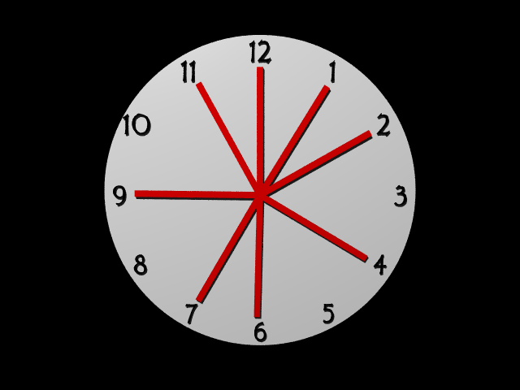
The rotations are not 210°! (They are 210.237°)

Slide 29
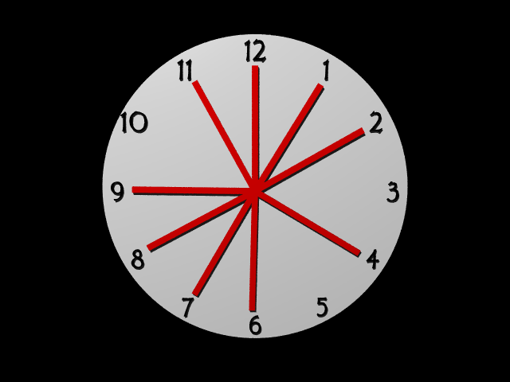
The rotations are not 210°! (They are 210.237°)

Slide 30
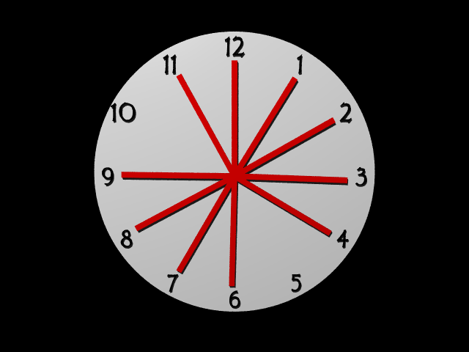
The rotations are not 210°! (They are 210.237°)

Slide 31
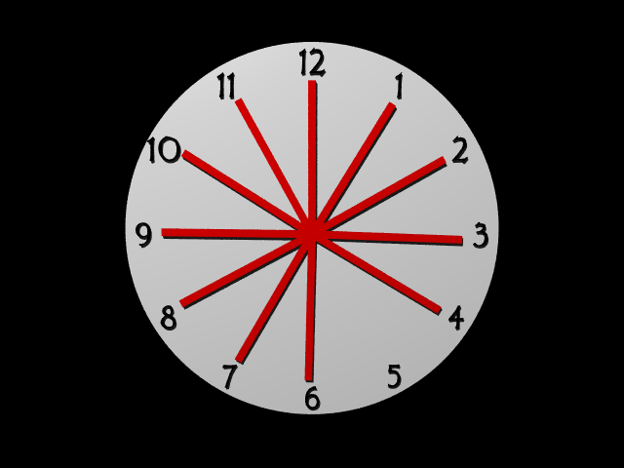
The rotations are not 210°! (They are 210.237°)

Slide 32
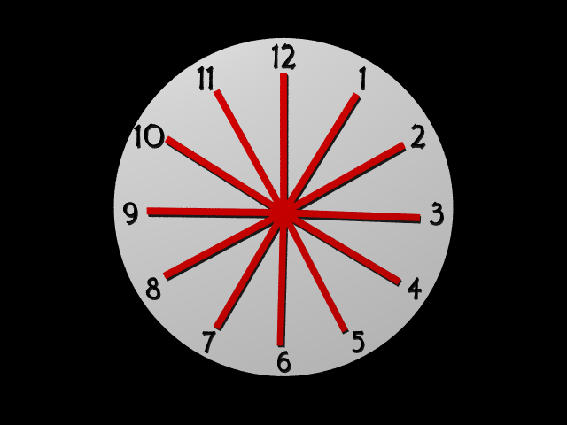
The rotations are not 210°! (They are 210.237°)

Slide 33
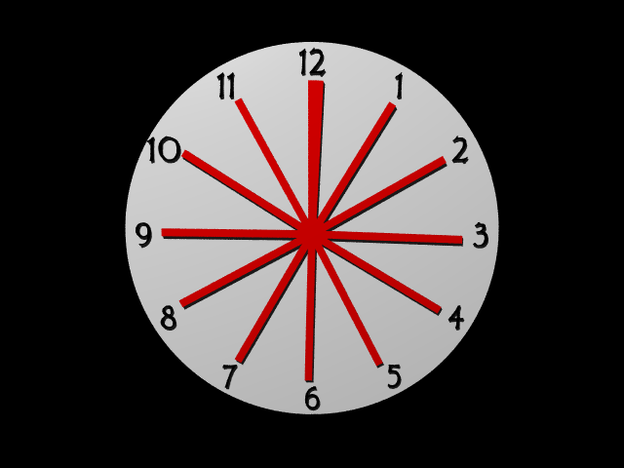
The rotations are not 210°! (They are 210.237°)

Slide 34
Another way of saying it:
(3/2)¹² = 129.75
2⁷ = 128
Just fifths do not “close the octave”

Slide 35
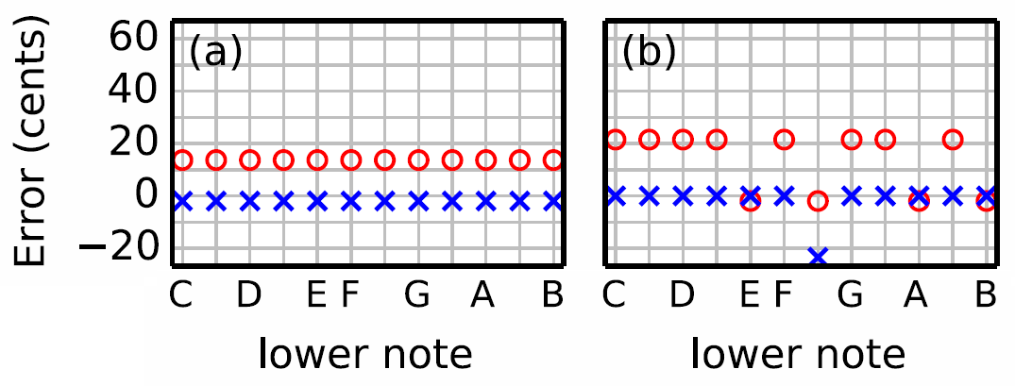
Equal Temp. vs. Pythagorean
“wolf thirds”
“wolf fifth”
= error of major 3rds (e.g. C to E or D to F#)
× = error of 5ths (e.g. C to G or D to A)

Slide 36
“Quarter comma meantone”
Early 1500s
Start with a just third, e.g. C-E
Define the fifth to be ¼ of that, i.e. so that
C ↔ G ↔ D ↔ A ↔ E (=5/4 × C)
Then go up & down in tempered 5ths from E and C to define the rest of the notes:
E → B → F# → C# → G#
C → F → B♭ → E♭ → A♭
×1.495…
r⁴/4 = 5/4
r = 1.49535…
×1.495…
÷1.495…
Mismatch of 21.5 cents,
“syntonic comma”

Slide 37
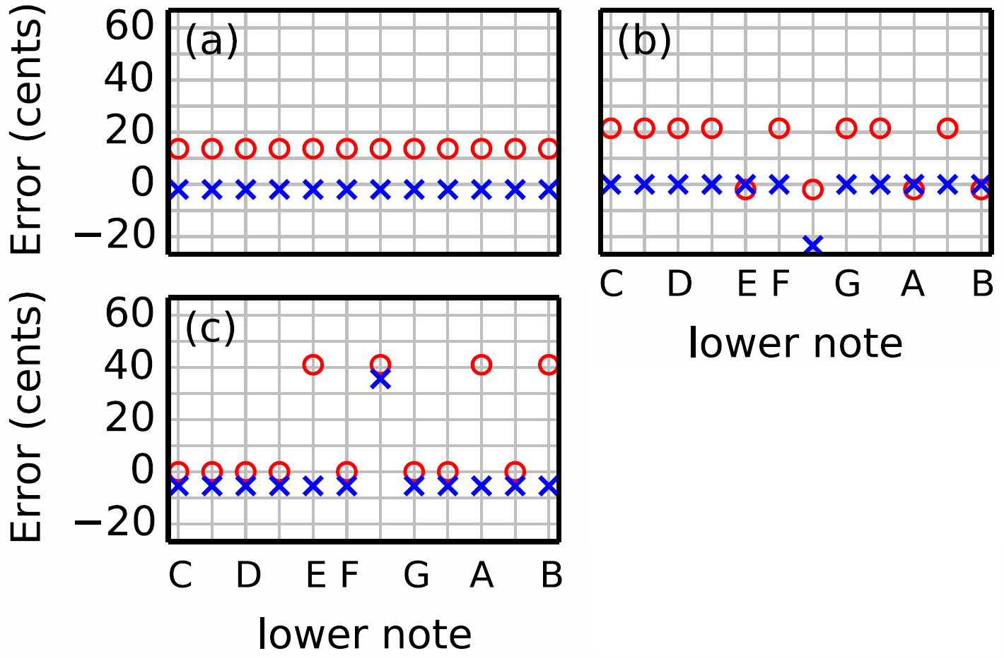
Equal temp.
Pythagorean
QC Meantone
“wolf thirds”
“wolf fifth”
= error of major 3rds (e.g. C to E or D to F#)
× = error of 5ths (e.g. C to G or D to A)

Slide 38
Generic Meantone
Quarter comma, alternate: start with D, then tune up and down like Pythogorean, but with tempered fifths (1.4954…).
Generic: define a starting note, define a “fifth”, tune up and down in fifths.
Note: Equal temperament can be thought of as meantone that uses the special fifth (2^{7/12}=1.4983…) which avoids all commas.
This gives a way for smoothly transitioning between e.g. QC meantone and equal temperament.

Slide 39
Equal temp.
Pythagorean
QC Meantone
= error of major 3rds (e.g. C to E or D to F#)
× = error of 5ths (e.g. C to G or D to A)

Slide 40
Which tuning method is best?
It depends!
But why do keyboards pretty much always use Equal Temperament today?
Summary: It’s all about avoiding dissonance, making intervals sound pleasant together
And consonance is all about just intervals
And just intervals are all about beating! Physics!!

Slide 41
Temperament Studio
Just and unjust fifths
Just and unjust major thirds
Wolf tones
Moving chords chromatically
Easter Eggs

Slide 42
If I play a perfect fifth on an organ tuned to equal temperament, and the lower note is an A with a frequency of 220 Hz, what will the dominant beat rate be?
F_{A} = 220 Hz
F_{E} = 2^{7/12} 220 Hz = 329.628 Hz
220 Hz
440 Hz
660 Hz
880 Hz
329.628 Hz
659.255 Hz
988.883 Hz
1318.510 Hz
660-659.255 = 0.745

Slide 43
Listening to Bach
What did Bach sound like to Bach?
What would more chromatic music sound like on an organ from Bach’s era?

Slide 44
Ways to Tune a Guitar
Electronic tuners are the “final word.”
So we can stop “fretting” about tuning (groan).
So let’s upset that equilibrium . . .

Slide 45
The ideal guitar tuner

Slide 46
What’s the best thing to optimize?
Least squares?
Limit size of largest beat?
Emphasize beating in root chord?
De-emphasize in IV chord?

Slide 47
URLs
Download Temperament Studio, link to very accessible paper, links to videos: http://www.physics.byu.edu/faculty/durfee/TemperamentStudio/
Spectrum Lab http://www.qsl.net/dl4yhf/spectra1tml

