Slide 1
Optically-measured electron spin lifetimes and spin relaxation in GaAs and SiC
John S. Colton
Physics Department
Brigham Young University, Provo, Utah
Samples from
U.S. Naval Research Lab:
Allan Bracker
Sam Carter
Thanks also to (NRL):
Bradley Weaver
Evan Glaser
Student researchers:
Ken Clark
Daniel Craft
Jane Cutler
David Meyer
Tyler Park
Phil White
Scott Crossen
Jacob Embley
Michael Meehan
Kyle Miller
Margaret Morris
EMN Meeting: Quantum Comm. & Quantum Imaging, Berlin, Aug 2016

Slide 2
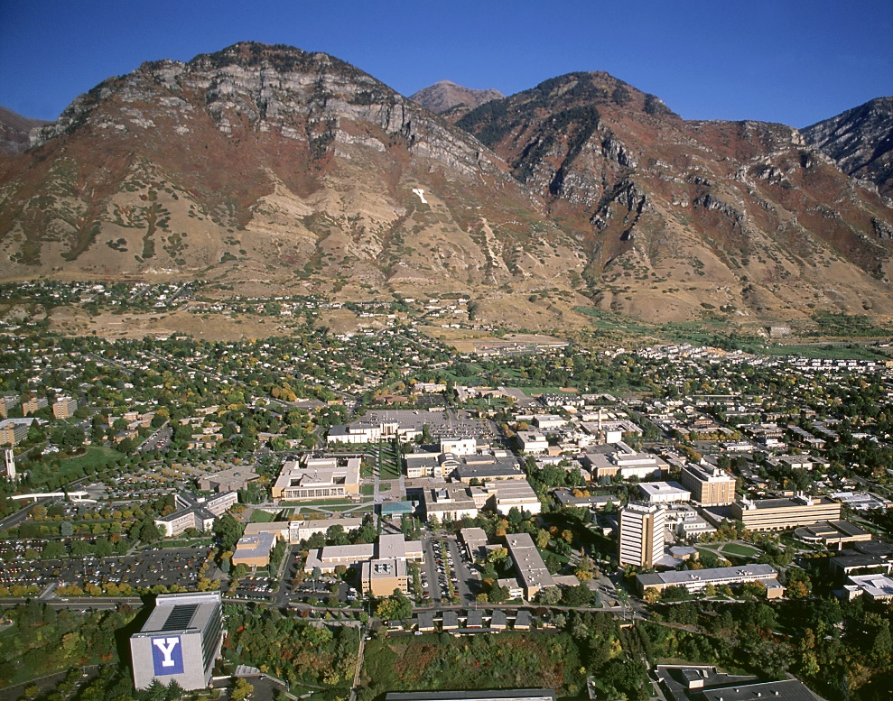
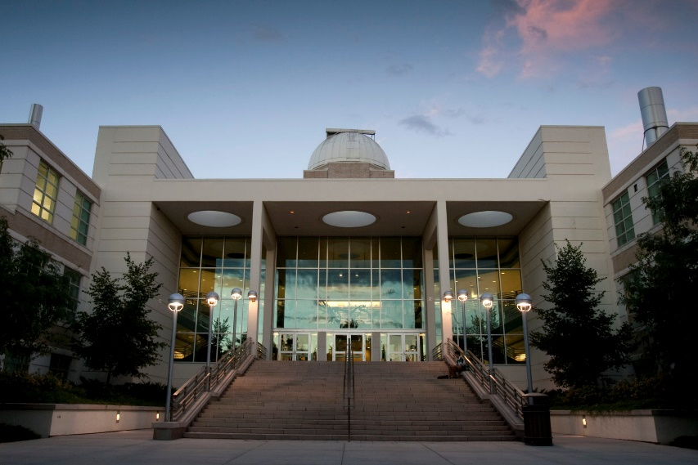
Brigham Young University, Provo, Utah
Church sponsored (Church of Jesus-Christ of Latter-day Saints, Mormon)
30000 students (27000 undergrad, 3000 graduate)
70% of students speak a second language (many from church missions)
Physics: 30 faculty, 400 undergrads, 30 grads
  Consistently top 5 in U.S. for size & placement in physics grad schools

Slide 3
Very Brief Outline
Introduction
GaAs
  Bulk
  Quantum wells
SiC vacancy defect
Conclusions

Slide 4
Quantum computing via spin (1998)
“DiVincenzo Criteria”
Scalable physical system with well-defined qubits
Preparable in |000...> state
Able to do many operations (~10⁴) before decoherence
Universal set of gate operations
Accurate single qubit measurements
http://www.research.ibm.com/ss_computing/
Optics!

Slide 5
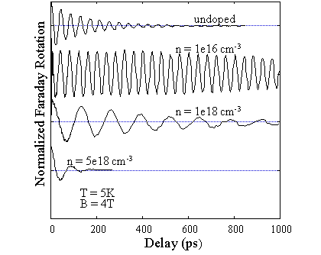
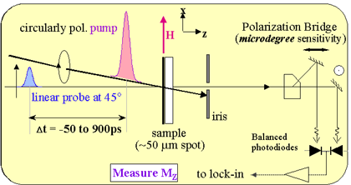
Time Resolved Faraday (or Kerr) Rotation (1998)
Awschalom group (UCSB, now Chicago)
Bulk GaAs
http://ime.uchicago.edu/awschalomlab/research/

Slide 6
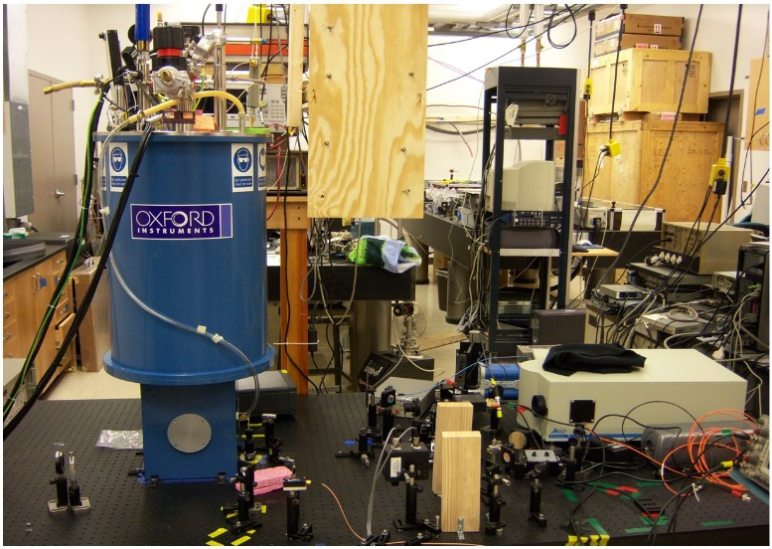
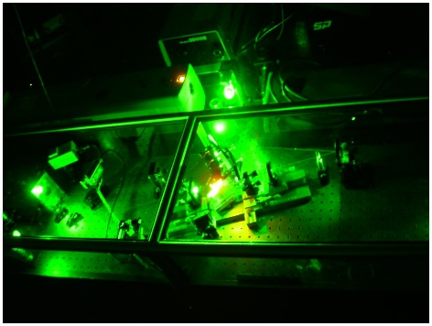
Optics to measure spin lifetimes
Initialize (polarize)
  Laser pump
  Thermal (low T, large B)
Depolarize
  Wait
  Microwave resonance
    Possibly repolarize via microwave pulses
Detect – laser probe
  Faraday/Kerr effect (rotation of linear polarization)
  Photolumimescence: degree of circular polarization
  PL intensity

Slide 7
Time-resolved Faraday (Kerr) rotation
Initialize (polarize)
  Laser pump
  Thermal (low T, large B)
Depolarize
  Wait
  Microwave resonance
    Possibly repolarize via microwave pulses
Detect – laser probe
  Faraday/Kerr effect (rotation of linear polarization)
  Photoluminescence: degree of circular polarization
  PL intensity
Magnetic Field: parallel vs. transverse
(precession!)
Types of lifetimes: T₁ vs. T₂ vs. T₂*

Slide 8
Types of materials
Defects
  Donors in GaAs
  NV Center in diamond
  V_{Si} in SiC
Quantum dots
  Gated QDs
  Self-assembled QDs
  GaAs QWs
Other?

Slide 9
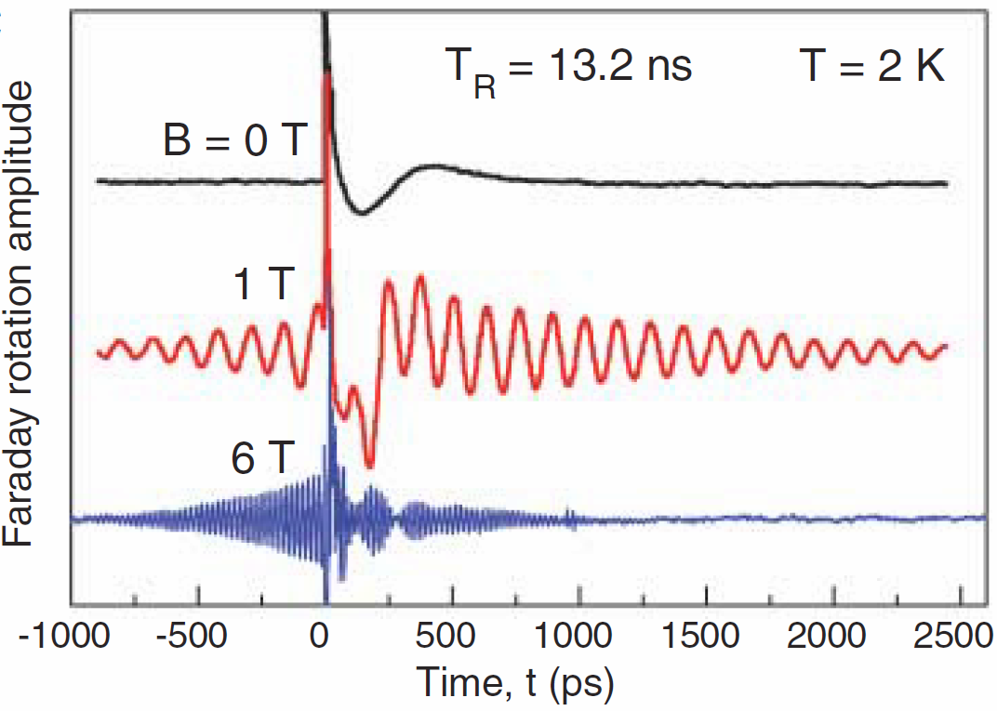
Importance of spin lifetimes
Materials characterization
Better understanding:
  Test existing theories
  Interesting new theories (e.g. Greilich et al., Mode locking in self-assembled QDs, 2006)

Slide 10
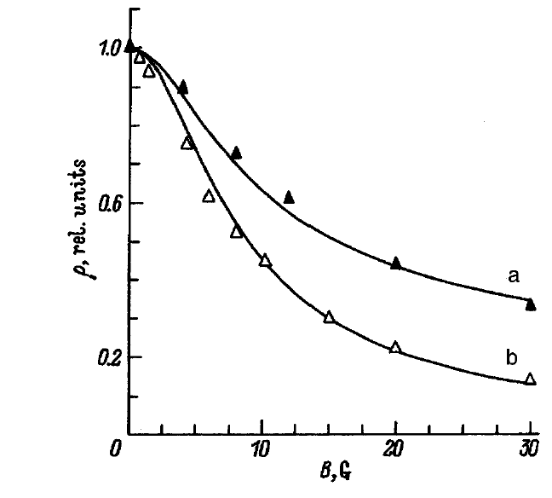
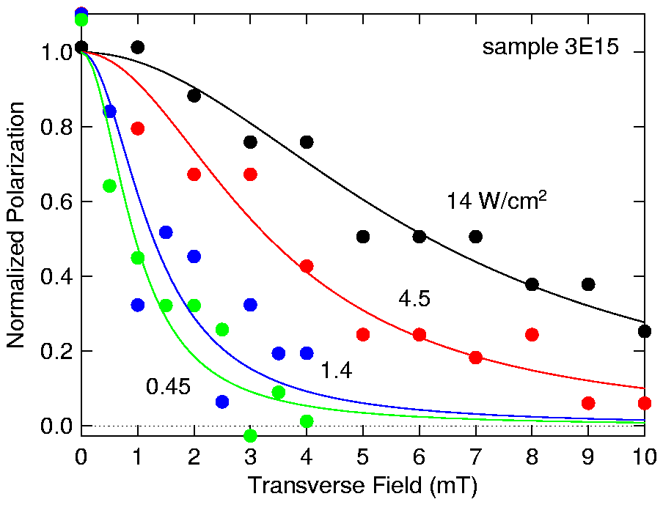
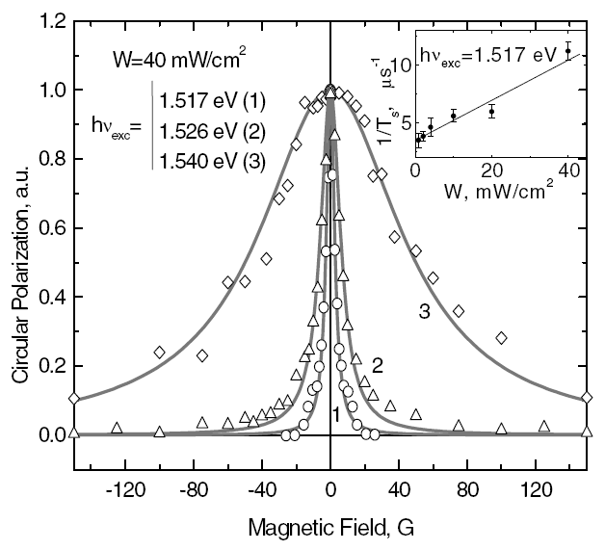
T₂* in Lightly Doped GaAs (2002)
Optical Orientation/PL Polar. Detection
Ioffe Institute
n = 1E15 cm⁻³
T₂* = 34 ns
Hanle Effect: Transverse Field
→ Lifetime from width
Phys Solid State 39, 1765 (1997)
T₂* = 26 ns
Nominally undoped
T₂* varies with Ε_{exc}
→ changing n
→ 5 - 300 ns
Phys Stat Sol (b) 233, 445 (2002)
Phys Rev Lett 88, 256801 (2002)

Slide 11
Using Optics: III-V Semiconductors
(Yu and Cardona)
CB
J_{z} = 1/2
L = 0
S = 1/2
→ J = 1/2
Spin Orbit Coupling: J = L + S
Optical selection rules for circular polarized light
hh
J_{z} = 3/2
L = 1
S = ½
→ J = 3/2
lh
so
J_{z} = 1/2
-1/2
+1/2
σ⁺
-3/2
-1/2
+1/2
+3/2
-1/2
+1/2
Spin Polarization ↔ Optical Polarization

Slide 12
Measuring T₁ (2003)
Why hadn’t it been done before?
  Too long!!
Idea:
Pulsed light

Slide 13
Data: n = 1×10⁻¹⁵ cm⁻³ sample (2007)
Some raw data
T₁ vs B for four temps
>20 μs (1.5K, 7T)
Beautiful exponential decays!
zoomed in
1E15 sample
Theory: T₁ decrease with B expected for QDs

Slide 14
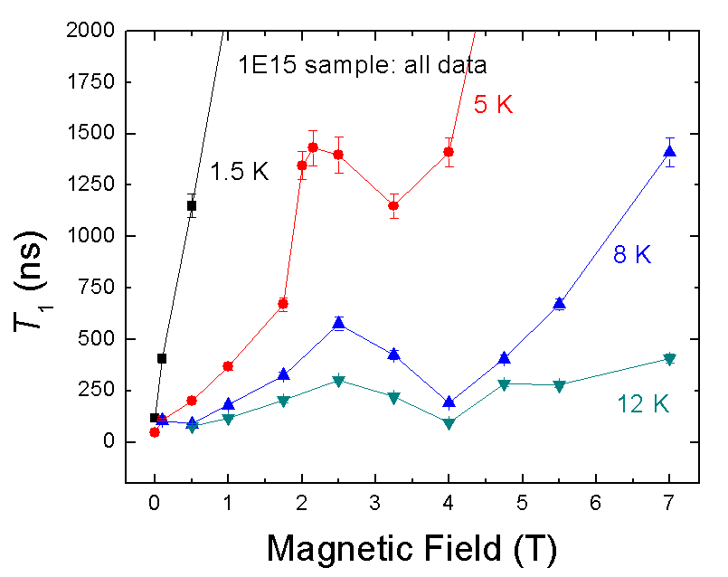
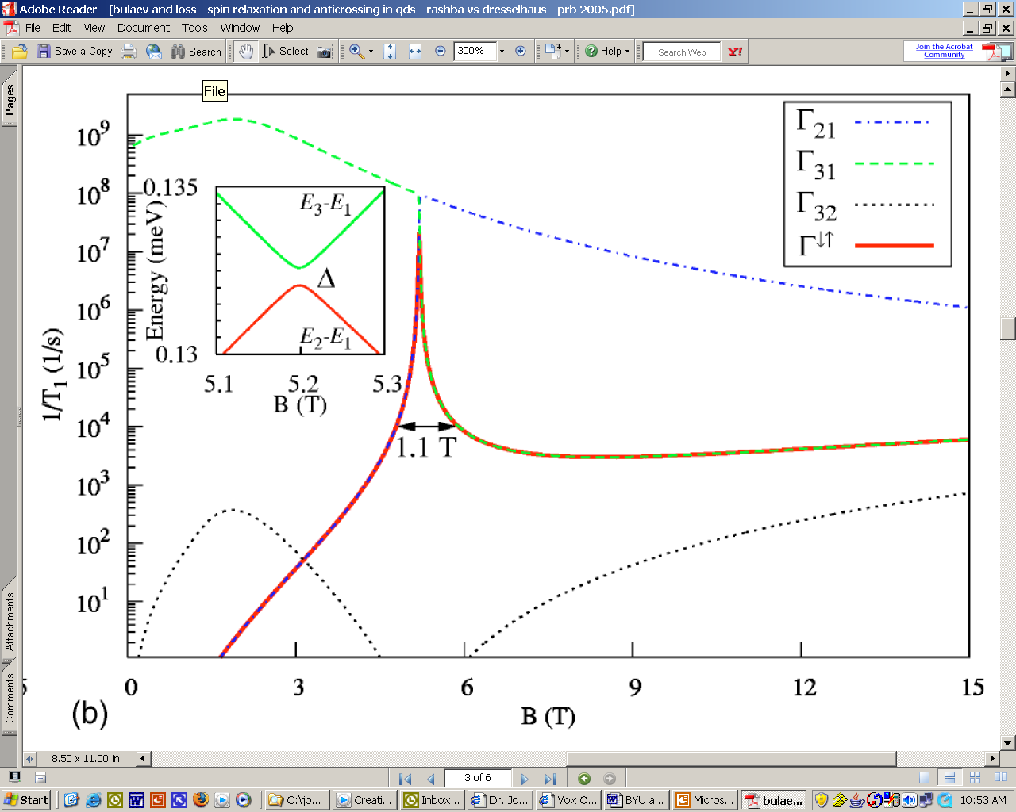
Quantum-dot-like behavior?
Our data
Rashba spin relaxation
Bulaev and Loss, PRB 71 205324 (2005)

Slide 15
Time-resolved Kerr rotation
(cw lasers, modulated)
n-GaAs Quantum Wells (2012)
2.8 nm well
4.2 nm well
AlGaAs barriers
6.2 nm well
8.4 nm well
14 nm well
GaAs substrate
Solid State Comm. 152, 410 (2012)

Slide 16
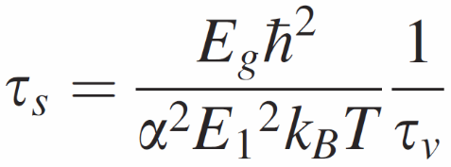
What do we expect?
Lack of bulk inversion symmetry → spin splitting of CB (“DP”)
D’yakonov and Kachorovskii (1986), QWs
Bastard & Ferreira (1992), ionized impurity
scattering
  τ_{s} = 2.5 ns for 15 nm well at 10 K
  perhaps 10-100 longer at 1.5 K
Bastard (1992), high fields (6-15 T)
  τ_{s} = 1-2 ns for 9 nm well, ~B^{1/2}
Terauchi et al (1999), 300 K, DK verified in part
Lau (2001, 2002), 100+ K
  matched experiments of Terauchi, and Kikkawa & Awschalom
  also T₂ ≈ T₁
Various T₂* measurements: a few ns in GaAs
  Longest lifetimes in any QWs: ~35 ns (II-VI)

Slide 17
n-Doped QWs: Selection Rules
hh and lh degeneracy lifted
Singlet trion:
e↑ + e↓ + h(either ↑ or ↓, either hh or lh)
Kerr rotation:

Slide 18
Wavelength Summary
Peak positions:
LH
HH

Slide 19
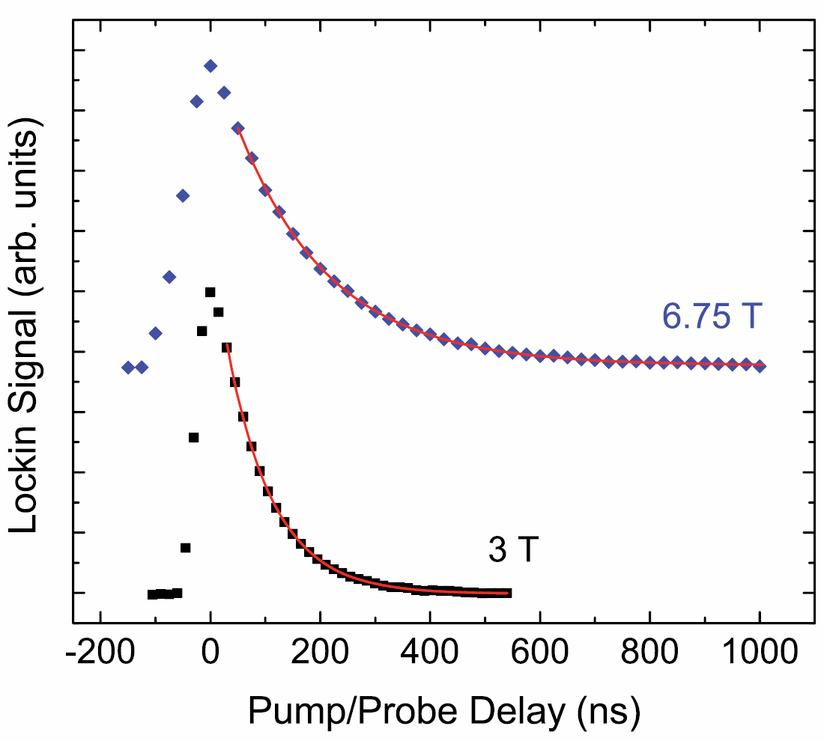
Quantum Well Spin Decays!
pump and probe overlapped
5 K
τ_{s} = 169 ns
τ_{s} = 85 ns

Slide 20
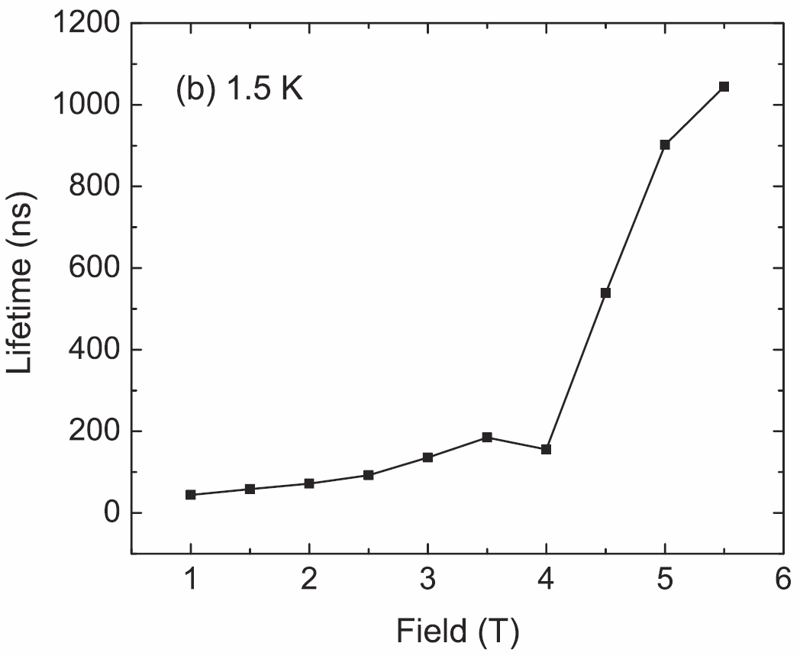
QW Spin Lifetimes, Summary
τ_{s} > 1000 ns!
Very long lifetimes!!
  Recall previous record was 35 ns (T₂*)
Lifetimes increase with B
  But not B^{1/2} dependence

Slide 21
Evidence of Two Spin Populations?
Compare: II-VI QWs
localized?
λ₁
“LHT”
λ₂
delocalized?
Zhukov et al, PRB 2007
(see also Hoffman et al, PRB 2006)
Localized vs. Delocalized

Slide 22
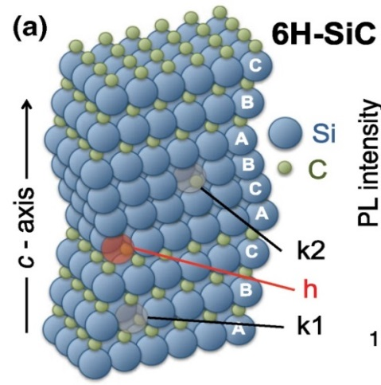
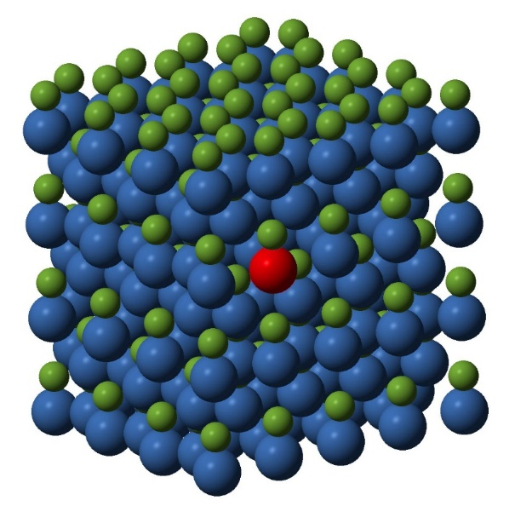
Defects in SiC (2016)
Similar to diamond NV center
  Group IV: no nuclear spins
Potential advantages over NV
  Fabrication
  Cost
  Wavelengths (IR vs. visible)
Spin-dependent deep defect states
  V_{si}
  Divacancies
  Antisite-vacancy pair
6H, 4H, and 3C polytypes
Irradiation: proton vs. electron
Riedel et al., PRL 109, 226402 (2012)
4H-SiC

Slide 23
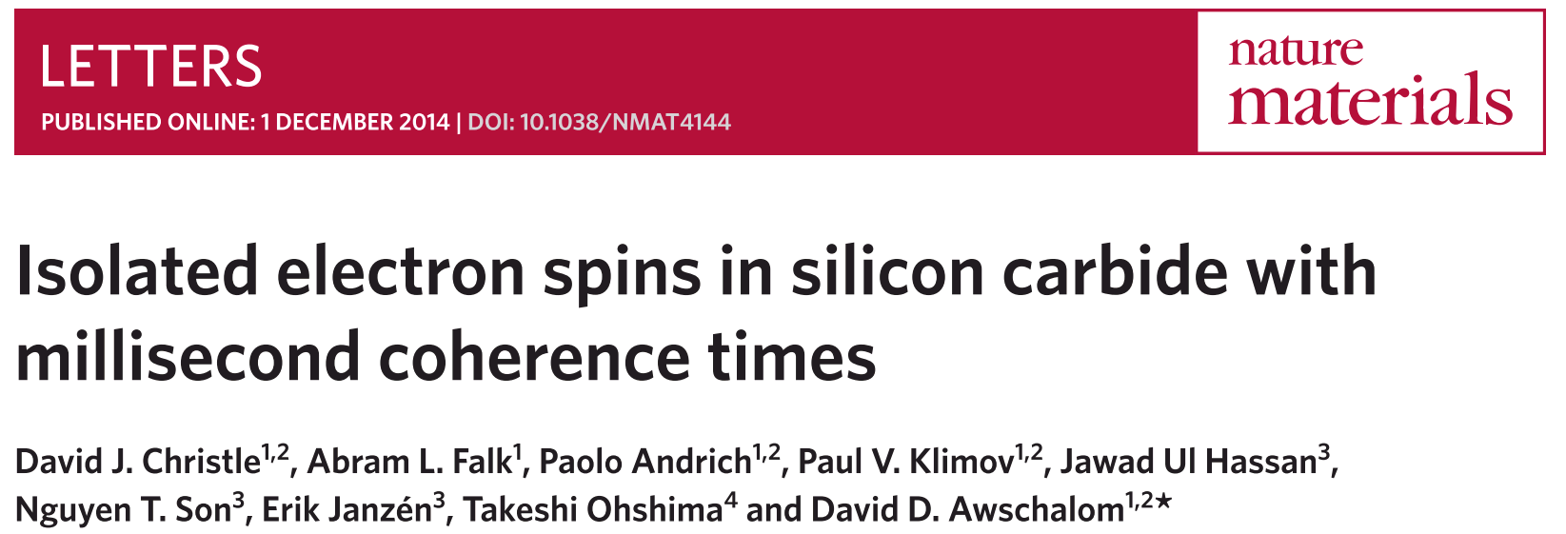
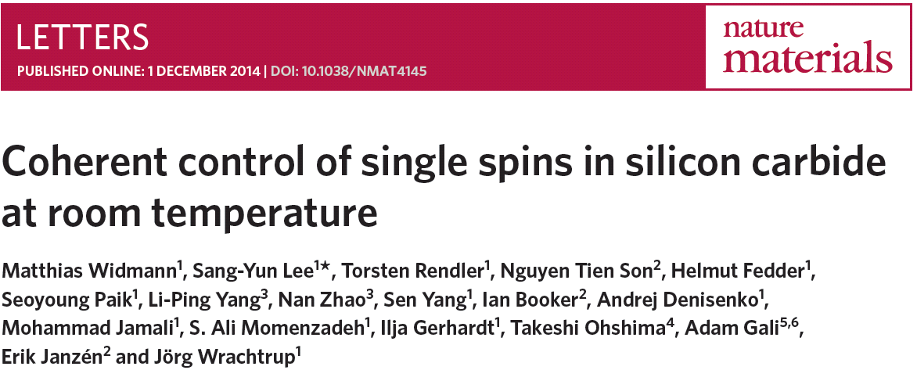
Silicon Vacancy Defects in SiC
  Divacancies
  20 K
  T₂ times of ~1 ms
  Silicon vacancies
  Room temperature
  T₂ times of ~160 µs

Slide 24
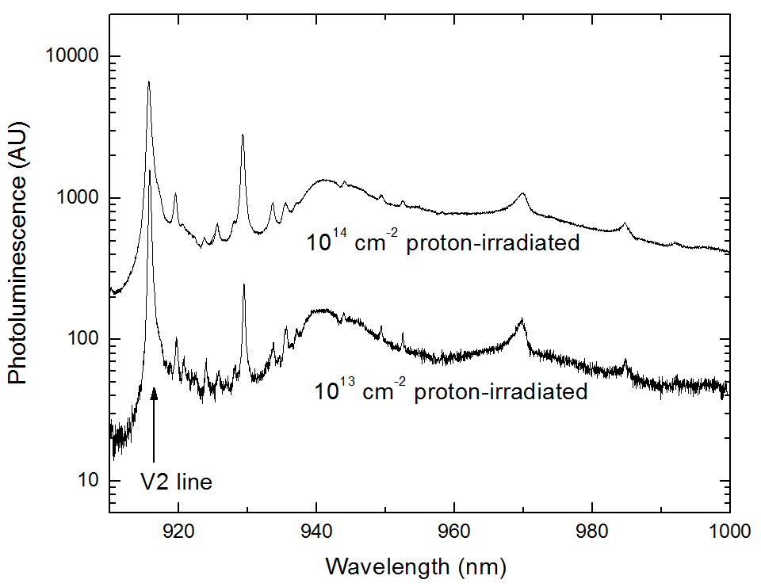
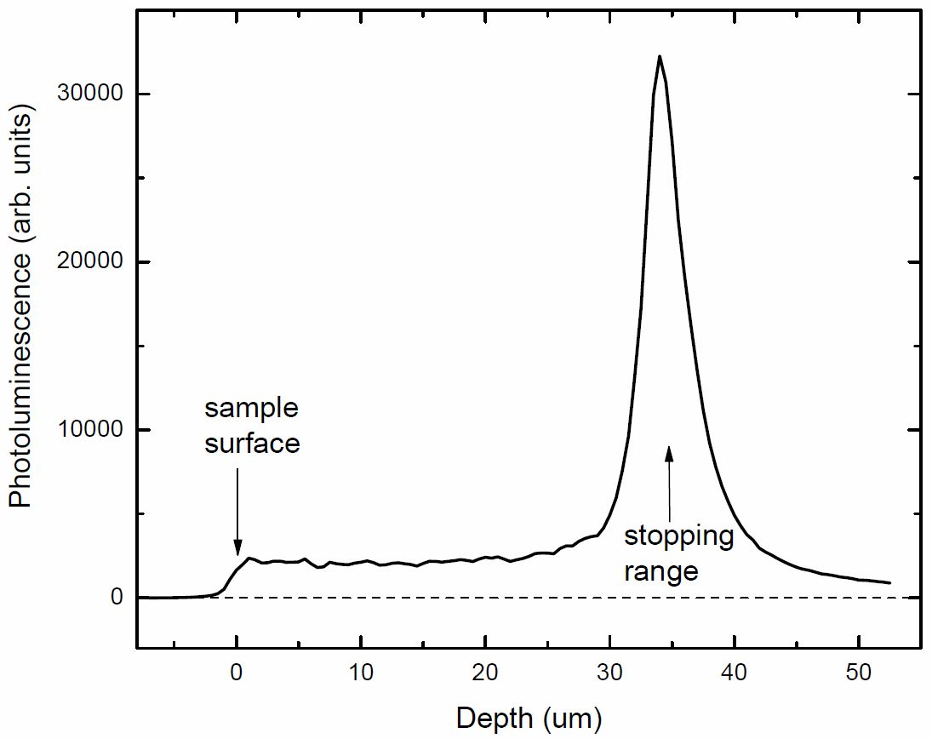
Photoluminescence:
Proton Irradiated Samples
6 K PL
Depth dependence

Slide 25
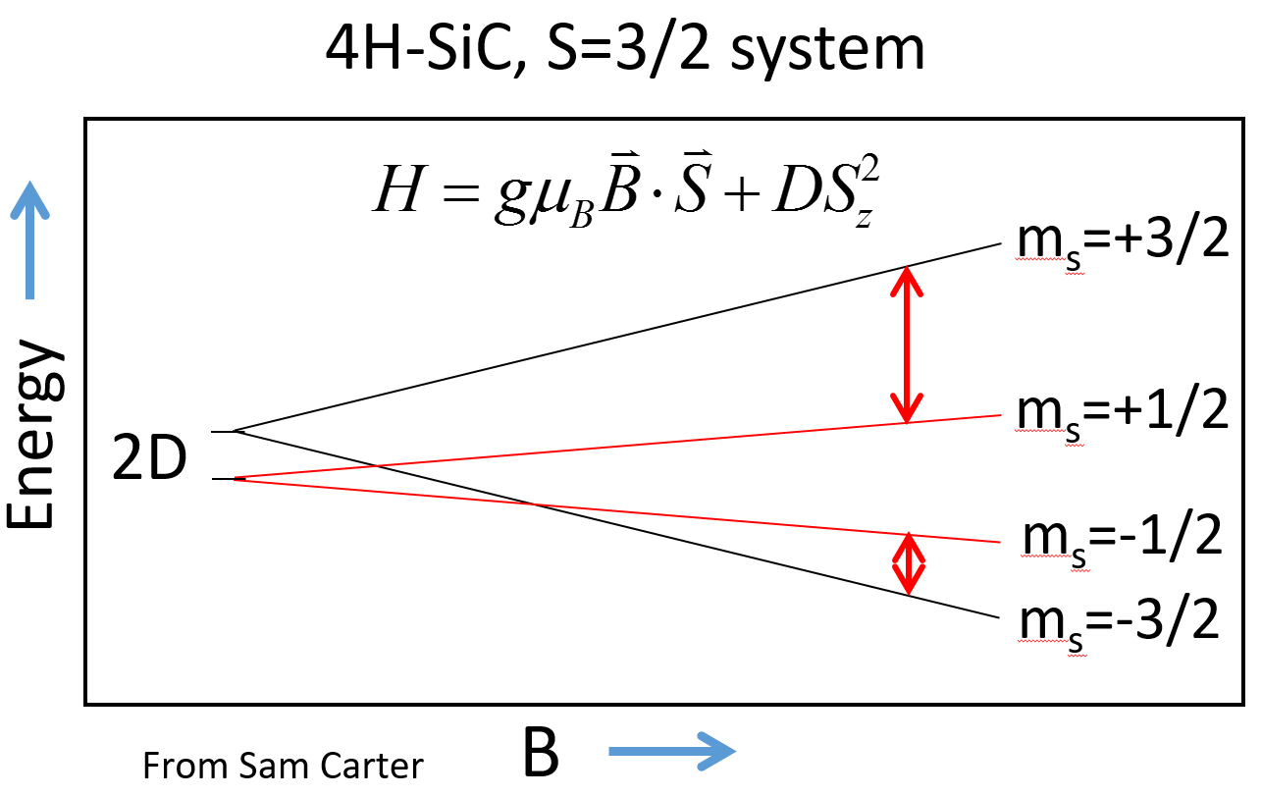
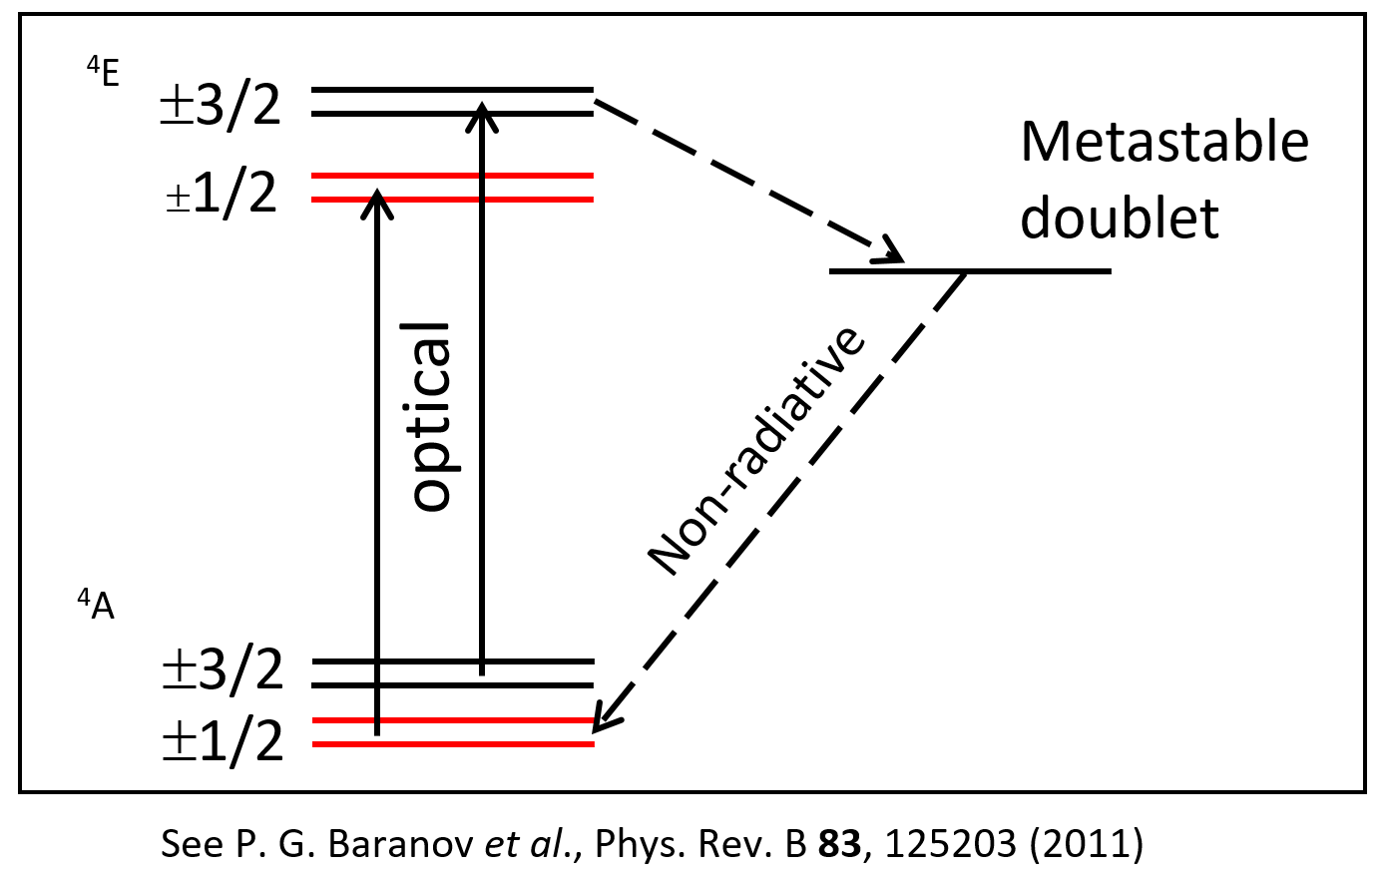
Spin Dependence
Laser promotes electrons to higher energies
Non-radiative transition causes the m_{s}=1/2 state to populate preferentially (and decreases photoluminescence)
Microwaves equalize spin populations, causing PL to increase

Slide 26
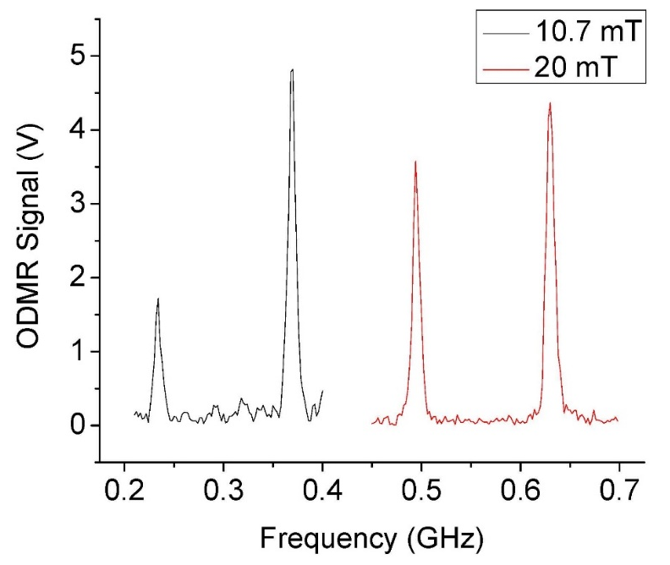
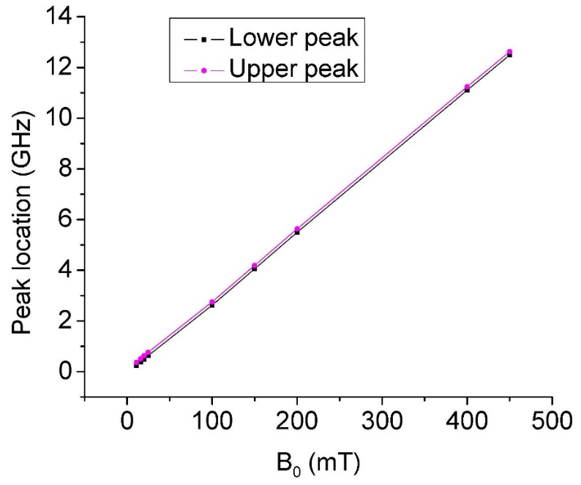

ODMR
3/2 ↔ 1/2 and
  -3/2 ↔ -1/2 peaks
Linear field dependence
$$hf=gμ_{B}B$$
$$\frac{f}{B}=\frac{gμ_{B}}{h}$$
$$g≈1.996$$
10 GHz ↔ 0.358 T

Slide 27
T₂ via Optically-detected spin echo
Initialize (polarize)
  Laser pump
  Thermal (low T, large B)
Depolarize
  Wait
  Microwave resonance
    Possibly repolarize via microwave pulses
Detect – laser probe
  Faraday/Kerr effect (rotation of linear polarization)
  Photoluminescence: degree of circular polarization
  PL intensity

Slide 28
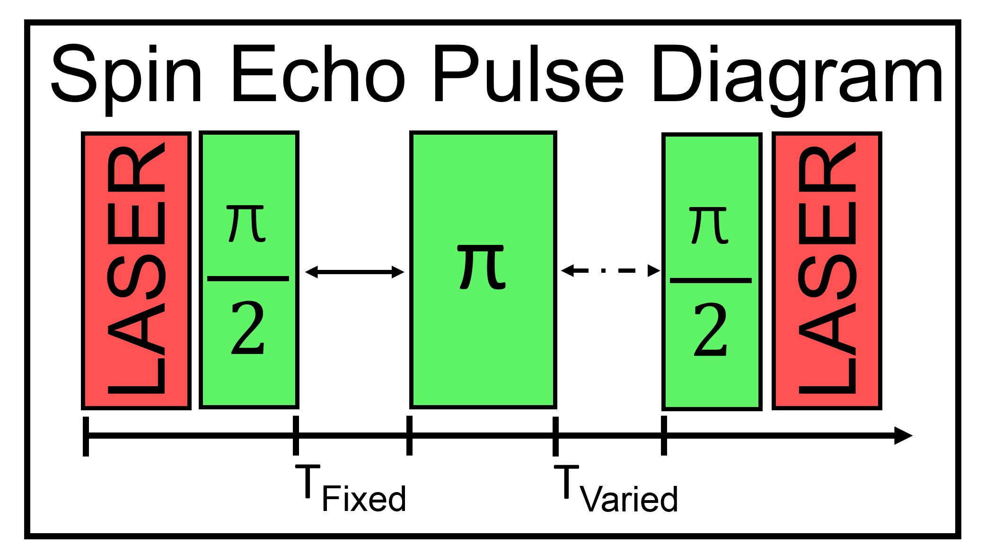
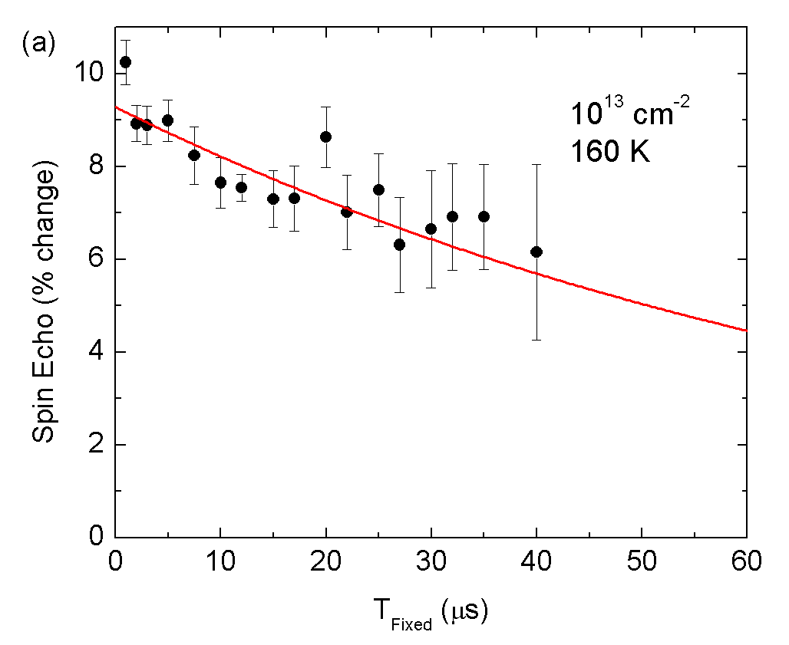
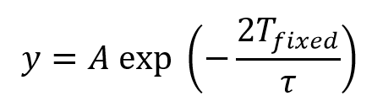
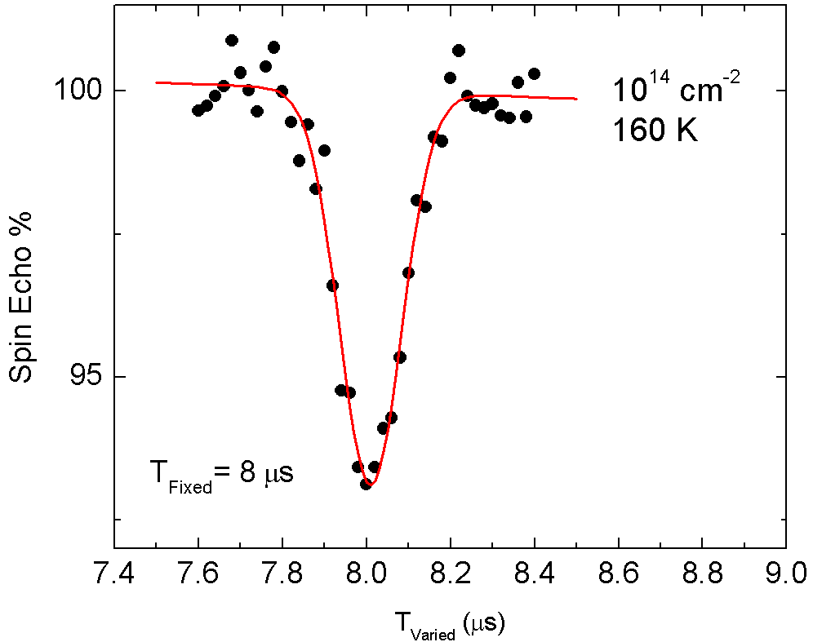
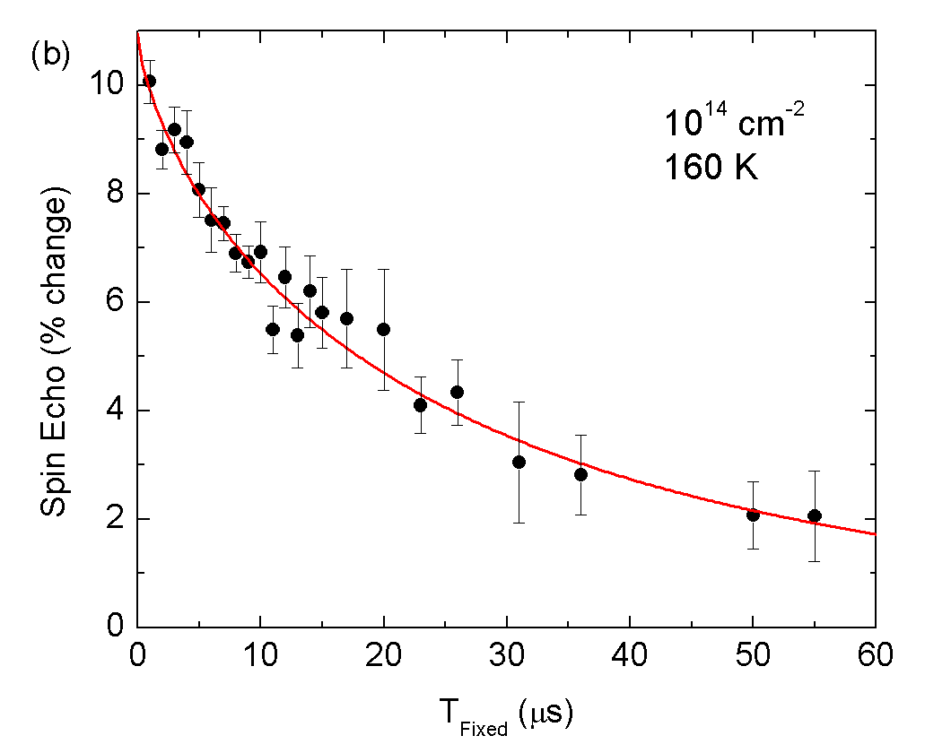
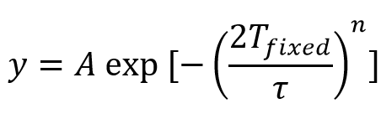
Spin Echo
Submitted to Phys Rev B, 2016

Slide 29
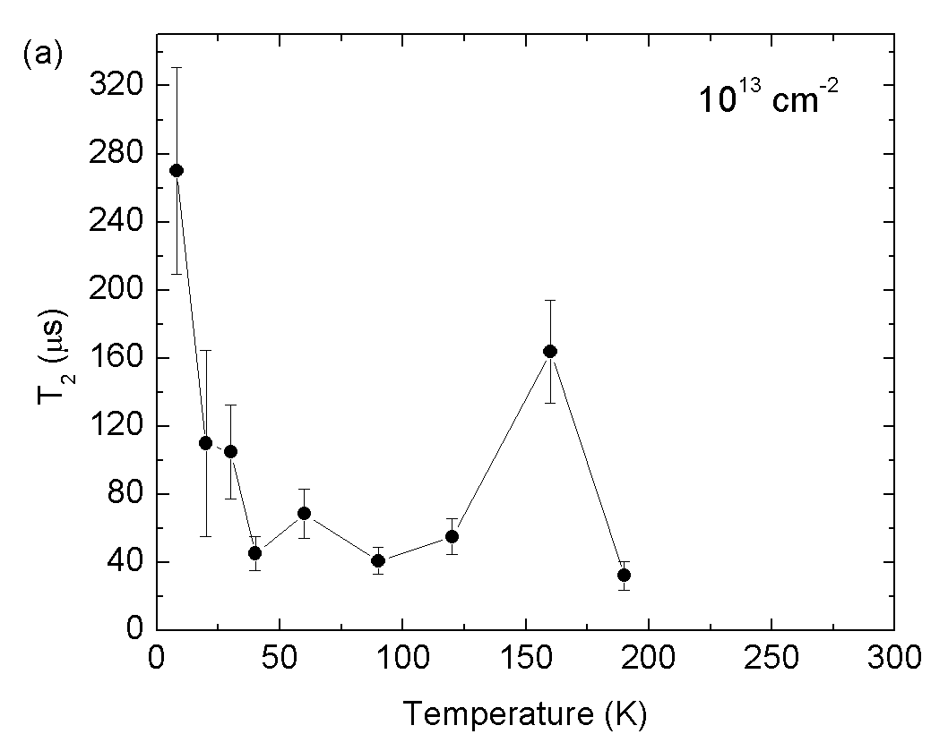
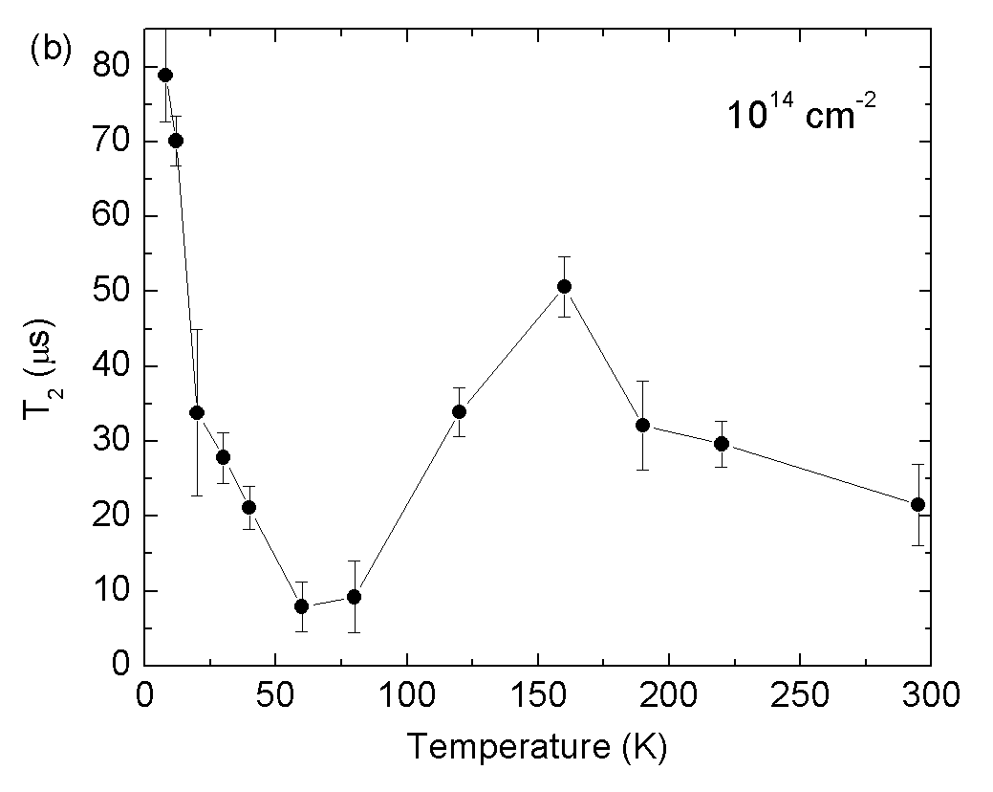
Spin Coherence vs. Temperature

Slide 30
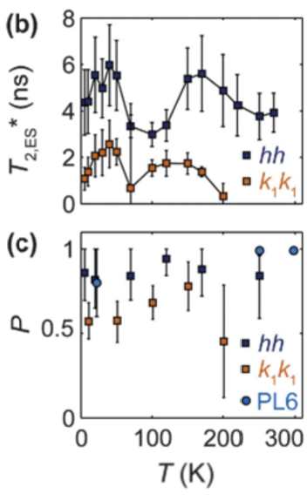
Similar Results
Found by Others
Falk et al., Phys. Rev. Lett. 114, 247603 (2015)
  Measured T₂* in silicon divacancies of 6H-SiC
Our results
Possible explanation: motional averaging from dynamic Jahn Teller effect. More theory needed!

Slide 31
Conclusions
Optics for measuring spin lifetimes
Spin lifetimes for verifying and motiving theory
SiC as an interesting new candidate material
→ If any of you are ever in Utah, please look me up!
Funding acknowledgements
National Academies / NRC
Naval Research Lab
NSF
NASA
BYU

