Slide 1
Cavities for electron spin resonance: predicting the resonant frequency
John S. Colton
Physics Department
Brigham Young University
Co-authors: Kyle Miller
Dr. Ross Spencer
Michael Meehan
Download the code at
http://www.physics.byu.edu/research/coltonlab/cavityresonance
Paper under review by IEEE Transactions
on Microwave Theory and Techniques
APS March Meeting, Mar 17, 2016

Slide 2
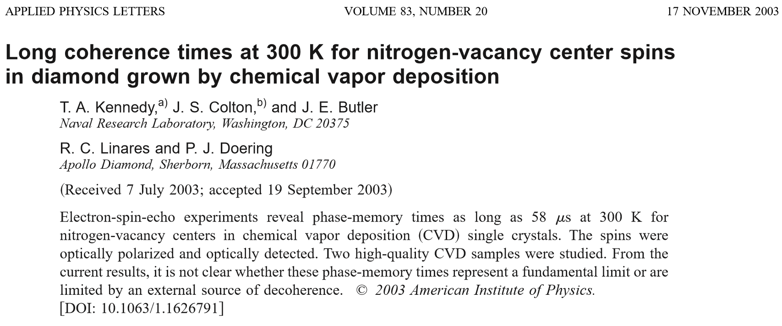
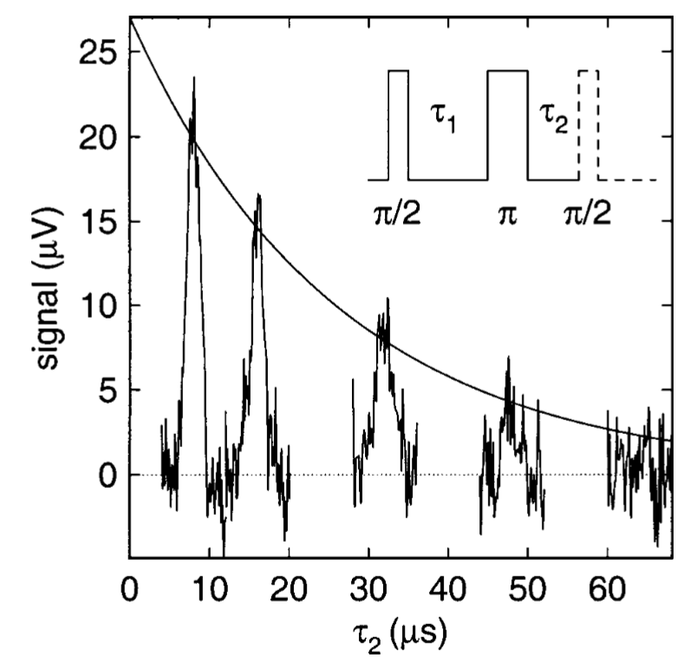
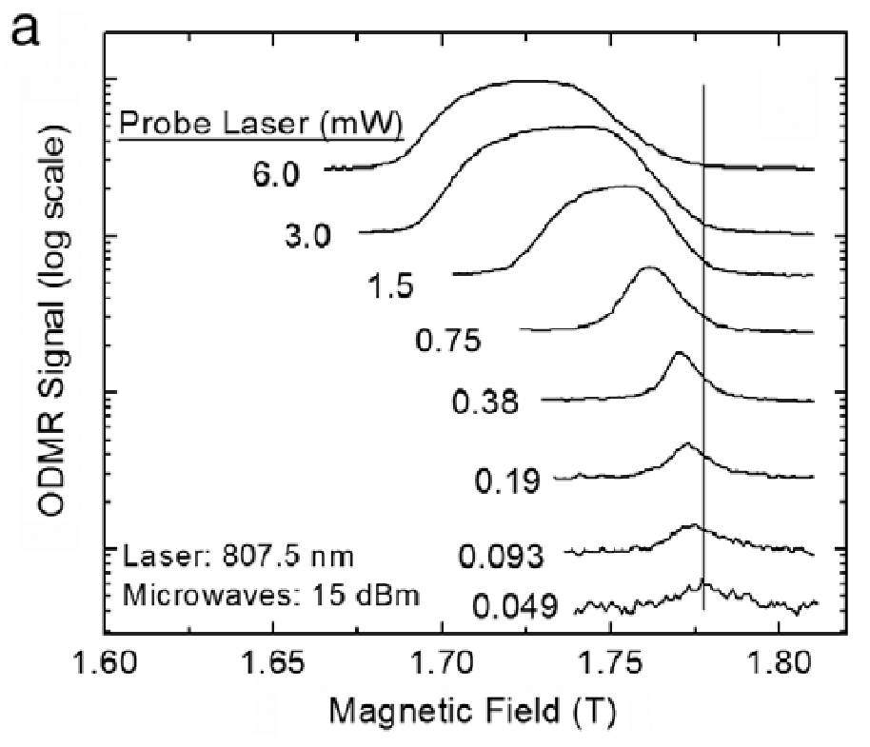
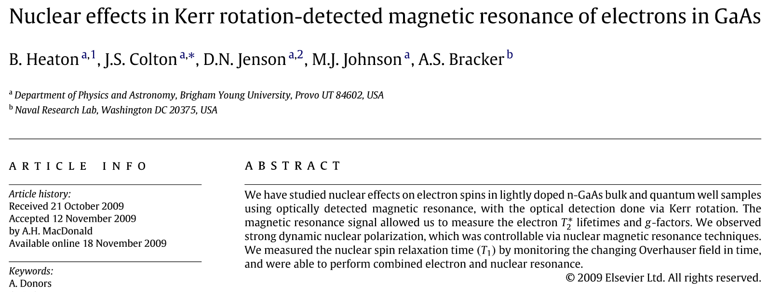
Motivation
Electron spin resonance in semiconductors

Slide 3
Cylindrical TE₀₁₁ Resonant Cavity
“011” specifies B_{z}
0: no φ dependence
1: one antinode across center
1: one antinode top to bottom
Strong B field in center by sample
Weak E field in center near sample
Avoids sample heating & cavity losses
Can modify resonant frequency with dielectric material, e.g. “dielectric resonators”

Slide 4
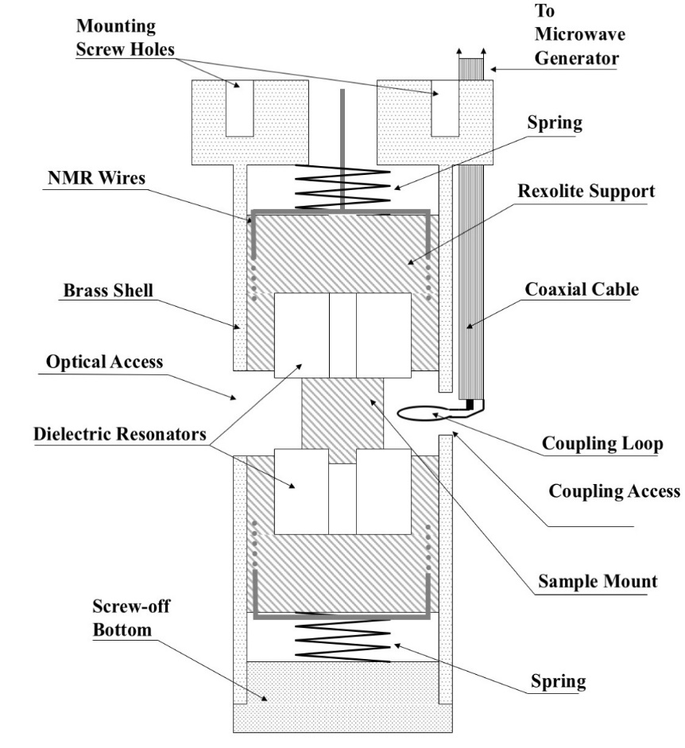
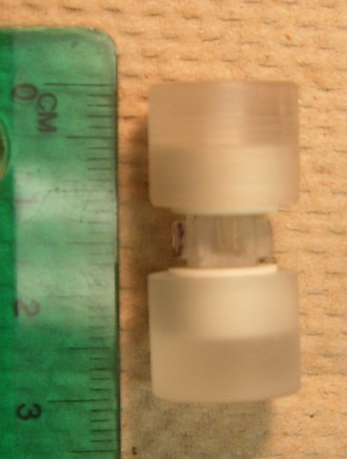
About 7-8 years ago…
(a)
Colton et al., Rev Sci Inst, 2009

Slide 5
What we want…
Design a cavity for desired frequency & mode
⇔ Easily calculate frequency of given design
And not have to pay ~$2000/year for a commercial software package (CST Microwave Studio or others)
And have it be more accurate/easier to use than methods we found in literature

Slide 6
What has previously been done
Requires simple geometries/approximations:
effective dielectric constants
lumped circuit model
coupled mode theory
mode matching of DRs
magnetic wall waveguide model
dielectric waveguide model
More sophisticated solution of wave equation (expensive and/or time consuming):
finite integration
finite element analysis
method of moments

Slide 7
Our idea:
Expand actual field in terms of the modes of an empty cavity, solve for “Fourier coefficients”
To get the B-field, can use Faraday’s Law:
$$∇×\left(\frac{D}{ε_{0}ε_{r}}\right)=−\frac{dB}{dt}$$
…or do an expansion in empty cavity B_{nmpl} modes

Slide 8
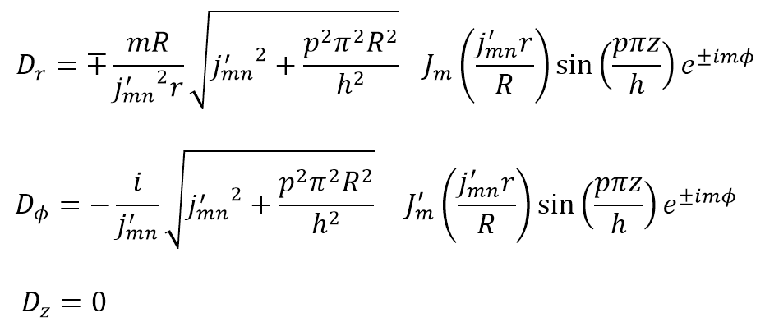
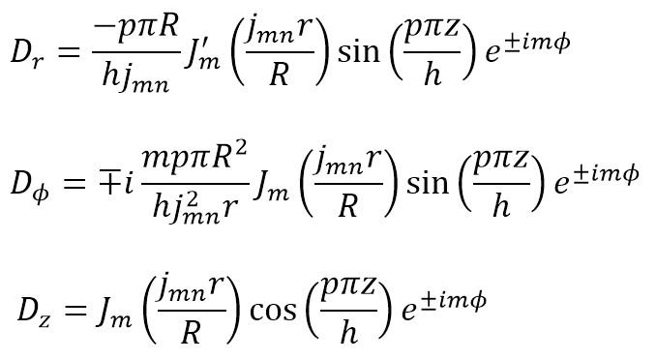
new index
TE Modes
$𝓁$=0
TM Modes
$𝓁$=1
If cylindrically symmetric: fix m
If m = 0: fix l
Summation

Slide 9
One page of math
$$∇×∇×\left(\frac{D}{ε_{r}}\right)=\frac{ω^{2}}{c^{2}}D$$
Start with wave equation:
$$\sum_{n,p,𝓁}{a_{mnp𝓁}}∇×∇×\left(\frac{D_{mnp𝓁}}{ε_{r}}\right)=\sum_{n,p,𝓁}{a_{mnp𝓁}}\frac{ω^{2}}{c^{2}}D_{mnp𝓁}$$
Plug in expansion:
Multiply by conjugate then integrate:
$$\sum_{n,p,𝓁}{a_{mnp𝓁}}\int_{V}{D_{mn^{′}p^{′}𝓁^{′}}^{∗}⋅∇×∇×\left(\frac{D_{mnp𝓁}}{ε_{r}\left(r,z\right)}\right)dV}=\sum_{n,p,𝓁}{a_{mnp𝓁}}\int_{V}{\frac{ω^{2}}{c^{2}}D_{mn^{′}p^{′}𝓁^{′}}^{∗}⋅D_{mnp𝓁} dV}$$
Use a vector identity, substitute in empty cavity wave equation results for “curl of curl”, simplify… (“s” and “q” are collected indices)
$$\sum_{q}{\left(\frac{p_{s}^{2}π^{2}}{h^{2}}+\frac{α_{s}^{2}}{R^{2}}\right)\int_{V}{D_{s}^{∗}⋅D_{q}\frac{1}{ε_{r}\left(r,z\right)} dV}∙aq}=\frac{ω^{2}}{c^{2}}\sum_{q}{\int_{V}{D_{s}^{∗}⋅D_{q} dV}}∙aq$$
A_{sq} a_{q} = λ B_{sq} a_{q}

Slide 10
Computer implementation
Typical matrix size: 512, 2048, 8192 empty cavity eigenfunctions
Aitken method: extrapolate from 8192 to infinite number
“Singularity search method” to find eigenvalues rather than diagonalizing matrix
Typical computation time: 0.5 hour if only TE (m=0), 2 hours if both TE and TM
16 computing nodes, each with 12-core, 2.3 GHz Intel Haswell, 4 GB of memory

Slide 11
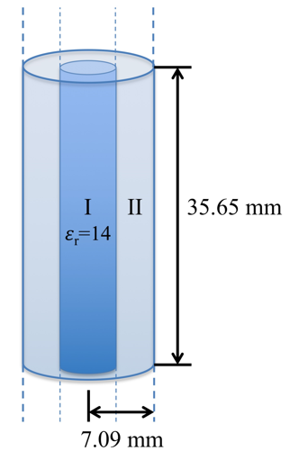
Test vs. Theory
Infinite dielectric cylinder in infinite cavity
Match boundary conditions
Focus on one vertical section
Solve transcendental eqn numerically

Slide 12
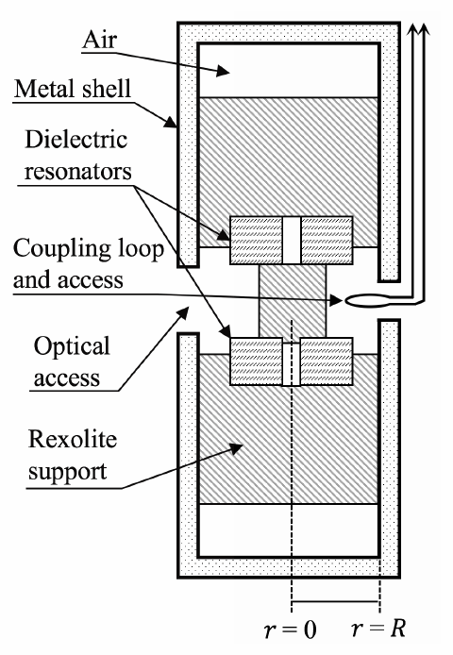
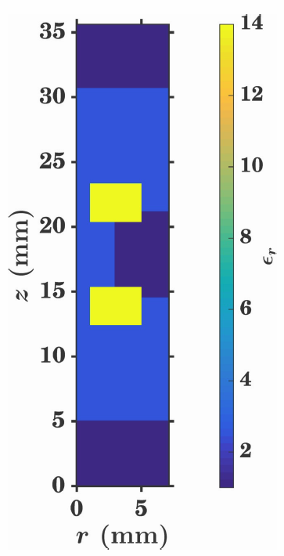
Modeling Stacked Dielectric Resonators

Slide 13
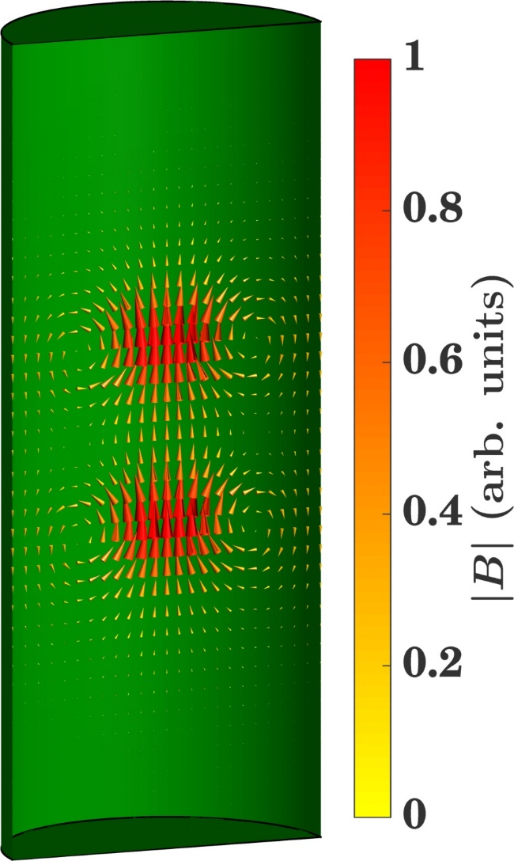
Field patterns, two 3 mm DRs (ε_{r} = 14)
Electric field
Magnetic field

Slide 14
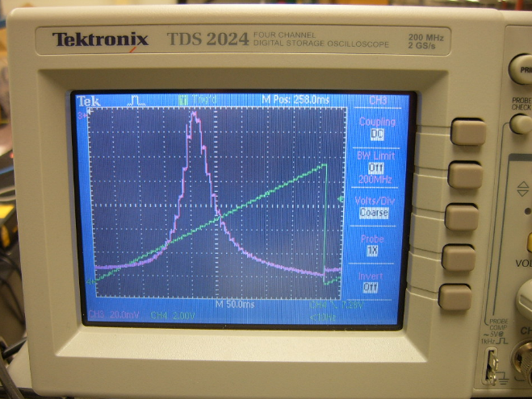
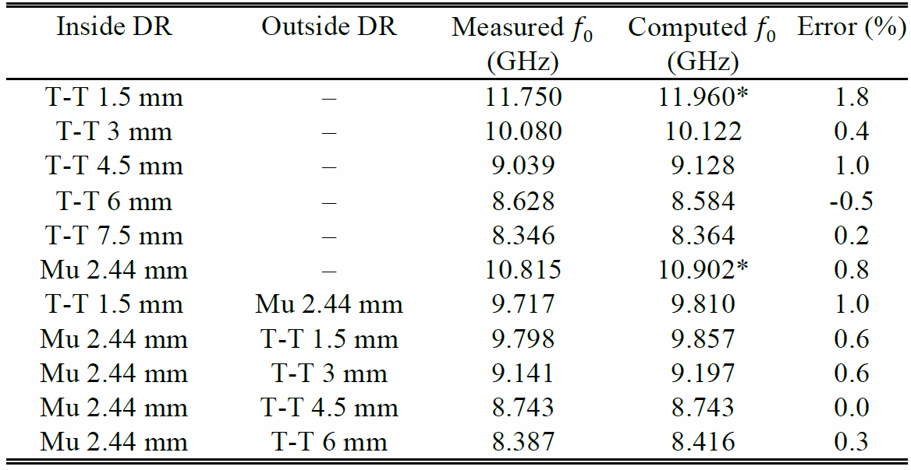
Comparison with Experiment
*extra empty cavity eigenfunctions needed

Slide 15
Conclusions
Calculate resonant frequencies and field patterns, arbitrary arrangement of material (cylindrically symmetric)
Error ≤ 0.4% for theory test (all but 1)
Error ≤ 1.0% for experimental test (all but 1)
Issues: sharp features → more eigenfunctions needed, Gibbs phenomena in E
Download the code at http://www.physics.byu.edu/research/ coltonlab/cavityresonance
Contact me for preprint, john_colton@byu.edu

Slide 16
Observing cavity resonances
The cavity resonance
Sweep microwave frequency, look for cavity absorption
Width → “Q factor”
Q ~ 2000
Spin resonance experiment
“Park” at that microwave frequency
Sweep magnetic field to see spin response when hf = gμ_{B}B

Slide 17
Summary of Technique
(but we don’t do it that way)

Slide 18
Why not Faraday’s Law?
Instead…

Slide 19
Computer implementation
What’s a “sound” method to index TE and TM modes with different radial and axial modes?
Let $q$ go from 1 to $2n_{max}p_{max}$
$$𝓁=mod\left(q−1,2\right) ;$$
$$j=(q+mod\left(𝓁+1,2\right))/2 ;$$
$$n=mod\left(j−1,n_{max}\right)+1 ;$$
$$p=(j−n)/n_{max}+1$$
Organized matrix size $2n_{max}p_{max}$ (typically size 512, 2048, 8192)

Slide 20
Matrix diagonalization gets hard…
“Singularity search method”
$$A_{sq}a_{q}=λB_{sq}a_{q}$$
$$\left(A_{sq}−λB_{sq}\right)a_{q}=b$$
Let $b$ be some small parameter
Scan $λ$
When $λ$ is an eigenvalue, LHS should be zero, so $a_{q}$ will get really big to equal $b$
Solve for the zeros of $\frac{1}{\sum{a_{q}}}$

Slide 21
Aitken extrapolation
For a converging sequence
Define the sequence $\left\{x_{n}\right\}$ by the function $f\left(x_{n}\right)=x_{n+1}$, where the sequence converges to $\overline{x}$ such that $f\left(\overline{x}\right)=\overline{x}$.
Expand $f$ about $\overline{x}$…
$$\overline{x}=x_{n+2}−\frac{{\left(x_{n+2}−x_{n+1}\right)}^{2}}{x_{n}−2x_{n+1}+x_{n+2}}$$
Retain grid size, but increase number of eigenfunctions (6*2⁰, 6*2¹, 6*2², ...)

Slide 22
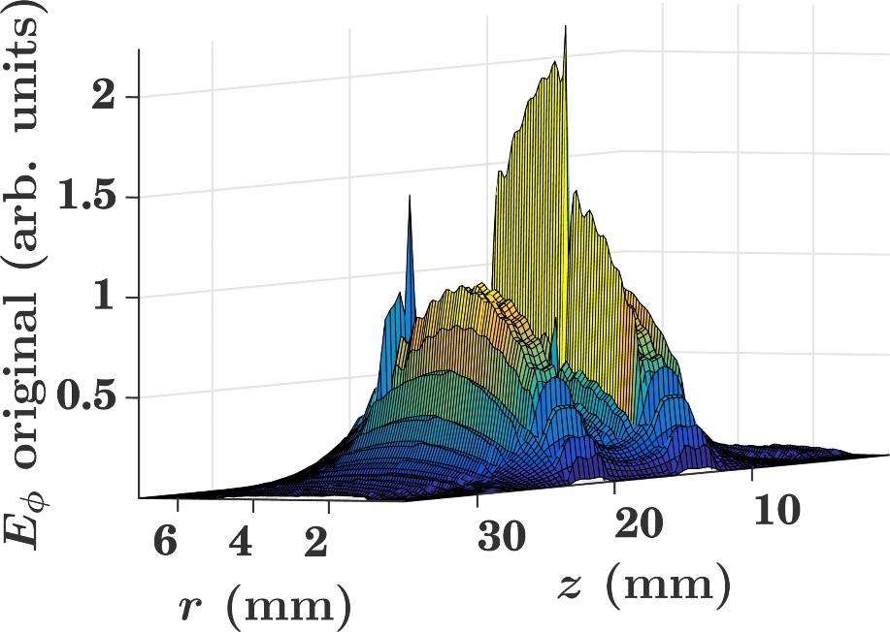
Electric field problems
Because we are solving for the displacement field D, E has some bad discontinuities

Slide 23
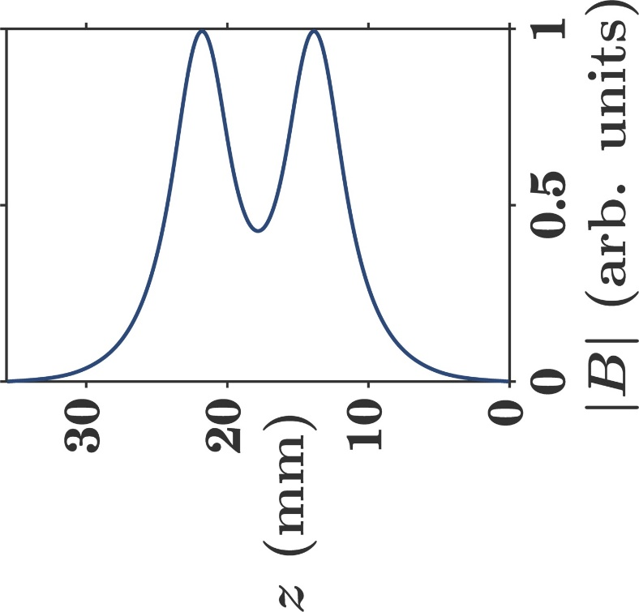
Magnetic field
The magnetic field, on the other hand, is continuous everywhere (no magnetic material)
1st derivatives are problematic (discontinuous E)
We can smooth B and then differentiate to obtain smoothed E fields!

Slide 24
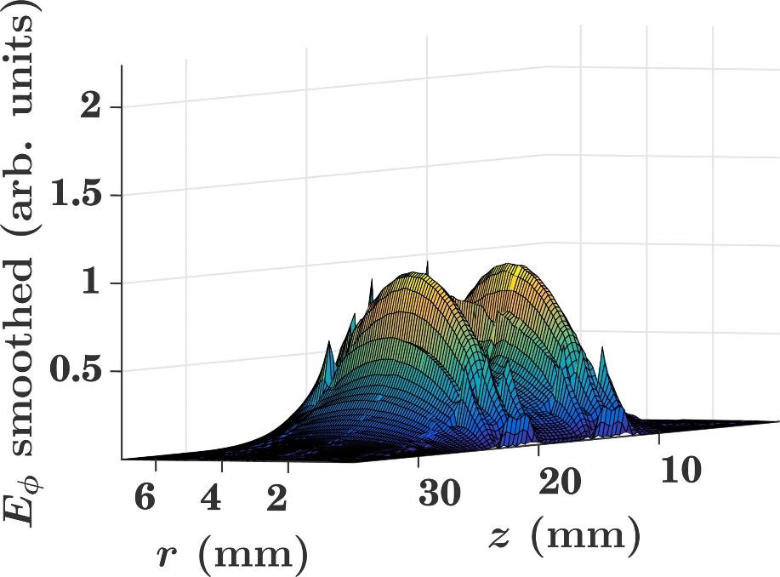
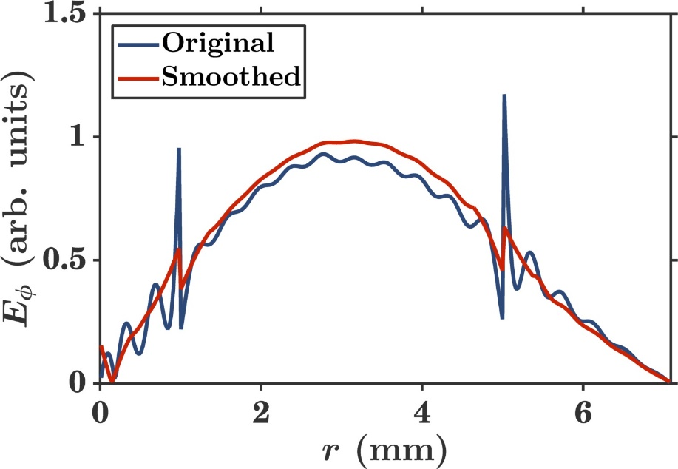
Smoothed electric field
Polynomial fitting of order 3 over sections of 31 points (only across homogenous $ε_{r}$)

Slide 25
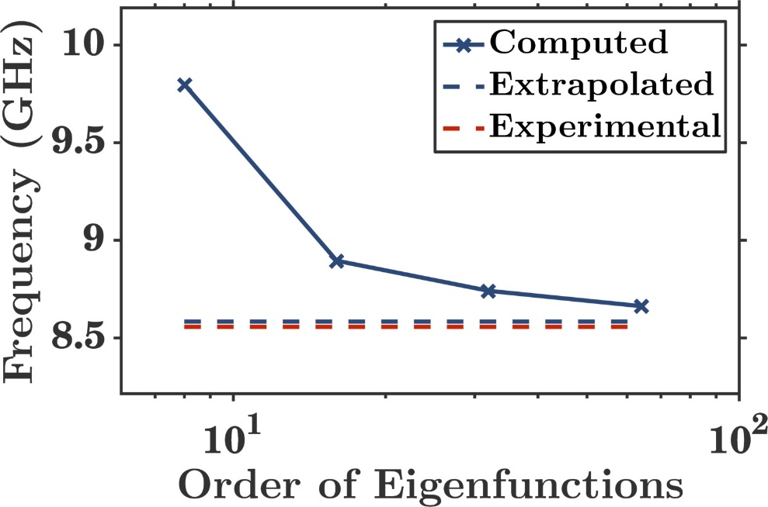
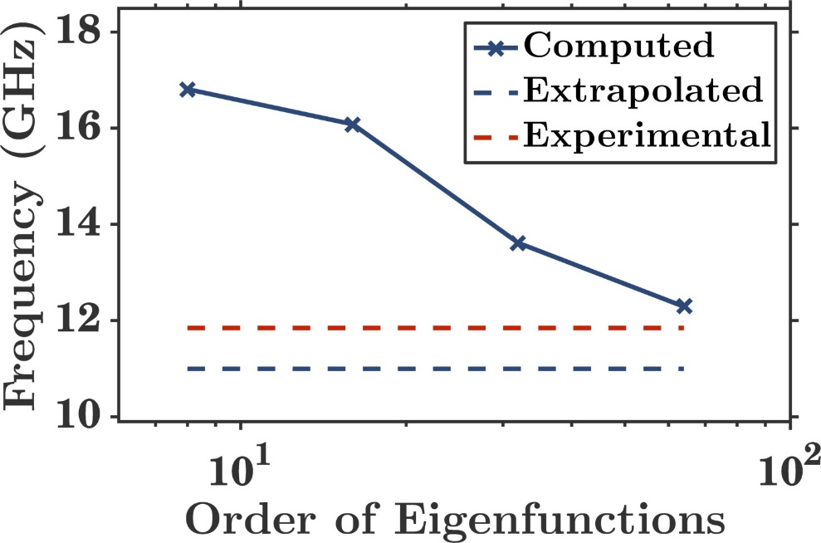
Convergence issues
For small DRs, more eigenfunctions were needed to accurately represent the field
T-T 6 mm DRs
T-T 1.5 mm DRs

Slide 26
Jaworski solution
Assumes $ε_{r}≃30$ and $0.4<h/{2R}<1$
Valid only for TE modes
Murata have $ε_{r}=29.7$ and $h/{2R}≈0.44$, accuracy of 1.0%
Trans-Tech have $ε_{r}=14$ and $h/{2R}$ varies from 0.15 to 0.6, accuracy of 12%

